Slide 1
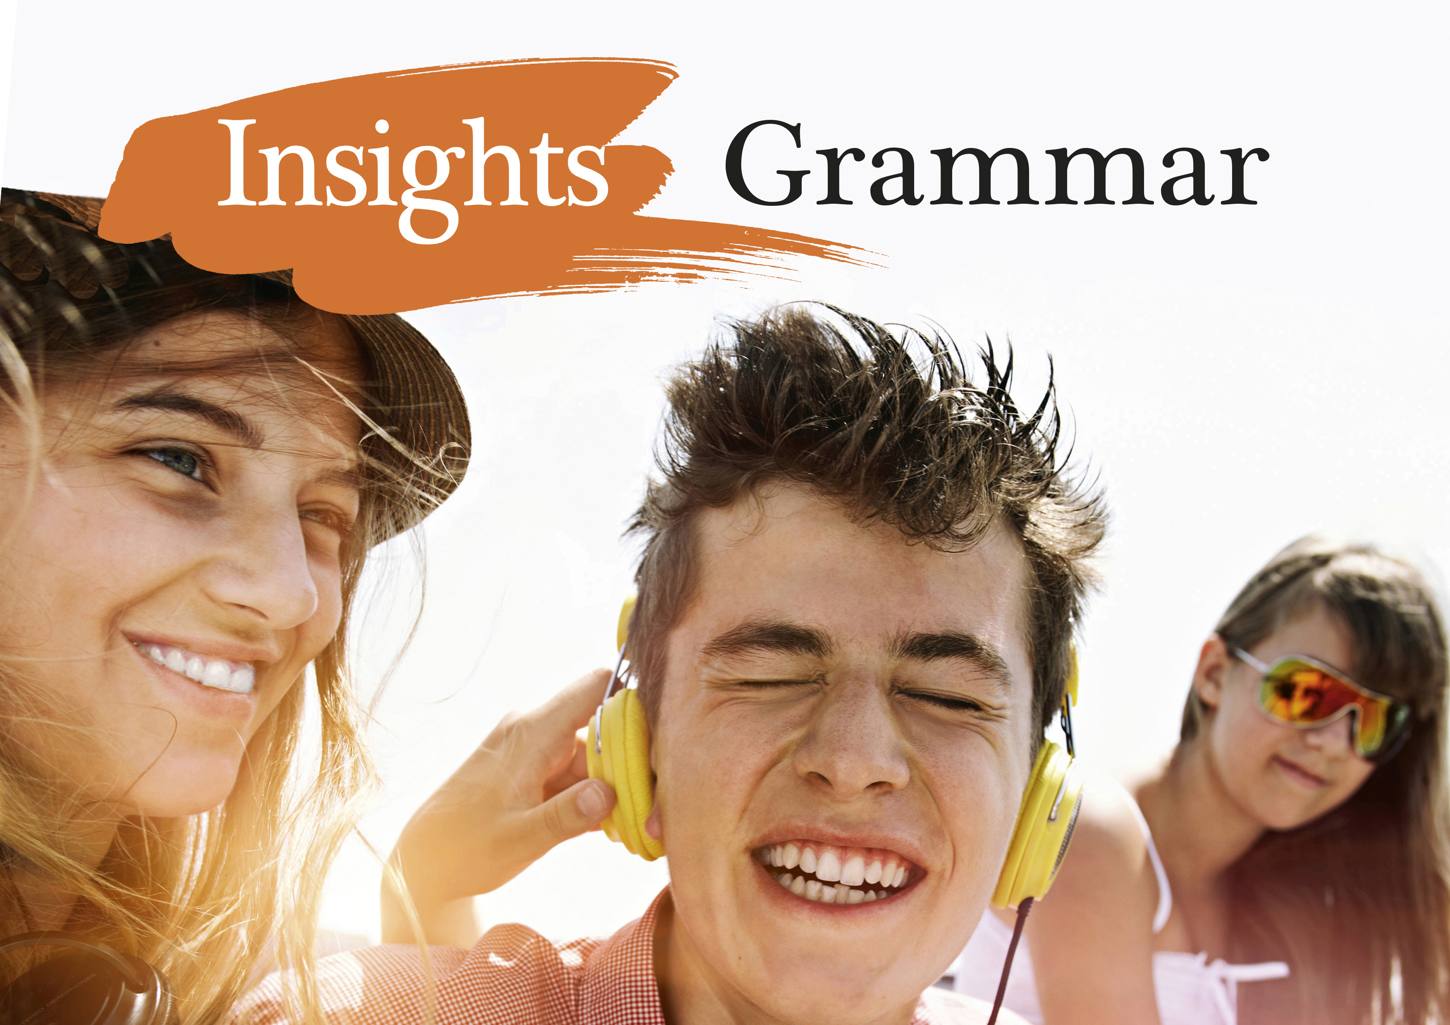
Notes:
<numero>

Slide 2
Lauseenvastikkeet
Relatiivilauseen lauseenvastikkeet

Slide 3
RELATIIVILAUSEEN LAUSEENVASTIKKEET
1. Aktiivimuotoisen relatiivilauseen lauseenvastike
muodostetaan jättämällä relatiivipronomini pois ja käyttämällä pääverbin -ing-muotoa.
The books that are lying on the floor are mine.
→The books lying on the floor are mine.
Anyone who wants a ticket to the play-offs, contact me.
→ Anyone wanting a ticket for the play-offs, contact me.
Notes:
<numero>

Slide 4
RELATIIVILAUSEEN LAUSEENVASTIKKEET
2. Passiivimuotoisen relatiivilauseen lauseenvastike muodostetaan jättämällä pois relatiivipronomini sekä passiivirakenteen be-verbi ja käyttämällä pääverbin 3. muotoa.
The dog that was hit by a car was not seriously injured.
→ The dog hit by a car was not seriously injured.
The criminals who were involved in the robbery have been arrested.
→The criminals involved in the robbery have been arrested.
Notes:
<numero>

Slide 5
RELATIIVILAUSEEN LAUSEENVASTIKKEET
3. Jos relatiivilauseen korrelaatissa on superlatiivi, järjestysluku tai jokin sanoista next, last, only, muodostetaan lauseenvastike infinitiivirakenteella to + infinitiivi.
Marie Curie was the first woman who won the Nobel Prize in Physics.
→ Marie Curie was the first woman to win the Nobel Prize in Physics.
You are not the only person who got the lyrics wrong in this song.
→ You are not the only person to get the lyrics wrong in this song.
What could be the nicest thing that you are told?
→ What could be the nicest thing to be told?
Notes:
<numero>

Slide 6
RELATIIVILAUSEEN LAUSEENVASTIKKEET
4. Joskus relatiivilauseen voi lyhentää prepositiorakenteella. Yleensä prepositio on tällöin in, with tai without.
Car drivers might not notice pedestrians who are not wearing a reflector.
→ Car drivers might not notice pedestrians without a reflector.
Manchester City are the team who are wearing sky blue jerseys.
→ Manchester City are the team in sky blue jerseys.
Do you recognize the man who is carrying an umbrella?
→ Do you recognize the man with an umbrella?
Notes:
<numero>

Slide 7
Activate:
Käytä lauseenvastiketta seuraavien relatiivisten sivulauseiden sijasta
1. The woman who is sitting next to you looks familiar.
The woman sitting next to you looks familiar.
2. She could be an Internet celebrity who we know for her YouTube channel.
She could be an Internet celebrity known for her YouTube channel.
3. Then we are not the only ones who recognize her.
Then we are not the only ones to recognize her.
4. She is not one of those who don’t have a story to tell when they go online.
She is not one of those without a story to tell when they go online.
Notes:
<numero>

Slide 8
Activate:
Käytä lauseenvastiketta seuraavien relatiivisten sivulauseiden sijasta
5. I saw a play which was written by William Shakespeare.
I saw a play written by William Shakespeare.
6. Romeo, who believed that Juliet was dead, decided to kill himself.
Romeo, believing that Juliet was dead, decided to kill himself.
7. Romeo and Juliet, which was first published in 1597, is world-famous.
Romeo and Juliet, first published in 1597, is world-famous.
8. I wouldn’t pick this as the only play which you should see this season.
I wouldn’t pick this as the only play to see this season.
Notes:
<numero>

