Slide 1
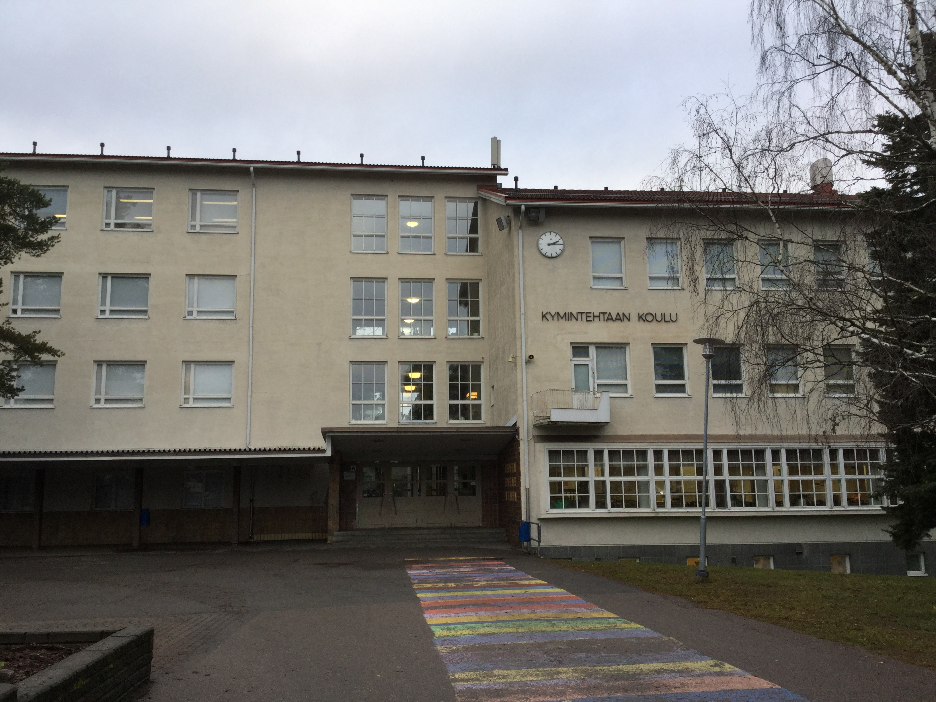
Our school

Slide 2
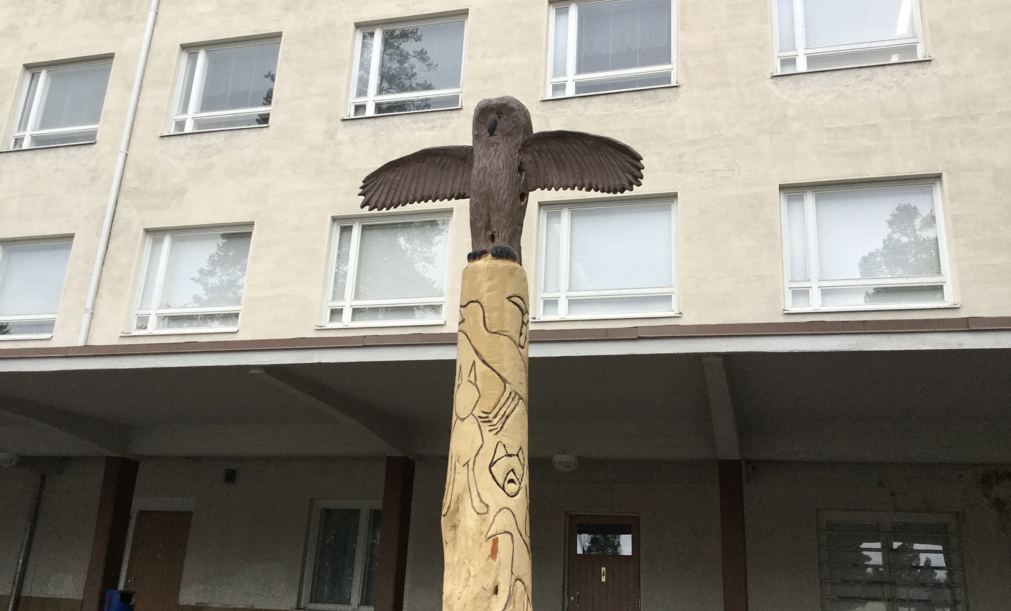
School yard
We have a lot of space. We also have an owl totem.

Slide 3
Students
There are over 300 students in our school. We don’t have any school uniforms.

Slide 4
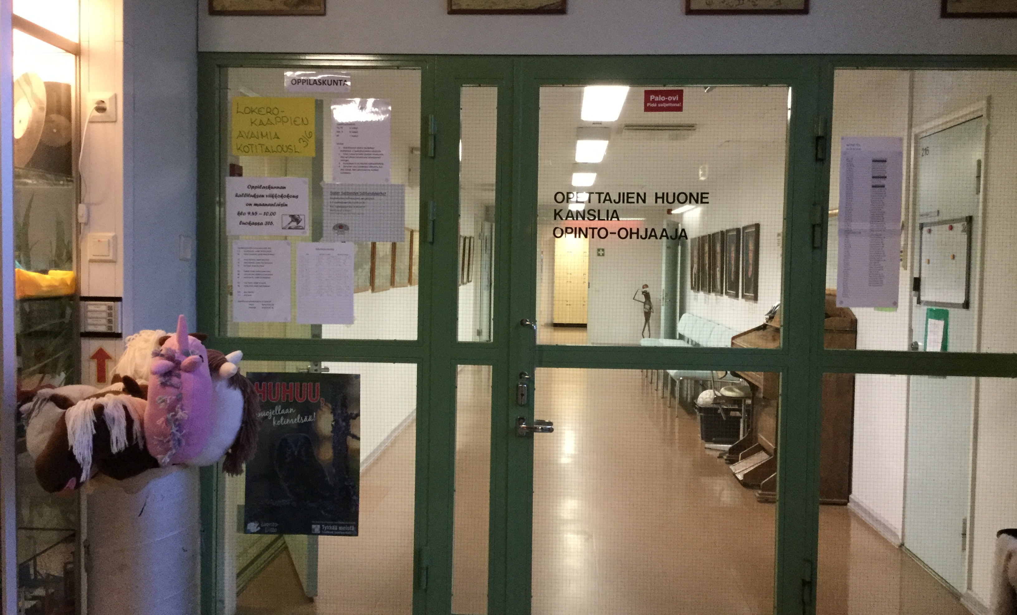
Teachers
We have 34 teachers but only 14 of them teach us.

Slide 5
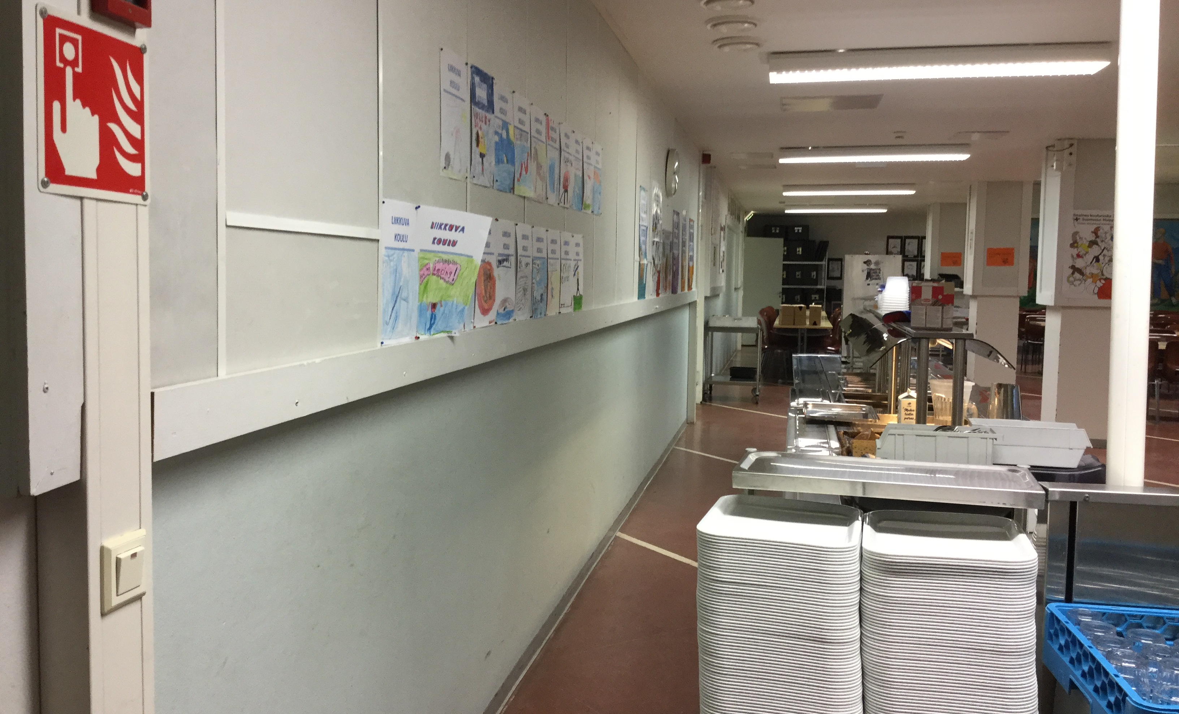
Cafeteria
Our food is always free.

Slide 6
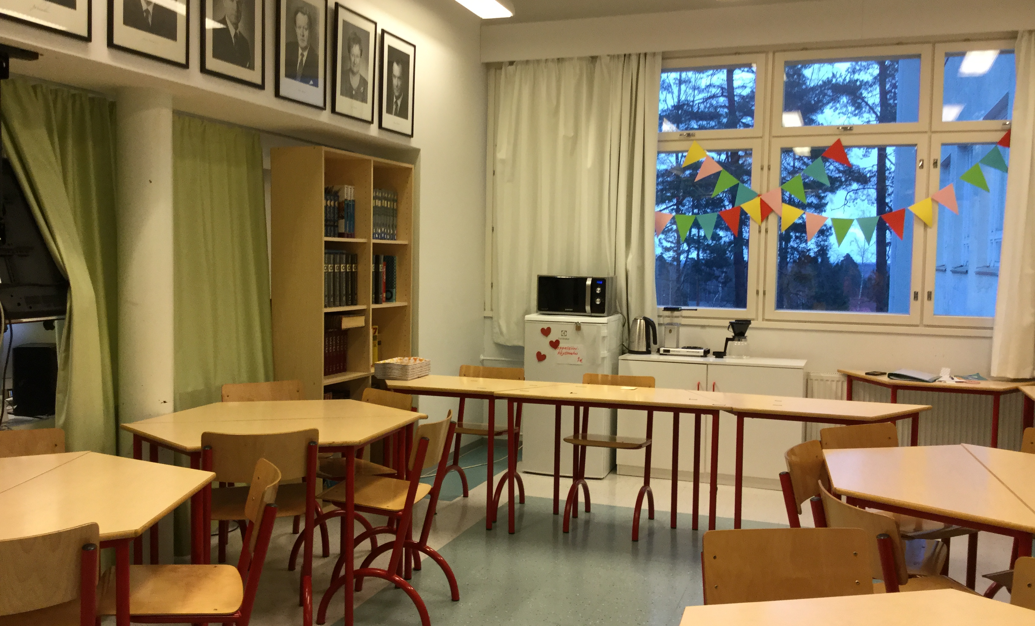
School cafe
We also have a school cafe. You can go there between some of the lessons. Your need to pay for it, but it's okay. Here the food is snack food.

Slide 7
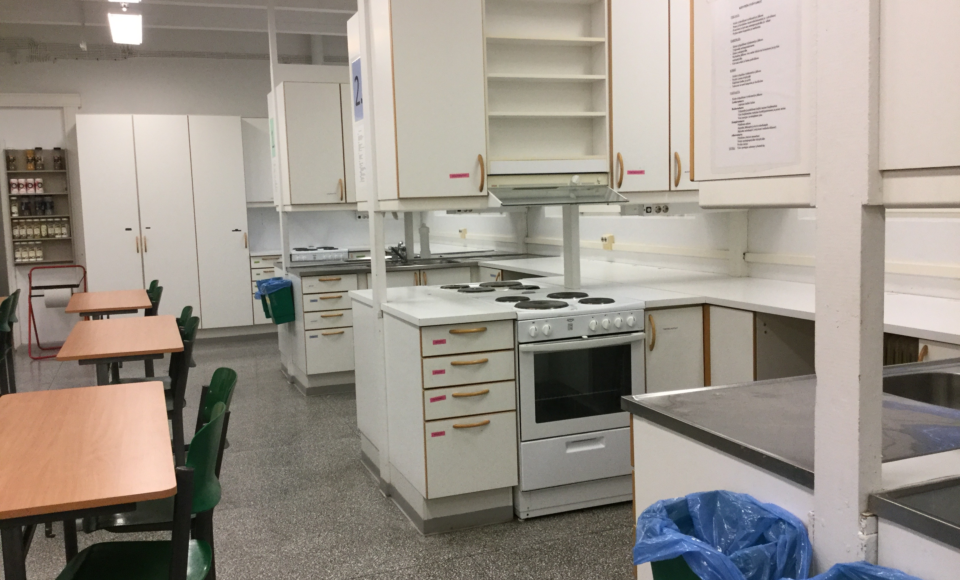
Home economics
Everyone loves food so let's continue with it!

Slide 8
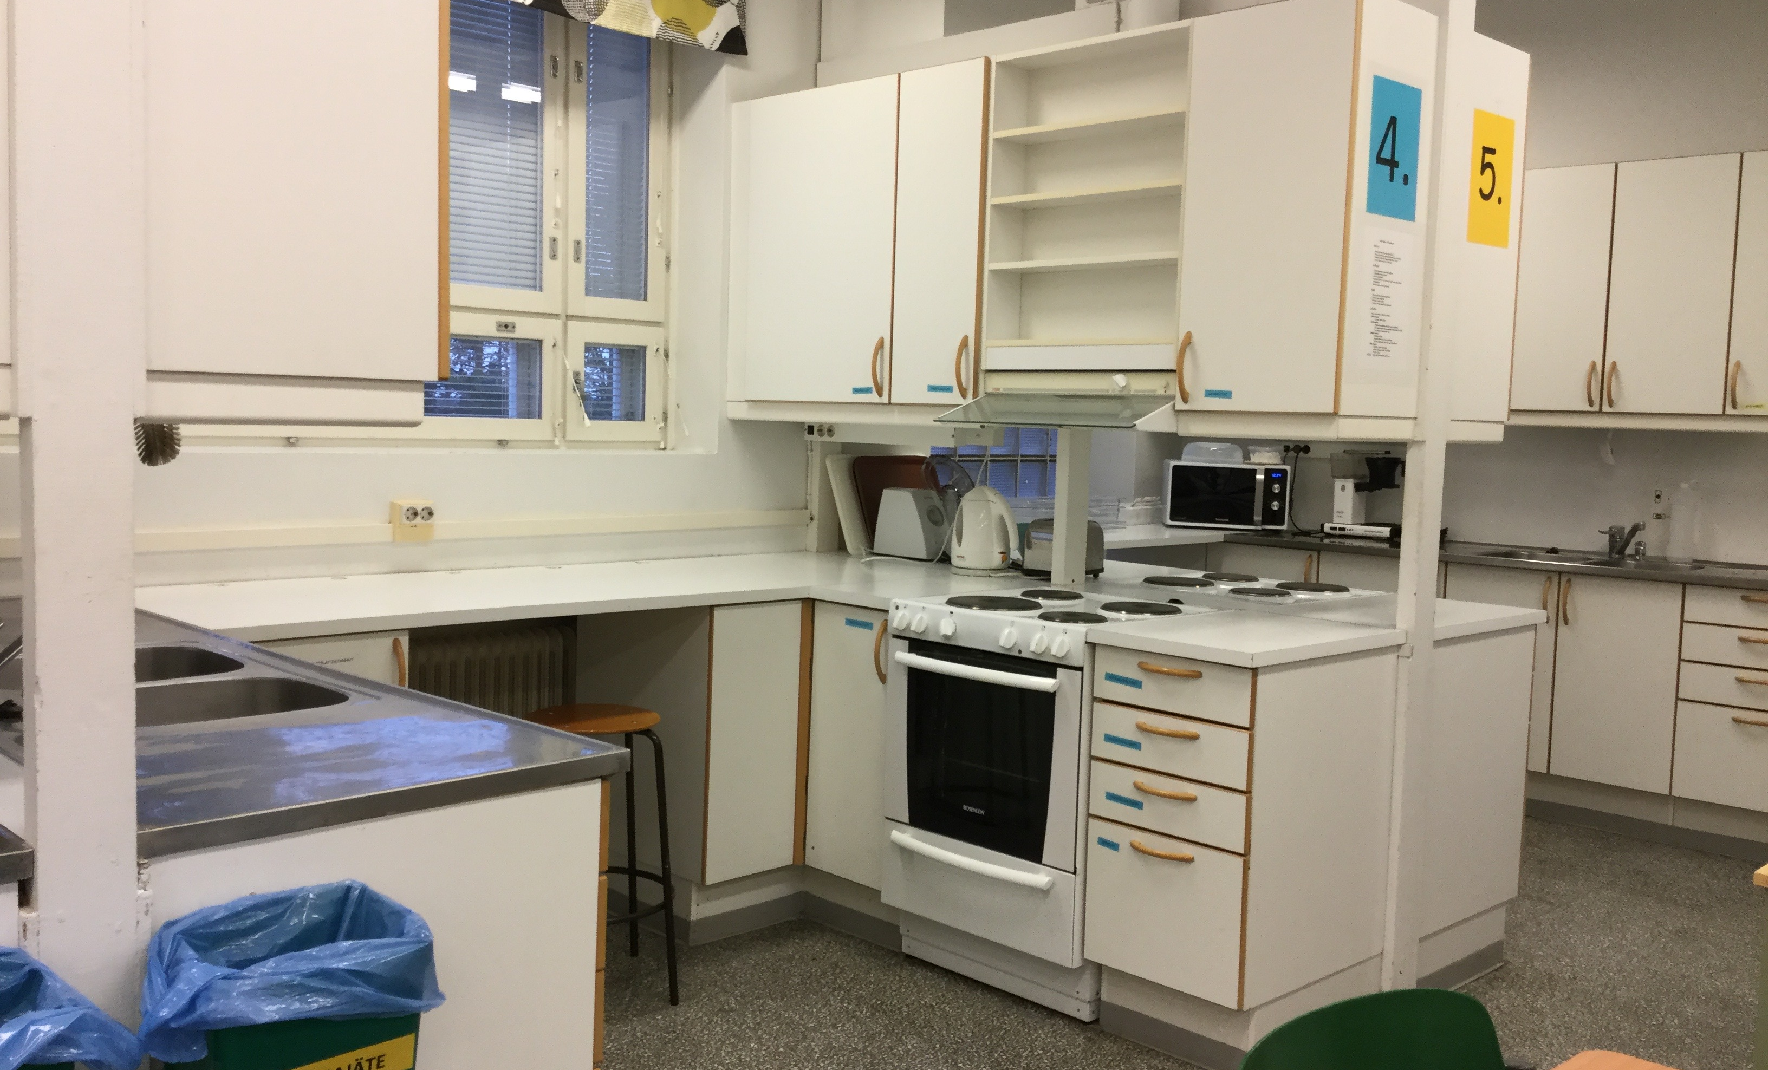
We have five kitchens.

Slide 9
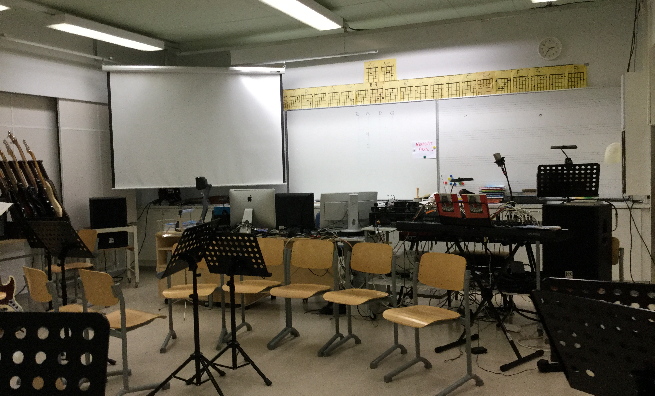
Music class
We have many instruments.

Slide 10
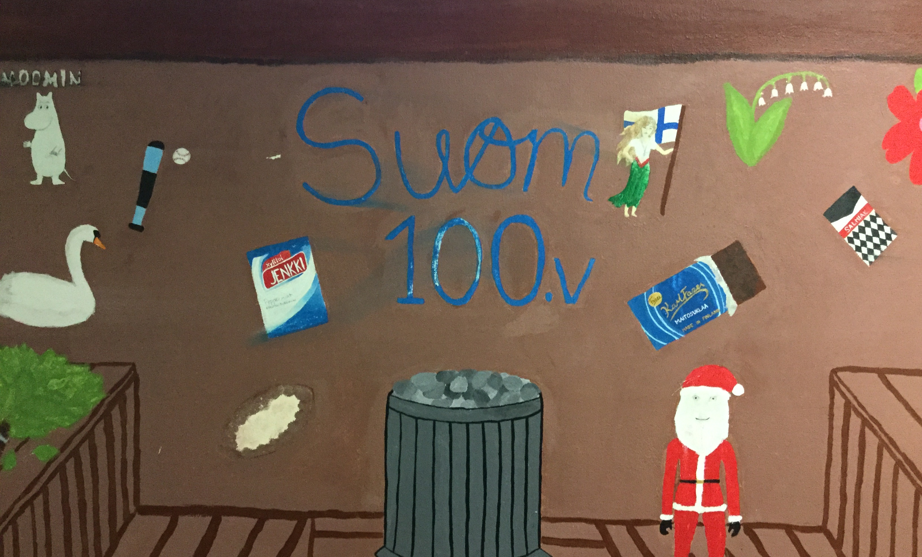
We have students’ art on the walls.

Slide 11
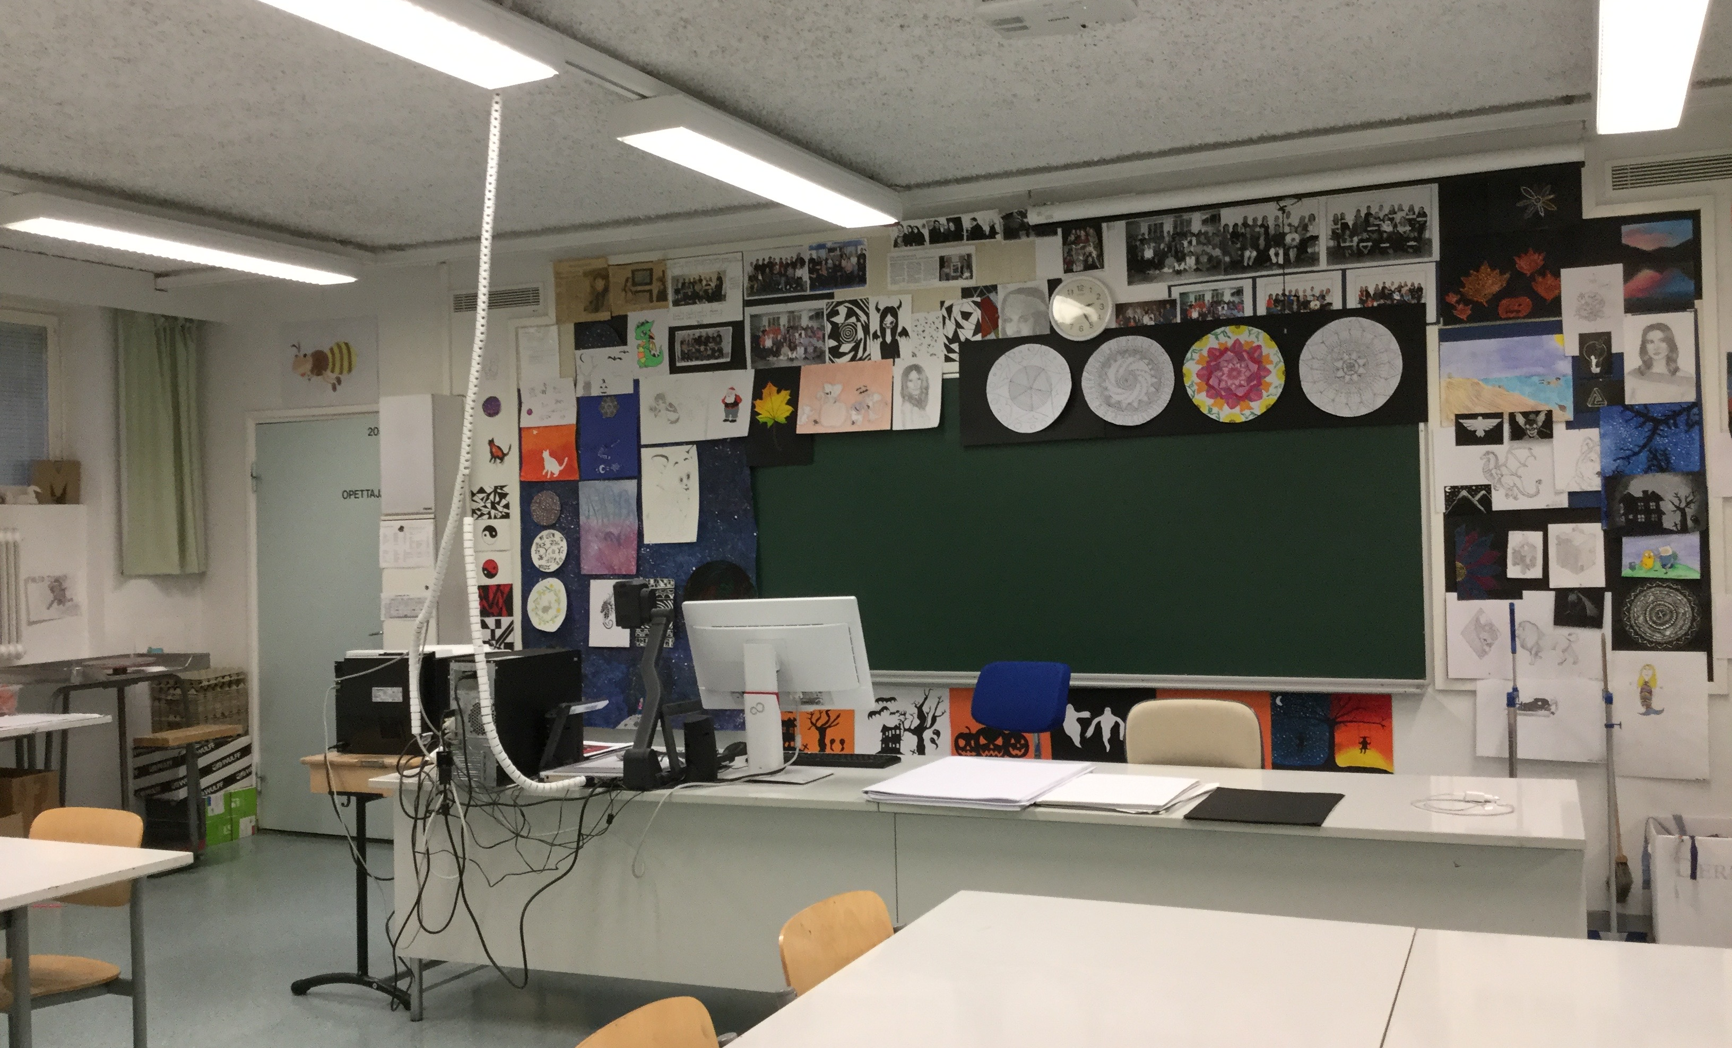
Art class
Students’ art pieces are displayed on the walls.

Slide 12
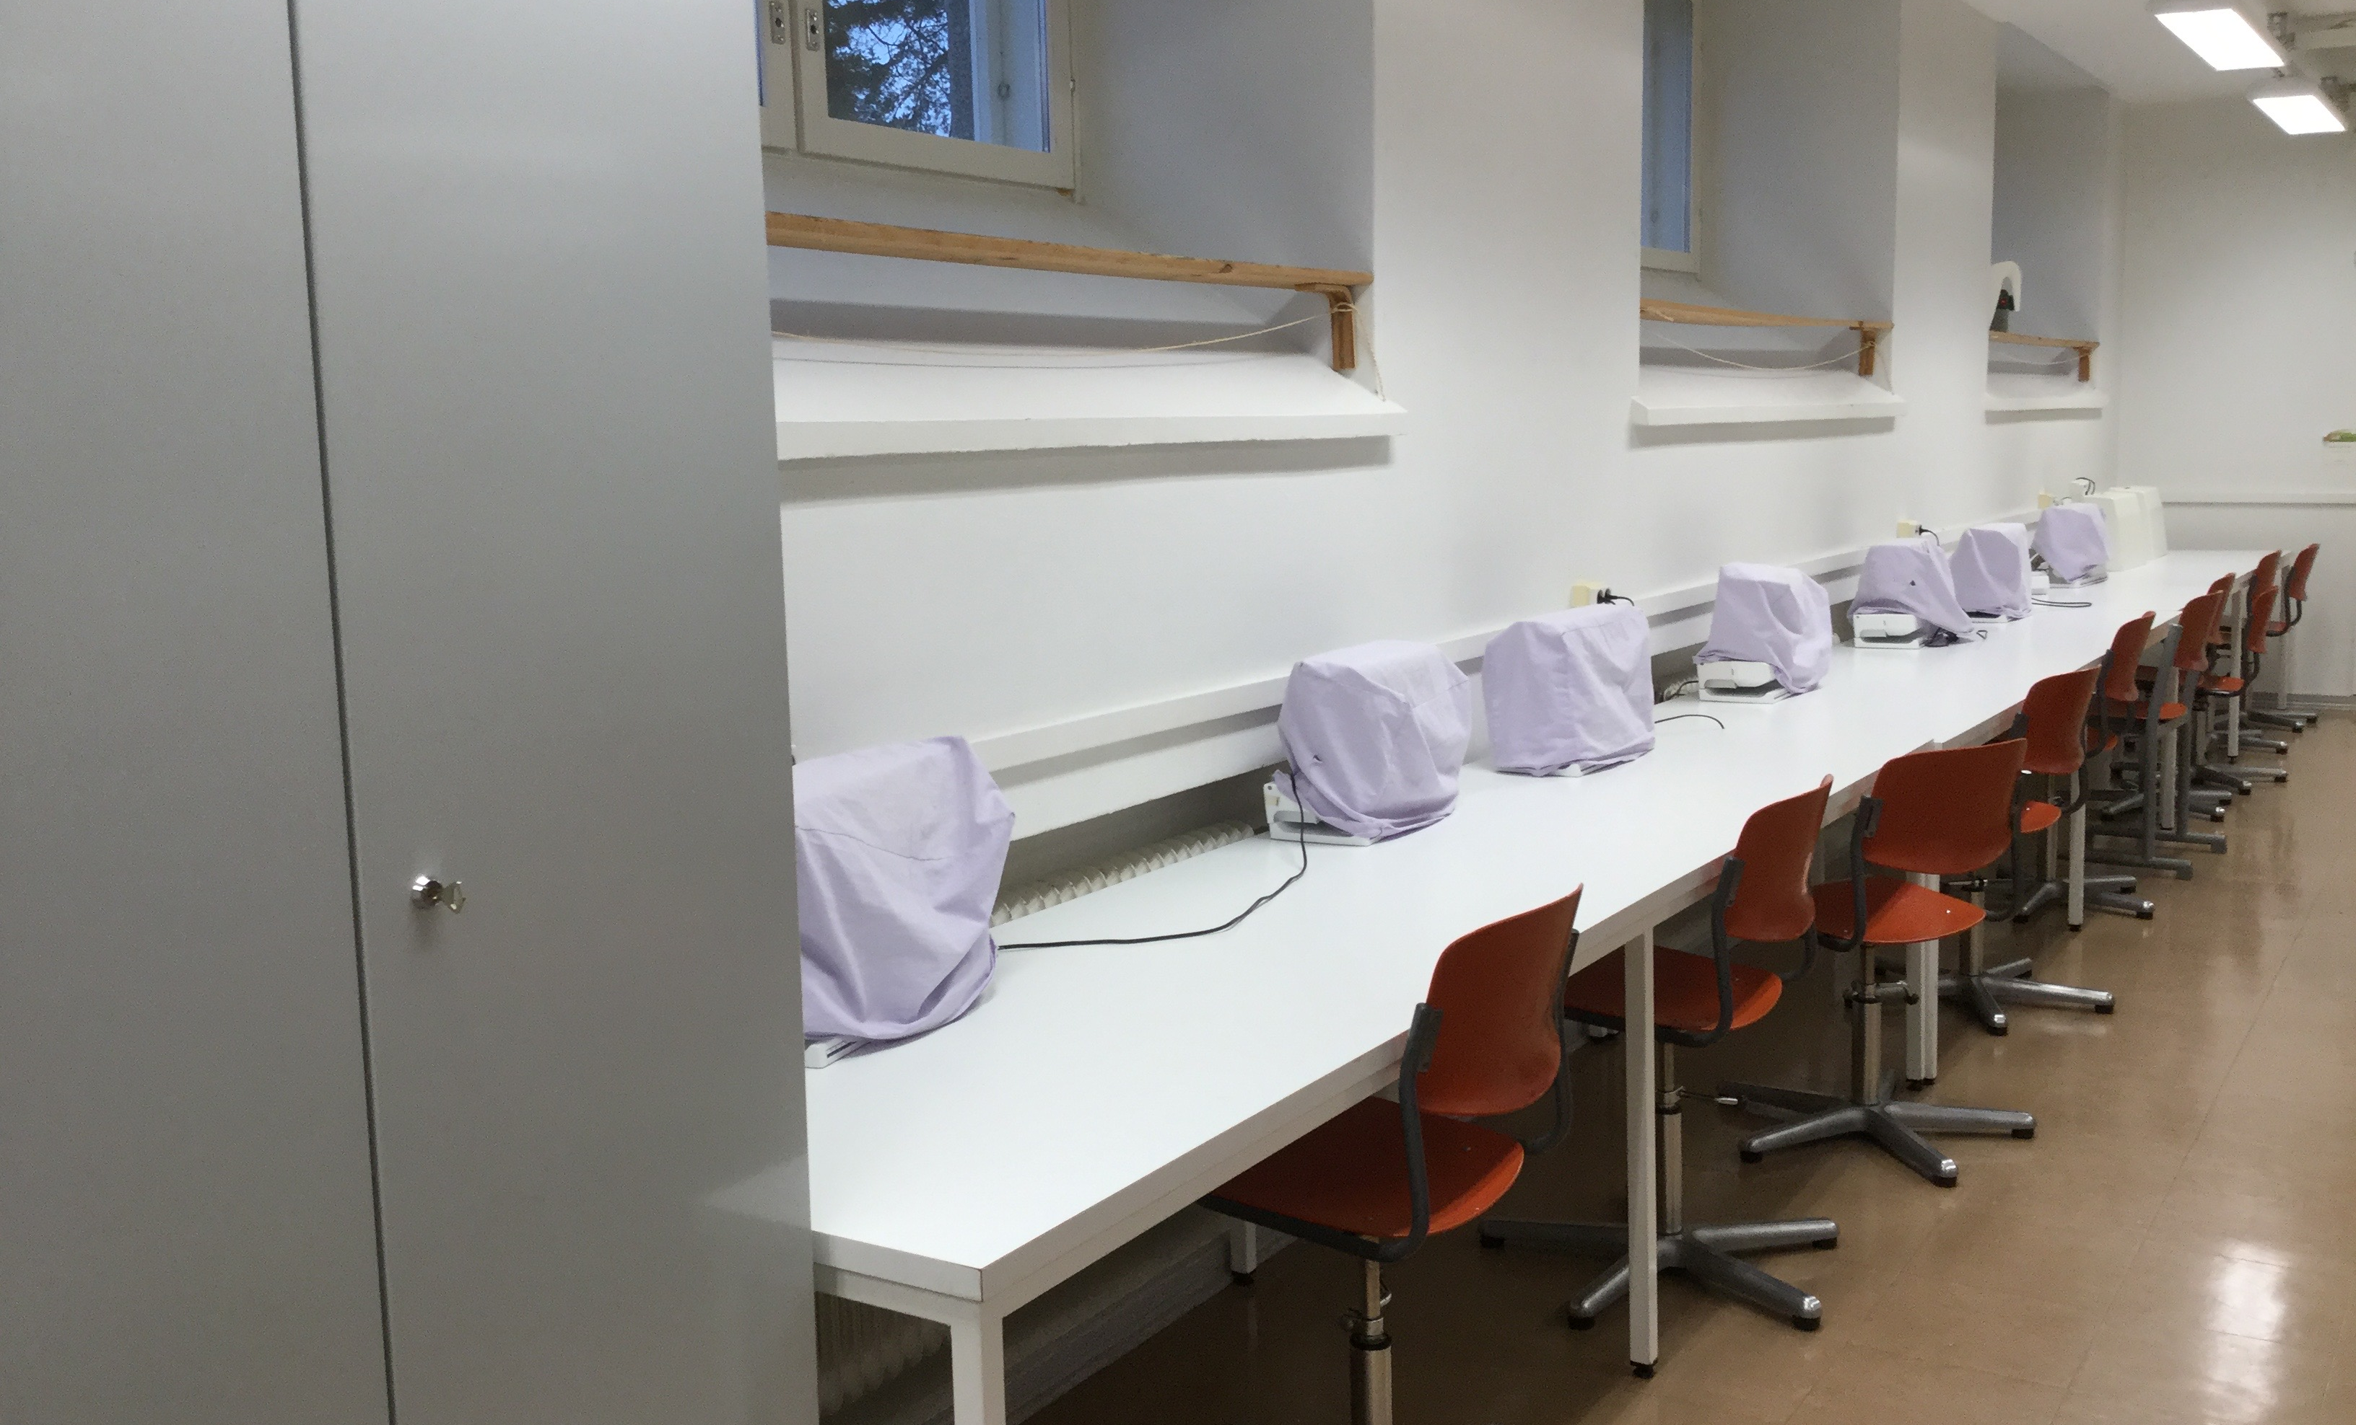
Crafts class
We have two craft classrooms, the other one is for wood and the other one is for fabric.

Slide 13
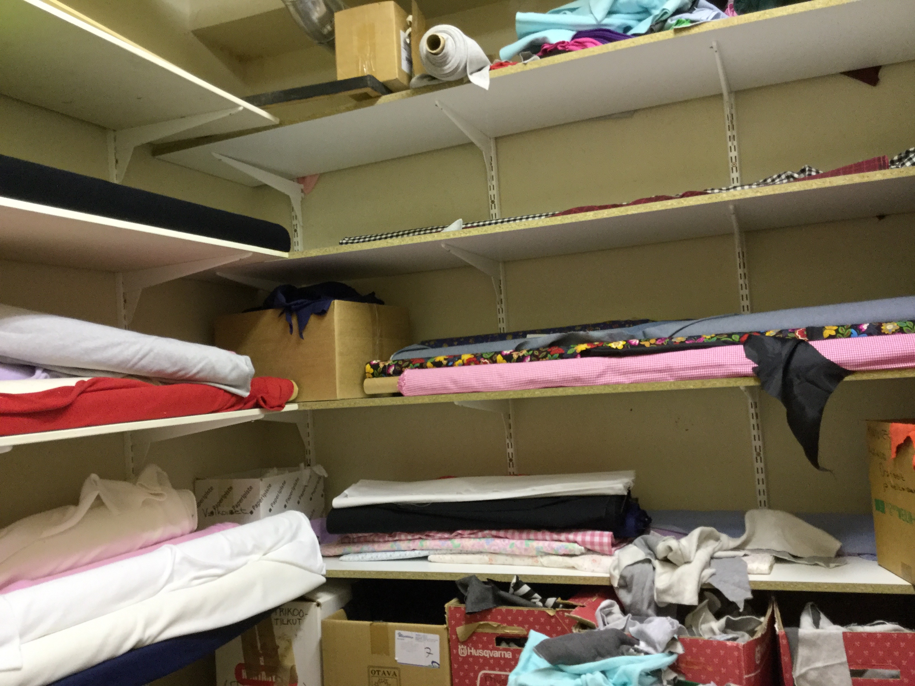

Slide 14
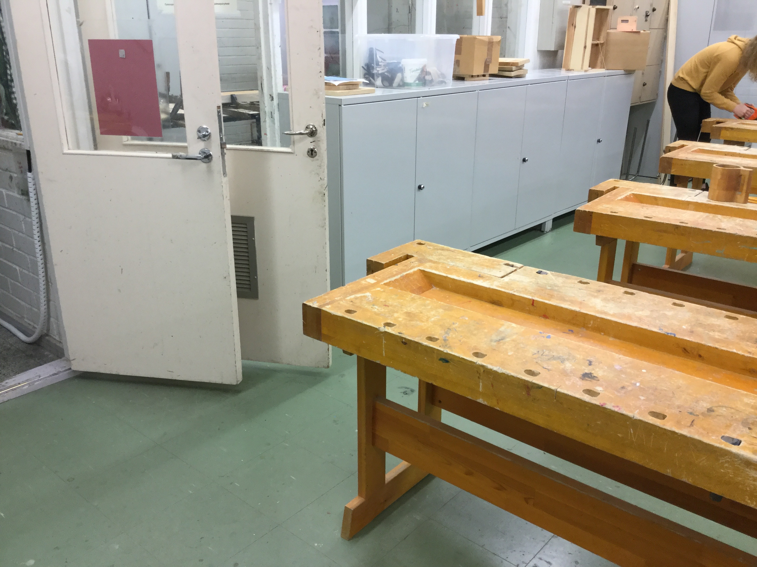

Slide 15
