Slide 1
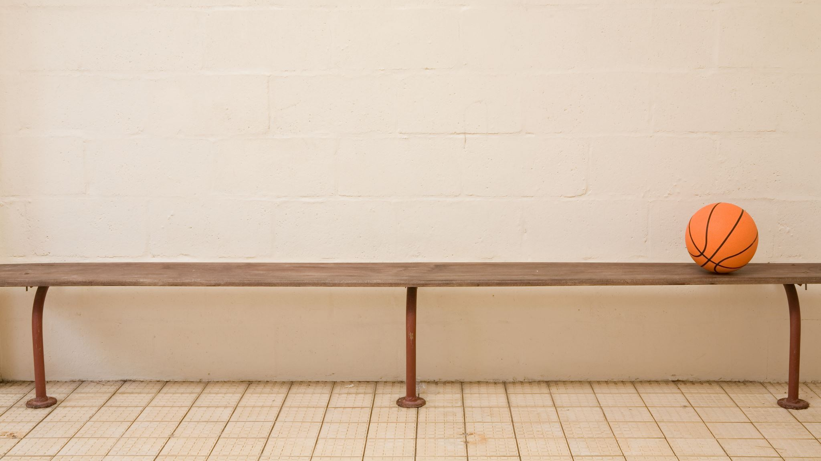
FIRST PRACTICE

Slide 2
GUESTIONS
TELL ABOUT YOUR SELF
Your name?
Your age?
Tell something about your family?
Your hobbies?
Your dreams?
What you are studuing now?
Where are you living?

Slide 3
Make a little story about youself using those guestions and
Send a video Whatsup

