Slide 1
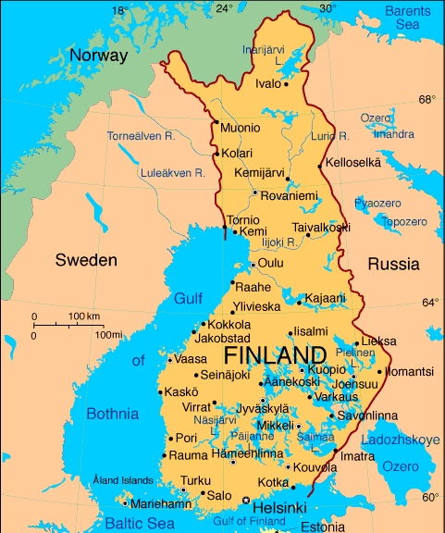
SUOMI FINLAND

Slide 2
Suomi (Finland) Mikkeli (St. Michel)
Independent 1917 (before that part of Russia and earlier part of Sweden)
Population 5 471 753 (2014)
Part of EU since 1995
Founded 1838
Population 54 726 (January 2015)
19th biggest town in Finland

Slide 3
SAUNA
SISU MARTTI AHTISAARI
SIBELIUS
SANTA CLAUS
NOKIA
ANGRY BIRDS
EDUCATION SYSTEM
HÄKKINEN and RÄIKKÖNEN
COFFEE

