Slide 1
Photoreportage
Education for sustainable development in the light of climate change for reducing early school leaving. How to educate students life skills
Portugal, 23 – 29. 07. 2017
Jaana Luukkanen
Paivi Tahvanainen

Slide 2
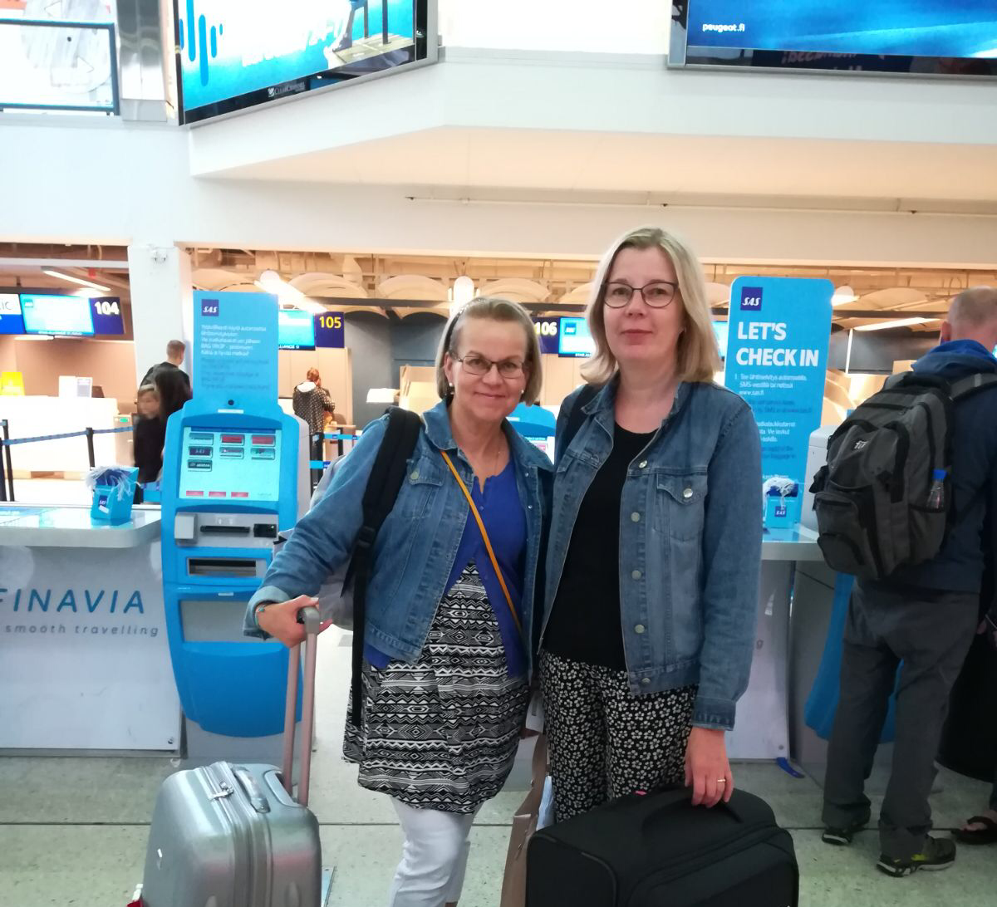

Slide 3
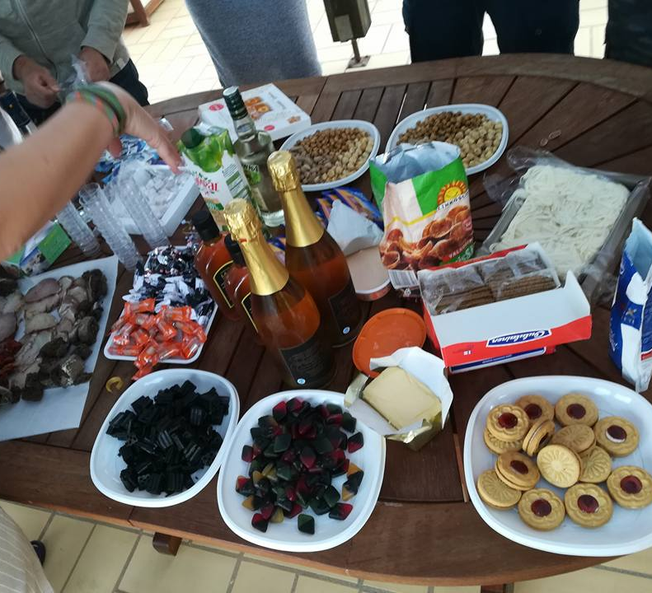
The first day: Our European Fair and culture sharing – meeting new friends

Slide 4
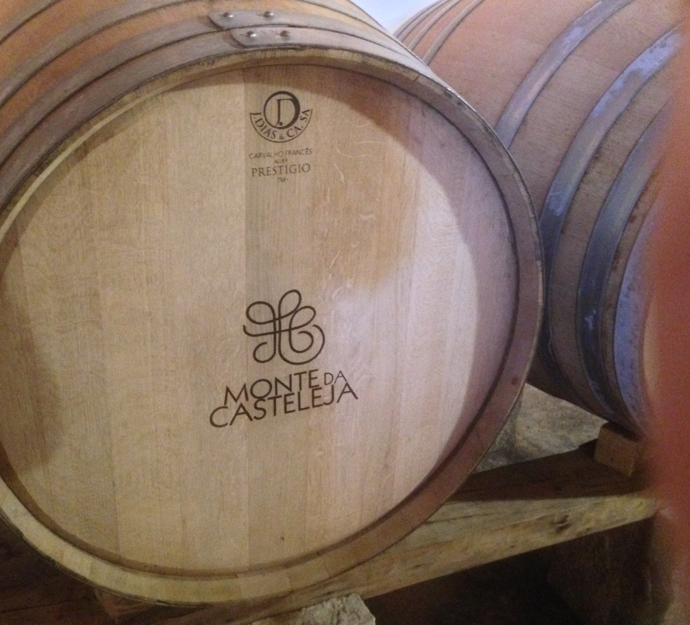
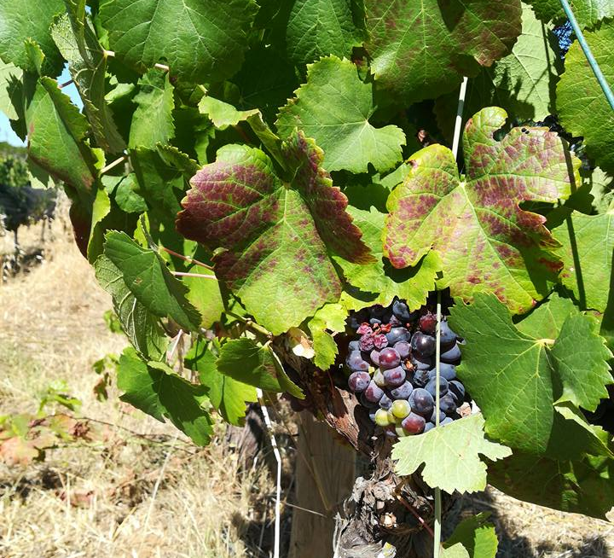
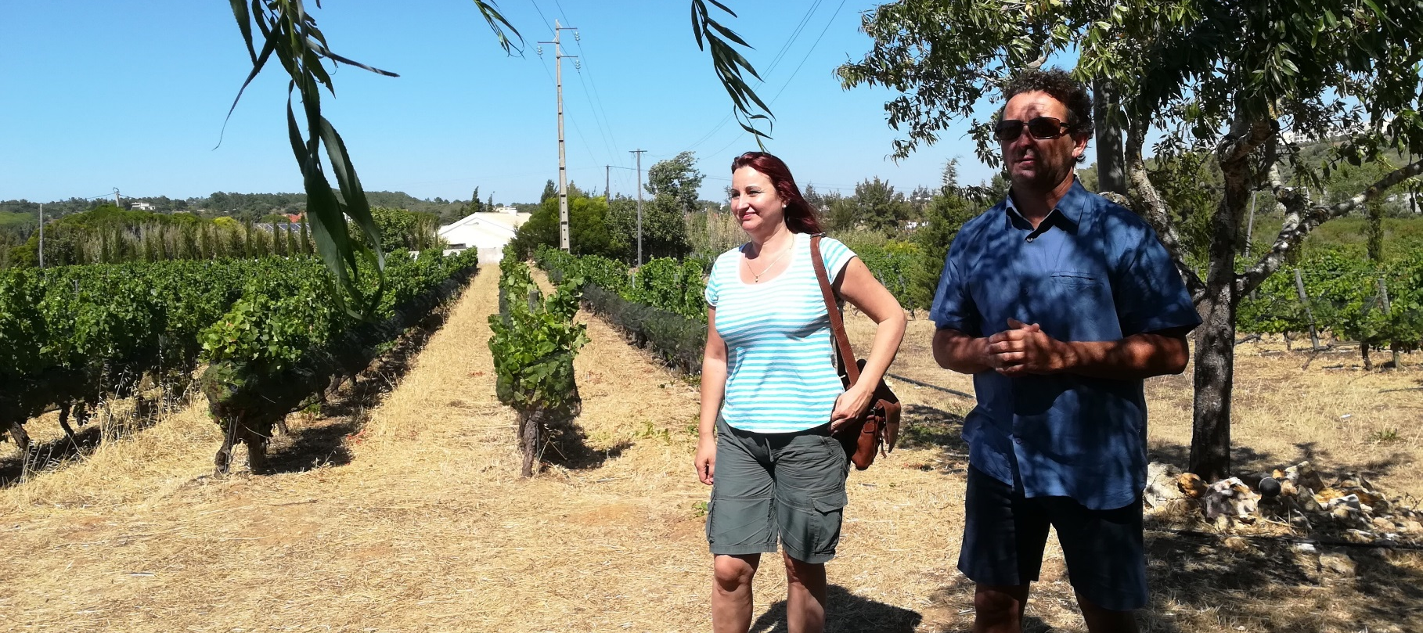
The second day: We compared systems of education in our countries and visited Monte da Casteleja (organic winery)
Making wine is art.

Slide 5
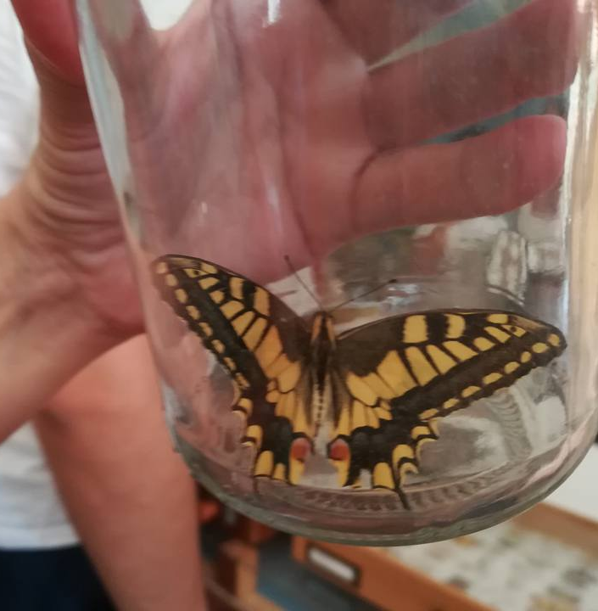
The third day: A Rocha Portugal field study center
A Rocha missions are conservation of the environment, education and cooperation with communities.
We learned that the study of insects (butterflies) is essential in helping understand changes in environment and manage habitats. Insects are very important in food chains and as pollinators.

Slide 6
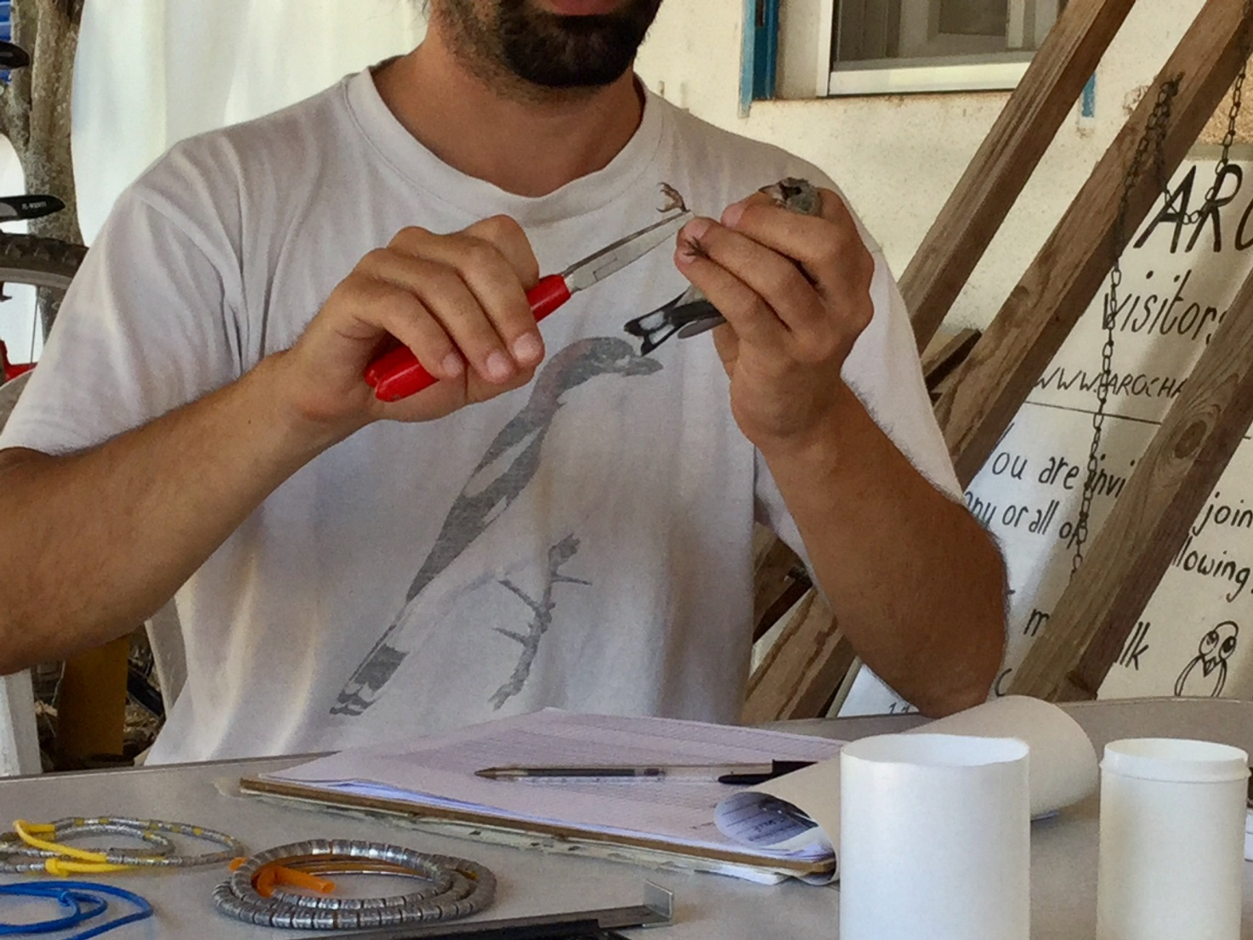
We gathered a lot of information about bird ringing.
The presence of birds is a good indicator of biodiversity, particularly in rural areas.
Changes in land use affect birds.

Slide 7
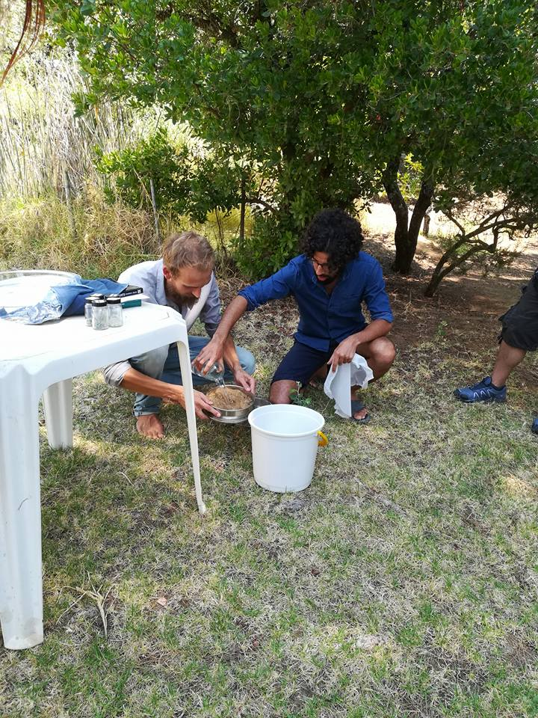
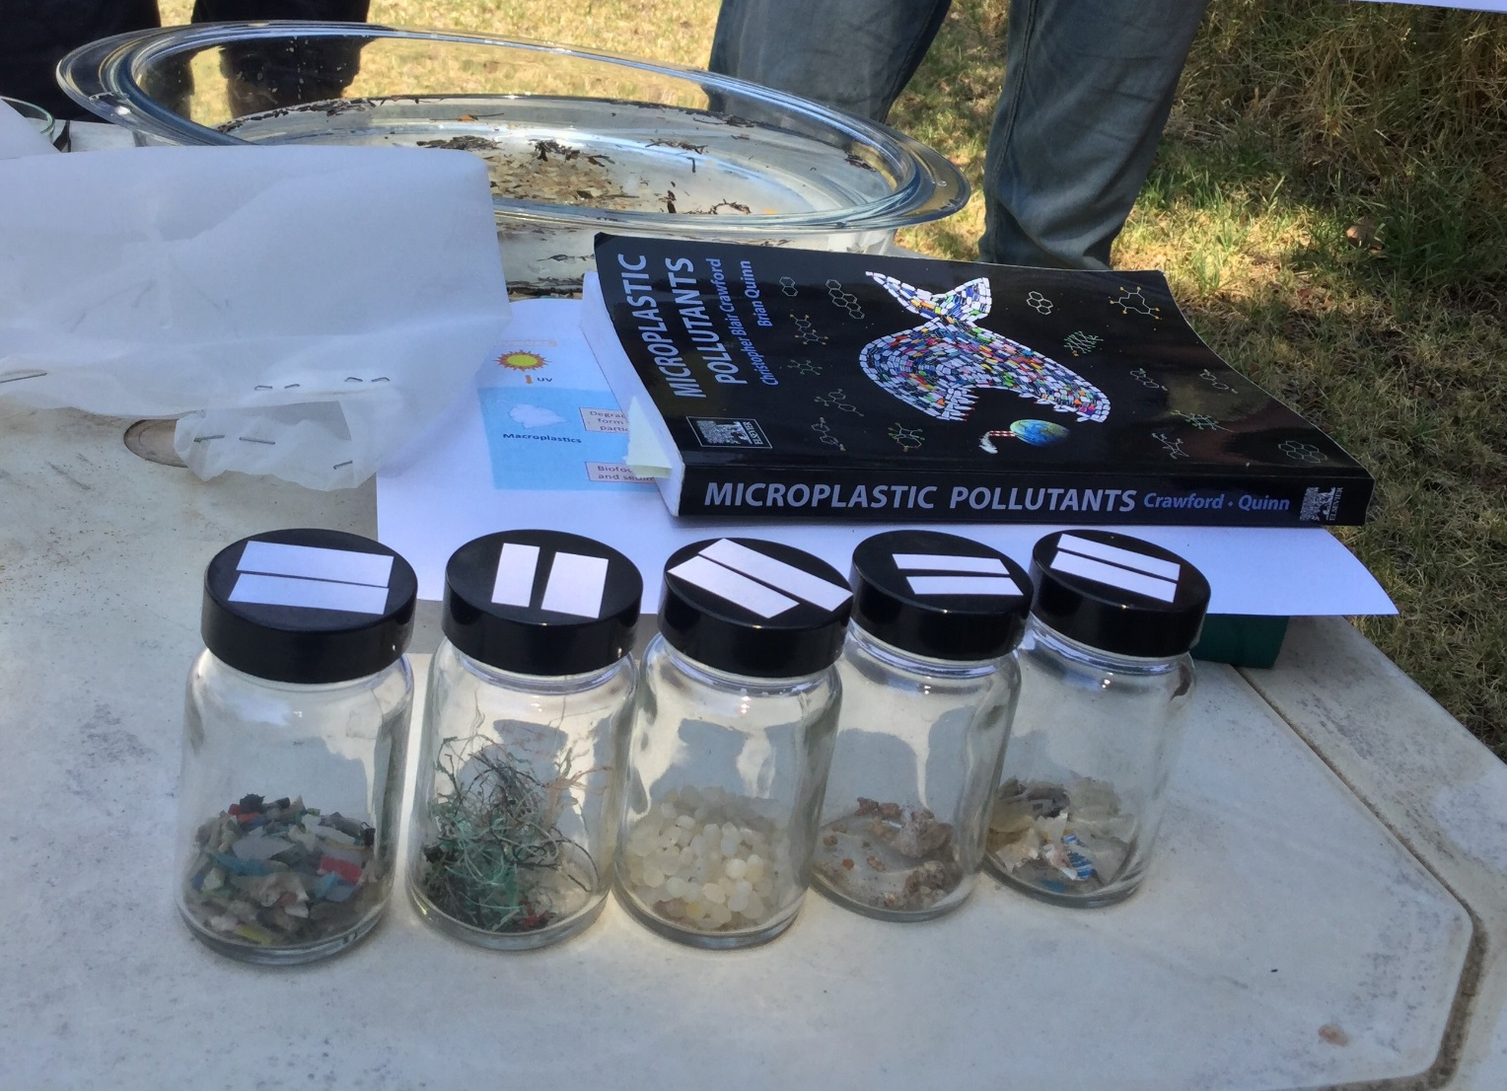
Microplastics in our seas is a big problem for animals and us.

Slide 8
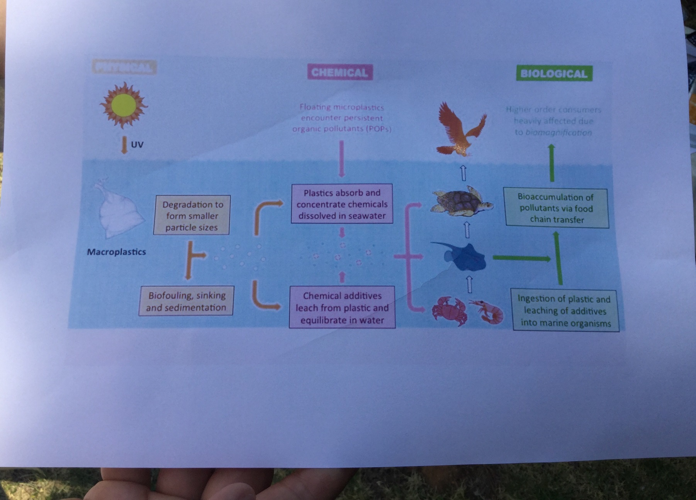
Microplastiscs is a growing threat to sea life and human health

Slide 9
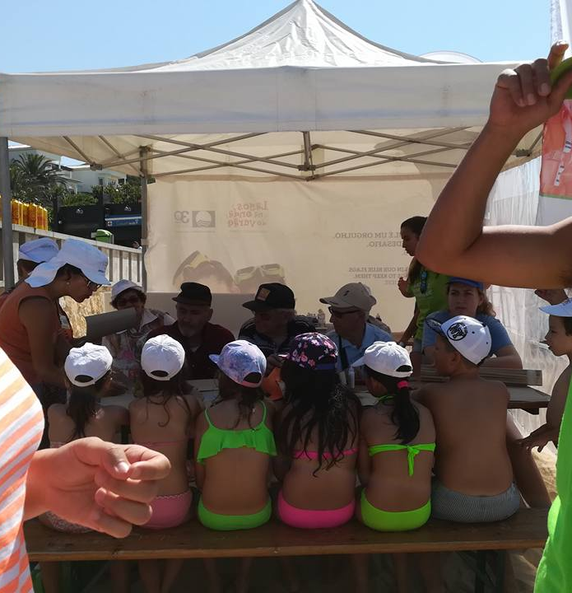
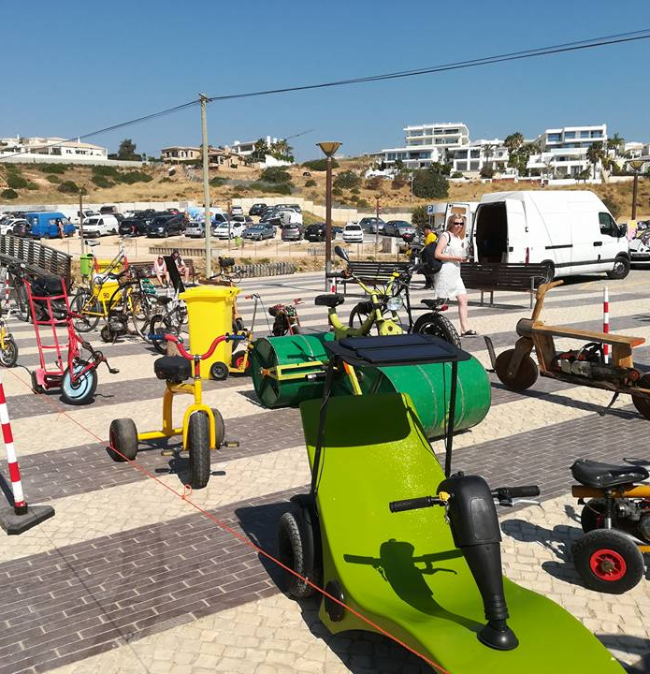
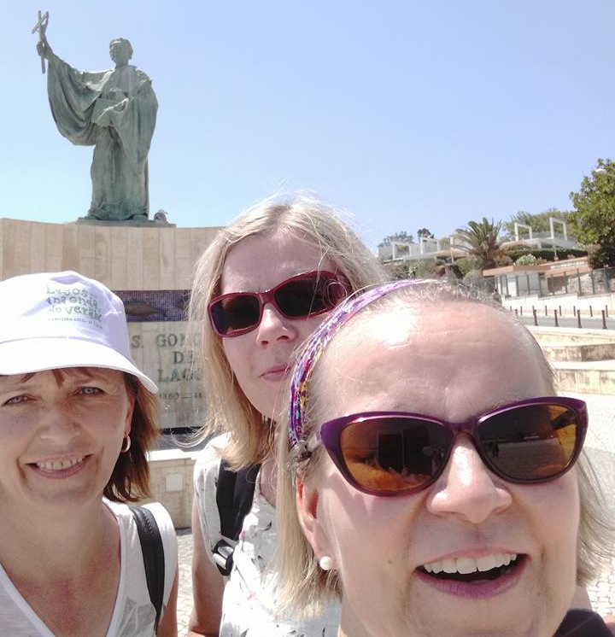
The fourth day: Creativity with recycling materials and cooperation with three generation – workshops and games on the beach organized in cooperation with the Municipality of Lagos

Slide 10
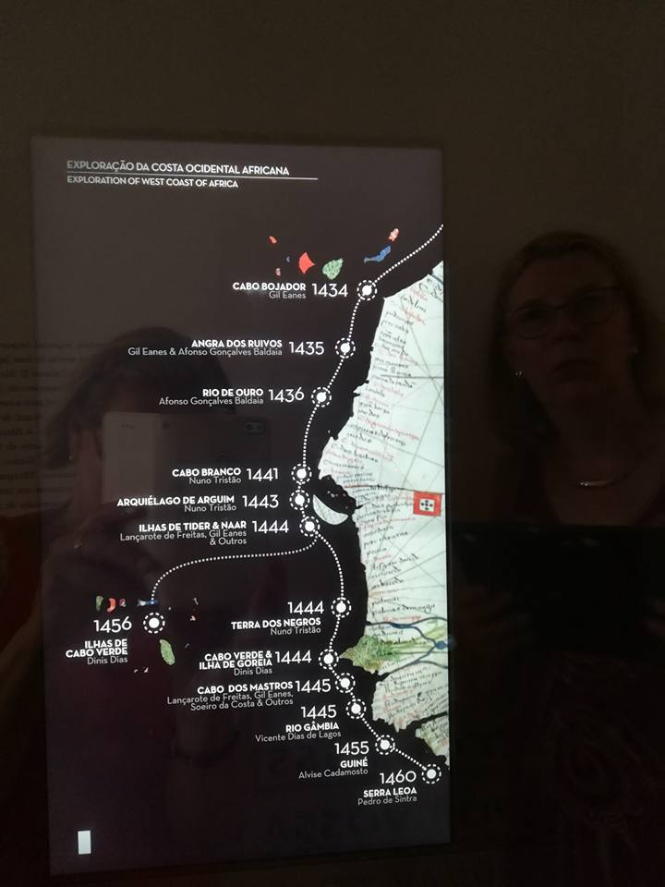
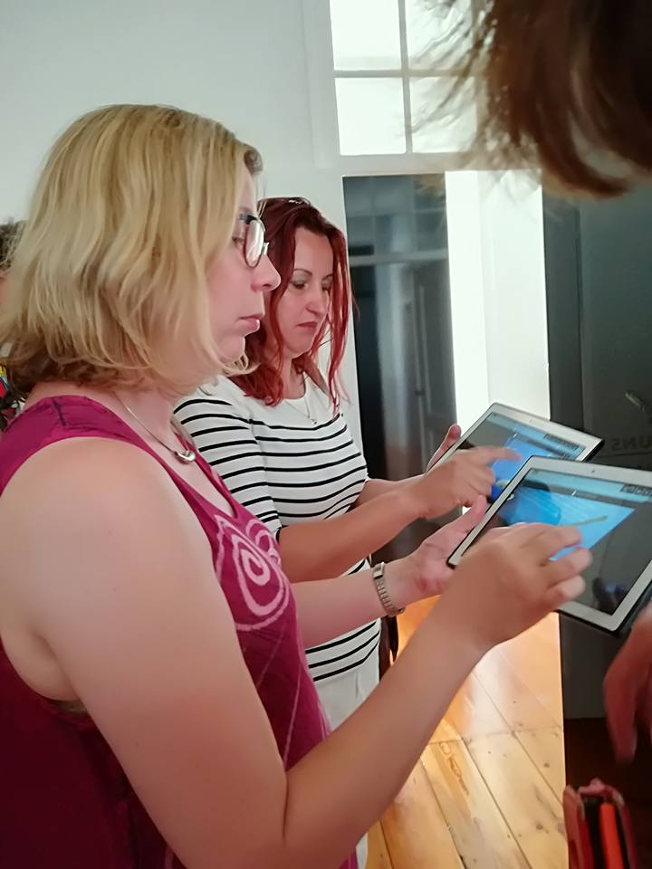
The fifth day: The past and the present joined with human rights – visiting Lagos Municipal Museum and the Slave Market

Slide 11
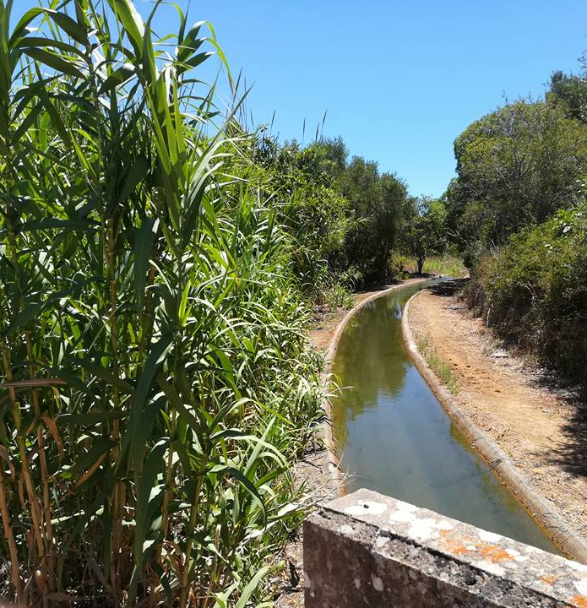
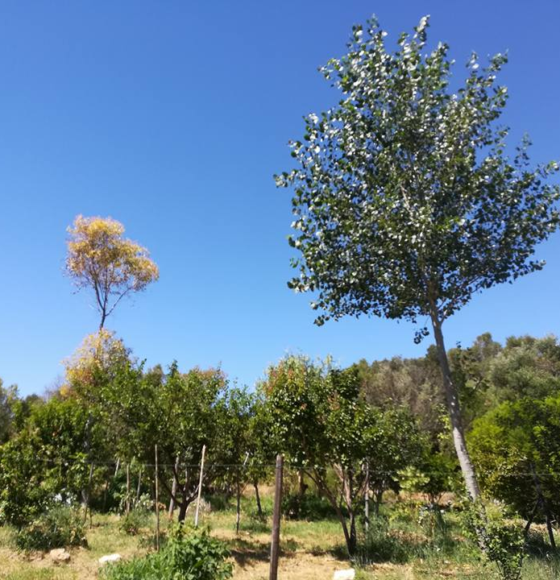
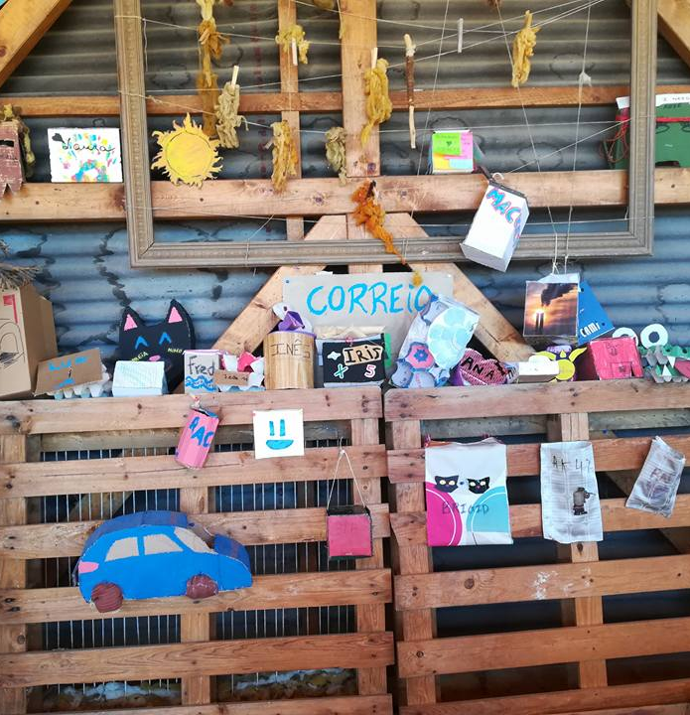
The sixth day: Sustainability in education and everyday life – visiting Quinta do Vale da Lama – Permaculture Institute

Slide 12
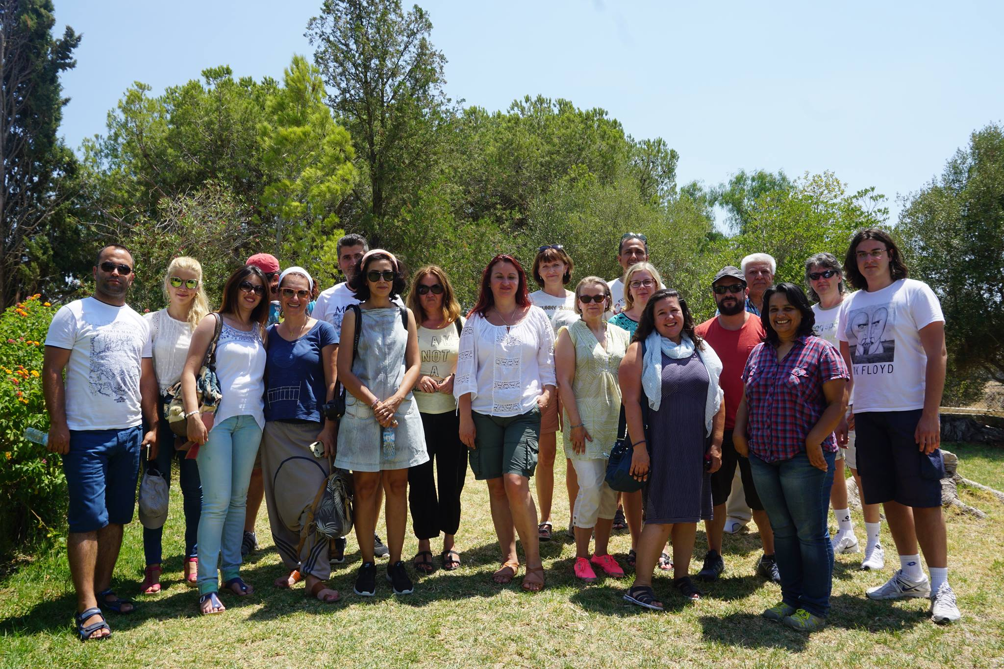
OUR CONCLUSIONS
Respect of life – big or small; plant or animal; old or young – equally important and connected with each other.
POWER is in cooperation

