Slide 1
Variables
Consider the graph below:
We all know about the x and y axes, but how do we determine what goes where?
y
x

Slide 2
Variables
If we know that the value of y is dependent on the value of x, we refer to y as either f(x) or then the dependent variable
y
x

Slide 3
Variables
The value of the dependent variable will change depending on that of the independent variable
y
x

Slide 4
Determine the Independent and Dependent Variables in Each Case
Alcohol consumption and reaction time
Concentration of a chemical and rate of reaction
A balloon fills more space when in a warmer temperature
A drug and cancer cell growth
The distance a ball flies and wind speed
Dosage of an active ingredient and efficiency of a medicine

Slide 5
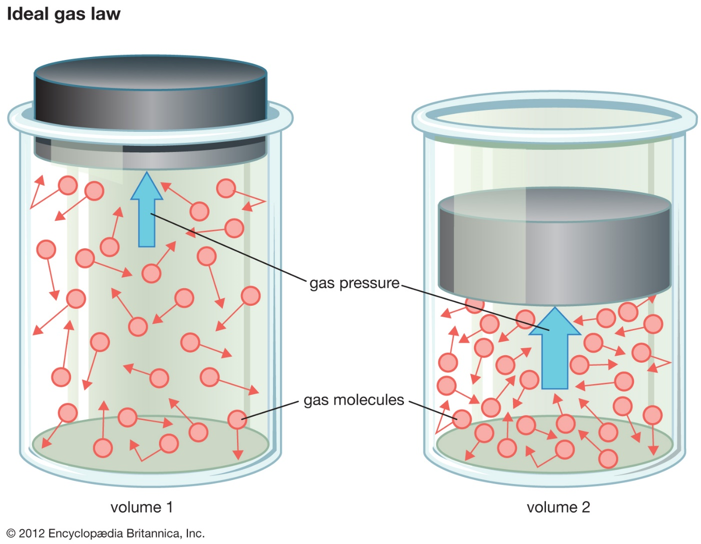
How about this?
Britannica.com (2020)

Slide 6
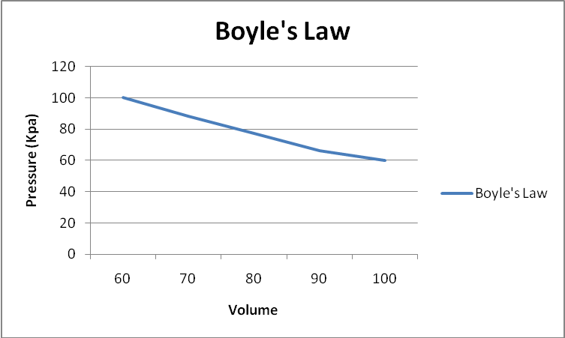
Explain What Is Happening Here
Wikipedia commons (2020)

Slide 7
Let’s Go Back to These Scenarios: What needs to be kepts constant? (What are the control variables?)
Alcohol consumption and reaction time
Concentration of a chemical and rate of reaction
A balloon fills more space when in a warmer temperature
A drug and cancer cell growth
The distance a ball flies and wind speed
Dosage of an active ingredient and efficiency of a medicine

Slide 8
Let’s Go Back to These Scenarios: What cannot be controlled?
(What are the confounding variables?)
Alcohol consumption and reaction time
Concentration of a chemical and rate of reaction
A balloon fills more space when in a warmer temperature
A drug and cancer cell growth
The distance a ball flies and wind speed
Dosage of an active ingredient and efficiency of a medicine

Slide 9
Consider the observations and research question you have recently come up with.
  What might the dependent and independent variables be?
  What might the control variables be?
  Are there confounding variables?

Slide 10
How to Display Data
Group name | Test 1 | Test 2
Left-handed | 2 | 3
Right-handed | 1 | 2
Ambidexterous | 0 | 2
Tables are effective in organizing data
Typically use numbers
Trends are more difficult to discern

Slide 11
Why should this data be presented as a pie chart?

Slide 12
How about a line graph or a bar chart?

Slide 13
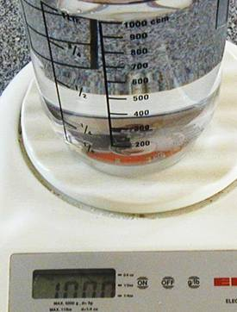
Numbers in Science
This liter of water weighs:
1 kilogram (1 kg),
1,000 grams (1,000 g),
10,000 decigrams (10,000 dg),
1,000,000,000 micrograms (1,000,000,000 µg)
1,000,000,000,000,000 pico grams (1,000,000,000,000,000 pg)
We must consider the use of scientific notation when dealing with numbers that are too big or too small to write conventionally.

Slide 14
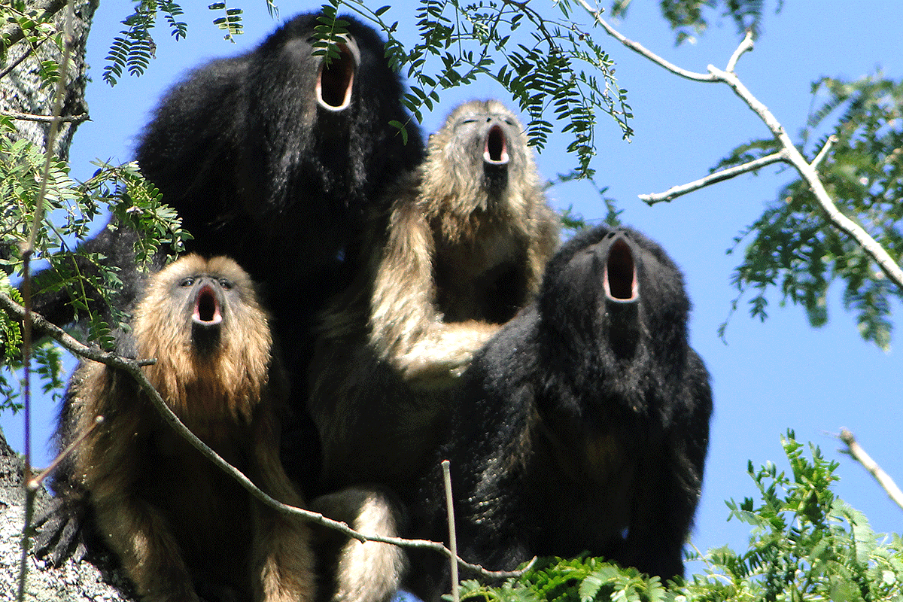
Qualitative and
Quantitative
Data
How are the following data sets similar? How are they different?
  Number of howler monkeys in tree, set 1
    1) 3
    2) 2
    3) 28
  Set 2
    1)10
    2) 9
    3) 3
    4) 5
    5) 7
    6) 20
    7)21
    8) 13

Slide 15
Quantitative Data
The mean (average) data point of a set describes that data up to a certain degree
The standard deviation (SD) explains the data in regards to the average
  the spread of data about the mean, measured in the same units as the data
  What does a high SD indicate? How about a low SD?
  Can we use SD with small sample sizes?
What is the importance of sample size in scientific investigations?

