Slide 1
THE RELATIONSHIP BETWEEN GENETICS AND BEHAVIOUR
(Dec 2019 syllabus revision)
IB Psychology LAJM

Slide 2
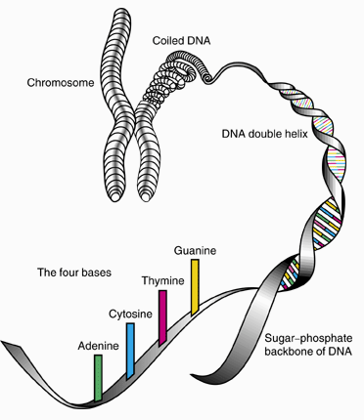
TASK
Review the following concepts:
  Genes and DNA
  Allele
  Genetic similarity and heritability
  Evolution
  Gene expression
  Epigenetics
  Methylation

Slide 3
TASK
“Genes and their effects on behaviour: Study one gene and its link to behaviour”
Review the 5-HTT gene
Review at least TWO studies related to the
5-HTT gene
  Caspi et al. (2003)
  Chiao and Blizinsky (2010)
  Kendrell et al. (2005)

Slide 4

TASK
Review the research methods for twin and kindship studies from your memos and/or from page 98

Slide 5

TASK
Review Bouchard & McGue (1981), Kendler et al (2015) and Scarr & Weinberg (1983) studies from your memos and/or from pages 100-104
  What do they tell you about the genetic similarity concerning intelligence?
Study genetic similarity for one behaviour

Slide 6

TASK
Review the Curtis, Aunger and Rabie (2004) and Fessler et al. (2005) studies from your memos and/or from pages 111–112 and the teacher’s additional materials
  How can disgust be explained with the theory of evolution?
Study one example
of evolutionary
explanation for
one behaviour

Slide 7
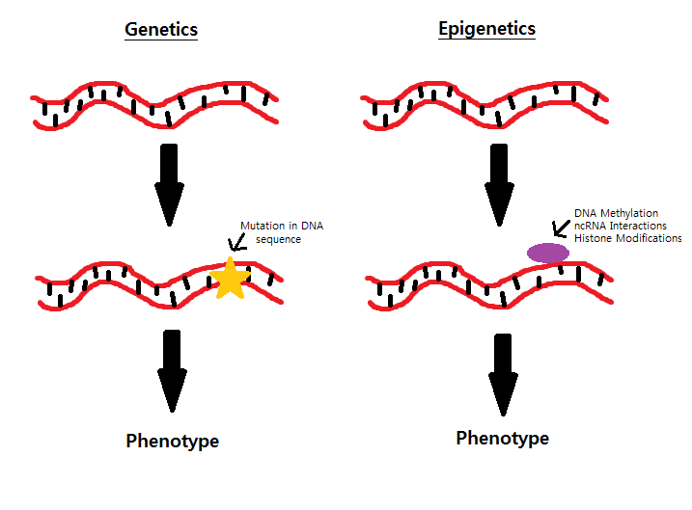
EXTRA TASK?
Review the Weaver et al. (2004) and Kaminsky et al. (2008) studies from your memos and/or from pages 105–106
  What do the studies tell you about epigenetics?
Are these needed for the revised syllabus?

Slide 8
Picture sources
Chromoseme-DNA <https://science.howstuffworks.com/life/genetic/designer-children1.htm> Accessed 10th of November 2017.
DNA <https://www.fearofflying.com/library/the-5-htt-gene/> Accessed 13th of February 2020.
Twins <http://www.redflagnews.com/headlines/identical-twin-studies-prove-homosexuality-is-not-genetic> Accessed 11th of November 2015.
Smart head/brain <https://www.quickanddirtytips.com/education/science/5-simple-ways-to-boost-our-intelligence> Accessed 13th of February.
Disgust <http://pixar.wikia.com/wiki/Disgust> Accessed 10th of October 2017.
Genetics and epigenetics <http://studentblogs.med.ed.ac.uk/reproductive-systems-group-2/introduction/> Accessed 9th of October 2018.

