Slide 1
THE RELATIONSHIP BETWEEN THE BRAIN AND BEHAVIOUR
(Dec 2019 syllabus revision)
IB Psychology LAJM

Slide 2
TASK
“The contribution of research methods used in the biological approach to understanding human behaviour”
Write sketch
responses to the following question:
  ”Evaluate two research methods used in the study of the brain and behaviour in biological approach”

Slide 3
TASK
Read the sample responses and compare your sketch responses to the samples
  How different or similar were they?
What were you able to learn from the sample responses?
What do you need to review based on these sample responses?

Slide 4

TASK
Review the essential concept related to research methods with the help of the Google doc ”19IB psych notes for revision”
  Contribute to the doc to the best of your ability!

Slide 5
TASK
”Techniques used to study the brain in relation to behaviour: Study one technique used to understand the brain and behaviour”
Choose ONE brain imaging technique from the syllabus and review it thoroughly with the help of the materials in ManageBac
Search for at least TWO studies that use the brain imaging technique
Please note!
You need to understand the basics
of the other techniques as well!

Slide 6
TASK
”Localization of function: Study one example of localization of function”
Review brain parts with their major functions
Choose ONE function
Search for at least TWO studies that provide evidence for and against the localization of the function
Convenient example
of a function: memory

Slide 7
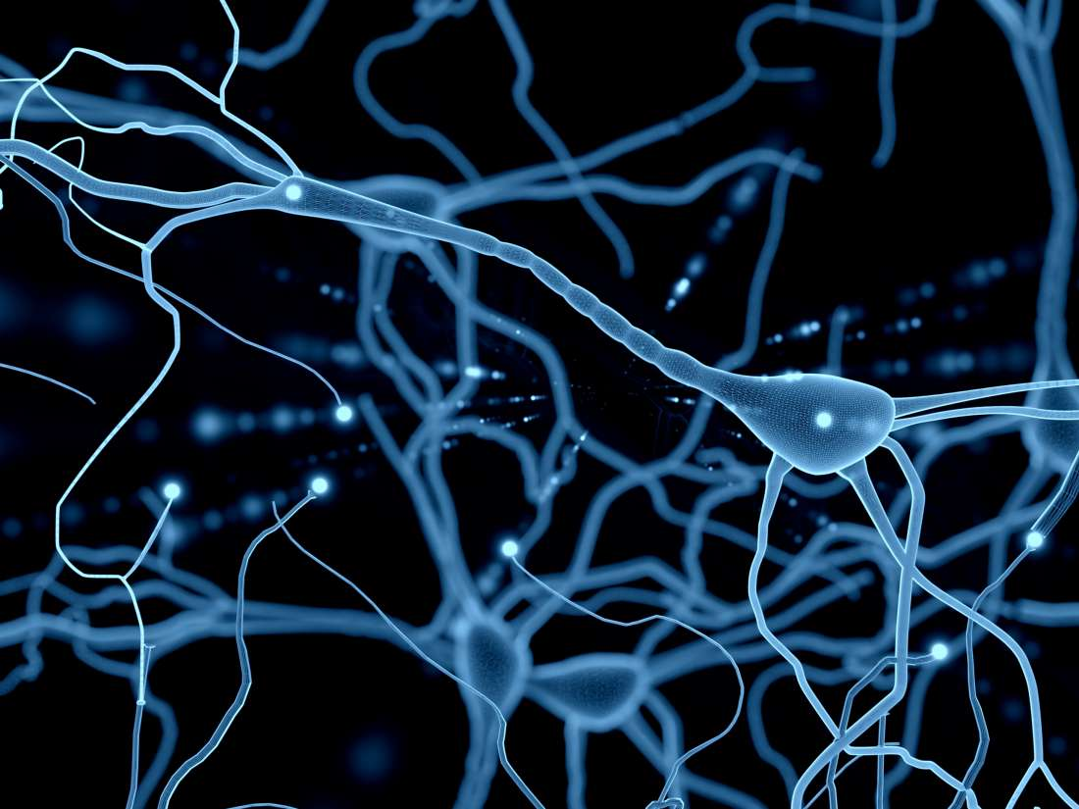
TASK
Review the following contents with ONE appropriate study
  Neural network
  Neural pruning

Slide 8
TASK
”Neuroplasticity: Study one example of neuroplasticity”
Review what was meant by neuroplasticity
Review at least TWO studies that relate to neuroplasticity and possibly cast a different light on the topic
  Use the whole syllabus

Slide 9
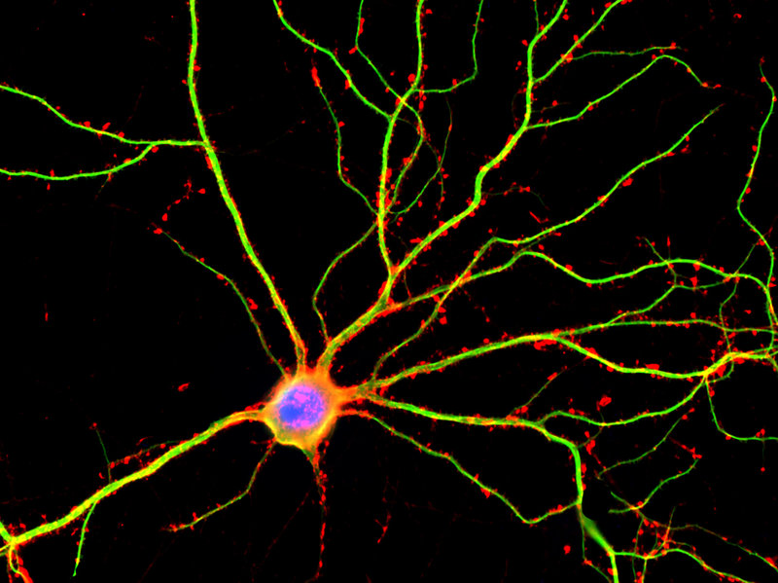
TASK
Review the following:
  Neuron and its parts
  Action potential
  (don’t use too much time with this)
  Synapse and synaptic transmission with excitatory and inhibitory neurotransmitters
  Agonist and antagonist

Slide 10
TASK
Review the following contents with the following studies:
  Excitatory neurotransmission: Fisher, Aron and Brown (2005) – Dopamine as an excitatory neurotransmitter in romantic love
  Inhibitory neurotransmission: Crockett et al. (2010) – Serotonin as an inhibitory neurotransmitter in prosocial behaviour
  Agonist and antagonist: Rogers and Kesner (2003) Acetylcholine (agonist) in the formation of memories with scopolamine (antagonist)

Slide 11
TASK
”Neurotransmitters and their effects on behaviour: Study one neurotransmitter and its effect on behaviour”
Review at least TWO studies that relate to neurotransmitters and possibly cast a different light on the topic
  Use the whole syllabus

Slide 12
Picture sources
Research head <https://synergycodes.com/blog/3-steps-to-conduct-your-research-easier/> Accessed 14th of January 2022.
Blue brain cells <https://medium.com/predict/artificial-neural-networks-mapping-the-human-brain-2e0bd4a93160> Accessed 10th of February 2020.
Green brain cells <https://fi.pinterest.com/pin/61854194853929129/> Accessed 15th of September 2017.

