Slide 1
QUICK QUIDE TO PERSONAL RELATIONSHIPS
18IB Psychology LAJM

Slide 2

Personal relationships
The role of relationships in human happiness cannot be underestimated

Slide 3

TASK
What is love?
Try to give a definition
What kind of components or dimension can be found in love?
Use your personal experiences
Don’t use any assistive devices or materials!

Slide 4
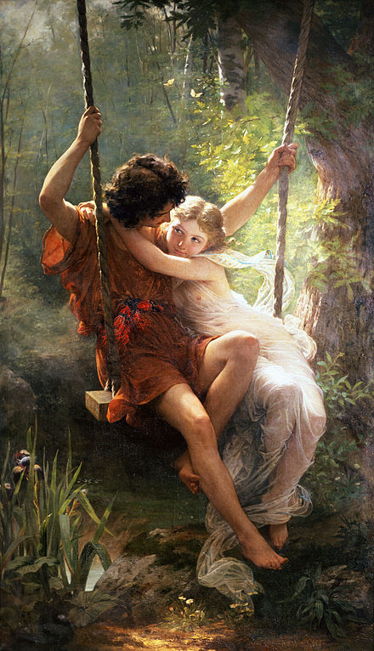
Love
Familial love (storge)
Love between a parent and a child
Friendly love (philia)
Love between friends
Romantic love (eros)
Passionate love
Divine love (agape)
Selfless love, charity

Slide 5
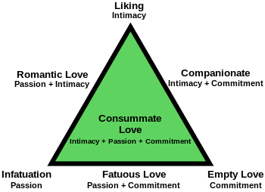
Love
Triangular theory of love (Sternberg, 1988)
Descriptive theory of love
Seem to be consistent with how people generally see love

Slide 6
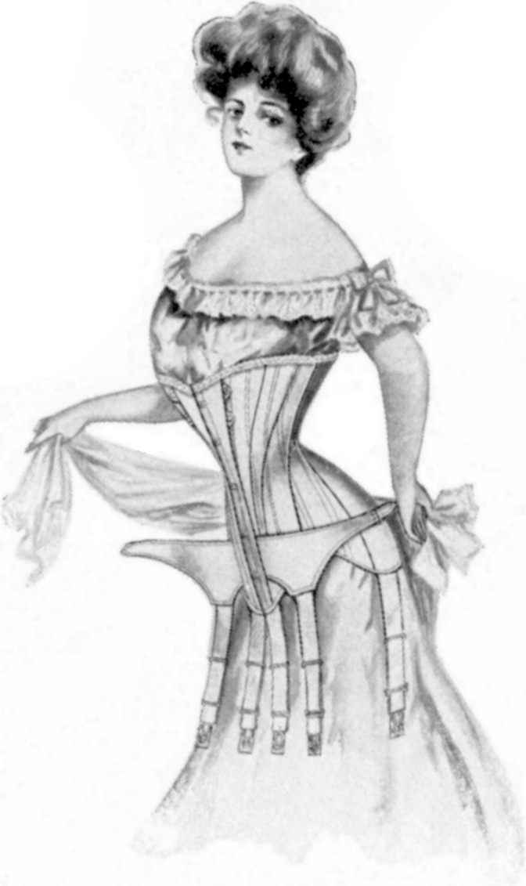
TASK
What kind of a male and female is attractive in your opinion?
Form groups and compile a product where you present your ideals
Are there any differences between male and female preferences?

Slide 7
Formation of personal relationships
Buss (1989)
Does gender play a role in the determination of desirable characteristics in a mate?
Over 10 000 participants in 33 countries filled questionnaires
Female preferences:
Financial capacity
Ambition and industriousness
Older male
Male preferences:
Physical attractiveness
Youth
SUPPORTS EVOLUTIONARY THEORY OF MATE SELECTION

Slide 8

TASK
Watch Helen Fisher TED-talk ”The Brain in Love”
What are the essential neurobiological processes in love?

Slide 9

TASK
Watch another Helen Fisher TED-talk ”Why we love, why we cheat”
What are the evolutionary and biochemical foundations of love?

Slide 10
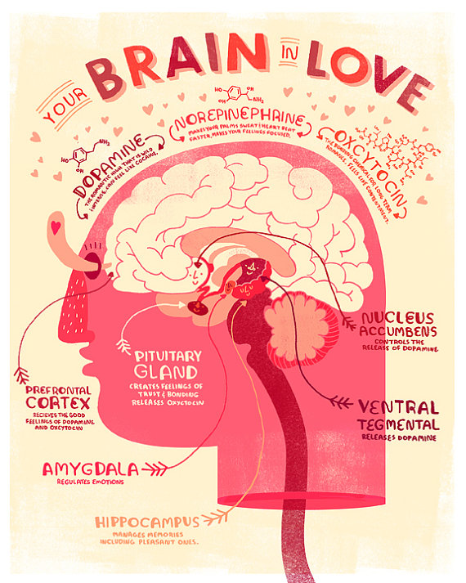
Formation of personal relationships
Study using fMRI shows that the same brain mechanisms active in substance abuse, is also active in the early stages of romantic love (Fisher et al, 2016)

Slide 11
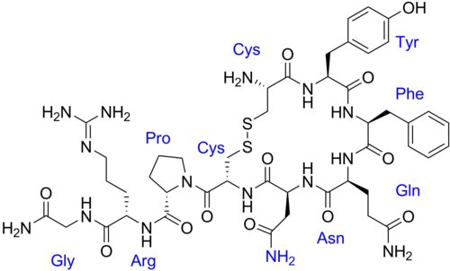
Formation of personal relationships
The hormones oxytocin and vasopressin play a role in relationship formation (Strathearn, 2001; Winslow et al, 1993)

Slide 12

TASK
How to get a mate?
Form small groups and come up with strategies that help you to get a mate

Slide 13

Formation of personal relationships
How to get a mate?
Reciprocity => we like those who like us
Proximity => be close to the person you like
Familiarity => mere exposure effect
Similarity => similarity breeds fondness

Slide 14

TASK
Has technology changed the way we form relationships?
Engage in conversation with your pair/group

Slide 15
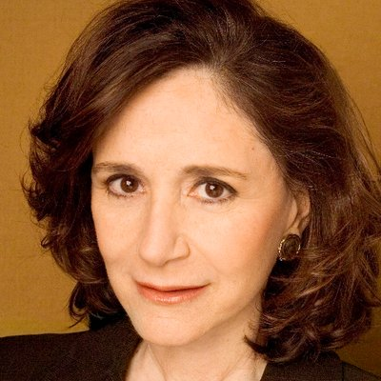
TASK
Watch Sherry Turkle TED-talk ”Connected, but alone”
Does technology change the way we form personal relationships?

Slide 16
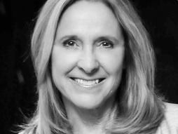
TASK
Watch Helen Fisher TED-talk ”Technology hasn’t changed love. Here is why.”

Slide 17
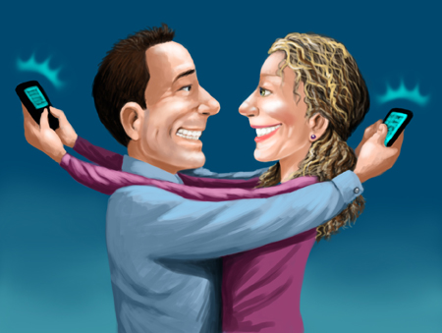
TASK
Did the two TED-talks complement one another on the effects of technology to personal relationships?

Slide 18
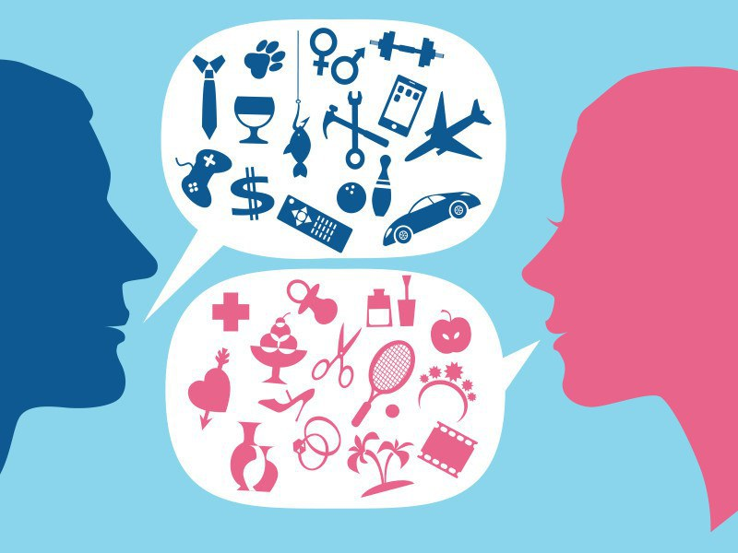
Role of communication
Deborah Tannen (1990)
Female communication focuses more on sharing feelings
Male communication focuses more on problem solving

Slide 19

Role of communication
YOU communication
Blaming the partner for something
I communication
Expressing our own feelings

Slide 20

REVIEW
What was meant by attribution?
Explanation of causes of behaviour
An interpretation why people behave the way they do
Dispositional and situational attributions

Slide 21
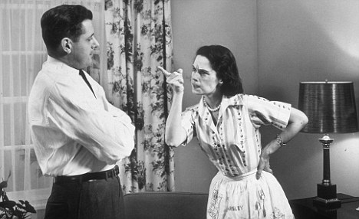
Role of communication
Attribution style
In healthy relationships positive behaviour is attributed to personal dispositions and negative behaviour to situational factors
Negative attribution style can hurt a relationship

Slide 22
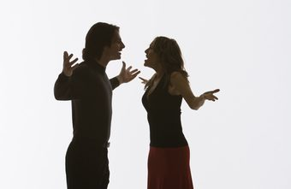
Role of communication
Patterns of accommodation
How to deal constructively with conflicts and negative behaviour?
Notes:
Idealization of partner can contribute to constructive accommodation.

Slide 23
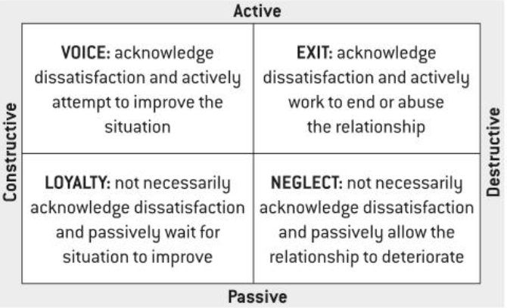
TASK
CREATE EXAMPLES TO EACH RELATIONSHIP CONFLICT STRATEGY

Slide 24

Role of communication
Gottman and Krokoff (1989)
Expressing anger and disagreement was NOT necessarily associated with marital dissatisfaction
Constructive conflict resolution style breeds marital satisfaction

Slide 25

Role of communication
Attachment styles play important role in accommodation
Securely attached individuals favour constructive conflict resolution

Slide 26
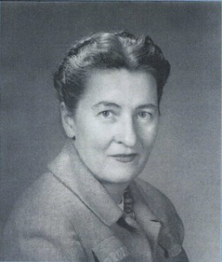
TASK
To find out more about different attachment styles and developmental psychology, watch the educational video on the topic

Slide 27
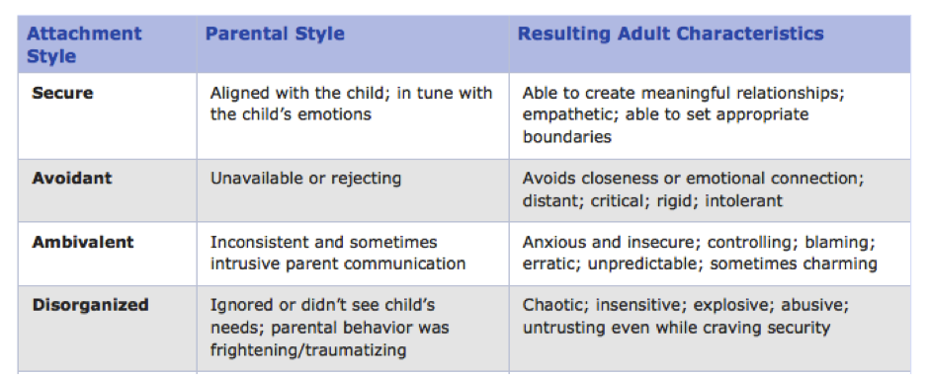
Role of communication

Slide 28
TASK
Practise different communication patterns with a “partner”
Form pairs and create mini-plays with a witty dialogue where different communication patterns appear
Gender differences in communication
I and YOU communication
Attribution styles
Patterns of accommodation
Attachment styles

Slide 29

TASK
Why relationships change or end?
Try give answers to the question from several perspectives
Don’t use any assistive devices or materials!

Slide 30
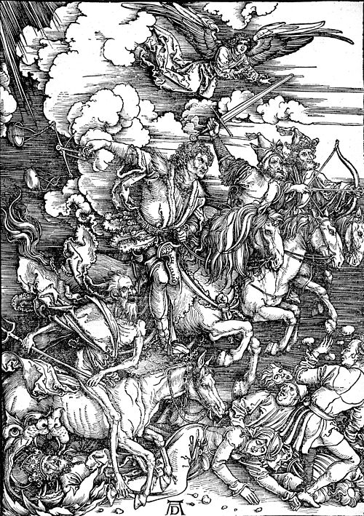
Why relationships change or end?
Gottman’s theory of the Four Horsemen of the Apocalypse
Criticism => attacking the character of the person
Contempt => disrespect
Defensiveness => victimization
Stonewalling => withdrawing from conversation

Slide 31
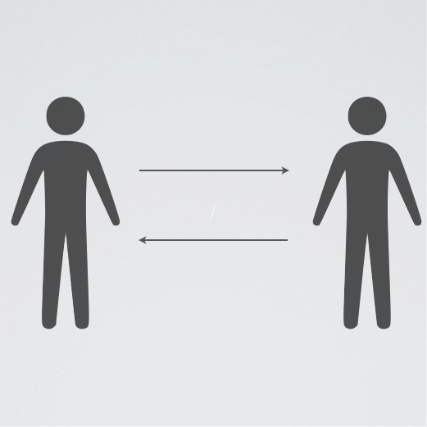
Why relationships change or end?
Social exchange theory (Kelley & Thibaut, 1959)
Relationships are maintained through a cost-benefit analysis

Slide 32

Why relationships change or end?
Equity theory (Adams, 1960s)
If relationships are perceived equal, they will be maintained
Balance of costs and benefits
Notes:
Empirical support (Hatfield, 1979), but considered cold.

Slide 33
TASK
What would be the costs and benefits of starting a relationship at this point of your life?

Slide 34
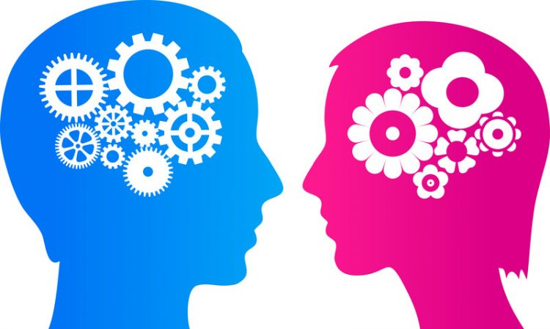
TASK
Do males and females expect different things from a relationship?
Is there a gender difference?

Slide 35
Why relationships change or end?
Factors of relationship satisfaction in males
Common interests
Desire to spend time together
Partner’s negative feelings
Flora & Segrim (2003)
Factors of relationship satisfaction in females
Quantity of female’s own negative feelings (in addition to the two first male preferences)
Notes:
(Flora and Segim, 2003)

Slide 36
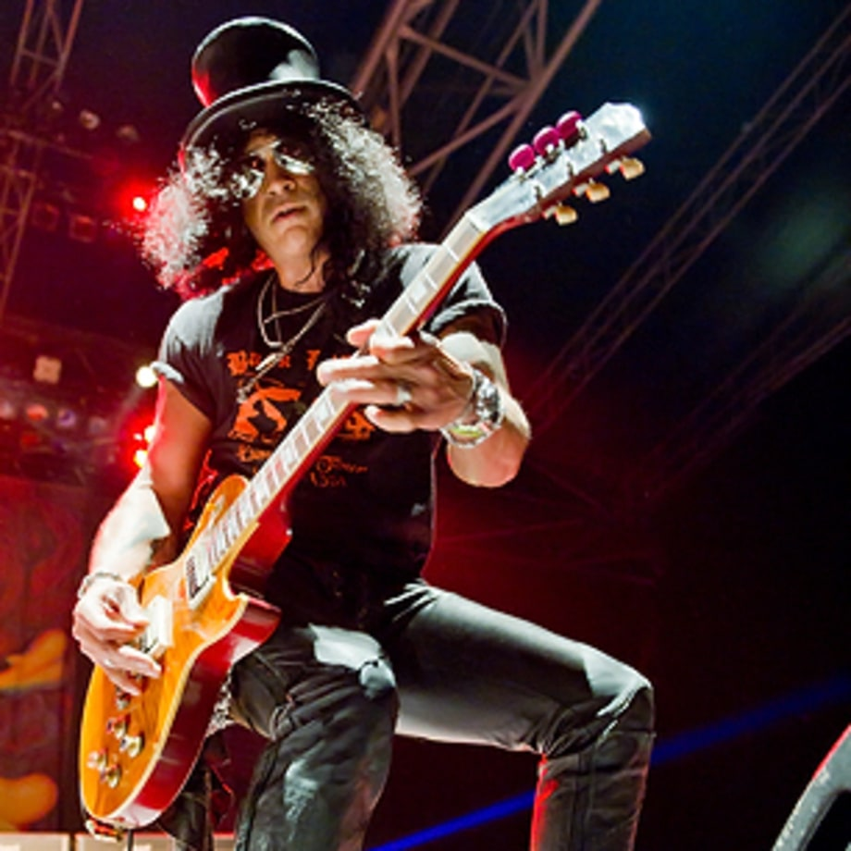
Why relationships change or end?
Fatal attraction theory (Felmlee, 1995)
The trait that initially caused attraction can lead to breakup

Slide 37
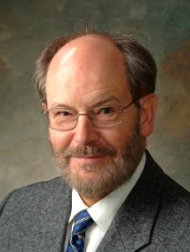
TASK
Watch the educational video on Steve Duck’s theory of breakdown

Slide 38
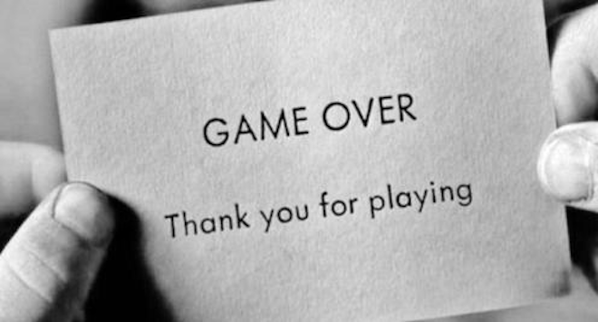
TASK
Could there be any other reasons for breakups?

Slide 39

TASK
How can you apply the things you learned from this PowerPoint in your own personal life?

Slide 40
Picture sources
Couple cooking <https://pixabay.com/fi/nainen-keittiö-mies-1979272/> Accessed 13th of November 2017.
Love character <http://weclipart.com/japanese+love+clipart> Accessed 13th of November 2017.
Spring <https://en.wikipedia.org/wiki/Eros_(concept)> Accessed 17th of April 2018.
Trianglar theory of love <https://en.wikipedia.org/wiki/Triangular_theory_of_love> Accessed 13th of November 2017.
Woman in corset <https://commons.wikimedia.org/wiki/File:CorsetStyles1909-1910p06A.png> Accessed 16th of April 2018.
Helen Fisher <http://www.greatthoughtstreasury.com/author/helen-fisher> Accessed 16th of April 2018.
Helen Fisher 2 <https://seniorplanet.org/planet-talk-love-chemistry-expert-helen-fisher/senior-planet-helen-fisher/> Accessed 18th of April 2018.
Your brain in love <https://www.etsy.com/listing/176998690/your-brain-in-love-anatomy-poster> Accessed 16th of April 2018.
Vasopressin <https://en.wikipedia.org/wiki/Vasopressin> Accessed 15th of February 2021.
Cupid <https://pixabay.com/fi/enkeli-arrow-jousi-sarjakuva-2029668/> Accessed 13th of November 2017.
Couple <https://www.talithatarro.com/weddings/engagements/kim-phillip> Accessed 15th of February 2021.
Tinder <https://mobiili.fi/2018/01/24/tinder-sovelluksen-salauksen-puute-avaa-hakkereille-oven-deittisovellukseen/> Accessed 17th of April 2018
Sherry Turkle <https://twitter.com/sturkle> Accessed 18th of April 2018.
Helen Fisher 3 <https://www.ted.com/speakers/helen_fisher> Accessed 18th of April 2018.
Love & Tech <https://www.theispot.com/whatsnew/2011/9/scott-pollack-love-tech.htm> Accessed 18th of April 2018.

Slide 41
Picture sources
Male and female communication <https://www.theodysseyonline.com/food-for-thought-social-roles-of-males-and-females> Accessed 20th of April 2018.
You and I <https://weheartit.com/entry/108849504> Accessed 20th of April 2018.
Lazy student <http://gojmti.blogspot.fi/2016/05/why-students-lazy-to-learn.html> Accessed 18th of August 2017.
Nagging wife <http://www.dailymail.co.uk/news/article-1262179/Married-men-live-longer-wives-nag-visit-GP.html> Accessed 23rd of April 2018.
Conficlting couple <http://smallbusiness.chron.com/advantages-amp-disadvantages-conflict-organizations-40821.html> Accessed 23rd of April 2018.
Old couple <https://auxx.me/true-love-look-couple-youd-want-something-like/> Accessed 2nd of September 2019.
Distant couple <http://drjanethope.com/for-couples/relationship-feeling-distant/> Accessed 15th of November 2017.

Slide 42
Picture sources
Mary Ainsworth <https://www.feministvoices.com/mary-ainsworth/> Accessed 23rd of April 2018.
Attachment styles <http://believeperform.com/performance/using-attachment-theory-to-better-understand-your-athletes/> Accessed 15th of November 2017.
Breakup <http://www.collective-evolution.com/2015/07/28/science-sheds-ligh-on-what-happens-to-your-brain-during-a-breakup/> Accessed 13th of November 2017.
The Four Horseman of the Apocalypse <https://fi.wikipedia.org/wiki/Ilmestyskirjan_ratsastajat> Accessed 23rd of April 2018.
Social exchange <http://social-exchange.me/participate.html> Accessed 15th of November 2017.
Scale <https://pixabay.com/fi/vaaka-tasa-käsi-tasapaino-asteikko-2402966/> Accessed 15th of November 2017.
Gernder differences <http://interestingthingsbox.com/2017/02/11-painfully-true-illustrations-prove-men-women-not-planet/> Accessed 15th of November 2017.
Slash <http://www.rollingstone.com/music/lists/100-greatest-guitarists-20111123/slash-20111122> Accessed 15th of November 2017.
Steve Duck <https://psychology.uiowa.edu/people/steve-duck> Accessed 13th of November 2017.
Game over <http://www.scienceofrelationships.com/home/tag/breakup> Accessed 15th of November 2017.
Couple 2 <https://keepinitfrugal.com/25-frugal-no-tech-date-night-ideas-for-couples/> Accessed 15th of February 2021.

