Slide 1
TREATMENT OF DISORDER(S) (18IB revision)
IB Psychology LAJM

Slide 2
TASK
”Biological treatment”
Review the main contents of this topic from pages 306–312, your memos and lesson presentations
Review at least TWO studies that can be applied with the topic

Slide 3
TASK
”Psychological treatment”
Review the main contents of this topic from pages 313–318, your memos and lesson presentations
Review at least TWO studies that can be applied with the topic

Slide 4
TASK
”The role of culture in treatment”
Review the main contents of this topic from pages 319–324, your memos and lesson presentations
Review at least TWO studies that can be applied with the topic

Slide 5
TASK
”Assessing the effectiveness of treatment(s)”
Review the main contents of this topic from pages 300–305, your memos and teacher’s materials
Review at least TWO studies that can be applied with the topic

Slide 6
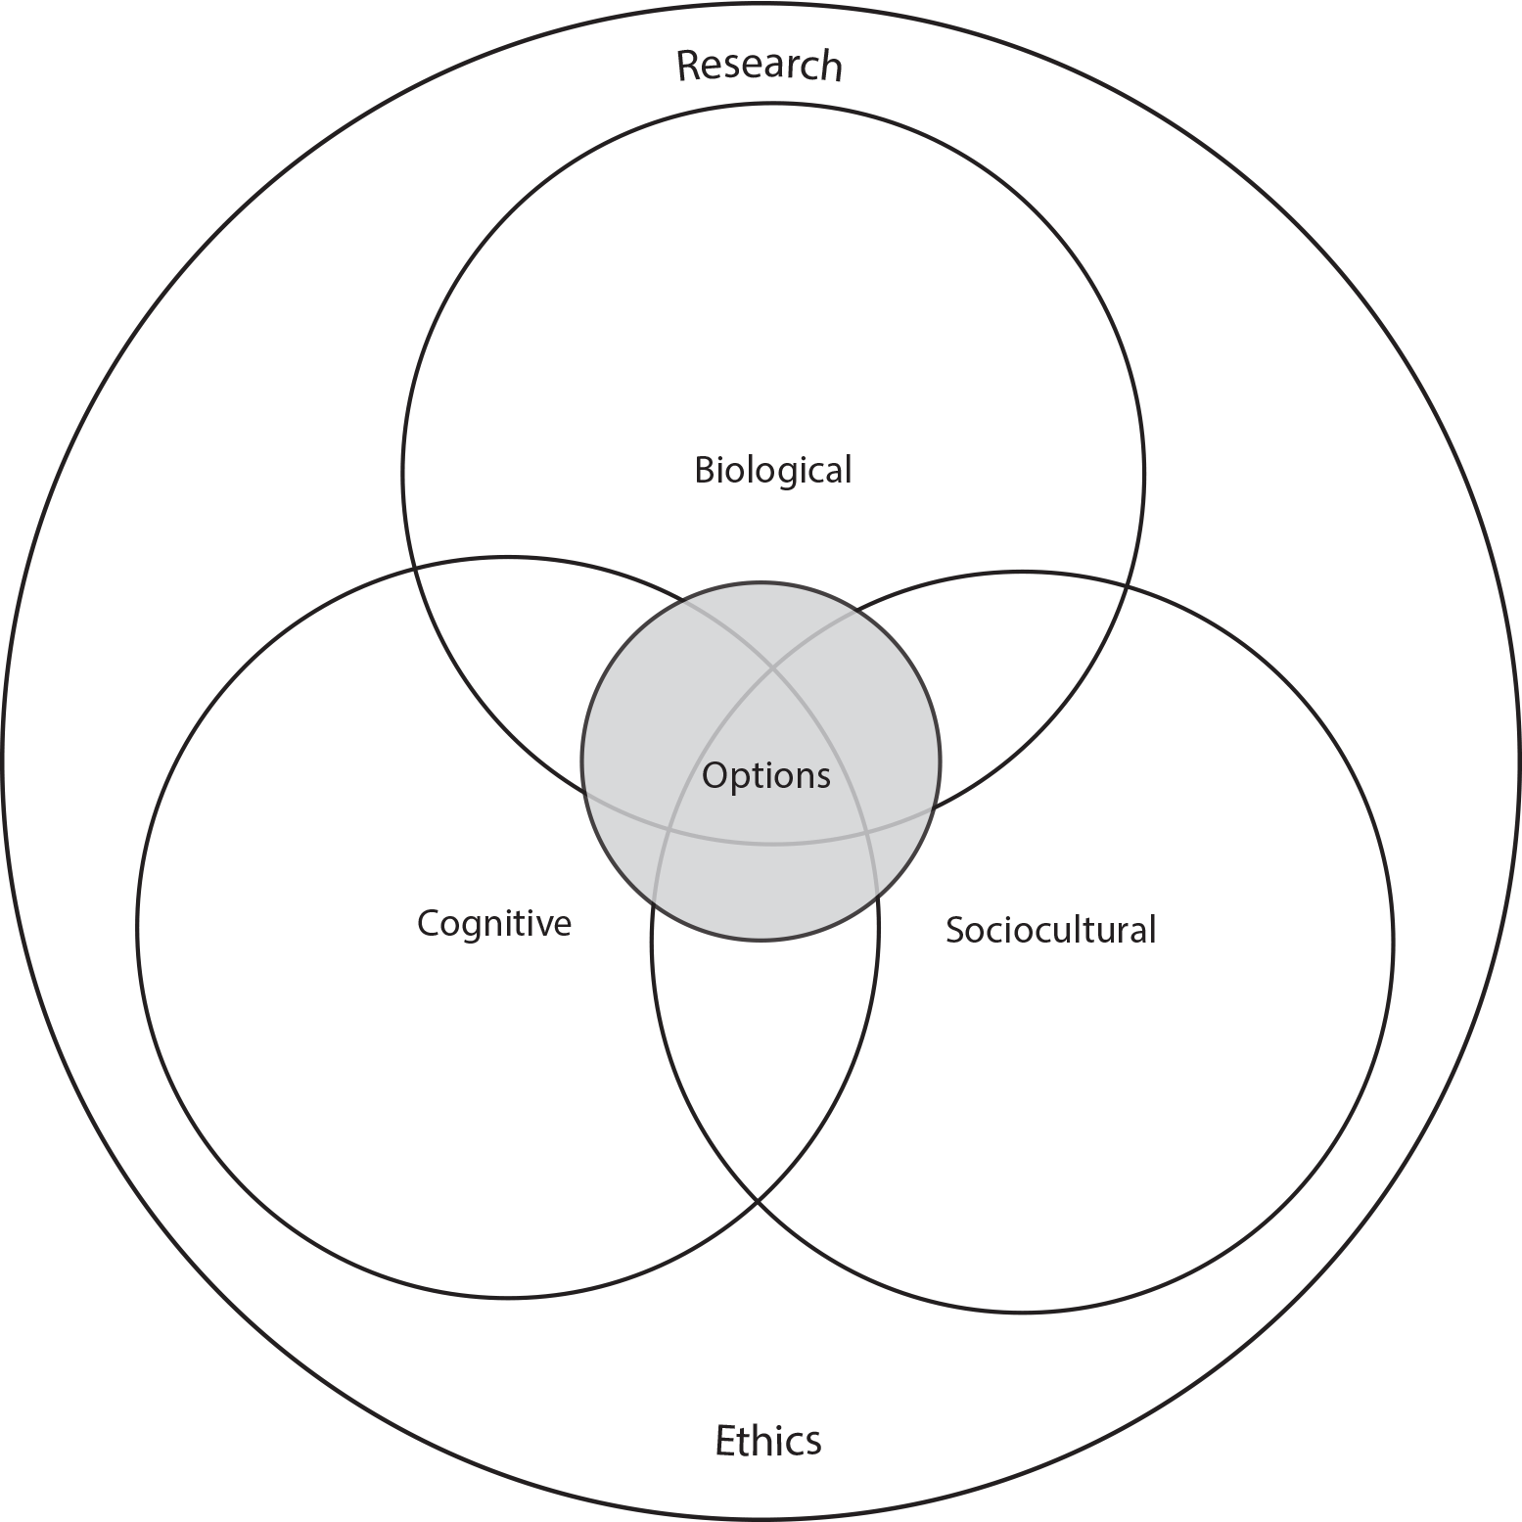
TASK
How do the different approaches of IB Psychology syllabus manifest themselves in Treatment of disorder(s)?

