Slide 1
ETIOLOGY OF ABNORMAL PSYCHOLOGY
(18IB revision)
IB Psychology LAJM

Slide 2
TASK
”Explanations for disorder(s)”
Review the main contents of this topic from pages 288–299
  Pay close attention to how core approaches are applied
Review at least TWO studies that can be applied with the topic

Slide 3
TASK
Read the sample responses
  All sample responses relate to the the topic “Explanations for disorder(s)”
After reading the response, pay attention to the examiner’s comments
How could these responses be improved?
  Make amendments

Slide 4
TASK
”Prevalence rates and disorder(s)”
Review the main contents of this topic from pages 266–268, your memos and teacher’s materials
Review at least TWO studies that can be applied with the topic

Slide 5
TASK
Read the sample response to the question ”Discuss prevalence rates and disorders”
After reading the response, pay attention to the examiner’s comments
How could these responses be improved?
  Make amendments

Slide 6
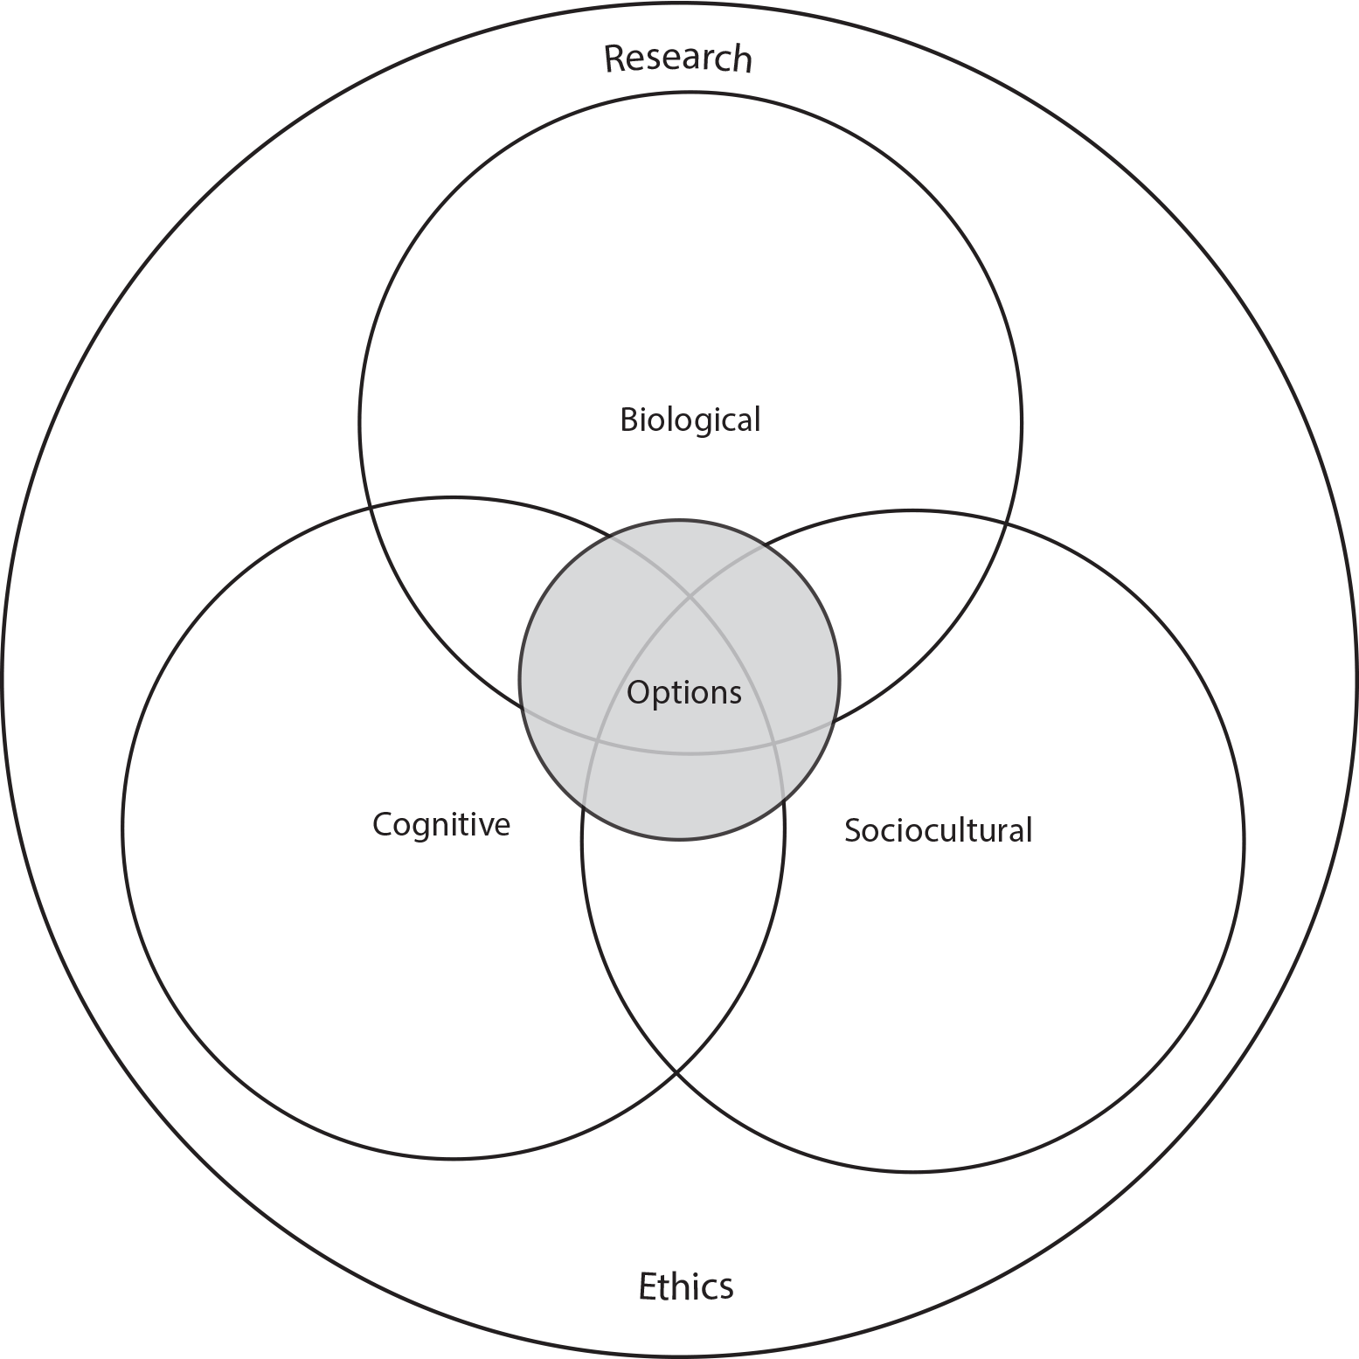
TASK
How do the different approaches of IB Psychology syllabus manifest themselves in Etiology of abnormal psychology?

