Slide 1
REVIEWING COGNITIVE PROCESSING IN A TECHNOLOGICAL (DIGITAL/MODERN) WORLD (Dec 2019 syllabus revision)
IB Psychology LAJM

Slide 2
TASK
The influence (positive and negative) of technologies (digital/modern) on cognitive processes
Skim through pages 189-196, your memos and teacher’s materials
Review at least TWO studies that relate positive and negative influences of techno-logies on cognition

Slide 3
TASK
Read the sample response to the question ”To what extent does technology have a negative and/or positive effect on cognitive processes”
After reading the response, pay attention to the examiner’s comments
How could this response be improved?
Make amendments

Slide 4
TASK
Methods used to study the interaction between technologies and cognitive processes
Reread pages 196-198
Review at least TWO studies with research methods in mind related this syllabus topic

Slide 5

TASK
Review all topics and contents from cognitive approach to understanding behaviour
What kind of Paper 1 questions could be created based on the HL extension?

Slide 6
TASK
Parts of cognitive approach to behaviour | a. Cognitive processing | b. Reliability of cognitive processes | c. Emotion and cognition
1. The influence (positive and negative) of technologies (digital/modern) on cognitive processes | 1a | 1b | 1c
2. Methods used to study the interaction between technologies and cognitive processes | 2a | 2b | 2c

Slide 7
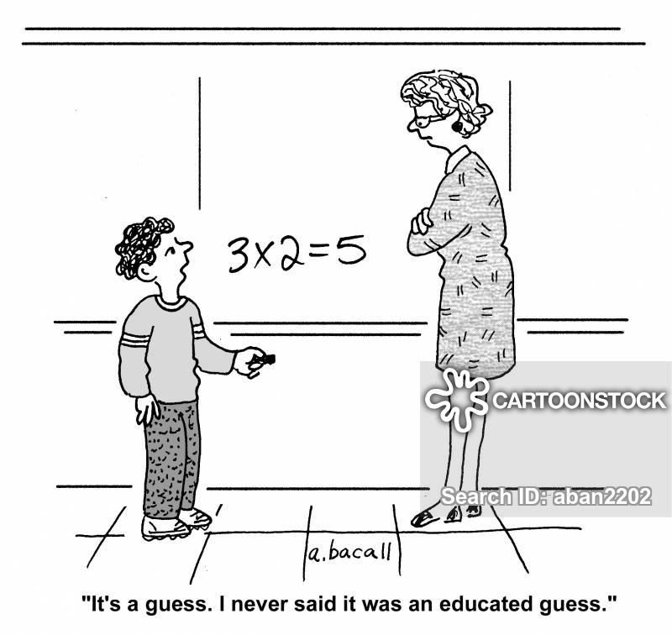
Past questions
So far there hasn’t been any questions in the finals related to the cognitive processing in a technological (digital/modern) world
Your guesses are as good as mine

Slide 8
Picture sources
Review <http://ajslp.pubs.asha.org/article.aspx?articleid=2204333> Accessed 22nd of November 2017.
Educated quess <https://www.cartoonstock.com/directory/m/maths_teaches.asp> Accessed 4th of November 2020.

