Slide 1
THINKING, DECISION-MAKING AND THEIR RELIABILITY
(Dec 2019 syllabus revision)
IB Psychology LAJM

Slide 2
TASK
”Thinking and decision-making: Study one model in thinking and decision-making”
Review the theory of of planned behaviour (TPB) from pages 151-153 and 341-343
Review Albarracin et al (2001) from page 153
  Does the study provide evidence for TPB?

Slide 3
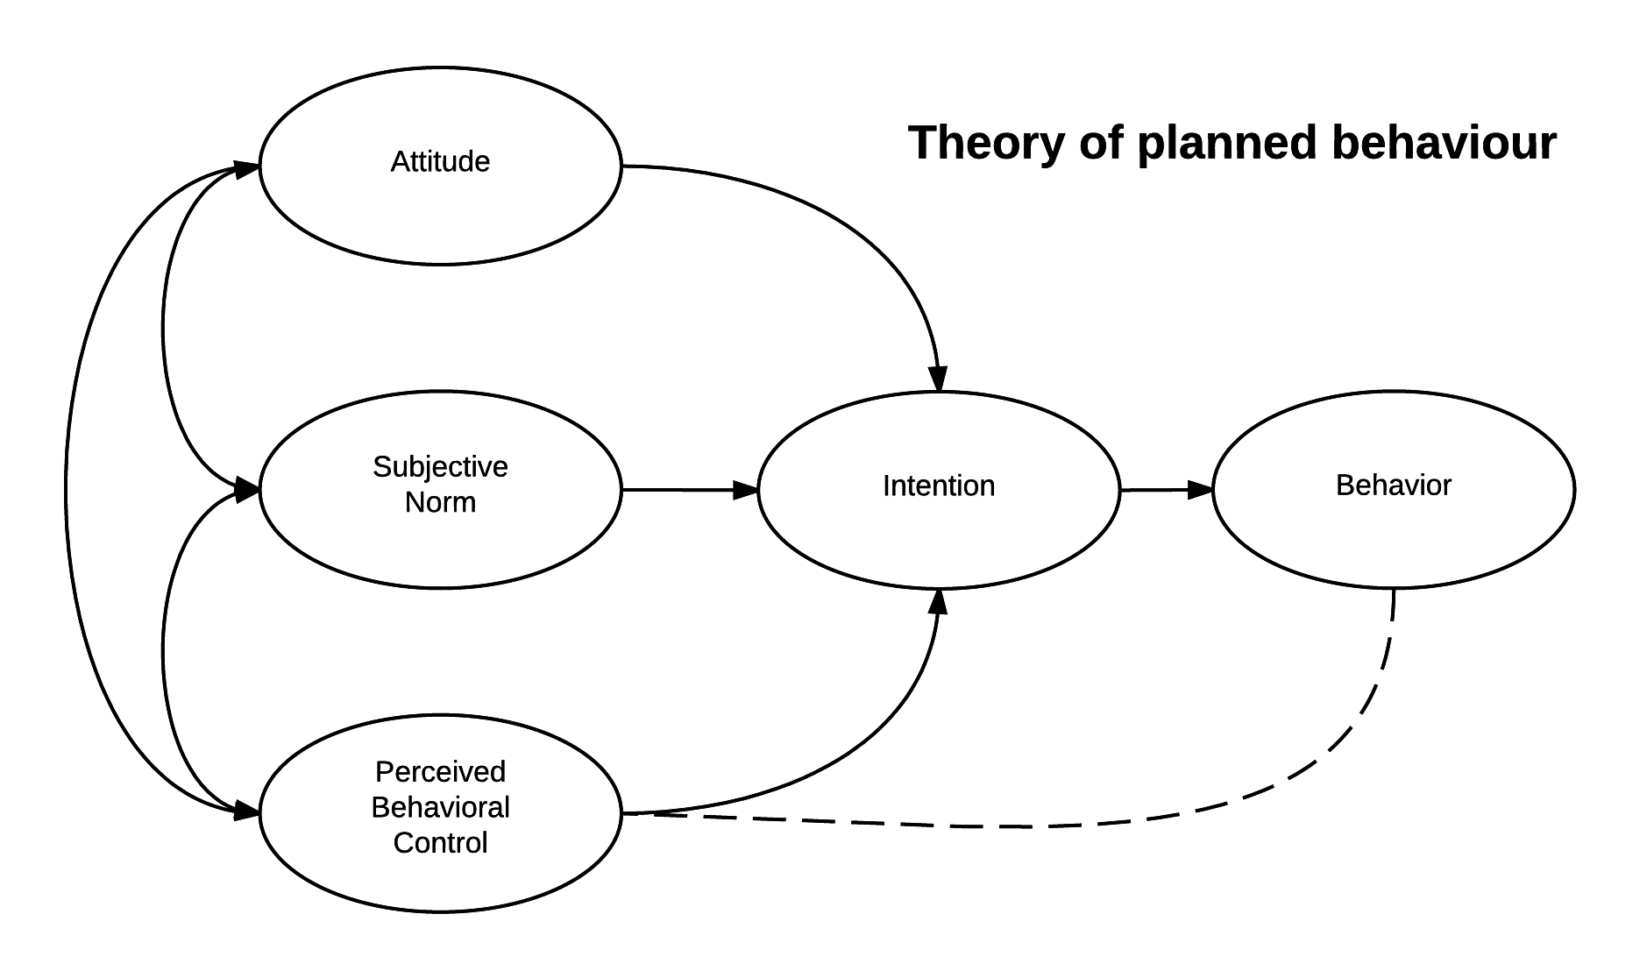
TASK
Study the gist of Godin and Kok (1996) from teacher’s additional materials
Pay close attention to the correlations between
  Attitudes and intention
  Norms and intentions
  Behavioural control and intention
  Intention and behaviour

Slide 4
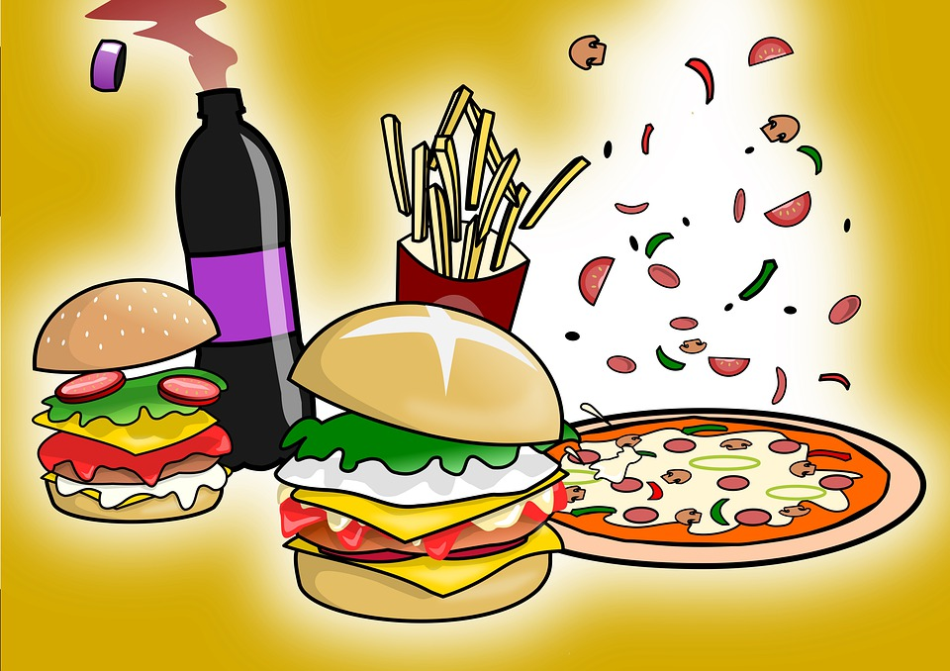
Thinking and decision-making
Dunn et al (2011)
  What are the determinants of fast food consumption?
  Determinants were derived from TPB
  404 Australians were measured both retrospectively (self-report) and prospectively (diary)

Slide 5
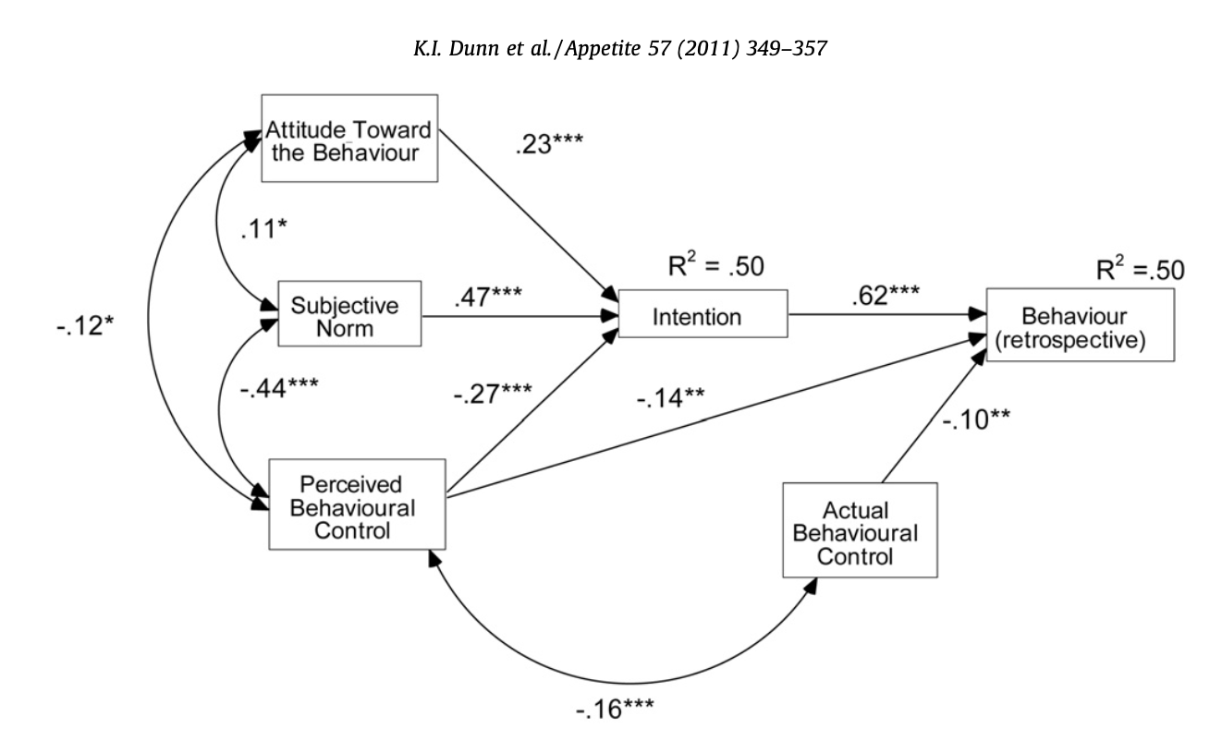
Thinking and decision-making
TPB successfully predicted fast food
consumption, especially for
retrospective behaviour

Slide 6
TASK
What are the strengths and the limitations of the TPB?
Do a TEACUP analysis of the theory

Slide 7
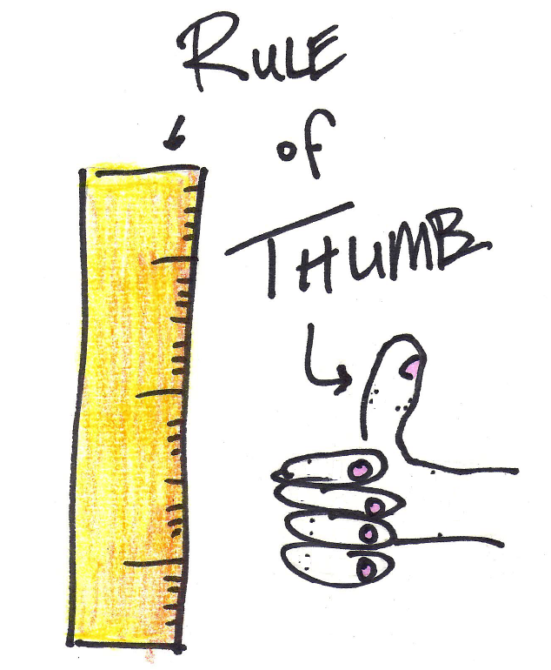
Biases in thinking and decision-making
Heuristics
  Shortcuts in thinking and decision-making that people take when there is no time or resources to analyse the situation thoroughly

Slide 8
Biases in thinking and decision-making
Anchoring
  Tendency to anchor our thinking and decision-making to the information we initially get
Representativeness
  Tendency to choose things that feel probable through representa-tiveness
Availability
  Tendency to rely too strongly on information that is readily available

Slide 9
TASK
”Biases in thinking and decision-making: Study one bias in thinking and decision-making”
Review the dual process model of thinking and decision making from pages 169-170
  How does information processing differ in System 1 and System 2?

Slide 10
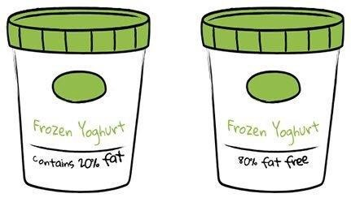
Biases in thinking and decision-making
Framing effect
  Drawing different conclusions from the same information, depending on how that information is presented
  Is the problem formulated in terms of gains or losses?

Slide 11
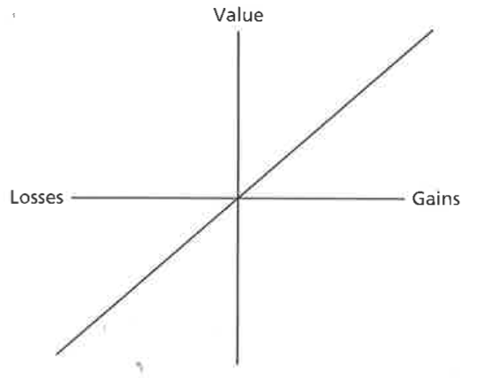
Biases in thinking and decision-making
Expected utility theory
  Normative model of choice
  One should multiply the utility of an outcome by the probability of that outcome, and choose the outcome that yields the highest number

Slide 12
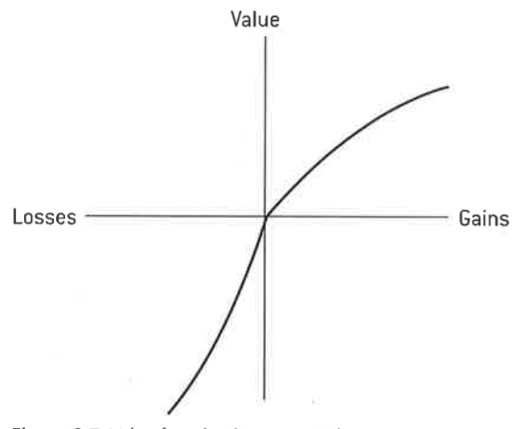
Biases in thinking and decision-making
Prospect theory
  Descriptive model of decision-making under risk
  Shift in the reference point causes changes in decision-making
  Potential gains cause risk aversion
  Potential losses cause more risk taking

Slide 13
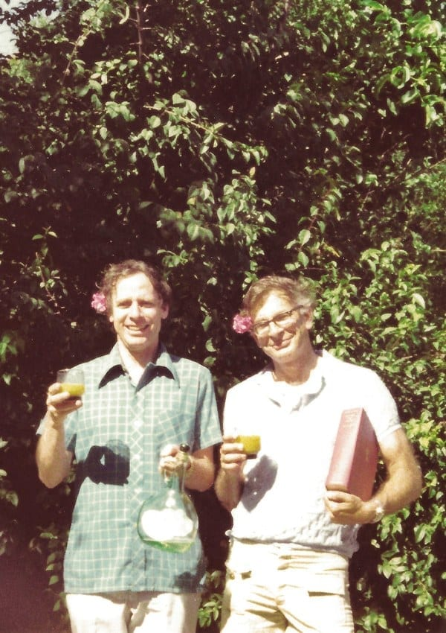
TASK
Read pages 172–173
Review Tversky and Kahneman (1981) study
  What kind of evidence does this study provide for framing effect and prospect theory?

Slide 14

TASK
Read the Keysar et al (2012) study
Effectively summarize the aim, procedure and results of the study in your own words
  How does foreign language influence framing effect?

Slide 15
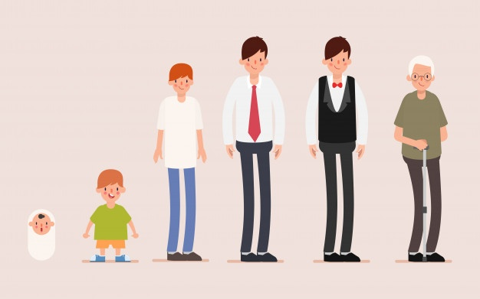
Biases in thinking and decision-making
Strough et al (2011)
  Does the susceptibility to framing effect change during lifespan?
  Meta-analysis of framing effect studies
  Framing effect stays relatively stable across lifespan

Slide 16
TASK
Read the sample responses to the question “Discuss the use of one or more cognitive biases in thinking and decision-making”
After reading the responses, pay attention to the examiner’s comments
How could these responses be improved?
  Make amendments

Slide 17
CRITICAL THINKING HUB
The contribution of research methods used in the cognitive approach to understanding human behaviour
Ethical considerations in the investigation of the cognitive approach to understanding human behaviour
What are the key content, terms and theories related to these topics ?
What are the possible studies that could be addressed with these topics?

Slide 18
TASK
Read the sample responses to the question “Contrast two research methods used in the study of cognitive processes”
After reading the responses, pay attention to the examiner’s comments
How could these responses be improved?
  Make amendments

Slide 19
Sources
Kahneman, D. (2011). Thinking, Fast And Slow. Great Britain: Penguin Books.
Popov, A., Parker, L. & Seath, D. (2017). Psychology Course Companion (2nd Edition). Oxford: Oxford University Press.

Slide 20
Picture sources
Theory of planned behaviour (TPB) <https://en.wikipedia.org/wiki/Theory_of_planned_behavior> Accessed 28th of August 2019.
Fast food <https://pixabay.com/fi/illustrations/fast-food-juhla-virvoitusjuoma-4683707/> Accessed 11th of November 2020.
Rule of thumb <http://daysgoneby.me/dyk-rule-thumb/> Accessed 19th of February 2018.
Framing effect <https://medium.com/@mohit.rajkumar/management-lesson-from-parenting-the-framing-effect-ae334ec7d8ab> Accessed 16th of November 2020.
Tversky and Kahneman <https://www.sunoresearch.com.br/tudo-sobre/amos-tversky/> Accessed 17th of November 2020.
Foreign language <https://www.worcs.tgacademy.org.uk/subjects/mfl/> Accessed 17th of November 2020.
Lifespan <https://www.freepik.com/free-photos-vectors/lifespan> Accessed 17th of November 2020.

