Slide 1
18IB Psychology Plan
IB Psychology LAJM

Slide 2
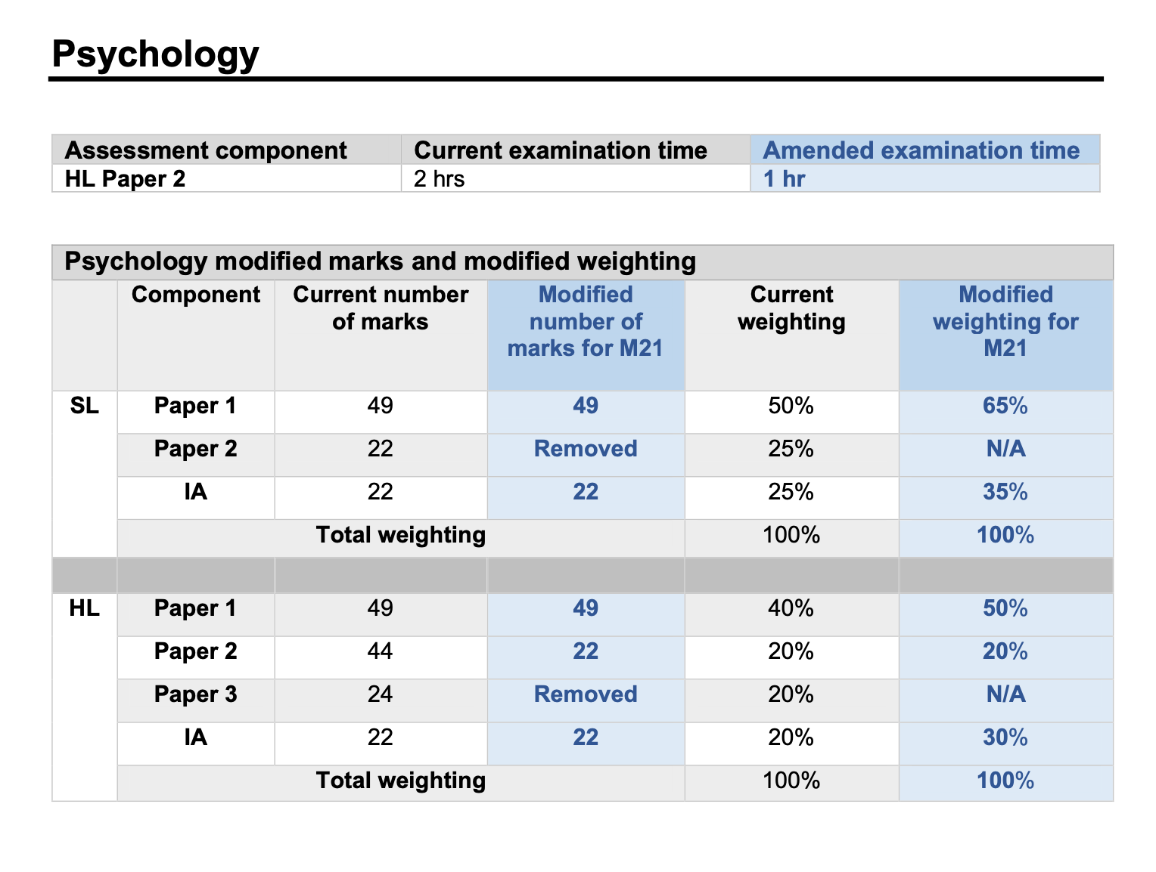

Slide 3
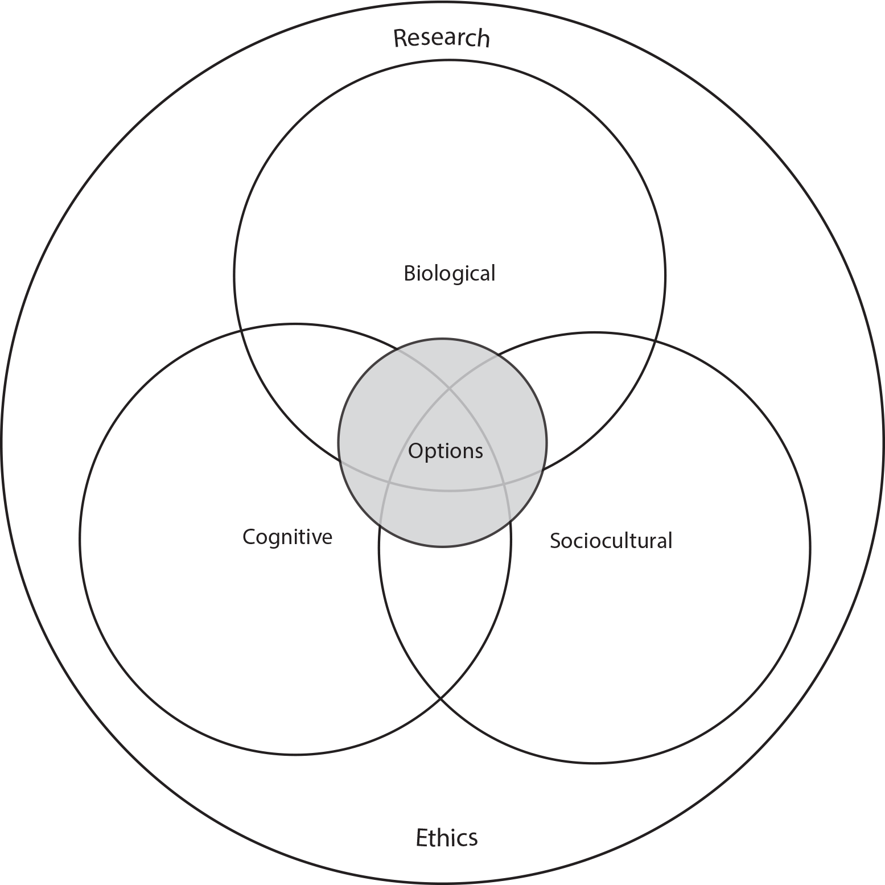
18IB psychology schedules
IB2 year plan
1st period: HL option
2nd period: Studying and reviewing the core + IA workshop
3rd period: Studying and reviewing the core HL extension + HL option (HL only)
4th period: Review and final mocks
MOCK
MOCK?
MOCK?
MOCKS
FINALS IN THE BEGINNING OF MAY

Slide 4

TASK
Immerse yourself with the IB Psychology core syllabus
Pay particular attention to the December 2019 revisions
What parts of the core syllabus should be revised?

