Slide 1
PSYCHOLOGY AND STATISTICS
IB Psychology LAJM

Slide 2
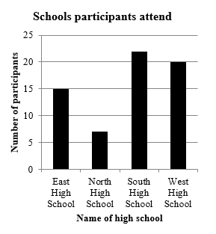
Why do we need maths in psychology?
To draw a graph to present the data
To make use of statistics

Slide 3
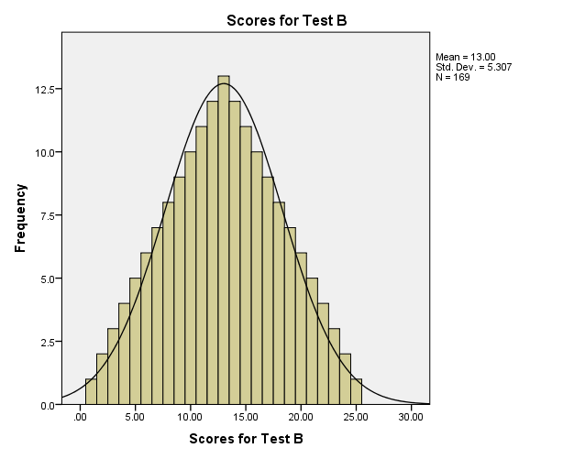
Why do we need maths in psychology?
Statistics are needed
To summarize the data with descriptive statistics
To draw conclusion from experiments with inferential statistics

Slide 4
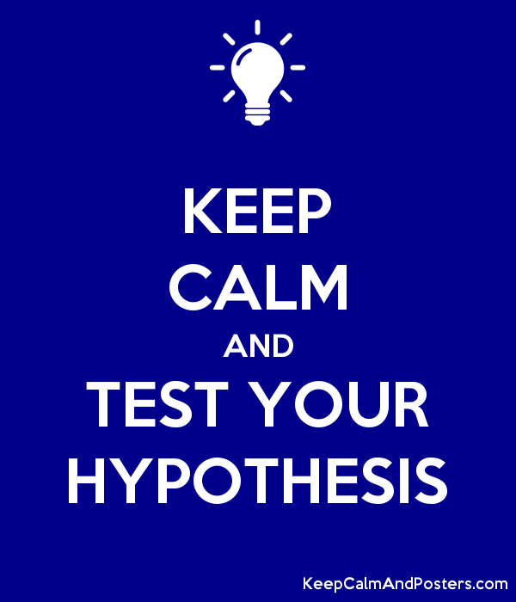
Why do we need maths in psychology?
Statistics are used to support or not to support a hypothesis
Strong statistical support means that we can accept the experimental hypothesis
No statistical support means we accept the null hypothesis

Slide 5
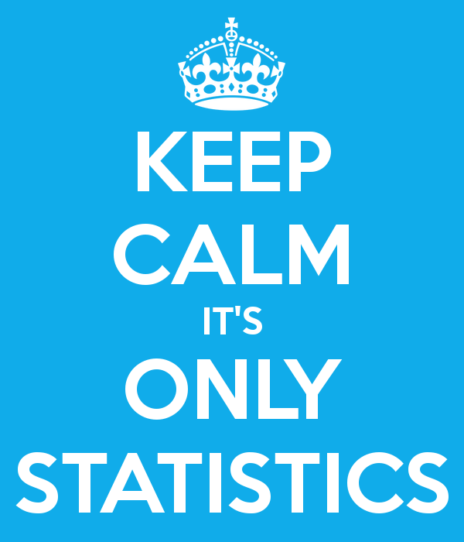
Statistics and IB Psychology IA
What do you need to know/understand
How you choose a statistical test for your set of data
How you interpret the results of your statistical test
You DO NOT need to be able to conduct the statistical test

Slide 6
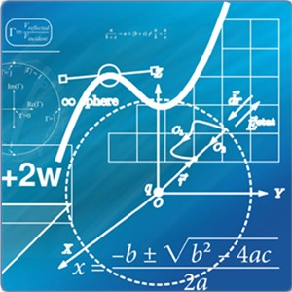
Statistics and IB Psychology IA
How to choose the correct statistical test
What is your level of measurement?
Is your hypothesis one-tailed or two-tailed?
What is your experimental design?

Slide 7
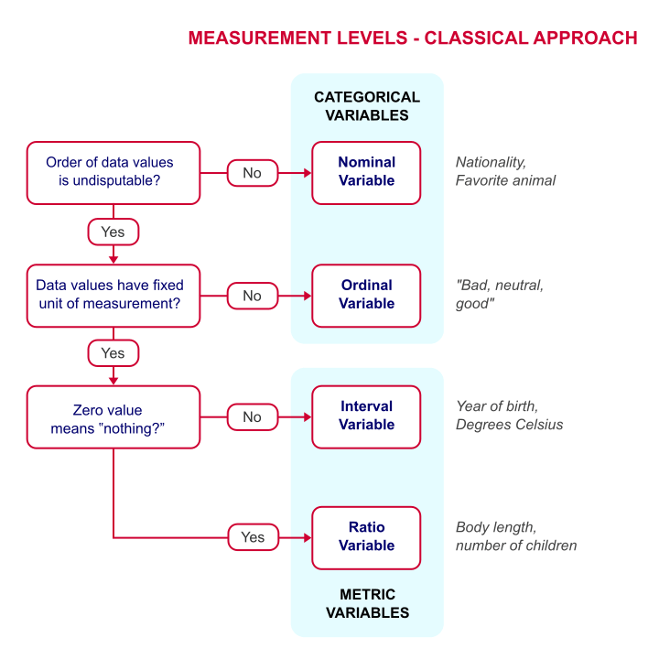
Levels of measurement

Slide 8
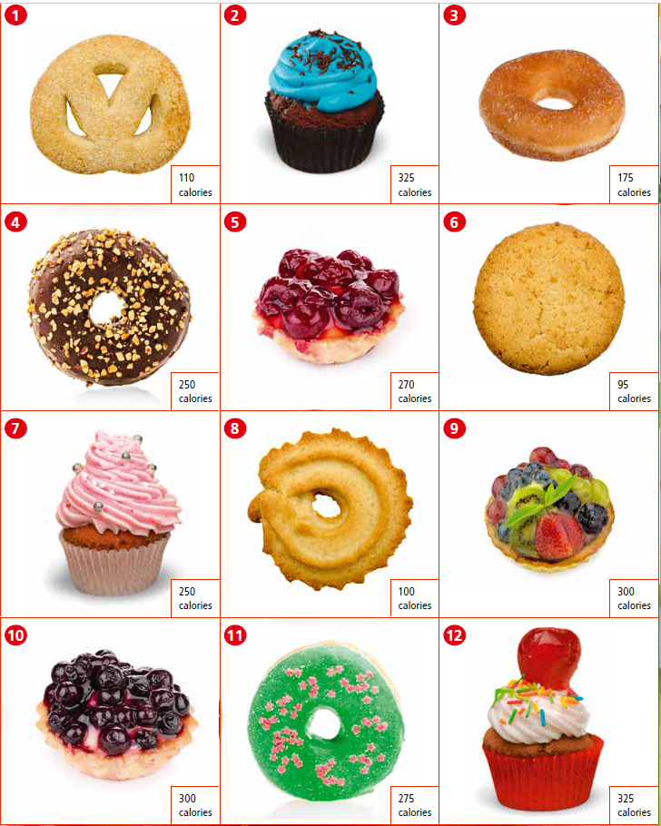
TASK
Organise the cakes
(1) Put the cakes into categories
(2) Place the cakes in order in terms your most to least favourite
(3) Place the cakes along a scale in terms of their calorie contents

Slide 9
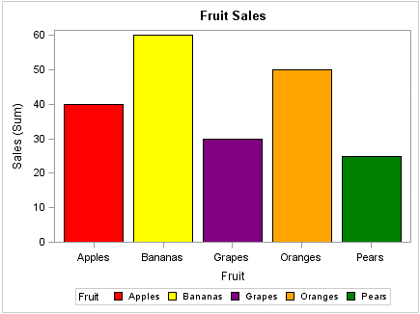
Levels of measurement
Nominal data
Frequency of categories
The data is shown as a bar chart
E.g. types of cakes, eye colours and nationality
Notes:
Further examples: types of fruits, nationality, favourite animal => frequency of categories. Order of data is NOT undisputable.

Slide 10
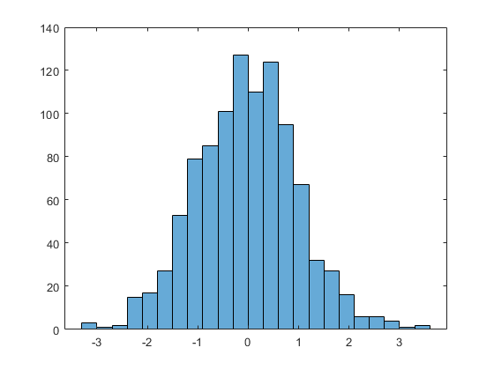
Levels of measurement
Ordinal data
Rank order
The data are shown in a histogram
E.g. ranking cakes into most – least tasty, positions in a race and questionnaire scales
Notes:
Order of data values is undisputable, but data values do NOT have fixed unit of measurement.

Slide 11
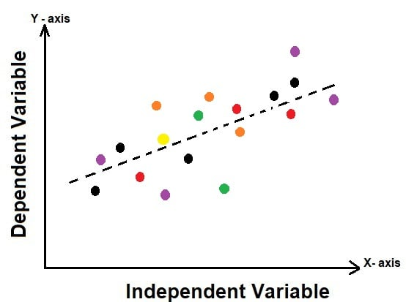
Levels of measurement
Interval data
Equal interval, fixed unit of measurement
The data are shown in scatter diagram and/or line graph
E.g. number of calories in a range of cakes, test scores and date of birth
Notes:
Data has fixed unit of measurement like date of birth and degree of Celsius.

Slide 12
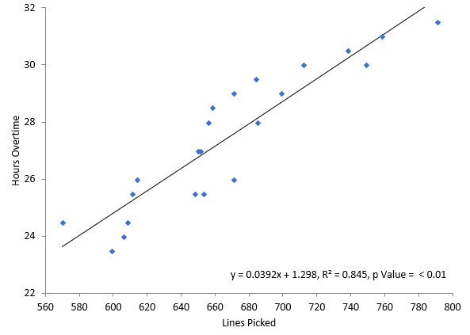
Levels of measurement
Ratio data
Like interval data, but with a true zero point
E.g. number of words remembered, number of children and weight in kilograms
Notes:
For example, weight in grams is a ratio scale, as something cannot weigh -600 grams. Also, when you ask participants to memorize a list of words – the number that they remember is ratio data. They cannot remember -2 words. No one can have -3 children.

Slide 13
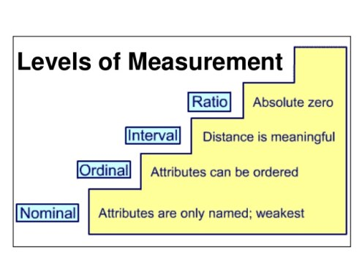
Levels of measurement
Students of IB Psychology are encouraged to use at least ordinal level variables in IA task

Slide 14
Hypotheses
One-tailed directional hypothesis predicts the nature of effect of the IV on the DV
E.g. higher IQ scores, fewer friends
Two-tailed non-directional hypothesis predicts that the IV will have an effect on the DV, but the direction of the effect is not specified
E.g. different levels of happiness, different memory abilities
Notes:
In a one-tailed hypothesis, the researcher predicts the direction of the relationship, E.g., adults will correctly recall more words than children.
In a two-tailed hypothesis, the researcher does not predict the direction of the relationship, only that there will be a difference, E.g., there will be a difference in how many numbers are correctly recalled by children and adults.

Slide 15
Experimental designs
Independent measures design
Matched pairs design
Repeated measures design
To keep things simple
in the IA replication,
choose between independent
measures design and
repeated measures design

Slide 16
Descriptive statistics
Average/central tendency
Mean = sum of scores divided by the number of scores INTERVAL/RATIO DATA
Median = centre/middle score ORDINAL DATA
Mode = most frequent score NOMINAL DATA

Slide 17
Descriptive statistics
Variability/dispersion
Spread of data; How the scores in a set differ from one another and from the mean?
Range = the difference between the highest and lowest score in a set ORDINAL DATA
Variance = the degree to which scores differ from the mean
Standard deviation = square root of the variance INTERVAL/RATIO DATA
Notes:
Standard deviation is the square root of sum of squared deviation from the mean divided by the number of observations.

Slide 18
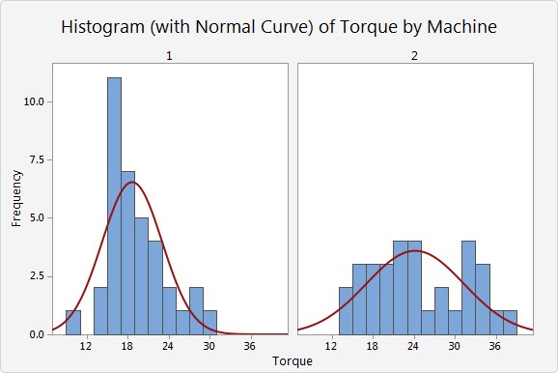
Descriptive statistics
In the IB Psychology IA report, use only the parts of descriptive statistics that are relevant to the analysis of your research data

Slide 19
Inferential statistics
All collected data in psychological research contain some degree of variability that can be attributed to chance
Inferential statistics are procedures of calculating the probability that the observed results could derive from chance alone

Slide 20
Inferential statistics
Statistical significance
Probability that the variability of scores could be caused by chance alone is small; The results cannot be explained by chance alone
p-value or probability value is less than .05 (5%) => there is a 95% chance of finding a significant difference/relationship

Slide 21
Inferential statistics
If p-value is .05, there is still a 5% chance that we are making a type I or type II error
Type I error = “false positive”, we rejected a null hypothesis which was actually true
Type II error = “false negative”, we accepted a null hypothesis which was not true
Notes:
A “false positive” is known as a type I error. After inferential statistical analysis, the researcher has incorrectly rejected the null hypothesis and concluded that there is an effect when there is not one.
A type II error is also known as a “false negative”. In this situation, the researcher has incorrectly accepted the null hypothesis, in other words, concluded that there is not an effect when there is one.

Slide 22
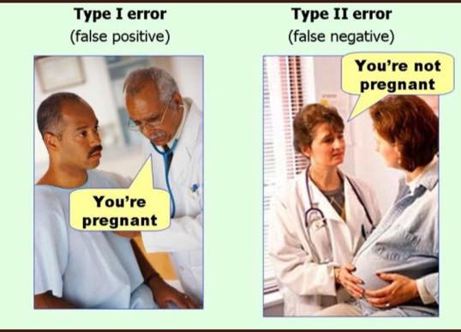

Slide 23
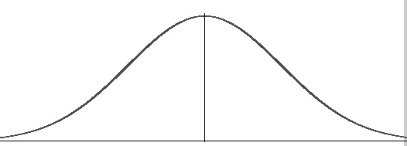
Inferential statistics
Parametric test
Non-parametric test
Normal distribution of data
Dependent Variable (DV) is an interval or ratio variable
Unrelated t-test
Related t-test
Normal distribution of data cannot be applied
Dependent Variable (DV) is a nominal, ordinal, interval or ratio variable
Mann Whitney U test
Wilcoxon signed-rank test
Chi-square test
McNemar’s test

Slide 24
Inferential statistics
Unrelated t-test
Compares groups of participants that are not related in any way
Used for independent measures experimental design
Related t-test
Compare groups that are related in some way
Used for repeated measures and matched pairs experimental designs
Both unrelated and related t-tests
can use only interval and ratio variables

Slide 25
Inferential statistics
Mann Whitney U test
Compares the means of a Dependent Variable (DV) of two entirely separate groups
Used for independent measures experimental design
Wilcoxon signed- rank test
Compares the means of a Dependent Variable (DV) of two groups that are related in some way
Used for repeated measures and matched pairs experimental designs
Both Mann Whitney U test and Wilcoxon signed-rank test
can use ordinal, interval and ratio variables

Slide 26
Inferential statistics
Chi-square test
Analyses associations between frequencies by categories
Used for independent measures experimental design
McNemar’s test
Tests consistency in responses across dichotomous variables
Used for repeated measures and matched pairs experimental designs
Both Chi-square test and McNemar’s test
can use only nominal variables
Notes:
Instead of McNemar’s test, repeated measures sign test can also be used, BUT if students of IB Psychology go for nominal data, independent measures and Chi-square test is recommended.

Slide 27
Reporting the results
No matter what the statistical test is, always include relevant information in your IA report
Example 1: “Using an independent t-test, a significant difference was found between the happiness of athletes (M = 43.2, SD = 7.1) and non-athletes (M = 30.1, SD = 6.9), t(49) = 9.4, p < .05.”
Example 2: “Using a Mann Whitney U test, a significant difference was found between the happiness of athletes (Median Rank = 47) and non-athletes (Median Rank = 68), Mann Whitney U = 64589, p < .05.”

Slide 28
Picture sources
Bar chart and standard deviation <https://ibpublishing.ibo.org/d_3_psych_gui_1702_1/apps/dpapp/tsm.html?doc=d_3_psych_gui_1702_1_e&part=3&chapter=1&section=1> Accessed 3rd of January 2018.
Keep calm and test your hypothesis <https://www.keepcalmandposters.com/poster/5733501_keep_calm_and_test_your_hypothesis> Accessed 4th of April 2019.
Keep calm it’s only statistics <https://odessablog.wordpress.com/2016/08/30/corruption-conviction-statistics-moj-publish-them-anywhere/keep-calm-its-only-statistics-1/> Accessed 4th of April 2019.
Statistics <https://www.slu.se/en/departments/energy-technology/research/biometry_systemsanalysis/applied-statistics-and-mathematics/> Accessed 4th of April 2019.
Levels of measurement 1 <https://www.spss-tutorials.com/measurement-levels/> Accessed 21st of November 2018.
Fruit bar chart <https://www.e-tabs.com/data-viz-blog/chart-chats-bar-chart/bar-chart-8/> Accessed 4th of April 2019.
Histogram <https://www.mathworks.com/help/matlab/ref/matlab.graphics.chart.primitive.histogram.html> Accessed 4th of April 2019.
Scatter diagram 1 <https://www.projectcubicle.com/scatter-diagram-scatter-plot-scatter/> Accessed 4th of April 2019.
Scatter diagram 2 <https://www.spcforexcel.com/knowledge/root-cause-analysis/scatter-diagrams> Accessed 4th of April 2019.
Levels of measurement 2 <https://www.kdnuggets.com/2015/08/statistics-understanding-levels-measurement.html> Accessed 21st of November 2018.
Descriptive statistics <https://support.minitab.com/en-us/minitab-express/1/help-and-how-to/basic-statistics/summary-statistics/descriptive-statistics/before-you-start/example/> Accessed 4th of April 2019.
Type I and Type II errors <http://achemistinlangley.blogspot.com/2015/01/issues-in-communicating-climate-risks.html> Accessed 4th of April 2019.
Bell curve <http://www.statisticshowto.com/probability-and-statistics/skewed-distribution/> Accessed 3rd of January 2018.

