Slide 1
SOCIAL RESPONSIBILITY
IB Psychology LAJM

Slide 2

TASK
Think of a hero story, real or fictional
Explain to your pair/group what made the action heroic in your story

Slide 3
Prosocial behaviour
Helping behaviour
Any type of social assistance or interpersonal support
Prosocial behaviour
Behaviour that has the intention to increase the well-being of others
Altruism
Helping others for no reward or even at some cost to oneself

Slide 4
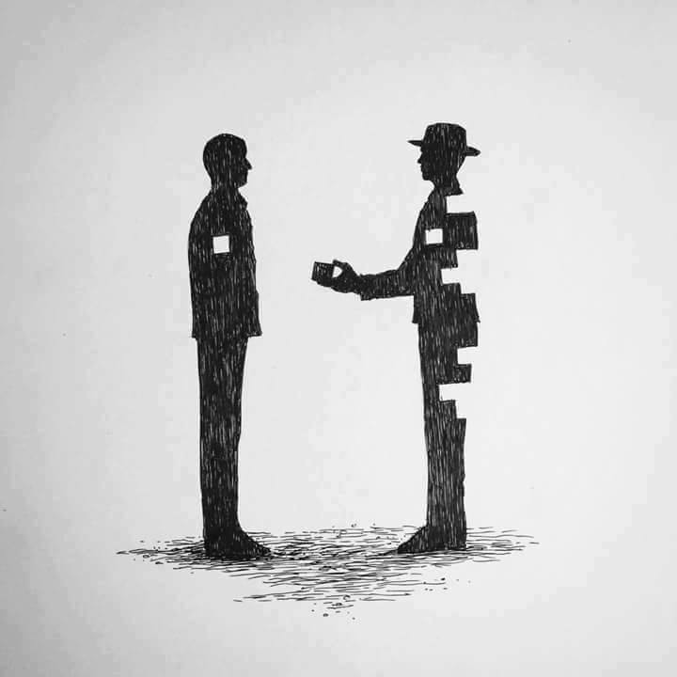
TASK
Can you explain why people do altruistic acts like in the hero stories?
Try to use your psychological knowledge
Don’t use any assistive devices or materials!

Slide 5
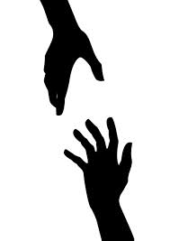
TASK
Form three groups
Reciprocal altruism model
Kin selection theory
Empathy-altruism hypothesis
Every group finds out the gist of their theory and does a TEACUP analysis of the theory
Use the teacher’s handout

Slide 6

TASK
Form three person mixed groups
Every group should contain one member of each approach
Teach each other!
In addition, engage in conversation

Slide 7
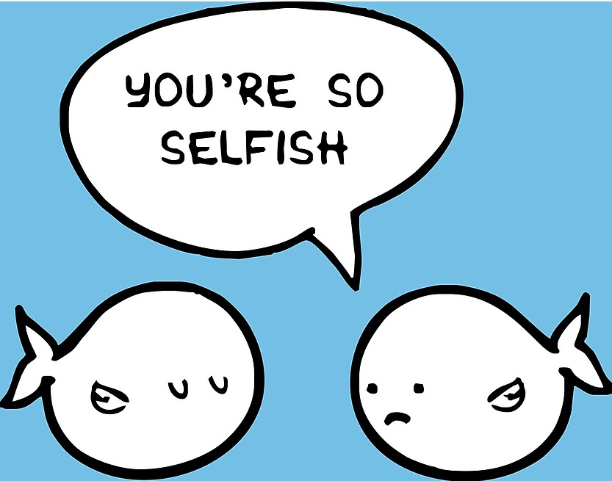
TASK
Find out what is meant by egoism
Are human beings more egoistic than altruistic?
Try to provide and argument to either direction

Slide 8
Prosocial behaviour
Psychological egoism
Everyone pursues one’s own interests
Ethical (normative) egoism
Everyone should pursue one’s own interests
Psychological altruism
Sometimes humans behave unselfishly (not always, though)
Ethical altruism
Humans should place other’s interest in front one’s own
Why do we need to be very careful when
talking about egoism and altruism in psychology?

Slide 9
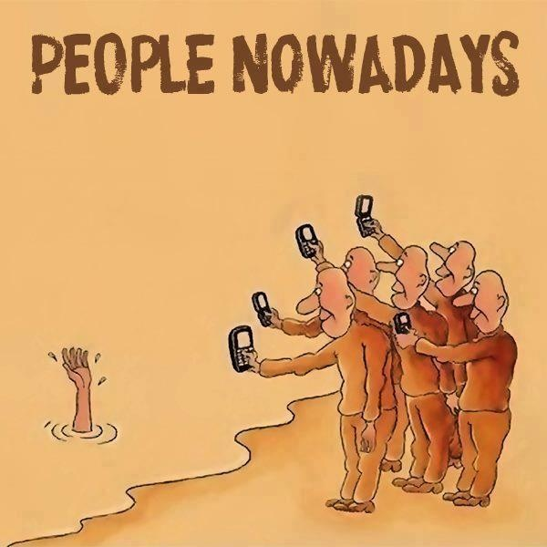
TASK
Are some people more likely to help others?
What kind of conditions might prevent us from helping others?

Slide 10
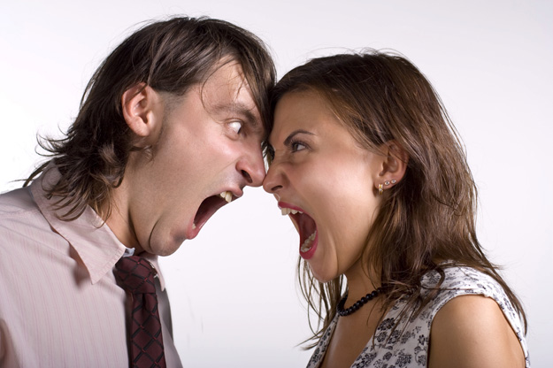
Culture and prosocial behaviour
Shotland and Straw, 1979
Social norms concerning privacy can outweigh the norms of helping

Slide 11
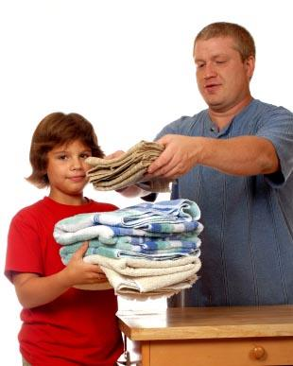
Culture and prosocial behaviour
Whiting and Whiting (1975)
Traditional cultures socialize their children to be more prosocial
Collectivism is positively related to higher empathetic concern

Slide 12
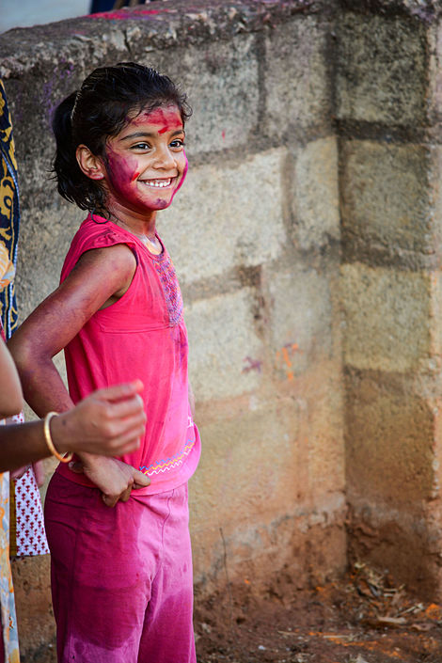
Culture and prosocial behaviour
Miller et al (1990) and Johnson et al (1989)
Cultural norms and moral values influence the perception of social responsibility

Slide 13
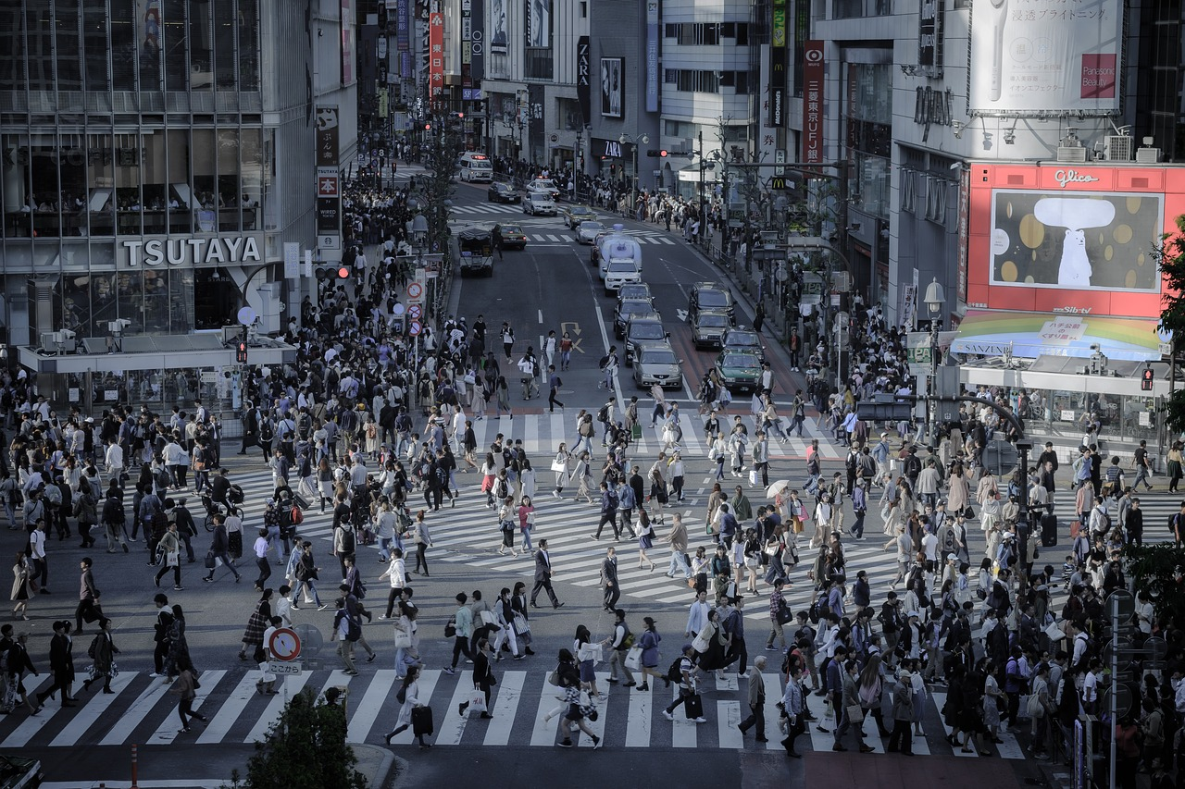
Culture and prosocial behaviour
Levine et al (1994, 2001)
Low population density and low economic productivity increase the likelihood of helping
Characteristics of the environment are more important than the nature of people
Notes:
Levine et al. in the 1990s

Slide 14
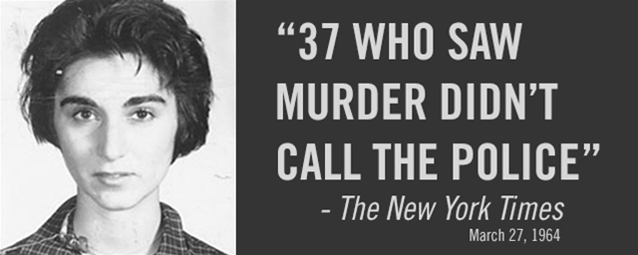
Bystanderism
How is the case of Kitty Genovese possible?

Slide 15
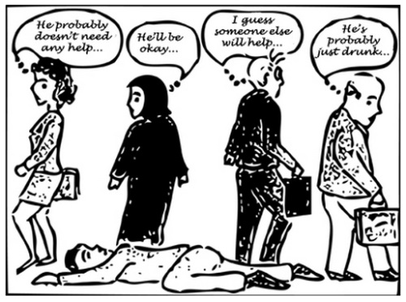
Bystanderism
Tendency to not to help the other, although the other needs help

Slide 16

TASK
Form two groups
Both groups has to make a play of a Latane, Darley and Mcguire study from 1968
”Intercom study”
”Smoke-filled room study”
Use the teacher’s handout

Slide 17
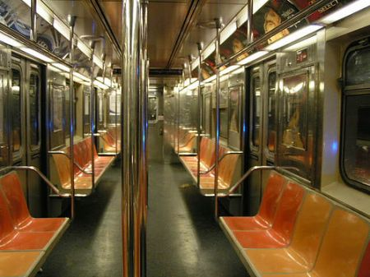
Bystanderism
Arousal: cost-reward model (Piliavin et al., 1981)
Emotional arousal motivates the bystander to reduce the arousal and engage in cost-reward analysis of helping

Slide 18
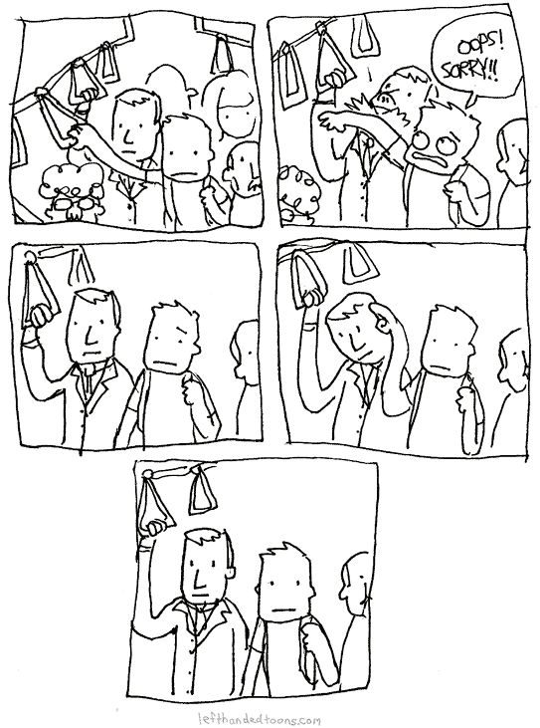
TASK
Read pages 415–416
Draw a comic strip of Piliavin et al. (1969) study ”Good Samaritanism: An underground phenomenon”

Slide 19
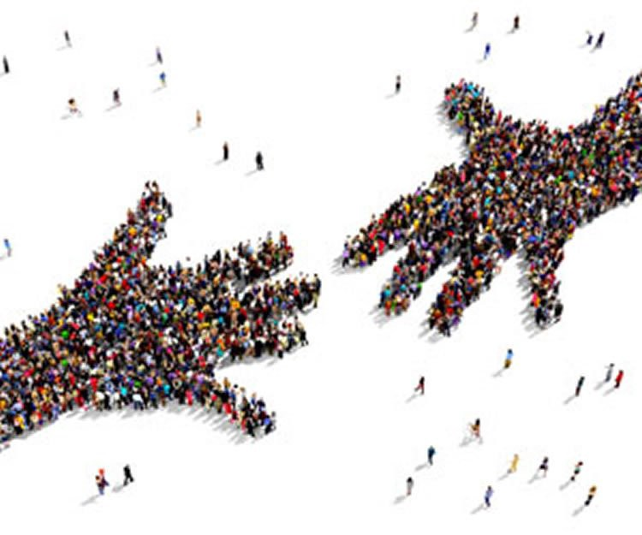
TASK
Form groups
Create a curriculum for promoting prosocial behaviour and avoiding bystanderism based on psychological knowledge
Use the teacher’s handout

Slide 20
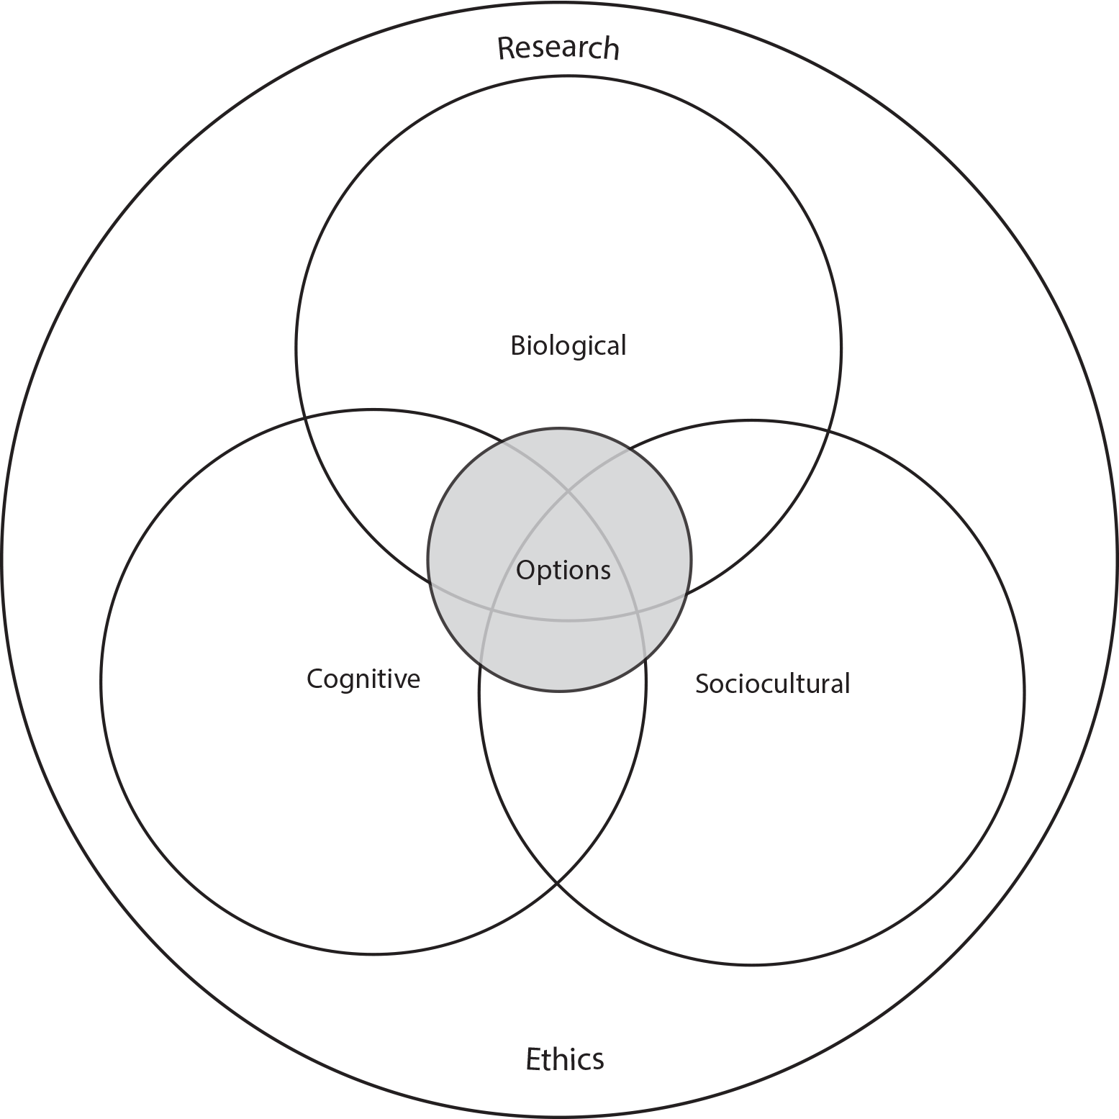
TASK
How do the different approaches of IB Psychology syllabus manifest themselves in what you have learned so far in Psychology of human relationships?

Slide 21
Past questions
Evaluate one or more studies related to promoting prosocial behaviour (M19)
Discuss by-standerism, with reference to one or more studies (N19)
Evaluate one or more research methods used in studies investigating social responsibility (N20)
Discuss one or more factors influencing by-standerism (M21)

Slide 22
Picture sources
Oskar Schindler <https://www.amazon.com/Oskar-Schindler-Account-Wartime-Activities/dp/081333375X> Accessed 9th of November 2017.
Altruism 1 <http://www.funnyjunk.com/Altruism/funny-pictures/6180357/> Accessed 9th of November 2017.
Altruism 2 <https://www.psychologicalscience.org/news/were-only-human/extraordinary-altruism-who-gives-a-kidney.html> Accessed 2nd of May 2018.
Group of three <https://www.freepik.com/free-icon/group-of-three-men-standing-side-by-side-hugging-each-other_717992.htm> accessed 13th of November 2017.
People nowadays <https://dzone.com/articles/bystander-effect-why-companies> Accessed 9th of November 2017.
You are so selfish <https://www.redbubble.com/people/miafajar/works/21121696-ego-sta-2?p=poster> Accessed 10th of September 2019.
Arguing couple < http://www.rebelcircus.com/blog/according-psychologists-couples-argue-love/ > Accessed 13th of November 2017.
Family chores < https://kids.lovetoknow.com/wiki/Family_Chore_Charts > Accessed 13th of November 2017.
Hindu Indian boy < https://en.wikipedia.org/wiki/Hindu > Accessed 3rd of May 2018.
Shibuya <Pixabay> Accessed 13th of November 2017.

Slide 23
Picture sources
Kitty Genovese <https://www.paultripp.com/articles/posts/kitty-genovese> Accessed 13th of November 2017.
Bystanderism <https://biologydictionary.net/bystander-effect/> Accessed 9th of November 2017.
Smoke <https://www.pexels.com/search/smoke/> Accessed 3rd of May 2018.
NYC subway pic <https://aicepsychologyreview.wikispaces.com/Piliavin,+Rodin,+Piliavin+-+Period+1?responseToken=045483aef537b331ccd3ae04eff5e4709> Accessed 13th of November 2017.
Subway comic strip <http://www.lefthandedtoons.com/1333/> Accessed 3rd of May 2018.
Crowd hands <https://medium.com/@spencercoursen/everyday-safety-and-the-importance-of-prosocial-behavior-8c756007aefa> Accessed 2nd of May 2018.
IB Psychology syllabus <https://ibpublishing.ibo.org/d_3_psych_gui_1702_1/apps/dpapp/guide.html?doc=d_3_psych_gui_1702_1_e&part=1&chapter=3&section=1> Accessed 16th of May 2018.

