Slide 1
ETIOLOGY OF ABNORMAL PSYCHOLOGY
IB Psychology LAJM

Slide 2
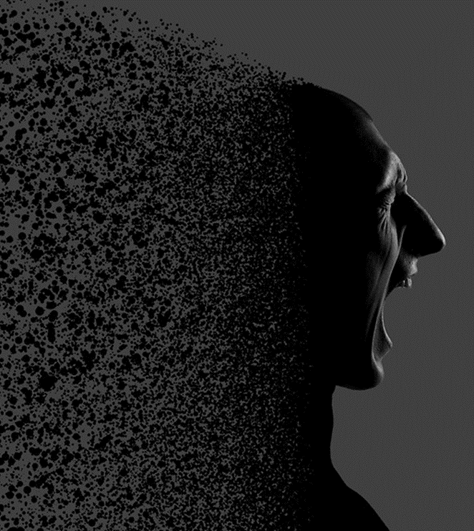
What is etiology?
Etiology
Cause of disorders
Different etiology leads to different kind of prediction and treatment of a disorder

Slide 3
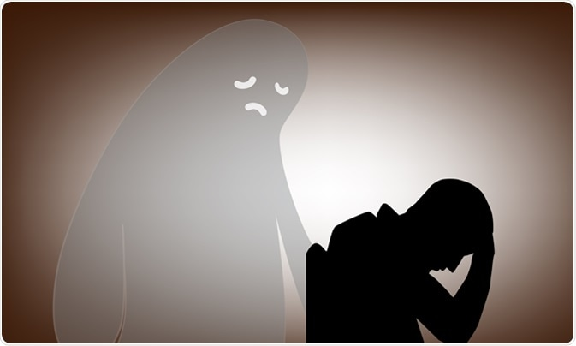
TASK
We shall focus on Major Depressive disorder (MDD)
Watch the WHO’s video about depression as an introduction to MDD

Slide 4
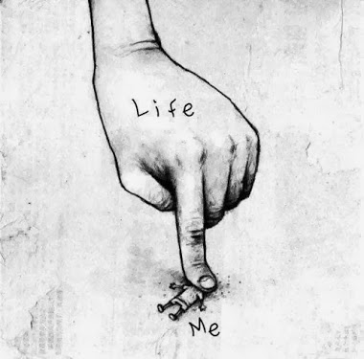
TASK
Before studying the etiology of MDD in detail, write down your own hypotheses
In your opinion, what are the possible causes for depression?

Slide 5

REVIEW/TASK
Review DSM-5 symptoms and criteria for diagnosis related MDD from page 266
Compare DSM-5 symptoms and criteria for diagnosis to ICD-11
What are the differences?

Slide 6
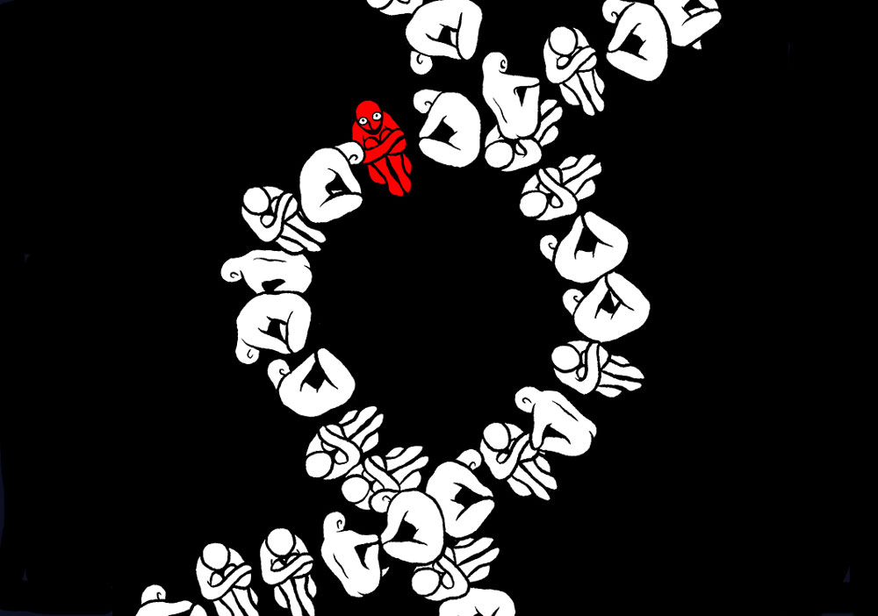
Biological explanations for depression
Genetic factors
Heritability
Gene-environment interaction (G x E)
Specific genes
Neurochemistry

Slide 7
TASK
Read pages 289–291
Found out the aim, procedure and results of the studies on right
What kind of evidence do they provide for biological explanations for MDD?
Kendler et al. (2006) Twin study of major depression
Silberg et al. (1999) Genetic heritability of depression in males and females
Caspi et al. (2003) Longitudinal study on the possible role of the 5-HTT gene in depression

Slide 8
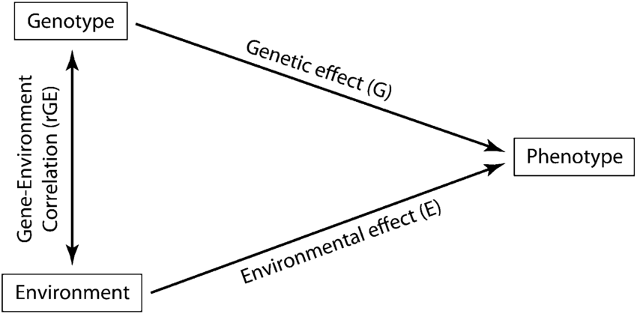
Biological explanations for depression
Gene-environment correlation (rGE)
Idea that genes and environment are NOT completely independent
Environmental factors might have a genetic component

Slide 9
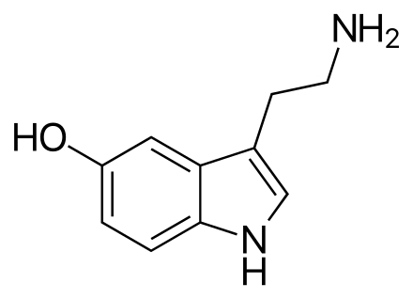
Biological explanations for depression
Serotonin hypothesis of depression
Low levels of serotonin in the brain causes depression

Slide 10
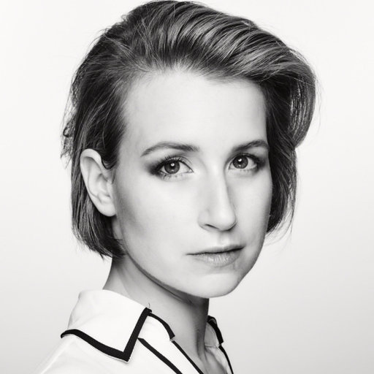
TASK
Watch the Rebecca Brachman TED-talk ”Could a drug prevent depression and PTSD?”
What does this video tell you about the biological causes of depression?

Slide 11

TASK
What have you been thinking about for the past five minutes?
What kind of thinking patterns went through your mind?
Were you in control of all these thinking patterns?

Slide 12
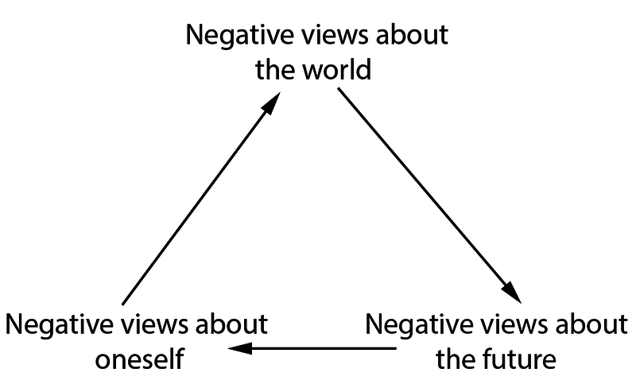
Cognitive explanations for depression
Aaron Beck’s cognitive theory of depression (1967)
Automatic thoughts: the semi-conscious sub-vocal narrative that naturally occurs in people’s daily activities
Theory concentrates on the negative appraisals of events

Slide 13
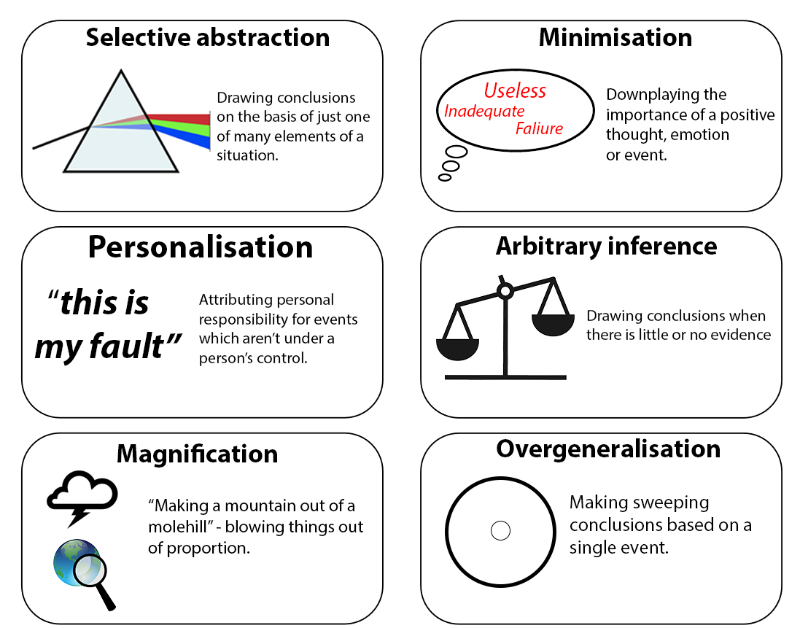
Cognitive explanations for depression

Slide 14
TASK
Read pages 297–298
Found out the aim, procedure and results of the studies on right
What kind of evidence do they provide for cognitive theory of MDD?
Alloy et al. (1999) Negative cognitive styles
Caseras et al. (2007) Attention bias in depression
Hammen and Krantz (1976) Logical errors with depression

Slide 15
Sociocultural explanations for depression
Vulnerability model of depression (Brown and Harris, 1978)
There are number of social factors or life-events that increase the likelihood of depression
(1) Three or more children under the age of 14
(2) Lack of intimate relationships
(3) Lack of employment
(4) Loss of mother before the age of 11
(5) Absence of social support
(6) History of childhood abuse

Slide 16
TASK
Read pages 298–299 and teacher’s additional material
Found out the aim, procedure and results of the studies on right
What kind of evidence do they provide for sociocultural explanations for MDD
Kivelä et al. (1996) Social predictors of depression in elderly people
Rosenquist, Fowler and Christakis (2011) Symptoms of depression in the social network

Slide 17

REVIEW/TASK
What were the cultural factors in clinical biases in diagnosis?
How can these cultural factors interfere with the etiology of depression?

Slide 18

TASK
Compare and contrast all three etiologies of depression
What is the most important cause of MDD?
Or are they all equally important?
What kind of evidence can you use to support your argument?

Slide 19

TASK
Return to your hypotheses about the possible causes for depression
Did your hypotheses get support or were they falsified?

Slide 20
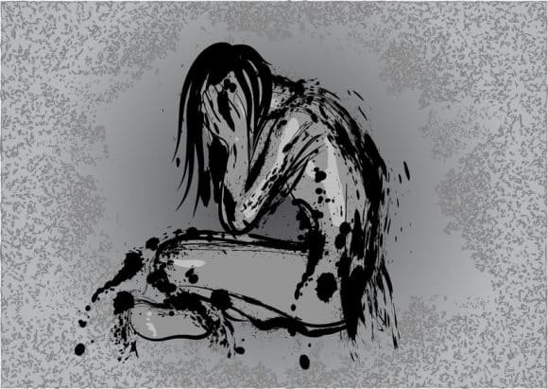
TASK
Watch the TED-Ed video about depression as a review for MDD

Slide 21
TASK
Form three groups
Groups rotate through three sample essay checkpoints that relate to the contents in Etiology of abnormal psychology
Read the sample essays with examiner’s comments and engage in conversation
What are the pros and the cons of each sample response?
What did you learn from reading the samples?

Slide 22
TASK
Read pages 266–268
What is meant by
Point prevalence rate
Period prevalence
Onset age
Go online and find out general prevalence rates and onset ages for most common psychological disorders e.g.
Anxiety
Depression
Obsessive compulsive
Trauma and stress related
Eating disorders

Slide 23

TASK
Read the additional material related to abnormal psychology in peda.net
What does the Kessler and Bromet (2013) study tell about the prevalence rates of major depressive disorder (MDD)?

Slide 24

TASK
Read the Parker et al. (2001) study on the symptoms of MDD between Chinese and Australian patients from teacher’s additional materials
How does this study complement the Kessler and Bromet (2013) study?

Slide 25
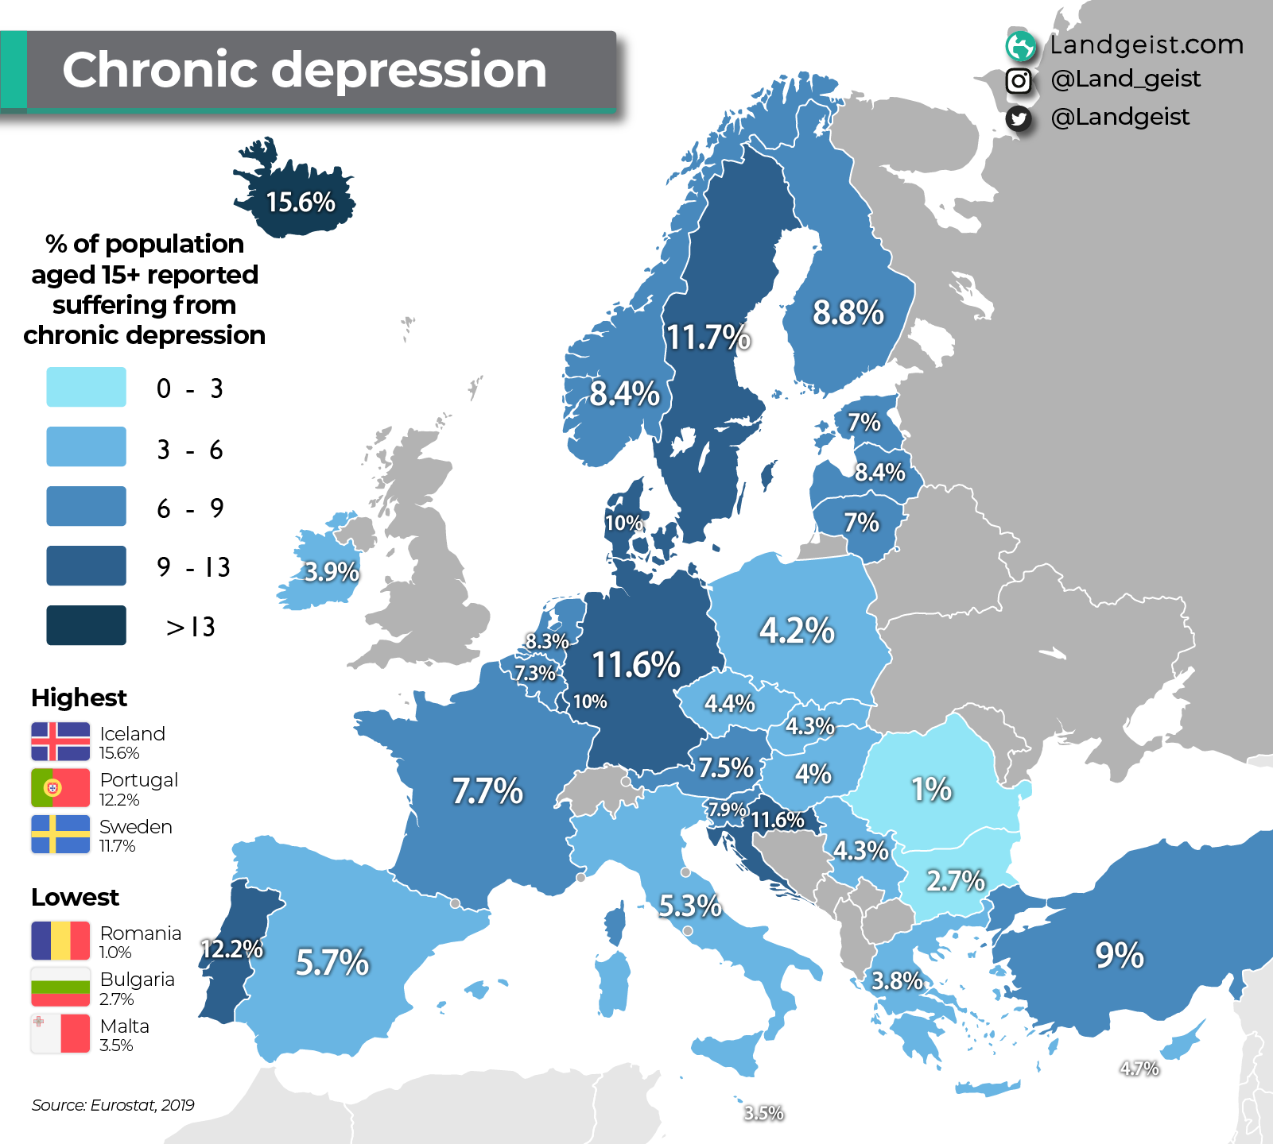
REVIEW
How can Brown and Harris (1978) study and vulnerability model of depression be used with the syllabus topic ”Prevalence rates and disorder(s)”?

Slide 26

TASK
Read the Amenson and Lewinsohn (1981) study on prevalence rates of MDD in men and women from teacher’s additional materials
How does this study complement the Brown and Harris (1978) study?

Slide 27
TASK
Read the sample response to the question ”Discuss prevalence rates and disorders”
After reading the response, pay attention to the examiner’s comments
What did you learn from this sample response?

Slide 28
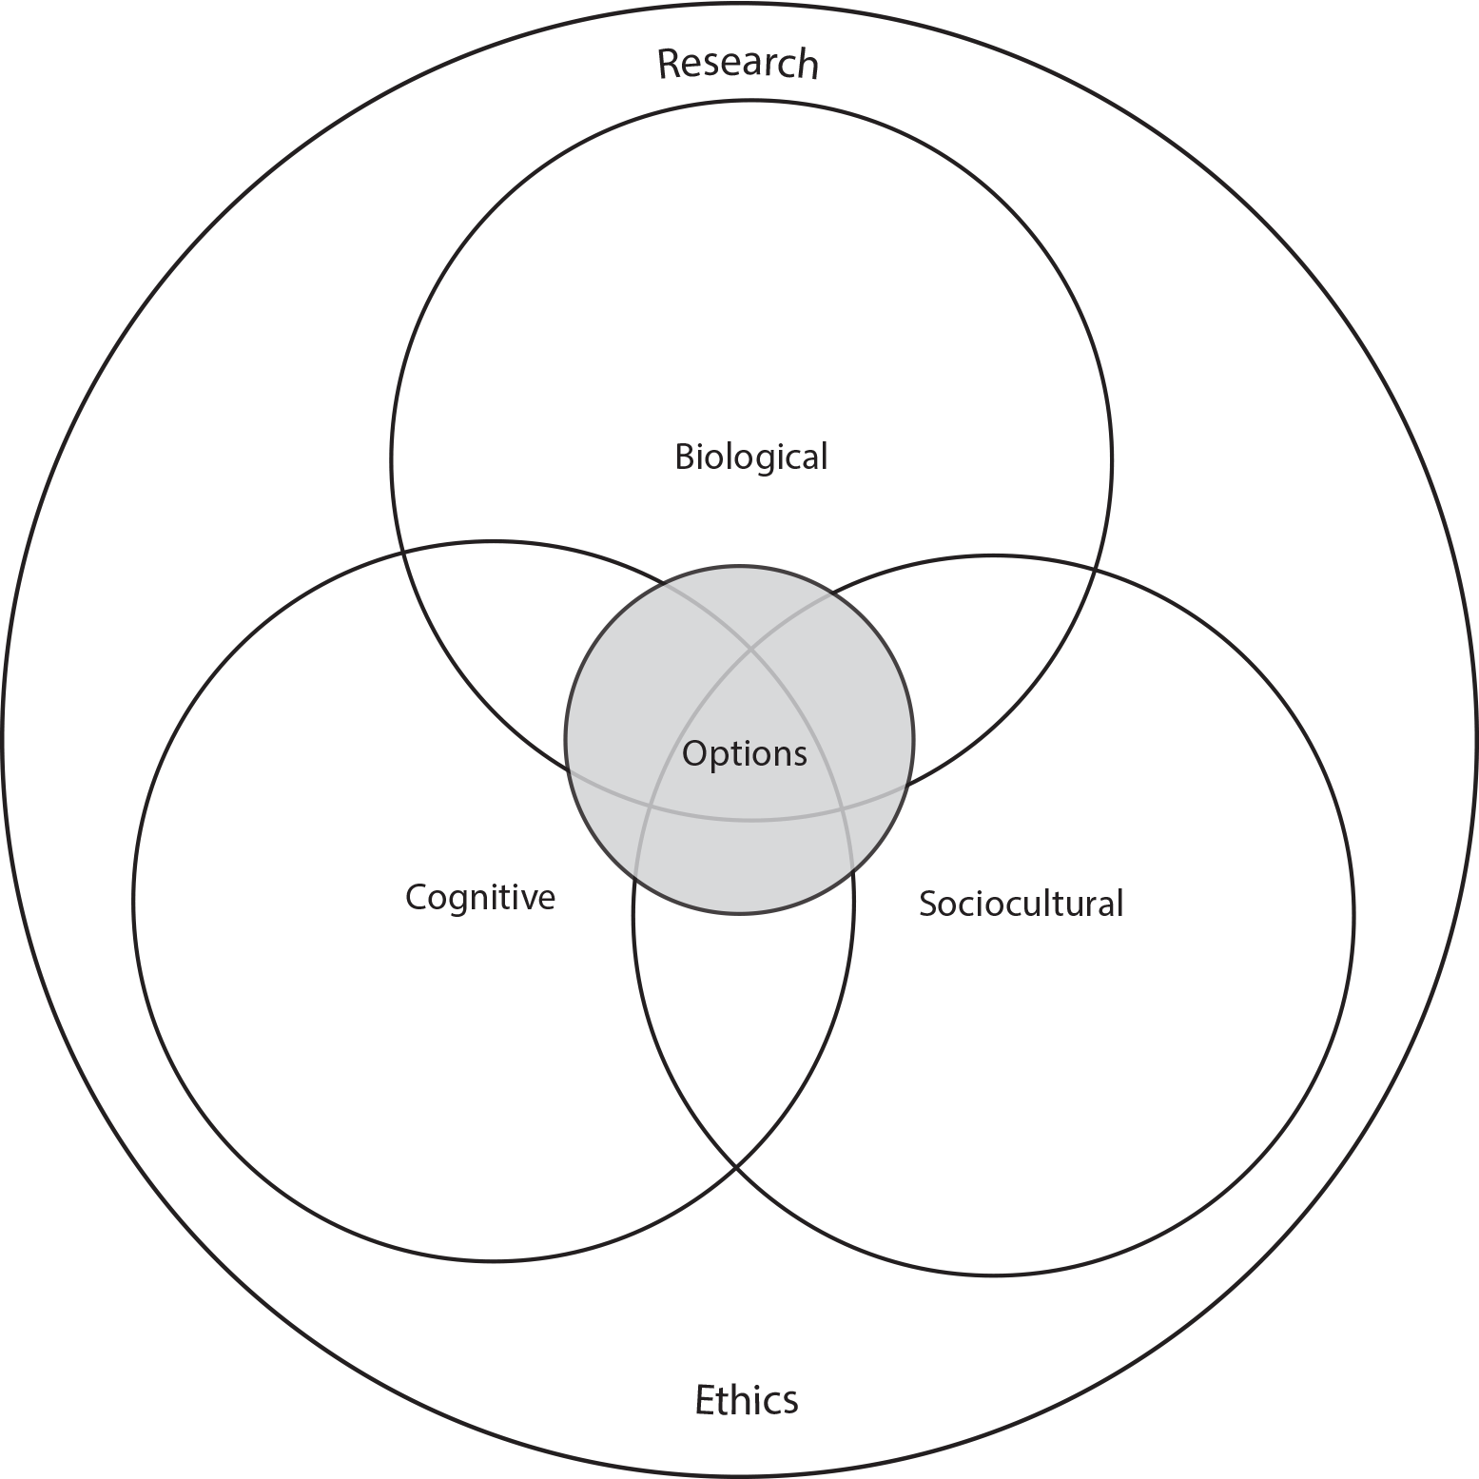
TASK
How do the different approaches of IB Psychology syllabus manifest themselves in what you have learned so far in Abnormal psychology?

Slide 29
Past questions
Discuss prevalence rates of one or more disorders (M19)
Contrast two explanations of one or more disorders (N19)
To what extent do sociocultural factors influence the etiology of abnormal psychology? (N20)
Discuss two research methods used in the investigation of the etiology of abnormal psychology (M21)
Evaluate one or more explanations for one psychological disorder (N21)
Evaluate one or more studies investigating prevalence rates of one or more psychological disorders (M22)

Slide 30
Picture sources
Black anxiety <http://www.mtv.fi/lifestyle/tunteet/artikkeli/lukupiiri-matka-hyytavan-vaaristyneeseen-pahaan-mieleen/5038120> Accessed 11th of August 2016.
Depression ghost <https://www.news-medical.net/health/What-is-Major-Depressive-Disorder.aspx> Accessed 15th of August 2019.
Depressing finger <https://yeswearestars.gr/en/depression-what-it-is-what-it-isnt/> Accessed 15th of August 2019.
Depressed person on a chair <http://www.psychologyandbehavior.com/depression-symptoms-major-depressive-disorder/> Accessed 15th of August 2019.
Depressed DNA <http://discovermagazine.com/2017/janfeb/30-crowdsourced-study-pinpoints-depression-genes> Accessed 19th of August 2019.
Gene-environment correlation <https://www.researchgate.net/figure/General-conceptual-model-for-a-gene-environment-correlation_fig1_255714015> Accessed 19th of August 2019.
Serotonin <https://en.wikipedia.org/wiki/Serotonin> Accessed 19th of August 2019.
Rebecca Brachman <https://www.researchgate.net/profile/Rebecca_Brachman> Accessed 15th of August 2019.
Five minutes <https://www.iconfinder.com/icons/2900587/5_min_clock_five_five_minutes_minute_timer_icon> Accessed 20th of August 2019.
Beck’s cognitive triad and faulty thinking patterns <https://en.wikipedia.org/wiki/Beck%27s_cognitive_triad> Accessed 20th of August 2019.
Culture heads <https://transparency.kununu.com/leaders-answer-what-is-company-culture/> Accessed 20th of August 2019.
Idea <https://gmu.ac.ae/already-business-idea/> Accessed 20th of August 2019.
Hypothesis lightbulb <https://unbounce.com/a-b-testing/how-to-formulate-an-a-b-test-hypothesis/> Accessed 19th of August 2019.
Depressed person drawing <https://www.docsopinion.com/2018/02/25/depression-symptoms/> Accessed 19th of August 2019.
MDD Chinese <https://www.rosehillcenter.org/mental-health-blog/am-i-depressed/> Accessed 6th of March 2023.
Prevalance of depression <https://landgeist.com/2022/06/11/prevalence-of-chronic-depression-in-europe/> Accessed 6th of March 2023.
Depressed couple <https://www.goodencenter.org/men-women-experience-depression-differently/> Accessed 6th of March 2023.
IB Psychology syllabus <https://ibpublishing.ibo.org/d_3_psych_gui_1702_1/apps/dpapp/guide.html?doc=d_3_psych_gui_1702_1_e&part=1&chapter=3&section=1> Accessed 16th of May 2018.

