Slide 1
THE INFLUENCE OF GLOBALIZATION ON INDIVIDUAL BEHAVIOUR
IB Psychology LAJM

Slide 2
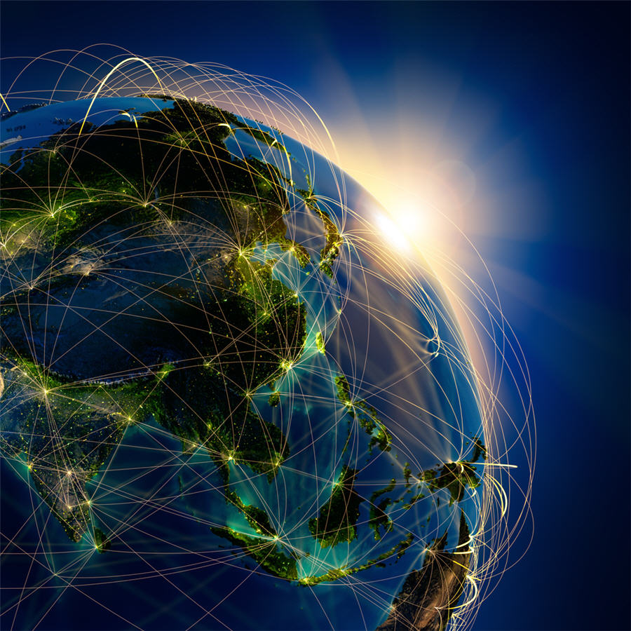
TASK
Go online and find different definitions of globalization
Can you find any similarities, differences and overlaps?

Slide 3

Globalization
The increasing interconnectedness of people worldwide through the growth of international exchange

Slide 4
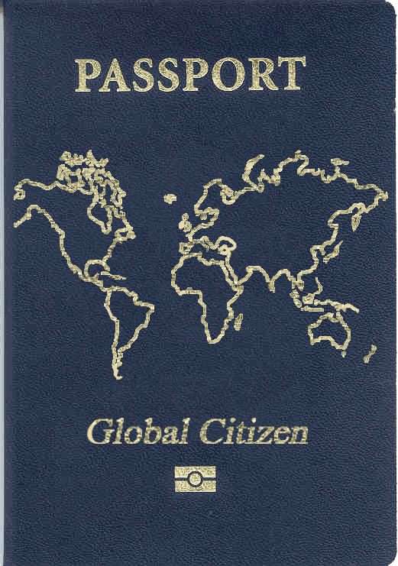
Globalization and behaviour
Global social identity (GSI)
The whole humankind becomes ”we” and there are no ”others”
Diminishing of the national identity in favour of global identity
IS GSI POSSIBLE?

Slide 5
TASK
If a GSI is to be established, it will require its own set of social norms for ingroup members
Create a list of cultural norms that you believe all members of the human race can agree upon
What problems do you encounter when you try to do this?
Is it possible to have GSI without global social norms?

Slide 6
TASK
Read pages 250-251
Find out the gist of Buchan et al (2011), Hamburger Kolleg (2015) and Rosenman, Reese and Cameron (2015) studies
How are they related to global social identity
To what extent do empirical studies support the possibility of GSI?

Slide 7

TASK
Watch Alexander Betts’ TED-Talk ”Why Brexit happened–and what to do next?”
How does this TED-Talk
relate to GSI?

Slide 8

TASK
How is the previous TED-talk related to present political situation in the USA?
You may also consider other places in the world
How can these examples
be related to the
IB Learner Profile?

Slide 9
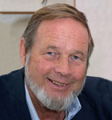
REVIEW
What were the acculturation strategies by Berry (2008)?
Quickly review assimilation, integration, separation and marginalization from pages 244–245

Slide 10
Interaction of global and local
Berry’s (2008) theory of globalization and acculturation
Outcomes of globalization depend on acculturation strategy
Assimilation: homogeneous world culture based on dominant cultures
Integration: societies show some common qualities but retain uniqueness
Separation: non-dominant groups reject the influence of dominant culture
Marginalization: destruction of non-dominant cultures
Do a TEACUP analysis to this theory

Slide 11
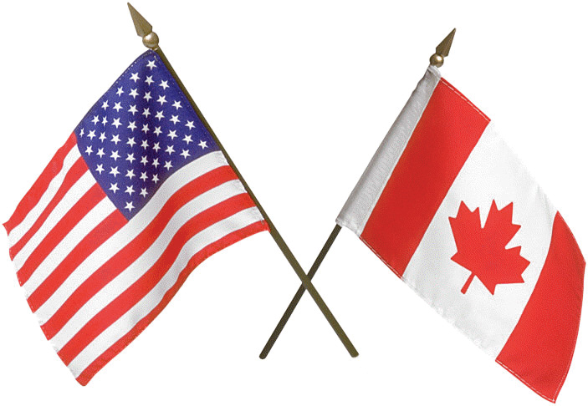
Interaction of global and local
Adams (2003)
Do cultural values of the USA and Canada converge over time?
Survey done with total of 14 000 participants at three points of time
Cultural values of these two cultures did not converge over time

Slide 12

TASK
Read Arnett (2002) article ”The Psychology of Globalization”
How does globalization influence adolescent’s identity?

Slide 13
Methods used to study globazation
Essential features:
Multiple methods and triangulation
Extensive use of correlations
Standardized methods for cross-cultural studies
Excessive reliance on self-report data
Generalizations from a sample to the level of a whole culture
Understanding that cultures are fluid and changeable

Slide 14
TASK
Read the sample response to the question ”Evaluate one or more research methods used in the study of globalization and behaviour”
After reading the response, pay attention to the examiner’s comments
How could this response be improved?
Make amendments

Slide 15

TASK
Review all topics and contents from sociocultural approach to understanding behaviour
What kind of Paper 1 questions could be created based on the HL extension?

Slide 16
TASK
Parts of socio-cultural approach to behaviour | a. The individual and the group | b. Cultural origins of behaviour and cognition | c. Cultural influ-ences on individual behaviour
1. The effect of the interaction of local and global influences on behaviour | 1a | 1b | 1c
2. Research methods used to study the influence of globalization on behaviour | 2a | 2b | 2c

Slide 17
Past question
Discuss how globalization may influence behaviour (M19)
Discuss one or more effects of the interaction of local and global influences on behaviour (M21 TZ1)
To what extent does globalization influence behaviour? (M21 TZ2)
How would you answer these essay questions?
Create sketch responses
Compare your ideas to the markschemes

Slide 18
Picture sources
Globalization 1 <http://www.mining.com/web/people-think-globalization-country/> Accessed 1st of October 2018.
Globalization 2 <https://www.heartland.org/multimedia/podcasts/daniel-griswold-globalization-and-free-trade-are-not-dirty-words> Accessed 1st of October 2018.
Passport, Global Citizen <http://www.raisingmiro.com/2011/02/28/podcast-episode-20/> Accessed 5th of February 2017.
John Berry <http://www.queensu.ca/psychology/people/emeritus-and-retired-faculty/john-berry> Accessed 13th of September 2018.
Alexader Betts <https://twitter.com/alexander_betts> Accessed 1st of October 2018.
Donald Trump <https://www.nytimes.com/interactive/2020/us/elections/donald-trump.html> Accessed 5th of November 2020.
Flags of USA and Canada <https://lop.parl.ca/About/Parliament/senatoreugeneforsey/book/chapter_4-e.html> Accessed 1st of October 2018.
Arnett <http://www.jeffreyarnett.com/about.htm> Accessed 1st of October 2018.
Review <http://ajslp.pubs.asha.org/article.aspx?articleid=2204333> Accessed 22nd of November 2017.

