Slide 1
CULTURE AND ITS INFLUENCE ON INDIVIDUAL
IB Psychology LAJM

Slide 2

Please note!
IB Psychology syllabus topics ”Cultural origins of behaviour and cognition” and ”Cultural influences on individual behaviour” with their contents are combined in this PowerPoint

Slide 3
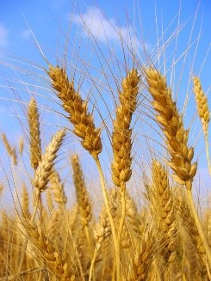
TASK
Do a mind map of culture
  Don’t use any assistive devices or materials
  Write the word culture in the middle of the map
  Try to compile a comprehensive map
  What kind of things are related to culture?
  How can you define culture?

Slide 4
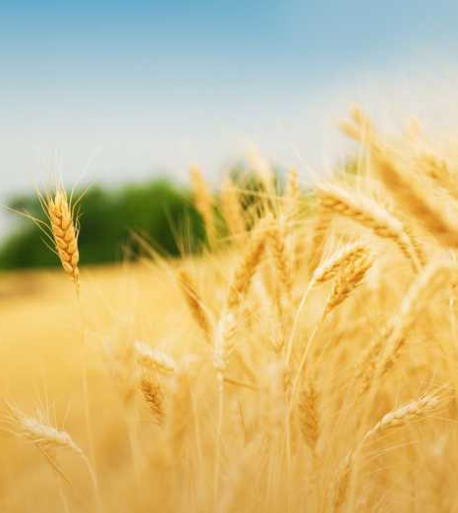
TASK
Read pages 202-203
Compare your mind map to the information presented in your textbook
  Pay close attention to surface and deep culture

Slide 5

Culture
There is no definitive definition of culture
  “Common rules that regulate interactions and behaviour in a group as well as a number of shared values in a group” (Lonner, 1995)
  ”Everything learned”

Slide 6
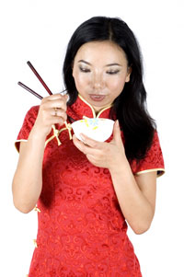
Culture
Cultural norms
  Attitudes, beliefs and behaviour patterns that are typical for a specific cultural group
Cultural groups are characterized by different norms and conventions.
What is the meaning of
cultural norms to an individual?

Slide 7
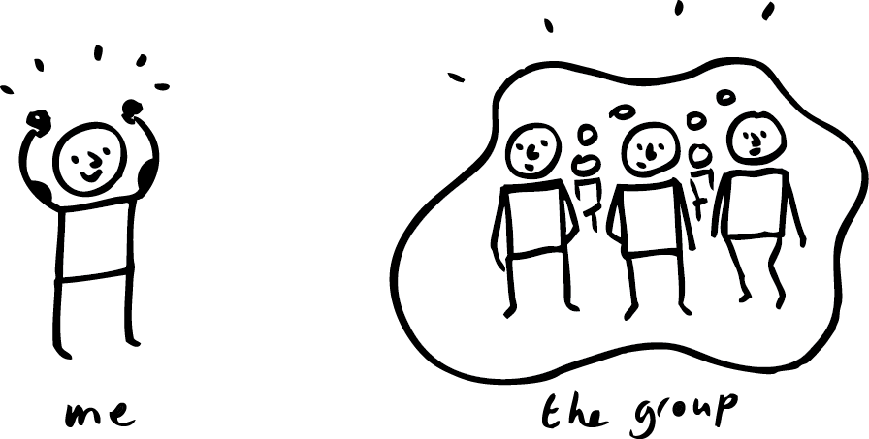
TASK
Study the gist of Chiu (1972) and Briley, Morris and Simonson (2005) from teacher’s additional materials
  How do these studies exemplify the influence of culture on behaviour and cognition?

Slide 8
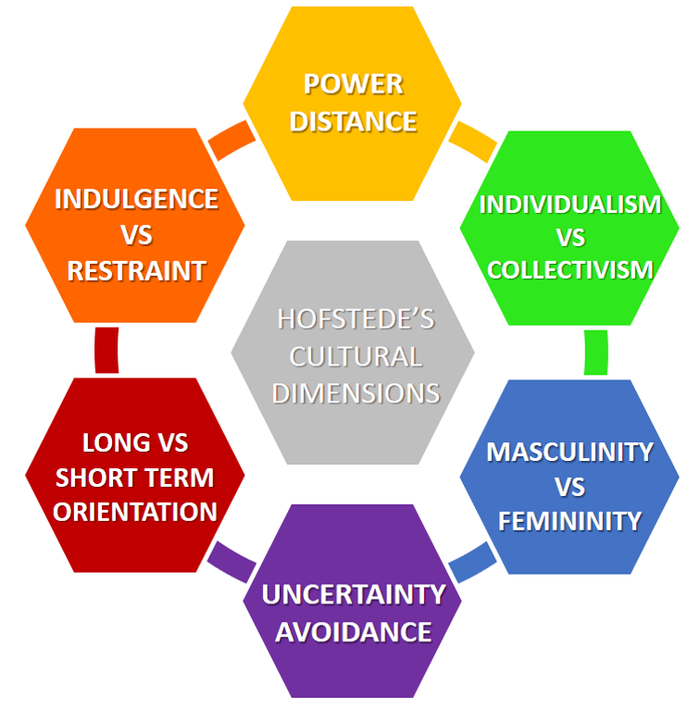
Cultural dimensions
Geert Hofstede’s model of cultural dimensions studies universal features of all cultures

Slide 9
TASK
Read page 209 and go to to Hofstede’s website and summarize the main points of each dimension in your own words

Slide 10
TASK
Go to Compare countries - Hofstede insights
  Pick one country and examine its scores for each of the cultural dimensions
  Choose another country and contrast the scores
  Can you see any correlations between any of the dimensions?

Slide 11
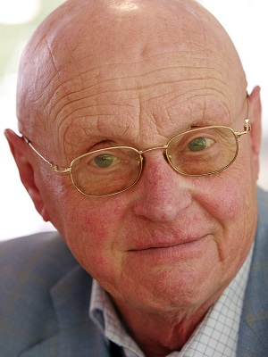
TASK
Watch ”10 minutes with Geert Hofstede on individualism vs. collectivism”
Pay attention to the correlations between dimensions!

Slide 12
TASK
Read pages 210-212
What were the aim, procedure and results
of Berry and Katz’s (1967) and Finkelstein (2010) studies?
  How do the studies relate to the Hofstede’s individualism vs. collectivism dimension?
Study the gist of Wei et al. (2001) from teacher’s additional materials
  Did this study provide an additional perspective to the Hofstede’s individualism vs. collectivism dimension?

Slide 13
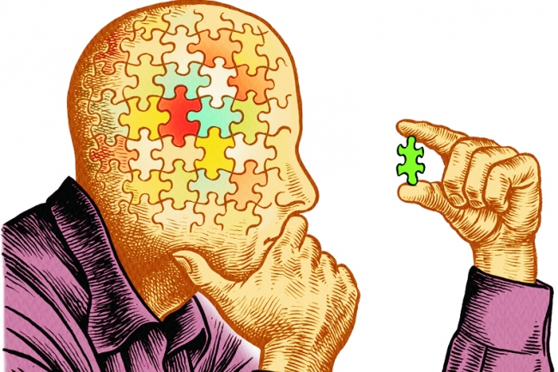
TASK
Critical thinking hub:
  Do MAGEC/GRENADE analysis of Berry and Katz (1967), Finkelstein (2010) and Wei et al. (2001) studies
  How do the studies provide support for Hofstede’s model?
  Aim for holistic approach

Slide 14
EXTRA TASK
If you want to study another cultural dimension, do the following:
(1) Watch ”10 minutes with Geert Hofstede on power distance index”
(2) Study the following studies from pages 213–214
  Meeuwesen, van den Brink-Muinen and Hofstede (2009)
  Eylon and Au (1999)

Slide 15

TASK
How can information from Hofstede’s model be applied in schools and in workplaces?
  Try to give concrete examples or guidelines
  You can use pages 211-214 and tasks in the previous slides as source materials
  Write your suggestions
  to the whiteboard

Slide 16
TASK
Read the sample responses to the SAQ question ”Describe one cultural dimension with reference to one relevant study” and to the ERQ/essay question ”Discuss the role that one cultural dimension may have on behaviour”
After reading the responses, pay attention to the examiner’s comments
What did you learn from these sample responses?

Slide 17
ENCULTURATION
ACCULTURATION
The process
by which individuals learn their culture in order to fully function within it
The process of psychological and cultural change as a result of contact and interaction between cultures
The individual and the culture
are in bidirectional relationship

Slide 18

TASK
Read pages 204-207
How can the culture of honour be used as an example of
both enculturation and acculturation?
What were the aim, procedure and results of Cohen et al (1996) and how does it relate to enculturation and acculturation?

Slide 19

TASK
Watch the Anita Collins TED-talk ”The benefits of music education”
  How does music education connect to other approaches in human behaviour in addition to the sociocultural one?

Slide 20
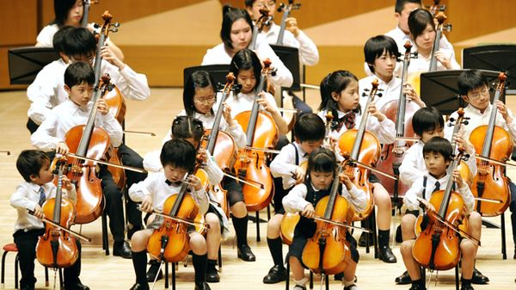
TASK
Study the gist of Trainor et al. (2012) and Demorest et al. (2008) from teacher’s additional materials
  How can music play a role in enculturation and how does it influence human behaviour?

Slide 21

REVIEW / TASK
What was meant by observational learning?
What role can observational learning play in enculturation?

Slide 22

TASK
Study the gist of Odden and Rochat (2004) from teacher’s additional materials
  What role does observational learning play in enculturation?

Slide 23
TASK
Read the sample responses to the SAQ question ”Explain one study of enculturation” and to the ERQ/essay question ”Discuss the enculturation of one behaviour”
After reading the responses, pay attention to the examiner’s comments
What did you learn from these sample responses?

Slide 24
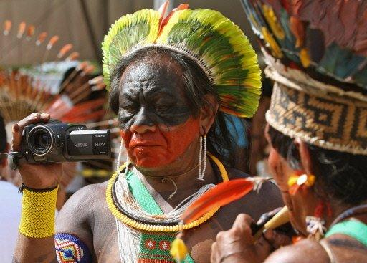
Acculturation and cultural change
Acculturation is one type of cultural change
  Usually takes place between dominant and non-dominant cultures

Slide 25

TASK
Watch Shereen El Feki’s TED-talk ”Pop culture in the Arab world”
How can globalization be a driving force in acculturation?

Slide 26
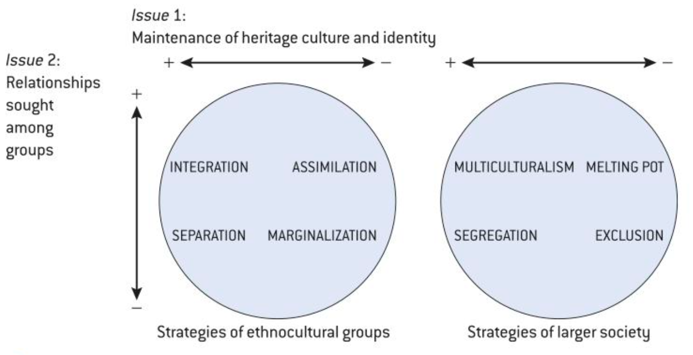
Acculturation
Two-dimensional model of acculturation (Berry, 1997, 2008)
Individuals can adopt four strategies of cultural change
  (1) Assimilation
  (2) Integration
  (3) Separation
  (4) Marginalization

Slide 27

TASK
Study the gist of Kim and Omizo (2006) from teacher’s additional materials
  How do both enculturation and acculturation contribute to the development of identity?
  How can this study be related to Berry’s model?

Slide 28

Acculturation
The healthy migrant effect
  Migrants tend to be healthier than their native-born counterparts at first
The negative acculturation effect
  Migrants tend to be less healthy than their native-born counterparts over time

Slide 29
TASK
There are descriptions of four studies on pages 246–247:
  Shah et al. (2015)
  Delavario et al. (2013)
  Ishizawa and Jones (2016)
  Da Costa, Dias and Martins (2017)
Choose TWO of the studies and find the aim, procedure and results of them
  How does acculturation influence health?
  How is obesity related to acculturation?

Slide 30

Acculturation
Acculturative stress
  Stress caused by coping with conflicting cultural norms (Sullivan, 2009)
  Integration strategies result in the lowest level of acculturative stress (Berry, 2005)
Have you experienced
acculturative stress?

Slide 31
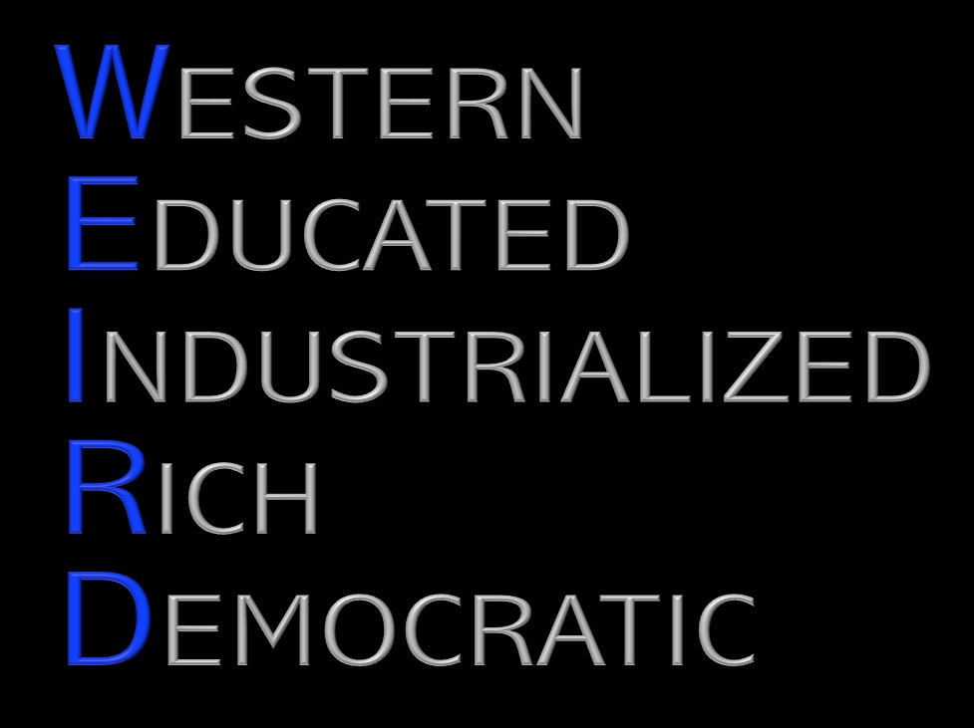
TASK
Read the following:
  Small chapter ”How are acculturation studies designed?” on page 245
  The ATL skills boxes on pages 245 and 246
What causes bias in acculturation studies?
  What are the limitations of acculturation studies?

Slide 32
TASK
Read the sample response to the SAQ question ”Explain acculturation with reference to one study”
After reading the responses, pay attention to the examiner’s comments
What did you learn from this sample response?

Slide 33
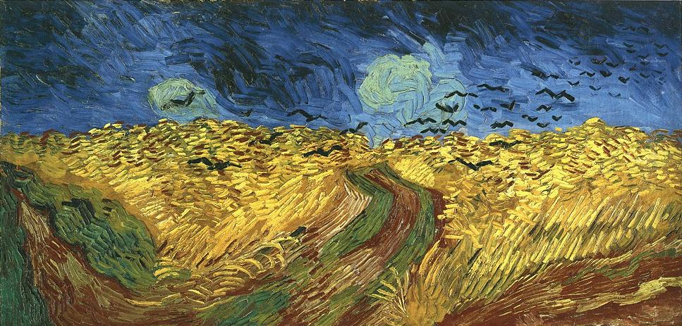
Approaches to culture
Etic approach
  Studies universal features of all cultures
  Examines cultures from an outside perspective
Emic approach
  Studies culturally specific features of a culture
  Understanding a culture from within

Slide 34
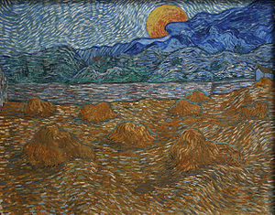
TASK
Find examples of etic
and emic approaches
  What are universal features of cultures?
  What are examples of culturally specific features?

Slide 35
Approaches to culture
Kashima and
Triandis (1986)
  Americans tend to explain their own success by dispositional attribution and Japanese by situational attribution
  Etic approach
Bartlett (1932)
  Swazi herdsmen have extraordinary ability to recall individual characteristics of
  their cattle
  Emic approach

Slide 36
Approaches to culture
Universalist perspective
  Psychological mechanism are largely the same across cultures, but experiences and behaviours can differ
Relativist perspective
  Psychological mechanisms are so different across cultures that they cannot be compared
What evidence do we have to
support either of these perspectives?

Slide 37
TASK
Critical thinking hub:
  Review the whole sociocultural approach and try to provide content, theories and studies related to the topics on the right
  Aim for holistic approach
  Write your responses in Teams
Contribution of research methods used in the sociocultural approach
Ethical considerations in the investigation of the sociocultural approach

Slide 38
TASK
Read the sample response to the SAQ question ”Explain one ethical consideration related to one research study of the individual and the group”
After reading the responses, pay attention to the examiner’s comments
What did you learn from this sample response?

Slide 39
TASK
Read the sample responses to the ERQ/essay question ”Evaluate the use of one research method used in the sociocultural approach to study the behaviour of the individual and the group”
After reading the responses, pay attention to the examiner’s comments
What did you learn from these sample responses?

Slide 40
Picture sources
Please note <> Accessed 11th of September 2018.
Grain field 1 <http://www.raahenseurakunta.fi/wp-content/uploads/2016/09/> Accessed 6th of September 2017.
Grain field 2 <http://www.earthtimes.org/going-green/food-agriculture-reorganisation/1515/> Accessed 11th of August 2015.
Grain field 3 <https://wallup.net/morning-nature-sun-rays-landscape-sunlight-field/> Accessed 11th of September 2018.
Woman eating with sticks <http://www.travelbeijing.com/beijing-china-travel-tips/beijing-social-and-cultural-customs.html> Accessed 6th of September 2017.
Me and group <https://fi.pinterest.com/pin/734720126679711913/> Accessed 27th of April 2020.
Hofstede’s cultural dimensions <https://www.business-to-you.com/hofstedes-cultural-dimensions/> Accessed 12th of September 2018.
Geert Hofstede <https://www.toolshero.com/toolsheroes/geert-hofstede/> Accessed 18th of September 2018.
Critical thinking puzzle <https://www.chronicle.com/article/Beyond-Critical-Thinking/63288> Accessed 10th of February 2019.
Happy workplace <https://www.shrm.org/hr-today/news/hr-magazine/0917/pages/how-to-build-a-better-workplace.aspx> Accessed 14th of September 2018.

Slide 41
Picture sources
Bushido <https://decalgremlins.com/products/bushido-kanji-sticker-vinyl-decal-feudal-japanese-warrior-shinto-katana> Accessed 17th of September 2018.
Musical education <https://www.francemusique.fr/en/music-education-japan-model-follow-15697> Accessed 4th of May 2020.
Anita Collins <https://www.moravian.edu/news/releases/anita-collins#.XrPP1C8vHOQ> Accessed 7th of May 2020.
Enculturation head <http://dpgsulo.com/english-and-language-acquisition/> Accessed 4th of May 2020.
Identity <https://www.paymentscardsandmobile.com/the-problem-with-self-sovereign-identity/> Accessed 4th of May 2020.
Acculturation <https://www.lifepersona.com/the-5-most-resulting-acculturation-examples> Accessed 19th of September 2018.
Shereen El Feki <http://evirtualsummits.com/member/3603/> Accessed 19th of September 2018.
Migrants <https://blogit.metropolia.fi/variousvariables/2017/12/08/highly-skilled-immigrants-aboard-build-finland/> Accessed 5th of May 2020.
WEIRD <http://davidbrin.blogspot.com/2016/08/> Accessed 5th of May 2020.
Acculturative group <http://www.trendingrealtors.com/Features.aspx> Accessed 19th of September 2018.
Wheat field with crows – van Gogh <http://www.vggallery.com/painting/p_0779.ht> Accessed 6th of September 2017.
Wheat fields – van Gogh <https://en.wikipedia.org/wiki/Wheat_Fields_(Van_Gogh_series)> Accessed 6th of September 2017.

