Slide 1
COGNITIVE PROCESSING IN A TECHNOLOGICAL WORLD
IB Psychology LAJM

Slide 2

TASK
What is media?
  Try to give your own definition
What kind of forms can media take?
  Compile a list
Don’t use any assistive devices!

Slide 3

Media
Etymology
  Medium (latin) = intervening, conveyor
Modern definition
  Communication and communication technology

Slide 4

Media
Media can be divided into categories based on the technology they use
  Graphic media
  Audio-visual media
  Multimedia
  New Media

Slide 5

TASK
Take a stand on the following statements:
  ”Digital media has changed the world and the way people behave”
  ”Media runs the world”
What kind of arguments and counter-arguments can you provide?

Slide 6
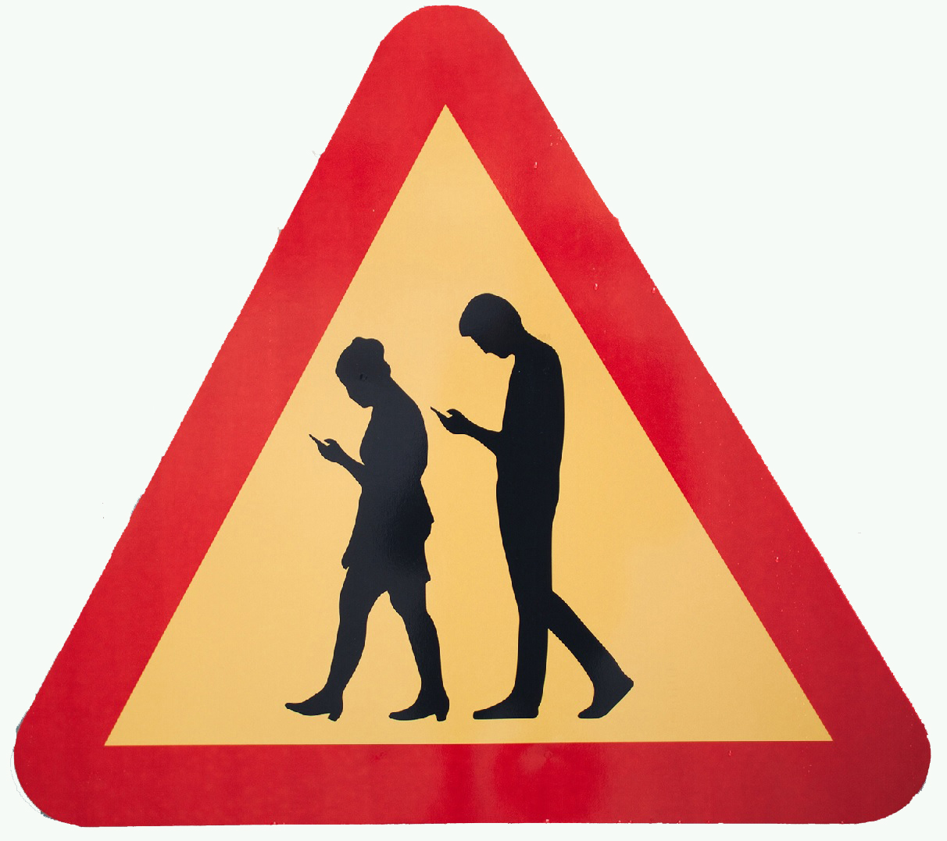
TASK
Media diary
  Keep track of your use of media for one week (seven days) with the help of teacher’s instructions
  Media diary will be analysed after the week

Slide 7
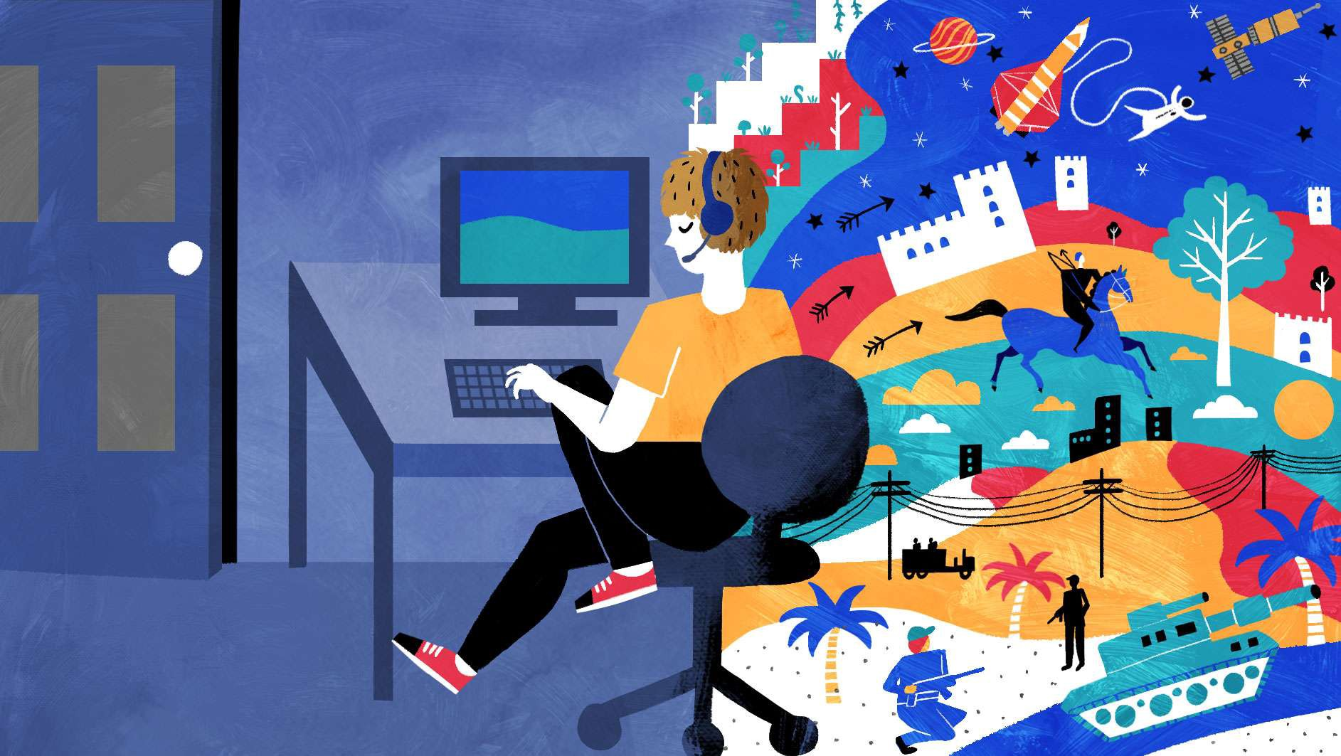
TASK
What kind of media
do electronic games represent?
What types of electronic games
are there?

Slide 8

TASK
What kind of electronic games do you play?
  What are your favourites?
  Give examples!
  If possible, try to give a demonstration to your fellow students or for the whole class

Slide 9

TASK
Is playing electronic games beneficial or detrimental to cognitive functions?
What factors affect how games influence us?
How can electronic games be used to improve human life?

Slide 10
TASK
Read pages 189-192
What were the aim, procedure and results of the following studies:
  Rosser et al. (2007)
  Sanches (2012)
  Fery and Ponserre (2001)
Utilize the exercise boxes on pages 190 and 191 in analysing the studies
You may also do a
MAGEC/GREANDE analysis
Keep in mind the question:
  Is playing electronic games beneficial or detrimental to cognitive functions?

Slide 11
Electronic games
Gaming enhances
  The scope of visuo-spatial vigilance (Green and Bavelier, 2003; Dye and Bavelier, 2010)
  Visuo-spatial capacity and related brain structures (West et al., 2017)
  Flexible swifts from task to task (Boot et al., 2008; Colzato et al., 2010)
  Observing multiple targets at the same time (Trick et al., 2005)
  Short-term memory functions (Colzato et al., 2010; Boot et al., 2008; Moisala et al., 2017)
WHERE CAN THESE
SKILLS BE IMPLEMENTED?

Slide 12
Electronic games
Game addiction
  Only 1-2% of gamers are game addicts (Wittek et al., 2016)
  10% of gamers are suffering from symptoms related to excessive gaming such as melancholy, fatigue and anxiety (Männikkö, 2017)
  Excessive gaming is connected with impaired cognition and psychic welfare (Ferguson et al., 2011)
HOW TO AVOID
EXCESSIVE GAMING
AND GAME ADDICTION?

Slide 13

TASK
Do aggressive and violent electronic games cause aggression and violence in the real-life?
  Try provide both arguments and counter-arguments

Slide 14
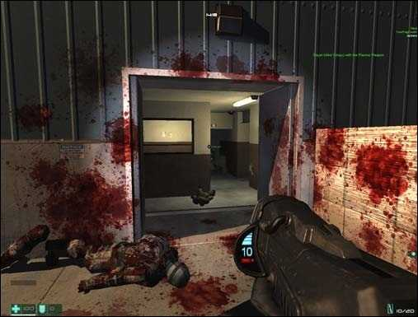
Electronic games
Games and aggressiveness
  Video game influences on increased aggression and reduced prosocial behaviour are minimal (Ferguson, 2015)

Slide 15
REVIEW
Is playing electronic games beneficial or detrimental to cognitive functions?
What factors affect how games influence us?
How can electronic games be used to improve human life?

Slide 16
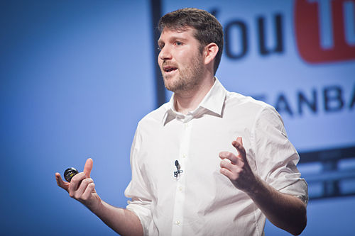
TASK
Watch the Eli Pariser TED-talk ”Beware online ”filter bubbles””
HOW CAN FILTER BUBBLES SKEW OUR SCOPE OF KNOWLEDGE?

Slide 17
TASK
Form groups
Choose an identical query in a search engine and compare the outputs on your personal computers
To what extent are the outputs similar?
How has the search engine’s algorithm shaped your outputs?
WHAT DOES THIS EXCERCISE AND ELI PARISER’S TED
TALK TEACH YOU ABOUT KNOWING IN THE DIGITAL WORLD?

Slide 18

TASK
Watch the Kurzgesagt video ”The Internet is Worse Than Ever – Now What?”
  How does this video differ from the previous TED-Talk?
IS INTERNET BAD FOR OUR
SCOPE OF KNOWLEDGE AFTER ALL?

Slide 19
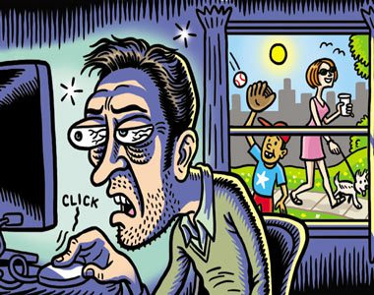
TASK
Read the article from The Guardian on the effects of the internet
  Has the internet changed the way we think?
  What are the pros and the cons of the internet?
  How has the internet changed since 2010?

Slide 20
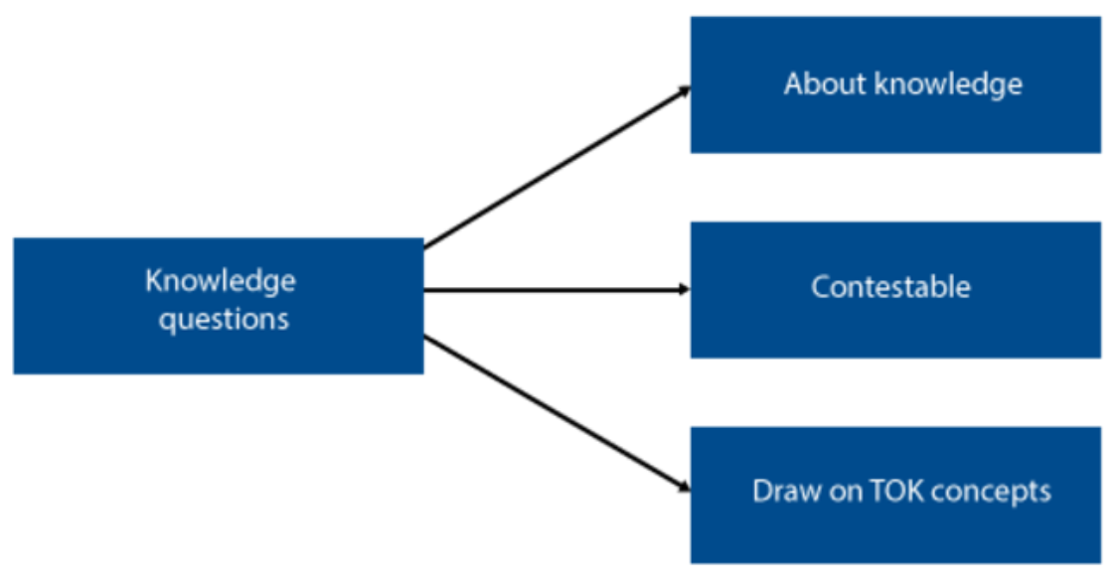
TOK-LINK
How do the following KQs relate to the contents we just covered?
  To what extent is the internet changing what it means to know something?
  How are online or virtual communities similar to/ different from “traditional” communities of knowers?
DISCUSS AND EXPLORE THESE KNOWLEDGE QUESTIONS

Slide 21
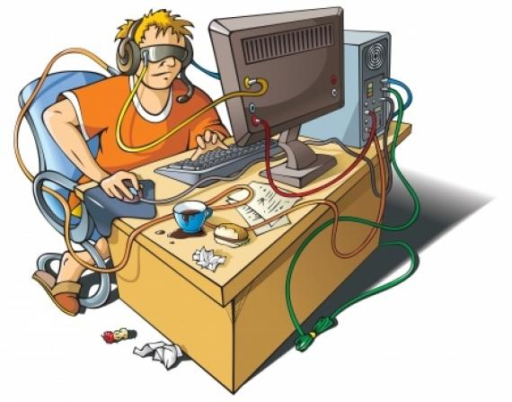
TASK
What kind of aspects in internet can cause addiction?
How can internet addiction manifest itself?

Slide 22
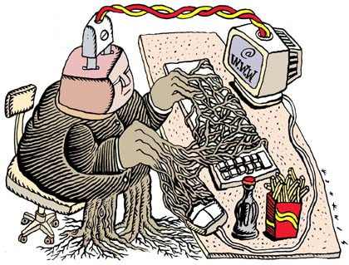
TASK
Do the internet addiction test (IAT) in Päihdelinkki (in Finnish) and/or in Net Addiction (in English)
  What does the result tell about your use of the internet?
HOW INTERNET ADDICTION CAN BE AVOIDED?

Slide 23

TASK
Read the box Psychology in real life on page 189
To what extent have you fallen into the phenomenon called digital amnesia?

Slide 24

TASK
Has digital technology enhanced or inhibited your learning?
  Try to give examples from both perspectives

Slide 25
Digital technology and learning
Learning the alphabets is faster when written by hand (Longchamp et al., 2005; 2008)
Memos written by hand are remembered better (Mueller & Oppenheimer, 2014)
Texts read from a paper are understood and remembered better
(Mangen et al., 2013; Noyes & Garland, 2003)
Reading a paper book is less stressful
(Wästlund et al., 2005)
Texts written by hand are of higher quality
(Berninger et al., 2009)

Slide 26

Digital technology and learning
On the other hand, students suffering from learning deficiencies might benefit from technology, because it can add motivation (Wollscheid et al., 2016)

Slide 27
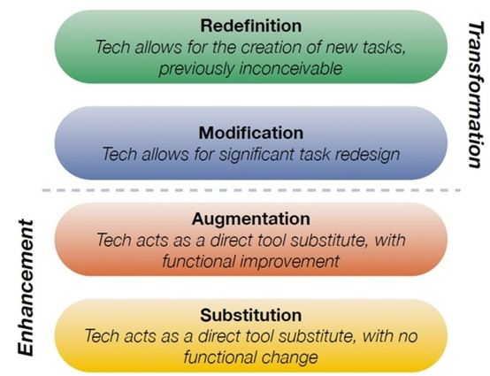
Digital technology and learning
In addition, technology can create new learning possibilities
  E.g. Dr. Ruben R. Puentedura’s
  SAMR model

Slide 28

TASK
How should digital technology be used in education?
  Try to provide guidelines based on what you have learned

Slide 29

TASK
One volunteer is needed
Audience will come up with tasks for the volunteer and the volunteer must do them simultaneously

Slide 30

TASK
In what kind of situations you have to do several tasks simultaneously?
How does multitasking affect your performance?
Is digital technology increasing the need for multitasking?

Slide 31
Multitasking
Moisala et al. (2015)
  Multitaskers do worse on tasks that require focus
  Multitasking burdens
  the brain
LISTENING
LISTENING + READING

Slide 32
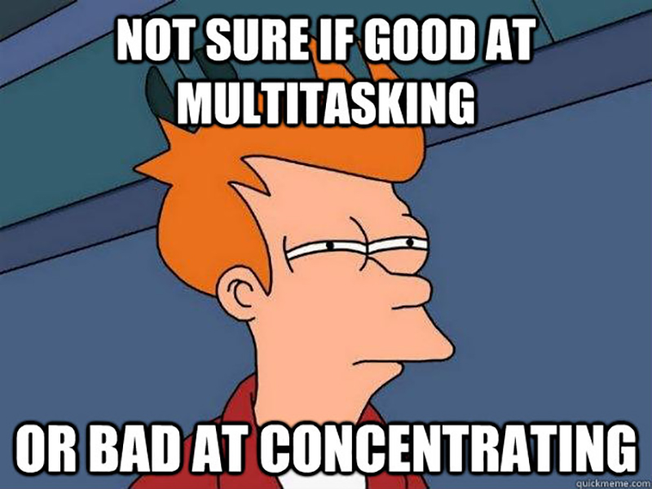
TASK
Read pages 192–194 and teacher’s additional materials
Complete the teacher’s handout on induced media multitasking

Slide 33

TASK
How should you change your habits and behaviour related to digital technology in order to avoid multitasking?

Slide 34

TASK
Does digital technology affect attention?
Can digital technology increase the rate of Attention Deficit Hyperactivity Disorder (ADHD)?

Slide 35
Digital technolgy and ADHD
Swing et al. (2010)
  Longitudinal study showed a relationship between screen time and reduced classroom attention in 6–12 year old students
  Over two hours of entertainment screen time per day anticipated attention problems
Polanzyk et al. (2014)
  Meta-analysis of 135 studies
  Prevalence of ADHD has NOT grown since 1985 till 2012
  The number of ADHD diagnosis has grown, but this seems to be due to the changes in diagnostic criteria and parental awareness

Slide 36
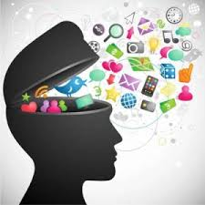
Attention Deficit Trait (ADT)
A phenomenon where attention starts to diminish in the same way as in Attention Deficit Disorder (ADD) and Attention Deficit Hyperactivity Disorder (ADHD), but without the neurophysiological dysfunctions

Slide 37

TASK
How can you foster and develop your ability to focus and concentrate?

Slide 38

TASK
Reflect your use of social media
  What kind of positive and negative effects it has on your behaviour and well-being?
HAVE YOU EXPERIENCED FOMO?

Slide 39

Digital techonology and human interaction
McDool et al. (2016)
  Longitudinal study with 10-15 years old
  spending more time on social networks reduces the satisfaction that children feel with all aspects of their lives, except for their friendships

Slide 40
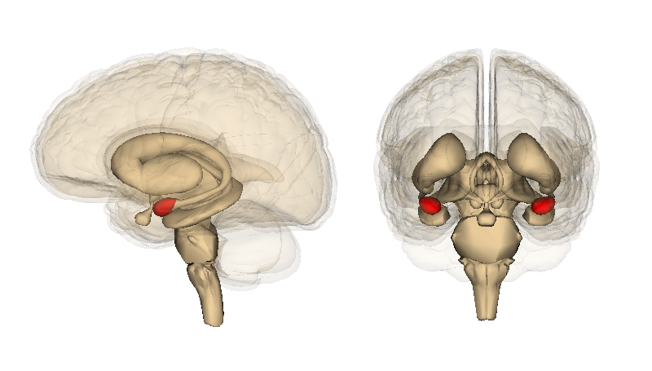
Digital techonology and human interaction
Bickart et al. (2011)
  Amygdala volume correlates with the size and complexity of social networks in adult humans

Slide 41
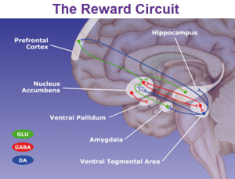
Digital techonology and human interaction
Montag et al. (2017)
  High daily usage of Facebook correlates with smaller grey matter volume in nucleus accumbens

Slide 42

TASK
Read the teacher’s additional materials and find out the gist of Konrath, O’Brian and Hsing (2011) study
  How does digital technology affect the empathic concern and perspective taking?

Slide 43
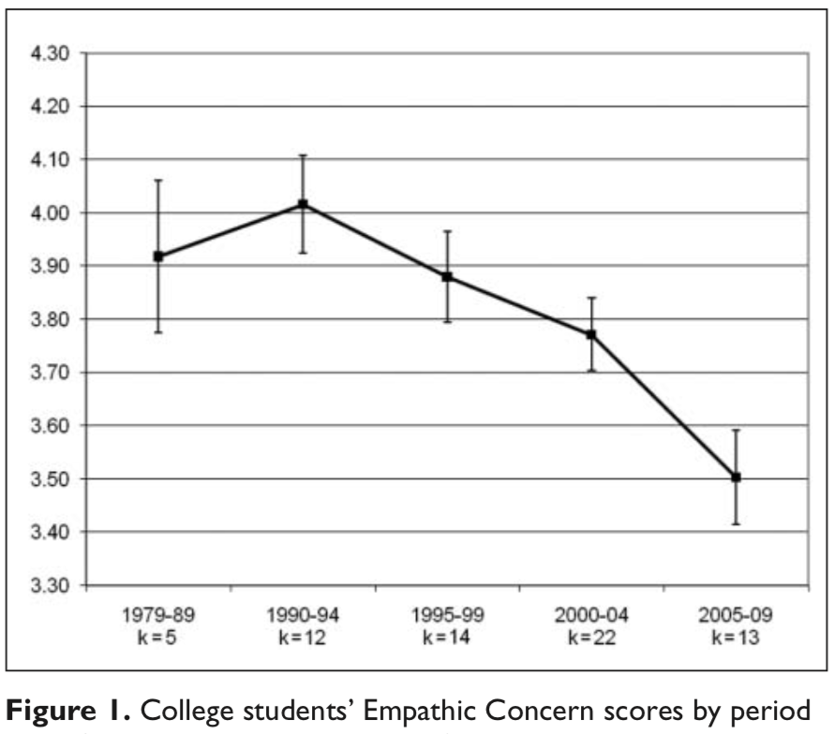
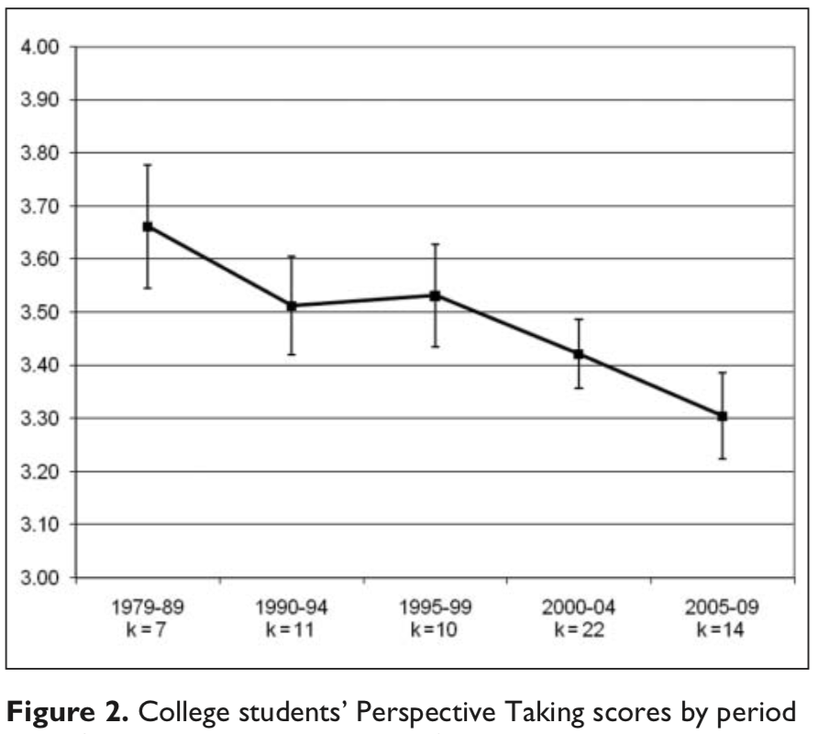
Digital technology and human interaction
Konrath, O’Brien and Hsing (2011)

Slide 44

TASK
Read pages 194-196 on digital technology and empathy in human interaction
  What do the Carrier et al (2015) and Howard-Jones (2011) studies suggest on the effect of digital technology on empathy?

Slide 45
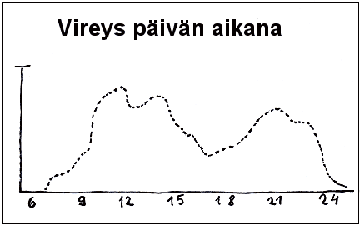
TASK
When are you the most awake during the day?
  Draw your own awakeness graph
What kind of factors influence your state of awakeness?

Slide 46

TASK
How many hours of sleep do you need?
  How does this information relate to your awakeness graph?
  What kind of factors influence on how many hours you need to sleep?

Slide 47
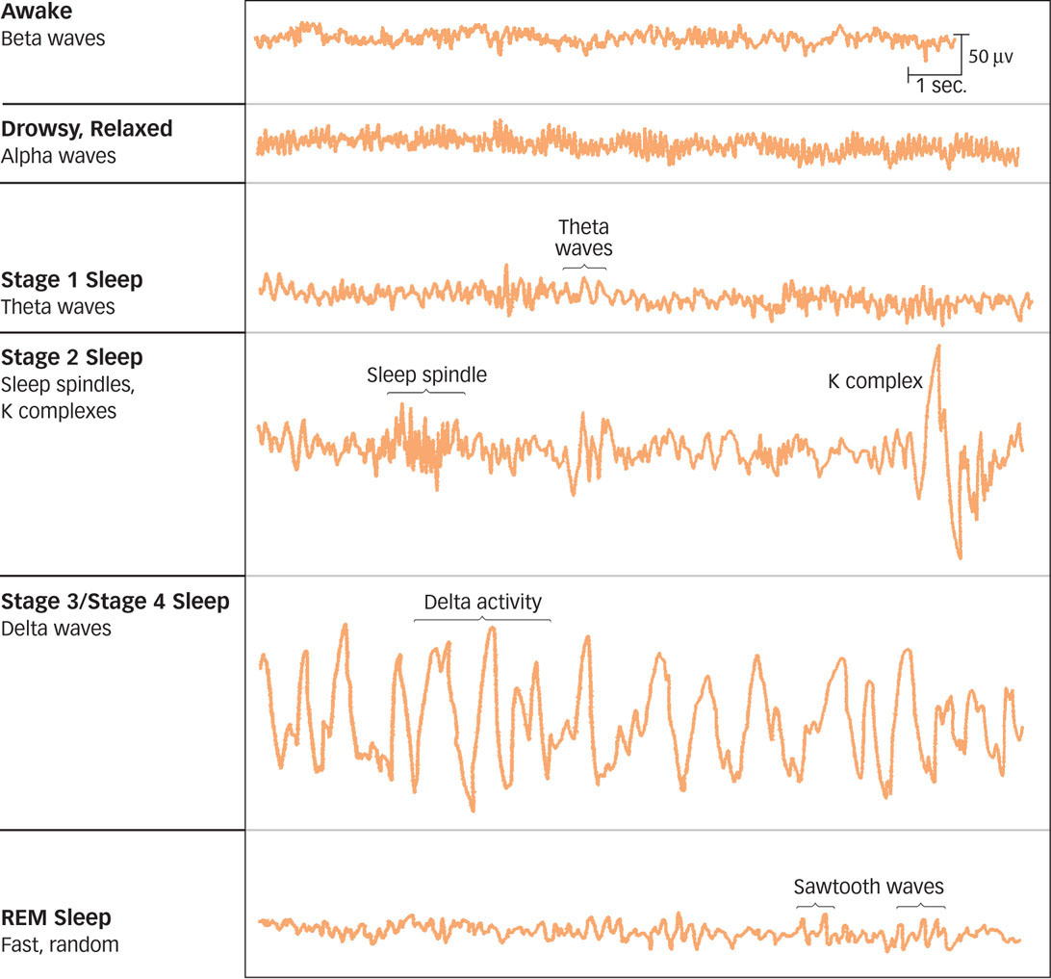

Slide 48
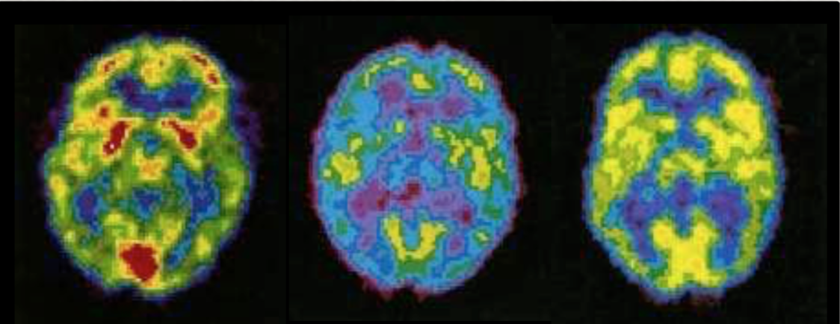
Sleep
AWAKE
DEEP SLEEP
REM SLEEP

Slide 49
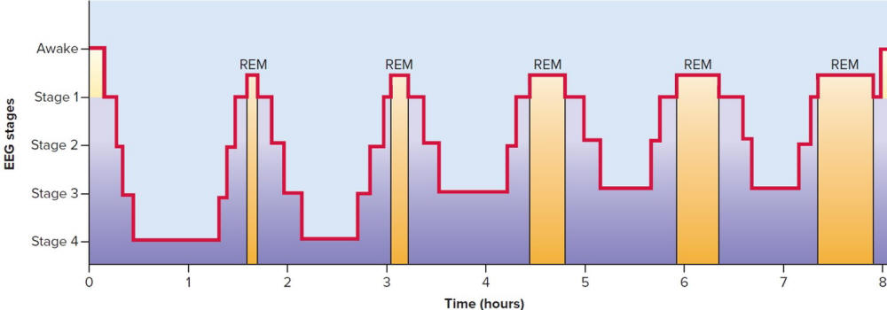
Sleep
Deep sleep stages are
important in consolidating
memories
REM-sleep is vital for
strengthening learning

Slide 50
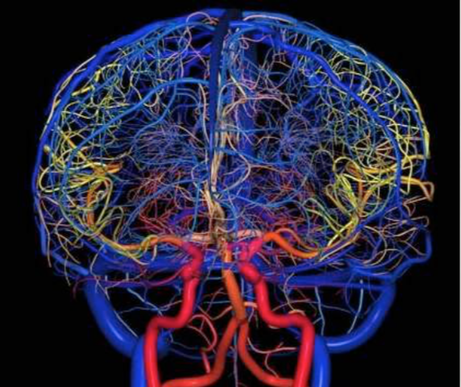
Sleep
Brain’s lymphatic system cleans up the the brain from metabolic waste during sleep
Sleep is vital to our overall well-being

Slide 51
Digital technology and sleep
One of the greatest threats of the use of digital devices is their negative impact on sleep (George & Odgers, 2015)
The young require 8 to 10 hours of sleep every night, but 58% of the young sleeps less than 7 hours a night (Emsellem et al., 2014)
HOW CAN DIGITAL DEVICES IMPAIR SLEEP?

Slide 52

TASK
How should you change your behaviour with digital devices in order to sleep better?

Slide 53
TASK
Compile a research report, upload it to ManageBac and prepare to present it to others
  What was your research question?
  What were your aim, procedure and results?
  How do your findings connect to the contents we have studied?
Form small groups
Choose a topic from ”cognitive processing in the digital world” and compile and implement a small survey
  What do you want to find out about the use and the effects of digital technology?

Slide 54
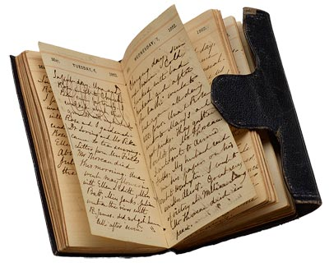
TASK
Analyse your media diary with the help of the teacher’s instructions
  Upload your report to ManageBac
Give feedback to your friend’s analysis and compare your media diaries and analysis
  How different or similar are they?

Slide 55

TASK
Form groups
Each group compiles a set of rules for media usage based on all the the things you have learned in this section
Save your set of rules in ManageBac

Slide 56
TASK
Read pages 196–198
Review the whole ”Cognitive processing in the digital world” section with the help of the textbook from methodological perspective
Think of all the studies we have covered and think of all the methods that were used to study the interaction between digital technology and cognitive processes

Slide 57

TASK
Review all topics and contents from cognitive approach to understanding behaviour
What kind of Paper 1 questions could be created based on the HL extension?

Slide 58
TASK
Parts of cognitive approach to behaviour | a. Cognitive processing | b. Reliability of cognitive processes | c. Emotion and cognition
1. The influence (positive and negative) of technologies (digital/modern) on cognitive processes | 1a | 1b | 1c
2. Methods used to study the interaction between technologies and cognitive processes | 2a | 2b | 2c

Slide 59
Past questions
Discuss the influence of technology on one or more cognitive processes (N20)
Discuss one or more studies of the positive and/or negative effects of technologies on cognitive processes (M22)
How would you answer this essay question?
Create sketch responses
Compare your ideas to the markscheme

Slide 60
Sources
Huotilainen, M. & Moisala, M. (2018). Keskittymiskyvyn elvytysopas. Jyväskylä: Tuuma-kustannus.
Moisala, M. (23rd of Sep, 2017). Digitaalisuuden vaikutus kehittyviin aivoihin. Lecture provided by Suomen aivosäätiö.
Popov, A., Parker, L. & Seath, D. (2017). IB Psychology Course Companion (2nd Edition). Oxford: Oxford University Press.

Slide 61
Picture Sources
Media space <http://www.torrens.edu.au/courses/design/bachelor-media-design> Accessed 12th of January 2018.
Media pole <http://teamsilverline.com/media-buying-101/> Accessed 12th of January 2018.
New media <http://www.mintidea.co.uk/social-media/4587885649> Accessed 12th of January 2018.
Media bulb <https://ww2.frost.com/research/industry/digital-transformation/digital-media/> Accessed 12th of January 2018.
Smombie <https://www.taalbank.nl/2015/11/23/smombie/> Accessed 12th of January 2018.
Gamer <https://medium.com/abc-news-australia/how-to-talk-to-teens-about-computer-games-15b032e38a88> Accessed 19th of December 2018.
Minecraft <https://www.thetimes.co.uk/article/computer-games-benefit-children-study-finds-pgx9kjzzd0b> Accessed 20th of December 2018.
Game controller <https://www.anexia-it.com/en/hosting-it-solutions/managed-hosting/gaming/> Accessed 19th of January 2018.
First-person shooter violence <https://www.pastemagazine.com/articles/2016/01/the-50-best-first-person-shooters-of-all-time.html?a=1> Accessed 8th of January 2019.
Eli Pariser <https://www.ted.com/talks/eli_pariser_beware_online_filter_bubbles> Accessed 8th of January 2019.
Kurtzgesagt logo <https://en.wikipedia.org/wiki/Kurzgesagt> Accessed 11th of December 2023.
Internet addiction 1 <https://www.addictionpro.com/article/internet-addiction-treatment-programs-rise> Accessed 8th of January 2019.
Internet addiction 2 <https://analyst.gr/2014/09/23/o-diadyktiakos-ethismos/> Accessed 12th of January 2018.
Internet addiction 3 <https://www.citelighter.com/technology/technology/knowledgecards/internet-addiction> Accessed 16th of January 2018.
Man with a cell phone <http://www.magazinestoday.co.nz/digital-amnesia-internet-killing-memory/> Accessed 12th of January 2018.
Student with a computer <https://www.flaticon.com/free-icon/student-boy-sitting-studying-with-a-computer-on-a-table_42914> Accessed 19th of January 2018.
Learning game <http://www.abclearningtime.com> Accessed 19th of January 2018.
SAMR <http://sacsteacher.weebly.com/samr.html> Accessed 19th of January 2018.
Children with computers <https://www.click.in/dindigul/tnds-computer-education-free-courses-with-govt-certificate-c72-v12536802> Accessed 10th of January 2019.
Volunteer <http://sjpersonnel.com.au/im-volunteer-will-win-job/> Accessed 17th of January 2018.
Multitasker 1 <https://newparadigmcoaching.com/life-coaching-blog/are-you-a-multi-tasker-what-is-your-problem-solving-style> Accessed 17th of January 2018.
Multitasking brain images <https://www.frontiersin.org/articles/10.3389/fnhum.2015.00086/full> Accessed 19th of January 2018.
Multitasking meme <https://www.winled.fi/blogi/multi-tasking-information-overload-pregnancy-brain/> Accessed 19th of January 2018.
Multitasker 2 <https://davidsonbelluso.com/the-reality-of-multitasking/> Accessed 10th of January 2019.
ADHD <https://www.guioteca.com/educacion-secundaria/deficit-atencional-en-menores-que-es-y-como-actuar/> Accessed 17th of January 2018.
ADT <http://176.32.230.49/stuartlennon2.com/digital-overload/> Accessed 14th of January 2019.

Slide 62
Picture sources
Focused mind <http://themodernvedic.com/life/importance-concentration/> Accessed 14th of January 2019.
FOMO <https://www.theodysseyonline.com/fomo-an-epidemic > Accessed 22nd of January 2018.
Children with cell phones <https://pumpic.com/security/cell-phone-rules-for-kids/> Accessed 22nd of January 2018.
Amygdala <http://www.braininjury-explanation.com/consequences/impact-by-brain-area/amygdala> Accessed 22nd of January 2018.
The reward circuit <https://stephanielenogue.com/2016/06/14/this-is-your-brain-on-science/> Accessed 22nd of January 2018.
People with digital technology <http://tiisetso360.blogspot.com/2015/04/poster.html> Accessed 7th of January 2020.
Empathy <https://www.osv.com/TheChurch/SinandVirtue/Article/TabId/669/ArtMID/13710/ArticleID/21199/How-to-foster-empathy.aspx> Accessed 22nd of January 2018.
Awakeness curve <http://ps3ihminenjatieto.blogspot.fi/2013/12/15-vireys.html> Accessed 23rd of November 2015.
Sleeping girl <https://www.helsinki.fi/en/news/health/too-little-sleep-in-childhood-has-negative-effects-on-cholesterol-levels> Accessed 14th of January 2019.
Sleep waves <http://www.macmillanhighered.com/BrainHoney/Resource/22292/digital_first_content/trunk/test/schacter3e/asset/img_ch5/c05_fig09.html> Accessed 14th of January 2019.
PET-scans, brain in sleep, Copyright Hank Morgan, Science source/Photo researchers, Inc.
Sleep cycles <https://corrosion-doctors.org/Dreaming%20is%20Personal/Cycles.htm> Accessed 14th of January 2019.
Brain’s lymphatic system <https://mappingignorance.org/2015/06/22/the-brain-has-a-direct-connection-to-the-lymphatic-system/> Accessed 14th of January 2019.
Sleeping with devices <http://theconversation.com/our-dependence-on-digital-devices-may-affect-sleep-and-memory-28464> Accessed 14th of January 2019.
Diary <http://www.themorgan.org/exhibitions/the-diary> Accessed 16th of January 2018.
Cell phone <https://www.osv.com/TheChurch/SinandVirtue/Article/TabId/669/ArtMID/13710/ArticleID/21199/How-to-foster-empathy.aspx> Accessed 22nd of January 2018.
Review <http://ajslp.pubs.asha.org/article.aspx?articleid=2204333> Accessed 22nd of November 2017.

