Slide 1
EMOTION AND COGNITION
IB Psychology LAJM

Slide 2
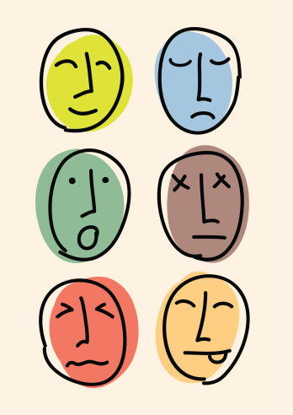
TASK
Give yourself a moment for introspection
  What kind of emotions are you experiencing at the moment?
  How do the emotions affect your cognition?
Engage in conversation with your pair/group

Slide 3
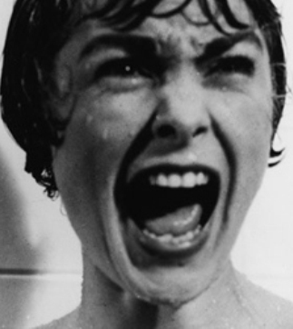
TASK
When was the last time when you had a really strong emotion?
  What was the stimulus?
  What were the physiological changes?
  What was the
  subjective feeling?
  What was the
  associated behaviour?

Slide 4
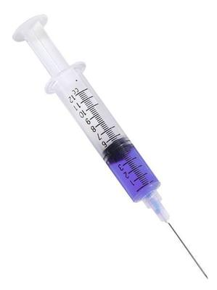
Schacter & Singer adrenaline experiment (1962)
Aim
  To test how cognition influences emotions by using adrenaline

Slide 5
Schacter & Singer adrenaline experiment (1962)
Procedure
184 male college students were divided into four groups. All were participants were told that they were going to be given a vitamin injection Suproxin. In reality, they were given an adrenaline injection (except for the placebo group). | Informed group were told that Suproxin might cause adrenaline like effects | In euphoria condition the confederates tried to amuse the participants
 | Ignorant group were given no information on the effects of Suproxin
 | Misinformed group were told that Suproxin might cause effect other than adrenaline | In anger condition confederates tried to annoy the participants
 | Placebo group were given an injection with no effect and no information
All groups were divided
into both conditions
(independent measures)

Slide 6
Schacter & Singer adrenaline experiment (1962)
Results
  Based on observation and questionnaires
  Informed group showed minimal changes in emotion
  Ignorant and misinformed groups showed significant changes in emotion
  Placebo group showed no changes in emotion

Slide 7

Schacter & Singer adrenaline experiment (1962)
Conclusion
  We label our physiological arousal with cognitive appraisal

Slide 8
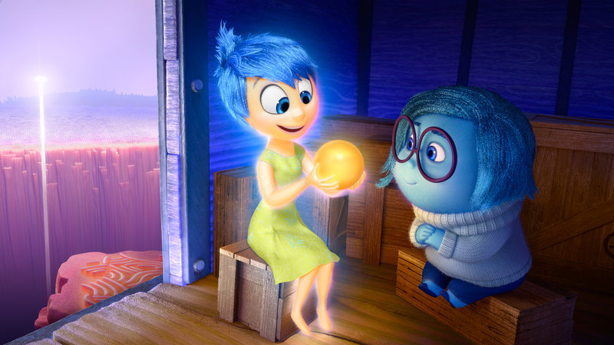
The influence of emotion on cognition
Interaction between emotion and cognition is bidirectional
  Cognition influences emotion through cognitive appraisal
  Emotion influences cognition via flashbulb memory mechanism

Slide 9
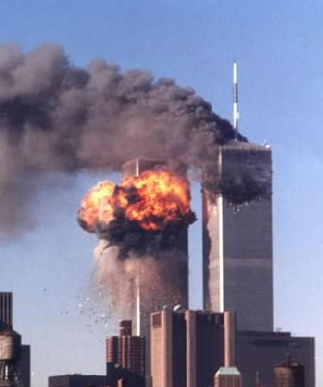
Flashbulb memories
Refer to dramatic and emotionally charged events that etch themselves onto our minds with unusual vividness, accuracy and durability
  Can be associated with shared events or personal traumas

Slide 10
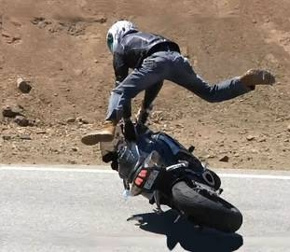
TASK
What kind of flashbulb memories do you have?
  How vividly and accurately can you remember these?
Can you rely on your flashbulb memories?
  Do you really remember emotionally strong events more accurately than other events?

Slide 11
TASK
Answer the following questions based on your previously acquired psychological knowledge:
  How flashbulb memories could be formed? What could be the psychological mechanisms?
  What could be the neural mechanism of flashbulb memories?
  Are flashbulb memories accurate and reliable?

Slide 12
Flashbulb memories
Theory of flashbulb memories (Brown and Kulik, 1977)
Model of formation
Model of maintenance
Event is surprising
Overt
rehearsal
Covert
rehearsal
Event is personally
consequential
Event is emotionally
arousing
Consolidation of
memory traces

Slide 13
TASK
Read pages 183–186 and find the aim, procedure and results of the following studies
  Brown and Kulik (1977): Psychological mechanisms of flashbulb memories
  Sharot et al. (2007): Neural basis of flashbulb memories
  Neisser et al. (1996): Encoding vs. rehearsal in forming flashbulb memories
  Neisser and Harsch (1992): Accuracy and reliability of flashbulb memories

Slide 14
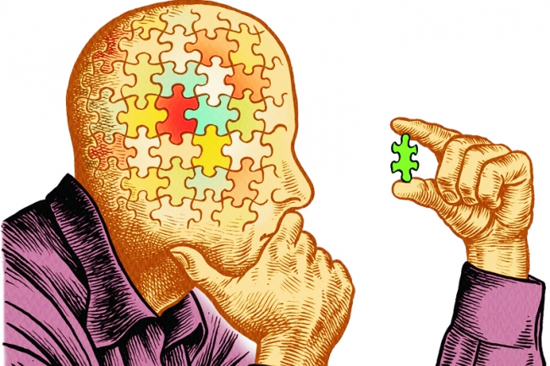
TASK
Critical thinking hub:
  Do TEACUP analysis of the theory of flashbulb memory
  Do MAGEC/GRENADE analysis of each study related to the theory of flashbulb memory
  Aim for holistic approach

Slide 15
TASK
Read the sample responses, both SAQs and ERQ/essays, in peda.net related to emotion and cognition
After reading the responses, pay attention to the examiner’s comments
What were you able to learn from these responses?

Slide 16
Picture sources
Emotional faces <https://datascience.berkeley.edu/sentiment-analysis-symposium-adventures-emotion-recognition/> Accessed 12th of January 2015.
Psycho <http://io9.gizmodo.com/5808083/ten-fear-responses-that-make-no-sense-and-why-we-have-them> Accessed 12th of January 2015.
Happy sunset <http://www.rgbstock.com/bigphoto/n4gg6uG/happy+at+sunset> Accessed 14th of January 2015.
Painted face <http://www.bemotion.fi/#!mielen-salatut-voimat-workshop-1-3/c1t6p> Accessed 14th of January 2015.
Adrenaline syringe <https://www.dreamviews.com/blogs/hyu/adrenaline-59342/> Accessed 5th of March 2018.
Head <http://hosen-shituf.gov.il/he/news> Accessed 5th of March 2018.
Joy and sadness <https://choice.npr.org/index.html?origin=https://www.npr.org/sections/health-shots/2015/06/13/413980258/science-of-sadness-and-joy-inside-out-gets-childhood-emotions-right> Accessed 10th of February 2019.
9/11 <http://www.blucoreshootingcenter.com/blog/tag/911/> Accessed 10th of March 2016.
Motorcycle accident <http://www.break.com/article/motorcycle-accidents-two-wheels-to-the-hospital-2806353> Accessed 10th of March 2016.
Critical thinking puzzle <https://www.chronicle.com/article/Beyond-Critical-Thinking/63288> Accessed 10th of February 2019.

