Slide 1
THINKING, DECISION-MAKING AND THEIR RELIABILITY
IB Psychology LAJM

Slide 2

Thinking and decision-making
Thinking modifies information
  E.g. analysis, synthesis and categorization
  Generates new knowledge

Slide 3
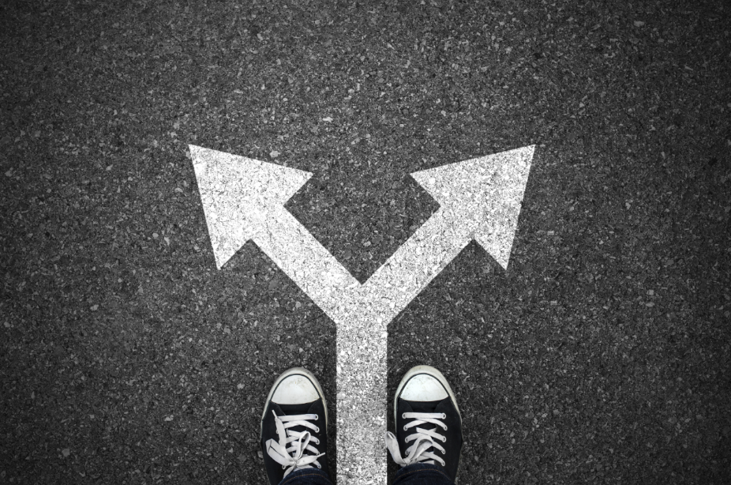
Thinking and decision-making
Decision-making is about making a choice between alternatives
  Before we can choose, we must think about different alternatives

Slide 4
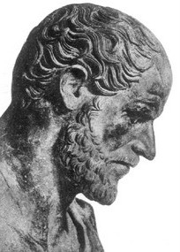
Thinking and decision-making
Normative models
  Describe the way thinking should be
  They assume that unlimited time and resources are available

Slide 5

Thinking and decision-making
Descriptive models
  Show what people actually do when they think
  Can be compared to normative models

Slide 6
Thinking and decision-making
Theory of planned behaviour, TPB
(Ajzen, 1982)
  Aims to explain the relationship between intentions and behaviours in decision-making
  Behavioural intention will lead to a particular behaviour and desired outcome
Behavioural intention is determined by
  Attitude – is the behaviour positive or negative?
  Subjective norm – is the behaviour socially acceptable?
  Perceived behavioural control – am I able to perform the action?

Slide 7
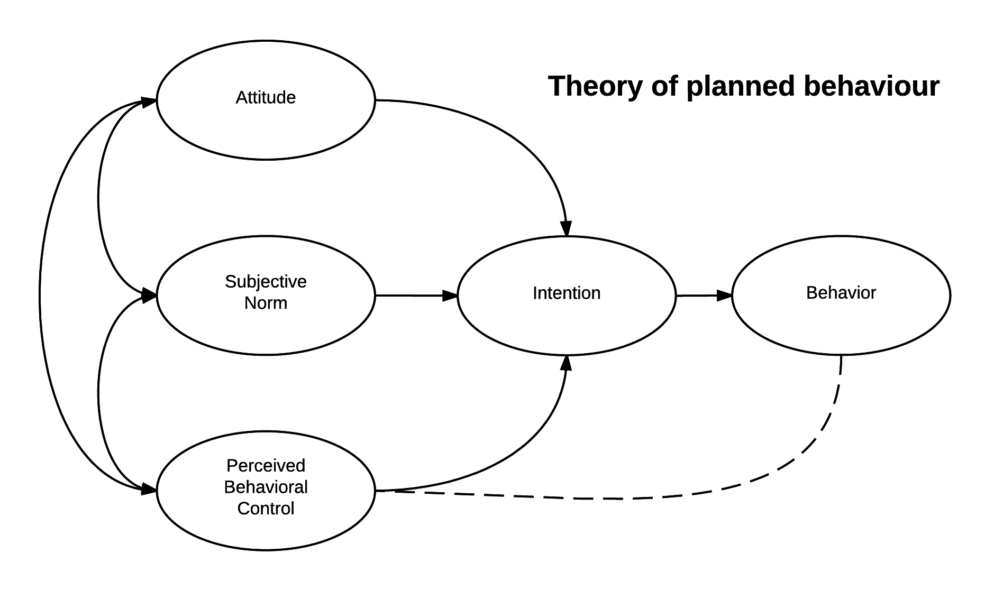
Thinking and decision-making
There should be large
correlations between:
If there are large correlations
between intention and future behaviour
TPB has high predictive validity

Slide 8
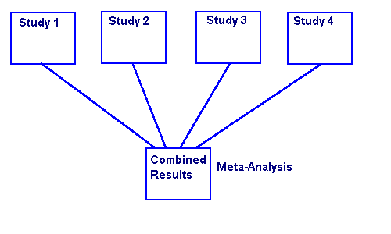
TASK
Study the gist of Albarracin et al (2001) study from page 153 and Godin and Kok (1996) from teacher’s additional materials
Pay close attention to the correlations between:
  Attitudes and intention
  Norms and intentions
  Behavioural control and intention
  Intention and behaviour
META-ANALYSIS IS
A STUDY OF STUDIES

Slide 9
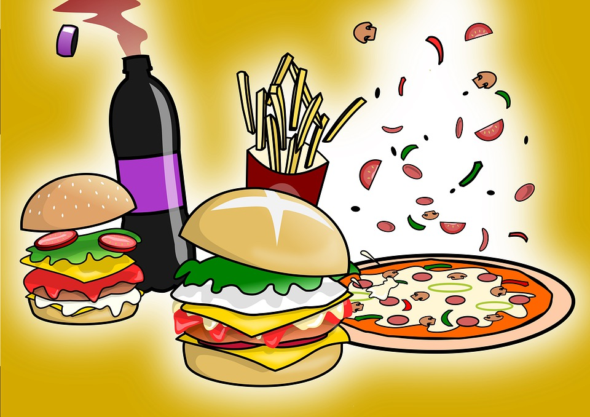
Thinking and decision-making
Dunn et al (2011)
  What are the determinants of fast-food consumption?
  Determinants were derived from TPB
  404 Australians were measured both retrospectively (self-report) and prospectively (diary)

Slide 10
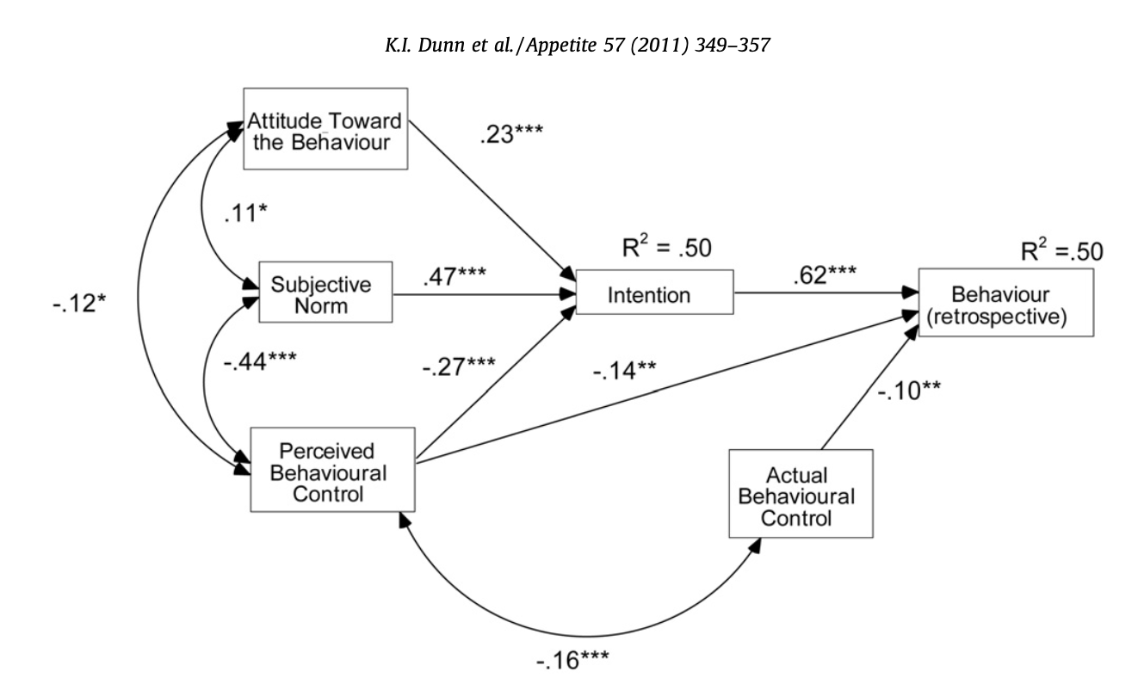
Thinking and decision-making
TPB successfully predicted fast food
consumption, especially for
retrospective behaviour

Slide 11
TASK
Apply the theory of planned behaviour to everyday situations
  Do an intervention programme as a mini-CAS project where the elements of TPB appear
In addition, do a TEACUP analysis of the theory

Slide 12

TASK
You have to bid for the house of your dreams on the right
The selling price is
300 000€
Write your bidding price on a piece of paper!

Slide 13
TASK
You have to bid for the house of your dreams on the right
The selling price is
900 000€
Write your bidding price on a piece of paper!

Slide 14
TASK
Read the following list once
Audrey Hepburn, Charlize Theron, Emma Stone, Robert Pattinson, George Clooney, Cary Grant, Halle Berry, John David Washington, Jennifer Lawrence, Liam Hemsworth, Uma Thurman, Seth MacFarlane, Jane Fonda, Robert Redford
Were there more females or males in the list?

Slide 15
TASK
Alan:
  intelligent
  industrious
  impulsive
  critical
  stubborn
  envious
Ben:
  envious
  stubborn
  critical
  impulsive
  industrious
  intelligent

Slide 16
TASK
WHICH ONE DID YOU VIEW MORE FAVOURABLE? ALAN OR BEN?
Alan:
  intelligent
  industrious
  impulsive
  critical
  stubborn
  envious
Ben:
  envious
  stubborn
  critical
  impulsive
  industrious
  intelligent
LOOK AGAIN!

Slide 17
TASK
Linda is a 31 years old, single, outspoken, and very bright. She majored in Philosophy. As a student, she was deeply concerned with issues of discrimination and social justice, and also participated in antinuclear demonstrations
Which alternative is more probable?
  (a) Linda is a bank teller
  (b) Linda is a bank teller and is active in the feminist movement

Slide 18
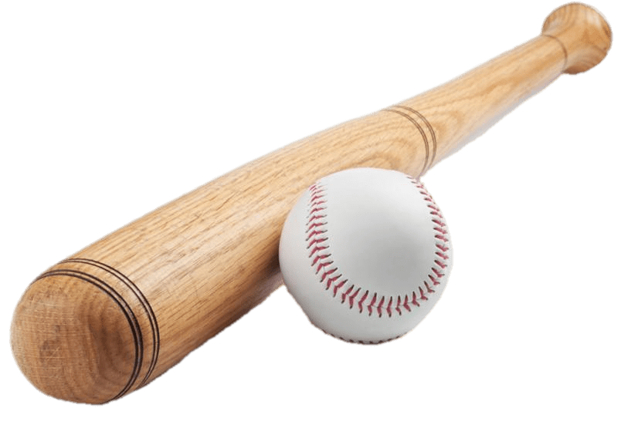
TASK
A bat and ball cost $1.10
The bat costs one dollar more than the ball
How much does the ball cost?

Slide 19
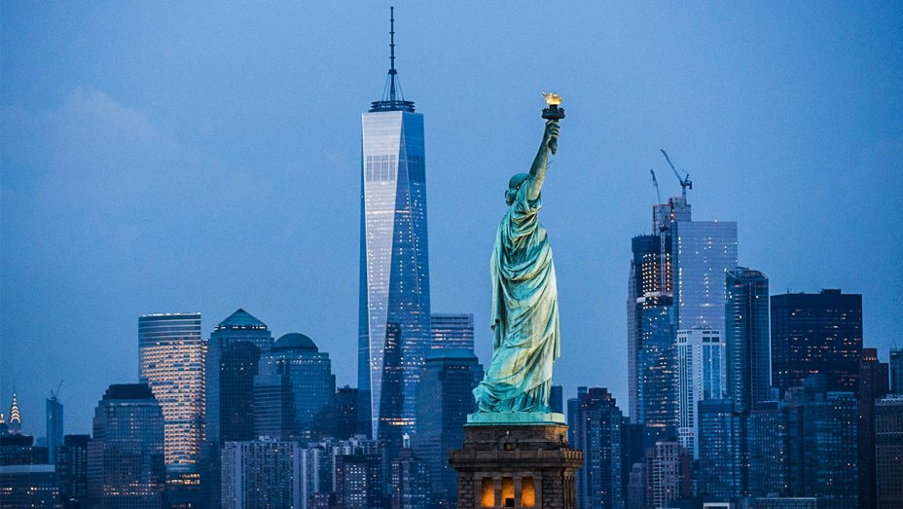
TASK
Read the following story:
  After spending a day exploring beautiful sights in the crowded streets of New York, Jane discovered that her wallet was missing

Slide 20
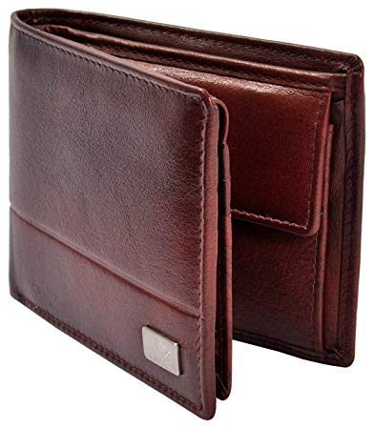
TASK
What happened to Jane’s wallet?
  Write down your answer using a single word
  Share your answer

Slide 21
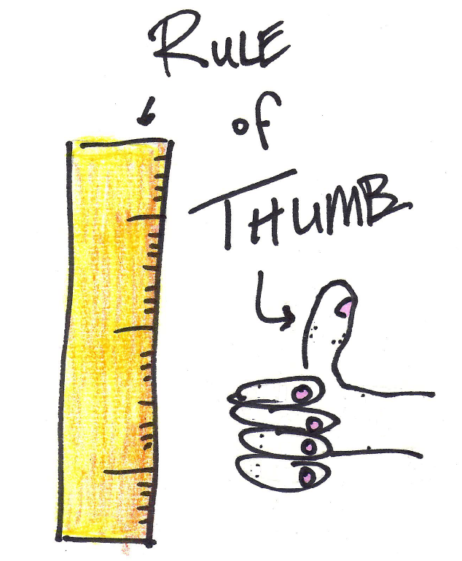
Biases in thinking and decision-making
Heuristics
  Shortcuts in thinking and decision-making that people take when there is no time or resources to analyse the situation thoroughly

Slide 22
Biases in thinking and decision-making
Anchoring
  Tendency to anchor our thinking and decision-making to the information we initially get
Representativeness
  Tendency to choose things that feel probable through representa-tiveness
Availability
  Tendency to rely too strongly on information that is readily available

Slide 23
Biases in thinking and decision-making
Englich and Mussweiller (2001)
  What role does anchoring play in determining sentences in courtrooms?
  44 German senior law students were given a scenario of a rape case with either a 34-month sentence (condition 1) or a 2-month sentence (condition 2)
  Participants in the condition 1 recommended on average eight months longer in prison than in condition 2 – for the same crime

Slide 24
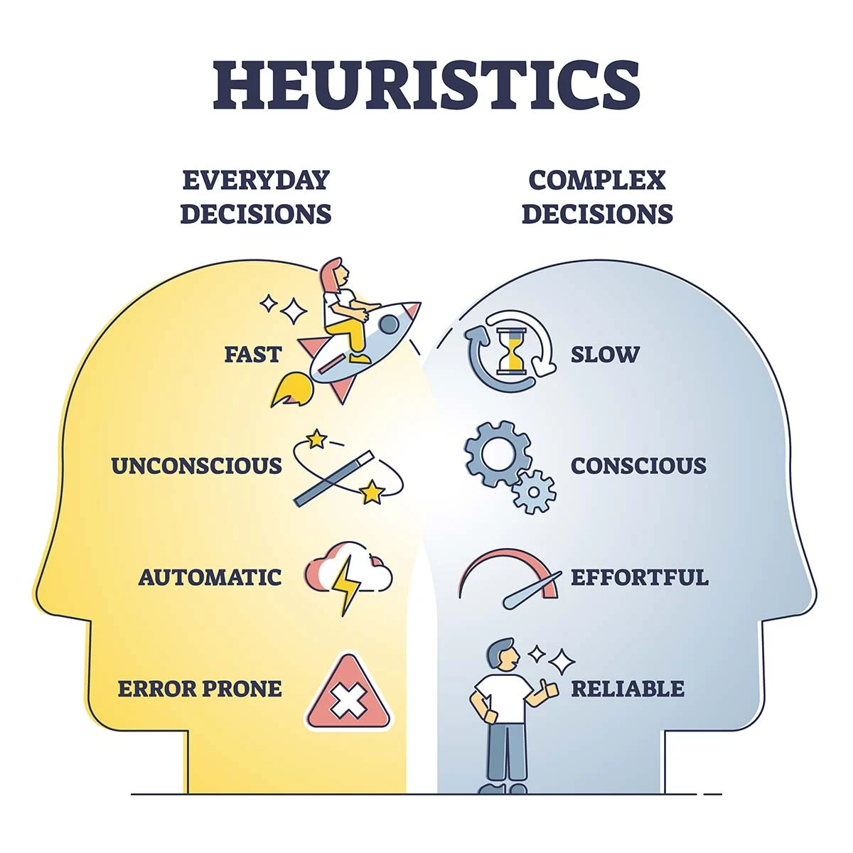
TASK
Watch this educational video on heuristics and biases in thinking and decision-making

Slide 25
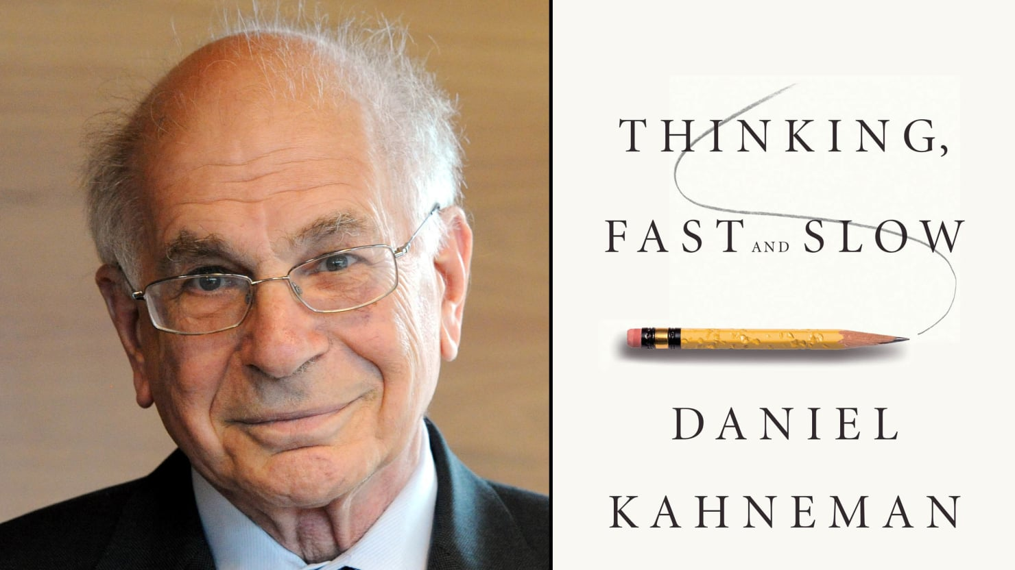
Biases in thinking and decision-making
Daniel Kahneman (2011): Thinking, Fast And Slow
  Humans have two independent cognitive systems that operate sequentially
  The Dual Process Model

Slide 26
Biases in thinking and decision-making
System 1
  Operates automatically and quickly, with little or no effort and no sense of voluntary control
  Thinking is fast, intuitive and unconscious
  Cognitive ease
System 2
  Allocates resources to the effortful mental activities that demand concentration
  Thinking is slow, analytical and conscious
  Cognitive strain

Slide 27
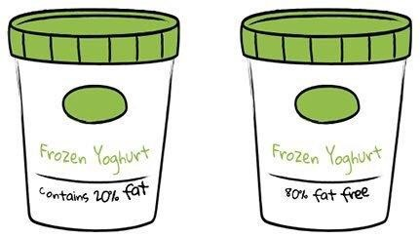
Biases in thinking and decision-making
Framing effect
  Drawing different conclusions from the same information, depending on how that information is presented
  Is the problem formulated in terms of gains or losses?

Slide 28
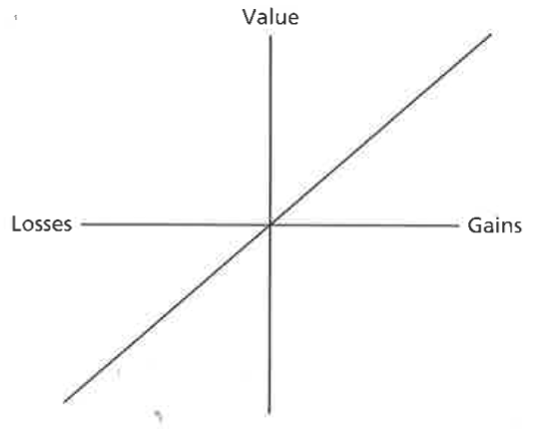
Biases in thinking and decision-making
Expected utility theory
  Normative model of choice
  One should multiply the utility of an outcome by the probability of that outcome, and choose the outcome that yields the highest number

Slide 29
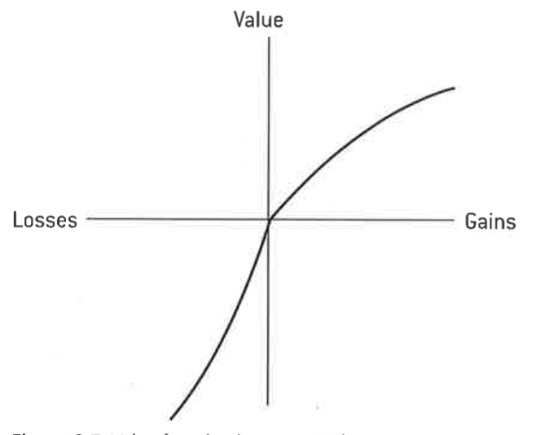
Biases in thinking and decision-making
Prospect theory
  Descriptive model of decision-making under risk
  Shift in the reference point causes changes in decision-making
  Potential gains cause risk aversion
  Potential losses cause more risk taking

Slide 30
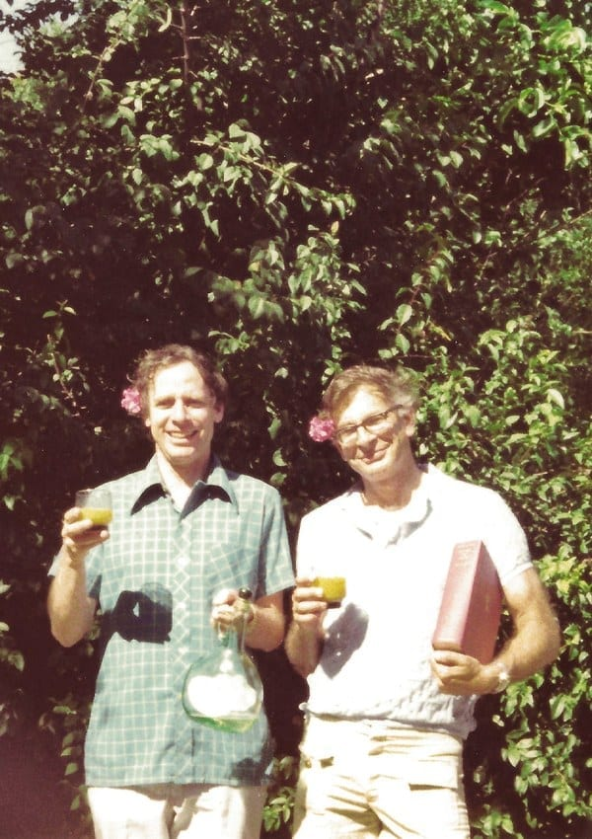
TASK
Read pages 172–173
What were the aim, procedure and results of Tversky and Kahneman (1981) study?
  What kind of evidence does this study provide for framing effect and prospect theory?

Slide 31

TASK
Read the Keysar et al (2012) study
Effectively summarize the aim, procedure and results of the study in your own words
  How does foreign language influence framing effect?

Slide 32
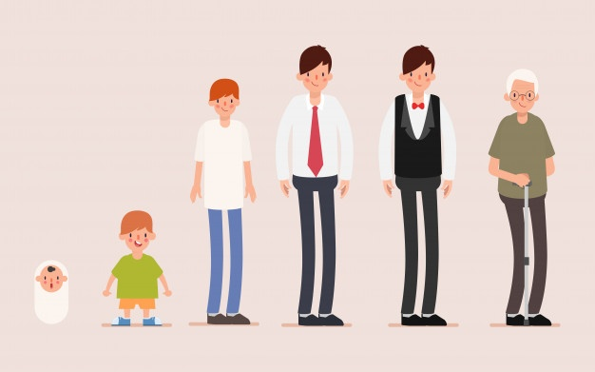
Biases in thinking and decision-making
Strough et al (2011)
  Does the susceptibility to framing effect change during lifespan?
  Meta-analysis of framing effect studies
  Framing effect stays relatively stable across lifespan

Slide 33
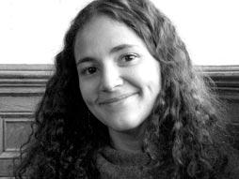
TASK
Watch Laurie Santos TED-talk “A monkey economy is as irrational as ours”

Slide 34
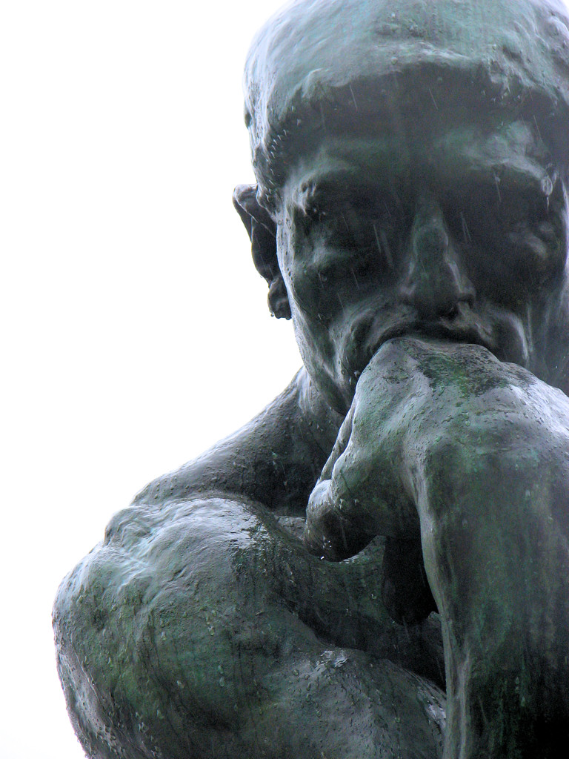
TASK
Is human thinking and decision-making reliable?
  On what basis they are?
  On what basis they are not?
  Can you trust your abilities in thinking and decision-making?

Slide 35
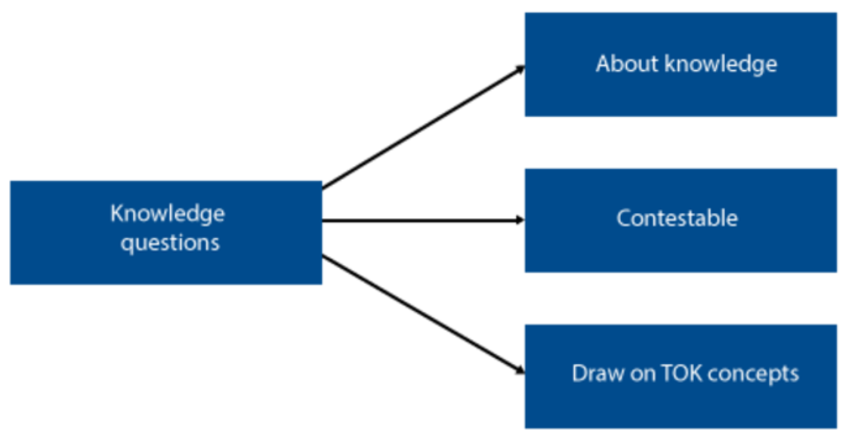
TOK-LINK
How do the following KQs relate to the contents we just covered?
  Is bias inevitable in the production of knowledge?
  What role do experts play in influencing our consumption or acquisition of knowledge?
DISCUSS AND EXPLORE THESE KNOWLEDGE QUESTIONS

Slide 36
TASK
Read the sample responses, both SAQs and ERQ/essays, in peda.net concerning thinking and decision-making and biases in thinking and decision-making
After reading the responses, pay attention to the examiner’s comments
What were you able to learn from these responses?

Slide 37
Sources
Kahneman, D. (2011). Thinking, Fast And Slow. Great Britain: Penguin Books.
Popov, A., Parker, L. & Seath, D. (2017). Psychology Course Companion (2nd Edition). Oxford: Oxford University Press.

Slide 38
Picture sources
Thinking emoji <https://emojiisland.com/products/thinking-face-emoji-icon> Accessed 11th of November 2018.
Decision <http://sourcesofinsight.com/tony-robbins-makes-decisions/> Accessed 11th of November 2018.
Aristotle <http://sourcesofinsight.com/tony-robbins-makes-decisions/> Accessed 11th of November 2018.
Shopping <https://www.edenred.at/einloesestellen/einloesestellen-ticket-compliments/> Accessed 11th of November 2018.
Meta-analysis <http://library.downstate.edu/EBM2/2700.htm> Accessed 19th of February 2018.
Theory of planned behaviour (TPB) <https://en.wikipedia.org/wiki/Theory_of_planned_behavior> Accessed 28th of August 2019.
Fast food <https://pixabay.com/fi/illustrations/fast-food-juhla-virvoitusjuoma-4683707/> Accessed 11th of November 2020.
Rule of thumb <http://daysgoneby.me/dyk-rule-thumb/> Accessed 19th of February 2018.
Dream house <https://www.archdaily.com/217544/travertine-dream-house-wallflower-architecture-design> Accessed 10th of November 2020.
Bat and ball <https://www.stickpng.com/img/sports/baseball/gear/baseball-bat--ball> Accessed 30th of August 2019.
New York <https://www.hollywoodreporter.com/news/netflix-launch-new-york-city-production-hub-1203045> Accessed 30th of August 2019.
Wallet <https://www.amazon.in/AM-LEATHER-Brown-Mens-Wallet/dp/B01JRZX4PG> Accessed 30th of August 2019.
Heuristics <https://www.simplypsychology.org/what-is-a-heuristic.html> Accessed 20th of November 2024.
Daniel Kahneman <https://www.thedailybeast.com/daniel-kahnemans-gripe-with-behavioral-economics> Accessed 19th of February 2018.
Framing effect <https://medium.com/@mohit.rajkumar/management-lesson-from-parenting-the-framing-effect-ae334ec7d8ab> Accessed 16th of November 2020.
Tversky and Kahneman <https://www.sunoresearch.com.br/tudo-sobre/amos-tversky/> Accessed 17th of November 2020.
Foreign language <https://www.worcs.tgacademy.org.uk/subjects/mfl/> Accessed 17th of November 2020.
Lifespan <https://www.freepik.com/free-photos-vectors/lifespan> Accessed 17th of November 2020.
Laurie Santos <https://www.ted.com/speakers/laurie_santos> Accessed 19th of February 2018.
Rodin’s thinker <https://commons.wikimedia.org/wiki/File:The_Thinker_Musee_Rodin.jpg> Accessed 19th of February 2018.

