Slide 1
THE ROLE OF ANIMAL RESEARCH
IN UNDERSTANDING
HUMAN BEHAVIOUR
IB Psychology LAJM

Slide 2
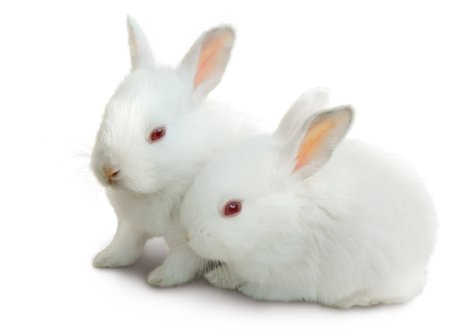
TASK
What kind of arguments can we have for and against the use of test animals in psychology?
How should test animals be treated in psychological research?
DEBATE!

Slide 3
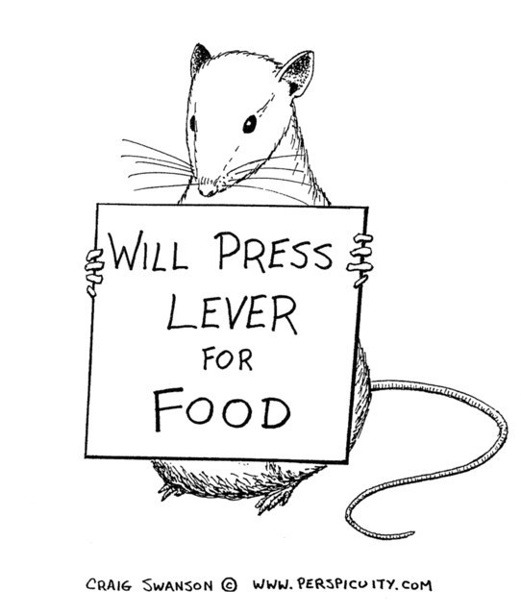
Reasons for animal research
(1) The underlying mechanisms of behaviour are similar across species and sometimes easier to study in nonhuman species

Slide 4
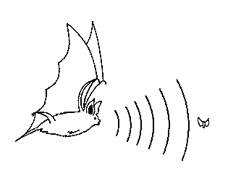
Reasons for animal research
(2) We are interested in animals for their own sake

Slide 5
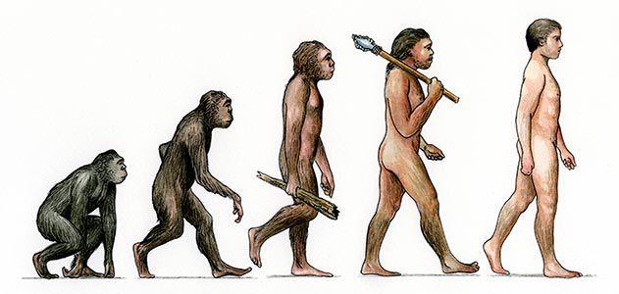
Reasons for animal research
(3) What we learn about animals shed light on human evolution

Slide 6
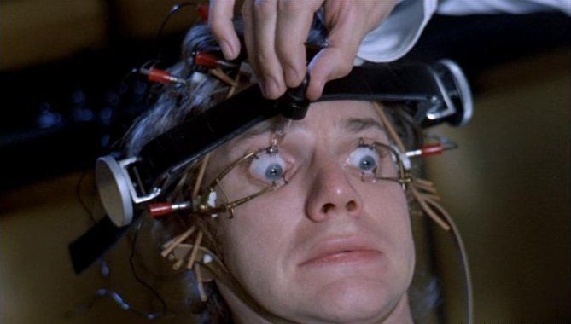
Reasons for animal research
(4) Legal or ethical restrictions prevent certain kinds of research on humans

Slide 7
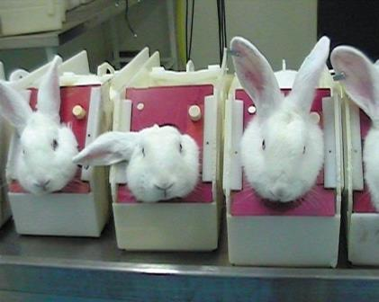
Ethical considerations
Central questions:
  If research is unethical with humans, is it acceptable with nonhumans?
  If so, under what circumstances?

Slide 8
Opposition to animal research
Minimalists
Abolitionists
Tolerate some forms of animal research but prohibit others depending on the value of the research
Three Rs: reduction, replacement and refinement
All animal have same rights as humans;
there is no room for compromise
Advancement of science doesn’t matter

Slide 9
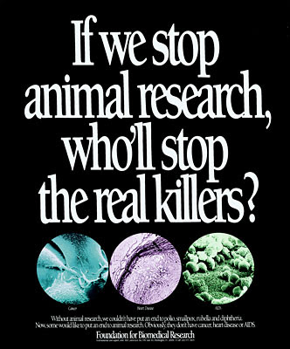

HOW CAN YOU ANALYSE THESE POSTERS
FROM ETHICAL PERSPECTIVE?

Slide 10

TASK
Read the APA guidelines for ethical conduct in the care and use of nonhuman animals
  Summarize the main points
Do the guidelines form a solid base for ethical treatment of research animals?

Slide 11
TASK
Do the following thought experiment
  Imagine you see a small van with 500 mice in it rolling towards a cliff
  There is no driver
  in the van
  In its way there is a stroller with a human baby in it
There are two possible outcomes
  You push the stroller away and let the van roll slowly off the cliff killing all the mice
  You do nothing and the stroller prevents the van from going over the cliff, but this kills the baby
WHAT DO YOU DO?

Slide 12
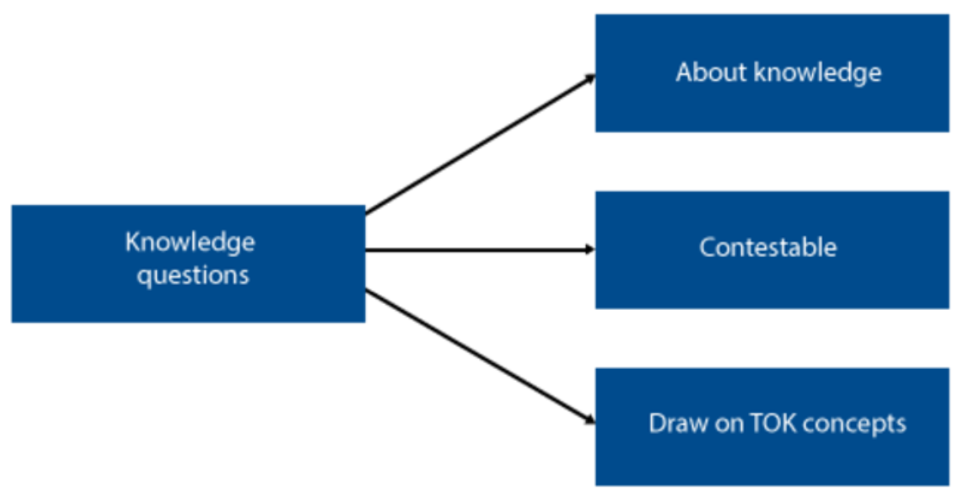
TOK-LINK
How do the following KQs relate to the contents we just covered?
  Should the pursuit of knowledge be subject
  to ethical constraints?
  Do scientist or the societies in which scientist operate exert a greater influence
  on what is ethically acceptable?
DISCUSS AND EXPLORE THESE KNOWLEDGE QUESTIONS

Slide 13
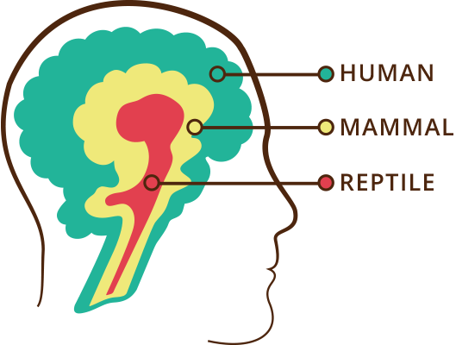
TASK
Read pages 116–118 and complete the teacher’s handout on the value of animal models
TRIUNE BRAIN

Slide 14
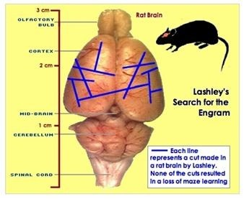

Review: examples of animal research
Lashley (1950s)

Slide 15
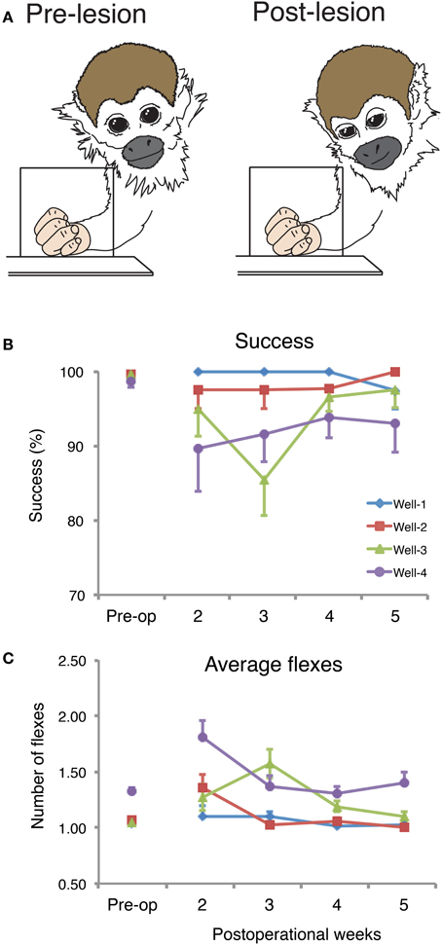
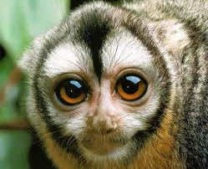
Review: examples of animal research
Merzenich et al. (1984)

Slide 16
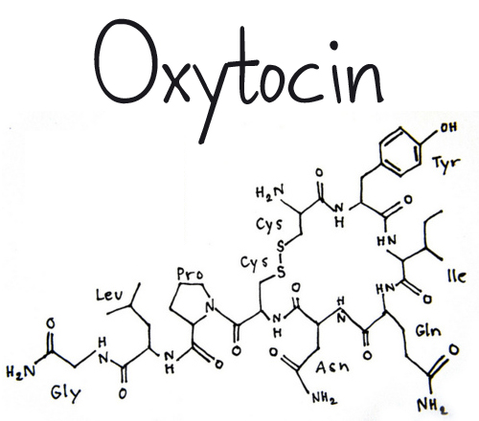
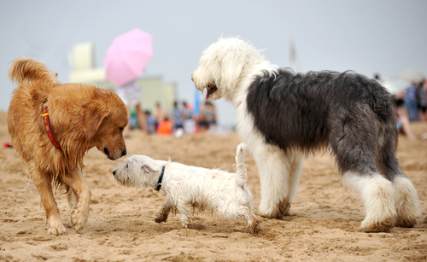
Review: examples of animal research
Romero et al. (2014)

Slide 17
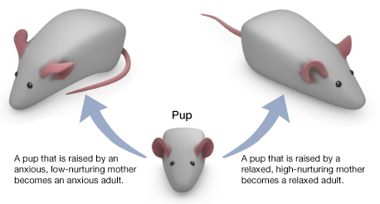
Review: examples of animal research
Weaver et al. (2004)

Slide 18
GROUP PROJECT
Form five groups
Each group is given one psychological study that used animals
Each group compiles a small presentation, presents it and uploads it to ManageBac
  Remember to mark your sources
Describe and evaluate the study
  What were the aims, procedure and results of the study?
  How were the animals treated?
  Did the study provide any insight into human behaviour?
  (Animal models)

Slide 19
GROUP PROJECT
GROUP 1: Harlow’s (1958) studies with monkeys (attachment)
GROUP 2: Seligman’s (1967) study with dogs (learned helplessness)
GROUP 3: Held & Hein’s (1963) study with kittens (perceptual-motor coordination)
GROUP 4: Köhler’s (1920s) studies with chimpanzees (learning)
GROUP 5: Gardner & Gardner’s (1972) study with chimpanzees (language acquisition)

Slide 20
TASK
Read the sample response to the question ”Discuss the value of animal models in the study of the brain and behaviour”
After reading the response, pay attention to the examiner’s comments
How could this response be improved?
  Make amendments

Slide 21

TASK
Review all topics and contents from biological approach to understanding behaviour
What kind of Paper 1 questions could be created based on the HL extension?

Slide 22
TASK
Parts of biological approach to behaviour | a. The relationship between the brain and behaviour | b. Hormones and pheromones and their effects on behaviour | c. The relationship between genetics and behaviour
1. The value of animal models in research to provide insight into human behaviour | 1a | 1b | 1c
2. Ethical considerations in animal research | 2a | 2b | 2c

Slide 23
Past questions
Discuss how animal research may provide insight into human behaviour (M19 TZ1)
Discuss two or more ethical considerations in animal research when investigating the brain and behaviour (M19 TZ2)
With reference to research investigating the brain, discuss the role of animal research in understanding human behaviour (N20)
Evaluate one or more studies that use an animal model to investigate the relationship between genetics and behaviour (N21)
How would you answer these essay questions?
Create sketch responses
Compare your ideas to the markschemes

Slide 24
Sources
Crane, J. & Hannibal, J. (2009). Psychology Course Companion. Oxford: Oxford University Press.
Gray, P. & Bjorklund, D. (2014). Psychology (7th edition). New York: Worth Publishers.
Kalat, J. (2016). Biological Psychology (12th Ed.). North Carolina State University: Cengage Learning.
Popov, A., Parker, L. & Seath, D. (2017). IB Psychology Course Companion (2nd ed.). Oxford: Oxford University Press.

Slide 25
Picture sources
Test animals <https://www.crueltyfreeinternational.org/DrugTesting> Accessed 26th of September 2017.
Test rat <http://www.fanpop.com/clubs/psychology/images/1361799/title/skinner-rat-fanart> Accessed 5th of January 2018.
Bat’s echolocation <http://web2.karsteducation.org/BatEchoes.htm> Accessed 5th of January 2018.
Human evolution <https://www.smithsonianmag.com/science-nature/the-top-ten-daily-consequences-of-having-evolved-72743121/> Accessed 5th of January 2018.
Clockwork-orange <https://meatyveganblog.wordpress.com/2013/10/16/breakingnews-actual-humans-now-used-for-human-product-testing-vegan-govegan-epa-cdc-eieio/> Accessed 5th of January 2018.
Test bunnies <https://www.crueltyfreeinternational.org/why-we-do-it/what-animal-testing> Accessed 5th of January 2018.
Animal research poster 1 <https://fi.pinterest.com/pin/92464598570208341/> Accessed 2nd of January 2018.
Animal research poster 2 <https://research4drugdiscovery.blogspot.fi/2012/10/> Accessed 5th of January 2018.
Knowledge questions <https://tok-a-journey.wikispaces.com/Knowledge+Questions> Accessed 25th of September 2017.
APA logo <https://www.ariessys.com/views-press/press-releases/the-american-psychological-association-to-deploy-editorial-manager-for-70-journals/> Accessed 2nd of January 2018.
Triune brain <http://pureaffair.com/triune-brain/> Accessed 5th of January 2018.
Lashley maze <https://mazeengineers.com/portfolio/lashley-iii/> Accessed 5th of January 2018.
Lashely cuts <https://www.quora.com/What-percentage-of-his-brain-did-Einstein-use> Accessed 5th of January 2018.
Owl monkey <https://soa111.wordpress.com/2011/02/08/owl-monkey-fact-sheet/> Accessed 5th of January 2018.
Merzenich et al. <https://www.frontiersin.org/articles/10.3389/fnsys.2014.00084/full> Accessed 5th of January 2018.
Oxytocin <http://brighterbrains.org/hub/product/oxytocin/> Accessed 5th of January 2018.
Dogs <https://nextgendog.com/study-suggests-that-dogs-use-oxytocin-for-bonding/> Accessed 5th of January 2018.
Weaver rats <http://sites.bu.edu/ombs/2010/11/11/licking-rat-pups-the-genetics-of-nurture/> Accessed 5th of January 2018.
Review <http://ajslp.pubs.asha.org/article.aspx?articleid=2204333> Accessed 22nd of November 2017.

