Slide 1
HORMONES AND PHEROMONES AND THEIR EFFECTS ON BEHAVIOUR
IB Psychology LAJM

Slide 2
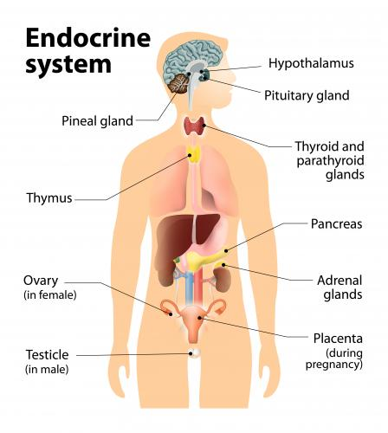
Hormones
Chemicals that are produced by the glands that make up the endocrine system

Slide 3
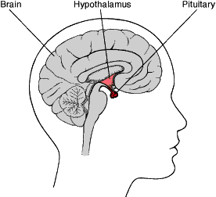
Hormones
Hypothalamus regulates the pituitary gland
Pituitary gland secretes hormones that regulate the endocrine system

Slide 4
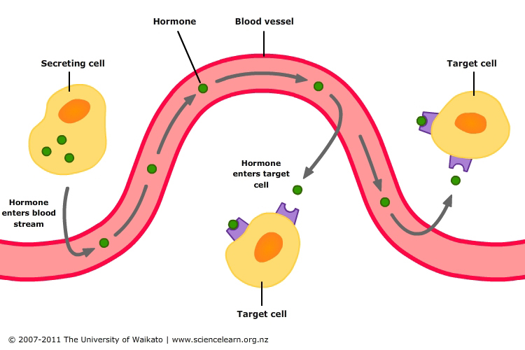
Hormones
Are secreted by the endocrine system into the bloodstream
Are carried by the blood to all parts of the body
Act on specific target cells based on the lock-and-key action

Slide 5
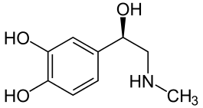
Hormones
Hormones influence slower than neurotransmitters, but the effect lasts longer
Same chemical can be either a hormone or a neurotransmitter depending on where the chemical is in the body

Slide 6
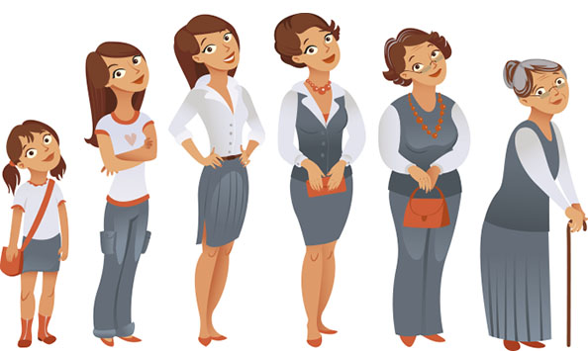
Hormones
Main effects of hormones:
Physical growth and maturation
Metabolic processes
Stress and activation level
Sexual maturation and arousal
Mood and attention

Slide 7
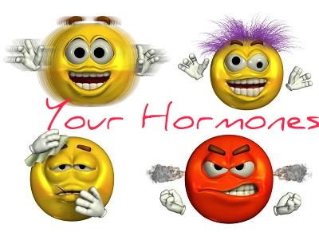
TASK
Form 5 groups
Co-operative learning
Each group is given one study on the behavioural effects of oxytocin
Groups study the studies and think ways how to teach the study to others
In the end, groups are mixed and everyone teaches each other

Slide 8

EXTRA TASK
Watch Paul Zak’s TED-talk ”Trust, morality – and oxytocin?”
What kind of criticism can be presented towards Zak’s arguments?

Slide 9
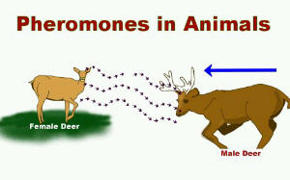
Pheromones
Are chemicals released by animals
Act on other members of the species to promote some response

Slide 10
TASK
Read pages 88–93 (+ find information from the internet if you have time)
Do humans produce pheromones and communicate by pheromones?
Find evidence for and against on the effects of the pheromones in humans!
Concentrate on the human sex pheromone
Prepare yourself for a debate!

Slide 11

TASK
DEBATE!
”Pheromones influence
human behaviour”

Slide 12
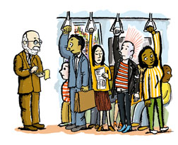
RESEARCH: Types of experiments
Laboratory experiment
Conducted in highly controlled, artificial conditions
E.g. Lundstrom and Olsson (2005)
Field experiment
Conducted in real-life setting
E.g. Cutler, Friedman and McCoy (1998)

Slide 13
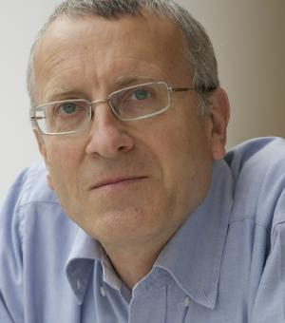
EXTRA TASK
Watch Tristram Wyatt TED-Talk ”The smelly mystery of the human pheromone”
Write down the arguments that are new to you

Slide 14
TASK
Read the sample responses, both SAQs and ERQ/essays, in peda.net concerning hormones and pheromones
Pay attention to the examiner’s comments!
What were you able to learn from these responses?

Slide 15
Sources
Bjorklund, D. & Gray, P. (2014). Psychology (7th edition). New York: Worth Publishers.
Crane, J. & Hannibal, J. (2009). Psychology Course Companion. Oxford: Oxford University Press.
Parker, L., Popov, A. & Seath, d. (2017). IB Psychology Course Book. Oxford: Oxford University Press.

Slide 16
Picture sources
Endoctrine system <https://www.thinglink.com/scene/855137537176371200> Accessed 9th of November 2017.
Brain <http://www.cushings-help.com/pituitary.htm> Accessed 2nd of December 2015.
Hormones in bloodstream <https://www.sciencelearn.org.nz/resources/1836-hormonal-control-of-digestion> Accessed 9th of November 2017.
Woman’s life-cycle <http://www.omaplus.fi/?s=artikkelit&p=108> Accessed 2nd of December 2015.
Adrenalin <https://fi.wikipedia.org/wiki/Adrenaliini> Accessed 2nd of December 2015.
Your hormones <http://www.aloewellnessdc.com/2014/10/16/hormone-testing-for-wellness/> Accessed 2nd of December 2015.
Paul Zak <https://en.wikipedia.org/wiki/Paul_J._Zak> Accessed 15th of September 2018.
Pheromones in animals <https://kennyspuathoughts.com/2013/05/17/why-women-are-attracted-to-sweaty-men-smells-scents-sweats-deodorants-pheromones-hormones-and-chemical-attraction/> Accessed 9th of November 2017.
Debate <http://themedinamite.com/tag/debate/> Accessed 3rd of March 2017
People in train <http://www.slate.com/articles/life/transport/2009/11/underground_psychology.html> Accessed 18th of August 2017.
Tristram Wyatt <https://www.zoo.ox.ac.uk/people/dr-tristram-wyatt> Accessed 26th of September 2018.

