Slide 1
THE BRAIN AND BEHAVIOUR
IB Psychology LAJM

Slide 2
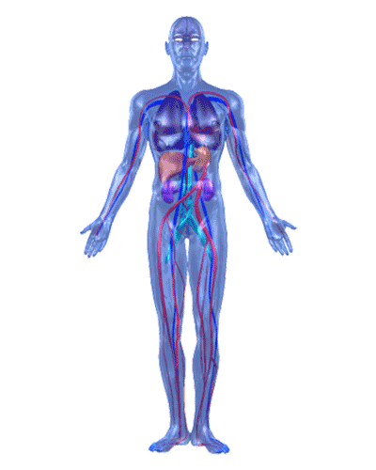
TASK
To what extent is our behaviour the result of physiological processes happening in our bodies?
What other factors should we take into consideration?

Slide 3
PHYSIOLOGY
BIDIRECTIONAL RELATIONSHIPS
SOCIAL/CULTURAL ENVIRONMENT
MENTAL
PROCESSES
WHICH FACTOR AFFECTING HUMAN BEHAVIOUR
IS THE MOST INFLUENTAL ONE?

Slide 4

Nature vs. nurture debate
Is the human behaviour the result of biological or environmental factors?
Interactionist approach
Biology and environment influence each other reciprocally

Slide 5
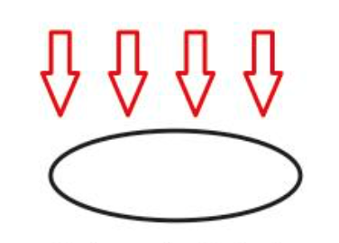
Holism
An attempt to explain human behaviour in all its complexity
All factors need to be taken into consideration
WHAT PROBLEMS ARISE?

Slide 6
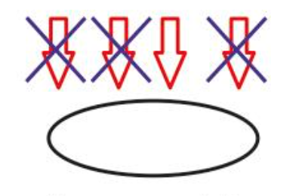
Reductionism
(1) An attempt to reduce the factors influencing human behaviour
(2) An attempt to reduce complex higher level phenomena into more simple lower level phenomena

Slide 7
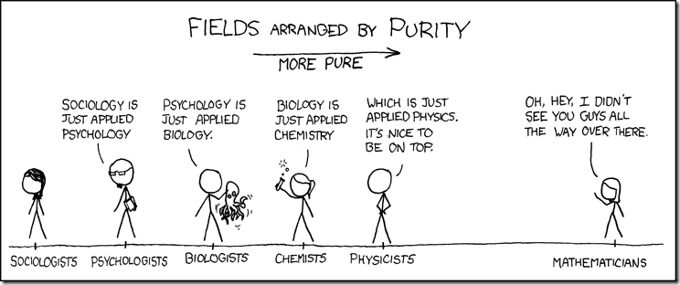
Reductionism
IS EVERYTHING JUST APPLIED PHYSICS?
OR SOMETHING ELSE?

Slide 8
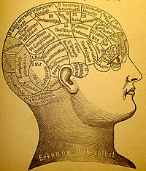
TASK
To what extent are holistic and reductionistic explanations of human behaviour valid?
Provide opposing and supporting arguments for both holism and reductionism

Slide 9

TASK
How does your mind exist?
How is your mind different from your body?
What is the relationship between your body and mind?

Slide 10

Mind–body problem
What is the relationship between matter and mind?

Slide 11
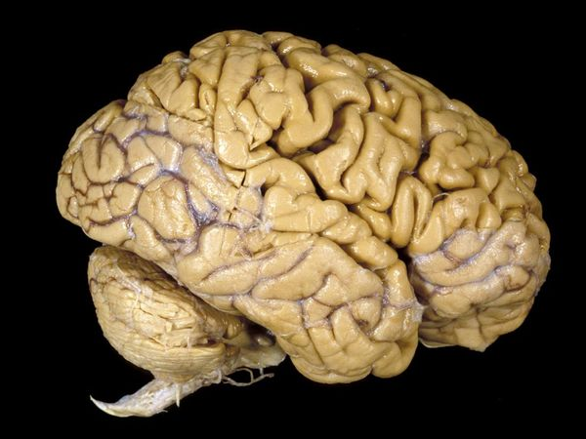
Materialism
The mind is just an abstract level of description of the physiological functions of the brain
The mind is not separate from the brain

Slide 12
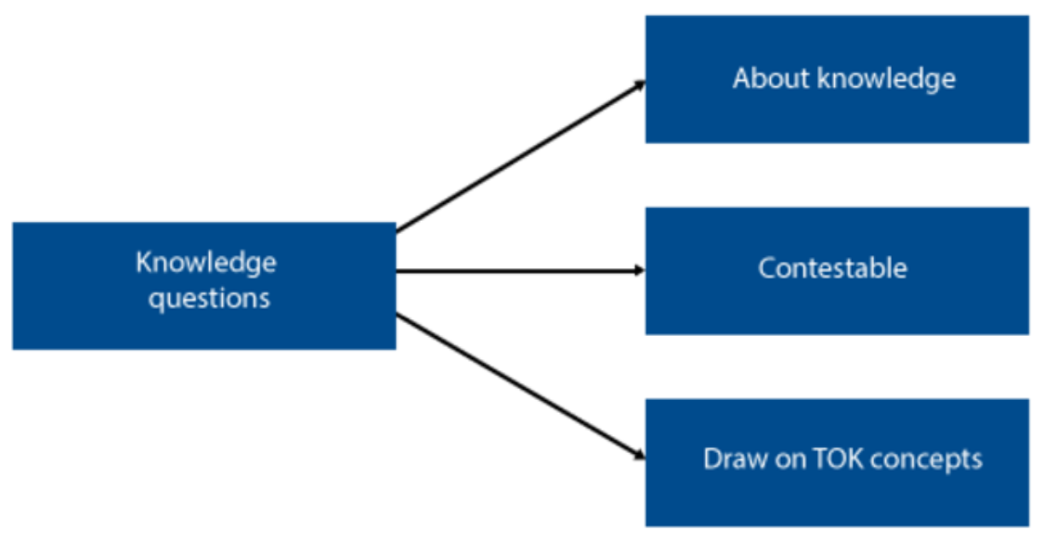
TOK-LINK
How do the following KQs relate to the contents we just covered?
Are some things unknowable?
What makes a good explanation?
What counts as a good justification for a claim?
DISCUSS AND EXPLORE THESE KNOWLEDGE QUESTIONS

Slide 13
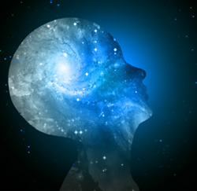
TASK
Do the “mind trip” with teacher’s instructions

Slide 14
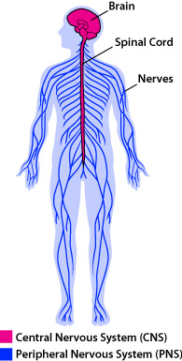
Neuron
Neuron = nerve cell
Neuron ≠ nerve
Our nervous system consists of circa 86–100 billion neurons (estimates vary)

Slide 15

TASK
Draw a neuron with the help of the teacher

Slide 16
TASK
Read the teacher’s handout
What are the functions of neuron’s parts?
Write the functions down on your drawing of a neuron
Find out what sensory neurons, motor neurons and interneurons are
What are the main functions of these types of neurons?
Where can we find these neurons?

Slide 17
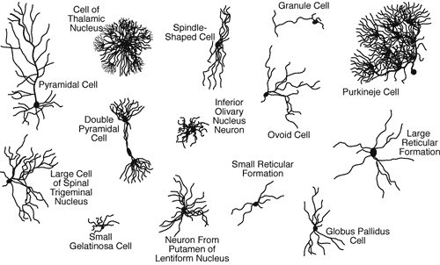
Neuron

Slide 18
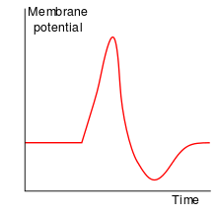
Action potential
Nerve impulse, a function unique to nerve cells
Information within a neuron is conveyed electrically in the form of action potentials

Slide 19
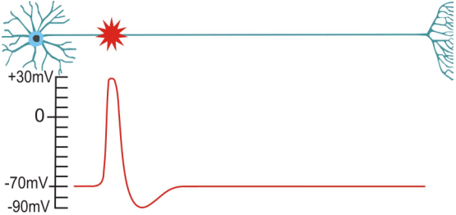
Action potential

Slide 20
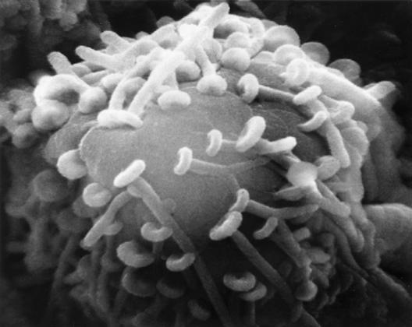
Synaptic transmission
Synapse is a junction between the axon terminal and the receiving neuron
Information between neurons is conveyed chemically through synapses

Slide 21
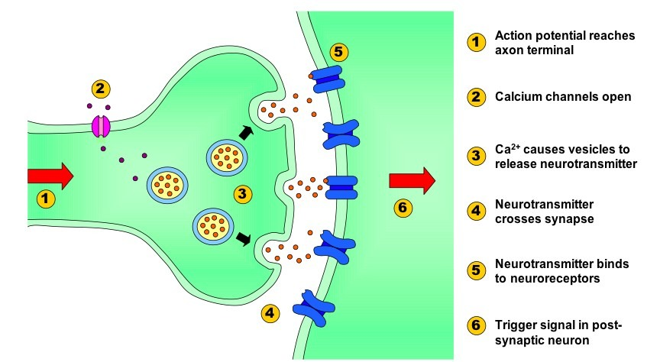
Synaptic transmission

Slide 22
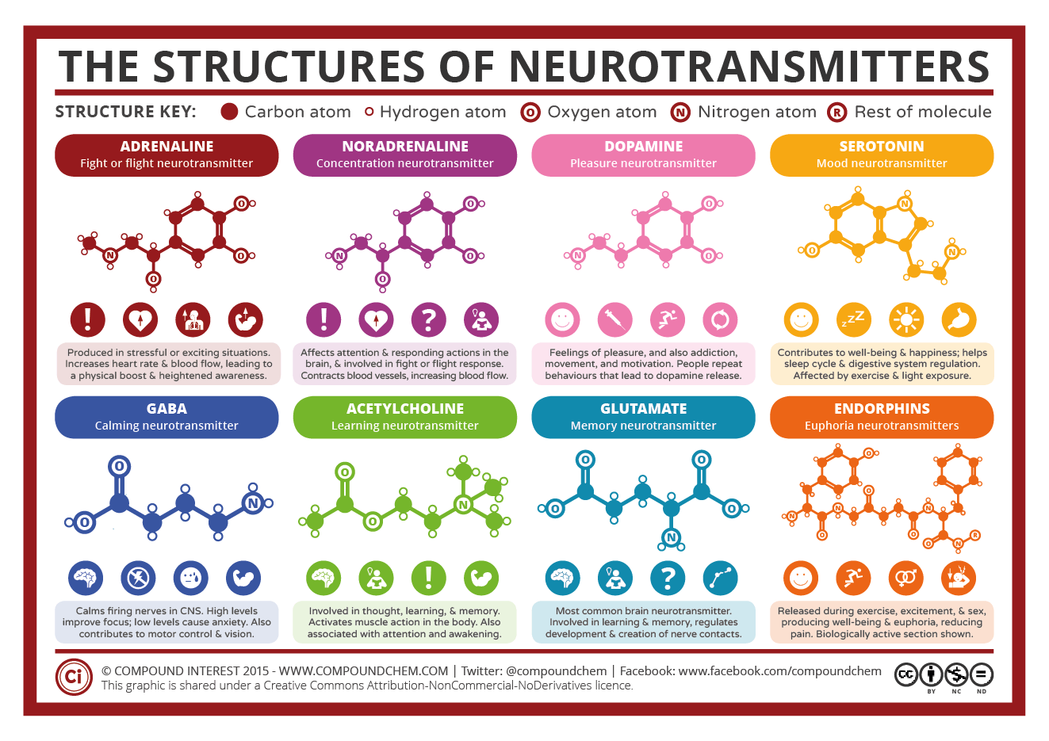
Adrenaline and noradrenaline are more hormones than neurotransmitters, but they can act like neurotransmitters
Same applies for endorphins

Slide 23
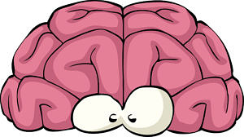
TASK
Watch the AsapSCIENCE video on common myths about the brain

Slide 24
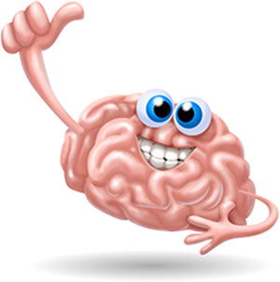
TASK
Read the paragraph ”Brain structure” from pages 47-48
Explain to yourself the structure of the brain, brain parts and their functions in your own words
Draw pictures and charts

Slide 25
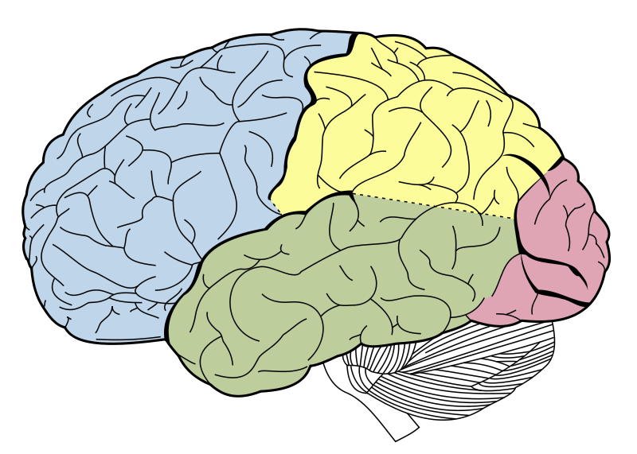
Brain research
Maps brain structures and localizes brain functions

Slide 26
Brain imaging technologies
Temporal resolution
How precise is the technology with respect to time?
Spatial resolution
How accurately the technology maps the brain?
Invasiveness
To what extent does the technology affect the normal functioning of the body?

Slide 27
GROUP PROJECT
Form 9 groups
Each group is given one type of brain imaging technology
Each group compiles a presentation, uploads it to ManageBac and presents it
Remember to mark all your sources!
Describe and evaluate the technology
How does the technology work and how is it used?
Give examples: stories, pictures, videos etc.
What are the pros and the cons in terms of temporal resolution, spatial resolution and invasiveness?

Slide 28
GROUP PROJECT
GROUP 1: Computerized Axial Tomography, CAT
GROUP 2: Magnetic Resonance Imaging, MRI AND Functional Magnetic Resonance Imaging, fMRI
GROUP 3: Positron Emission Tomography, PET
GROUP 4: Electroencephalography, EEG
GROUP 5: Magnetoencephalography, MEG
GROUP 6: Transcranial Magnetic Stimulation, TMS AND Transcranial Direct Current Stimulation, tDCS
GROUP 7: Diffustion Tensor Imaging, DTI
GROUP 8: Optical Imaging, OI
GROUP 9: Optogenetics

Slide 29
Brain imaging technologies
Analysing anatomical structure of the brain
CAT, MRI, DTI and OI
Analysing electrical brain activity
Single cell recording, EEG, MEG, TMS and tDCS
Analysing functional metabolic activity
PET, fMRI and OI
Altering brain activity
TMS, tDCS and optogenetics

Slide 30
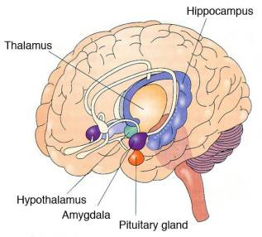
Localization
Brain research supports the idea that brain functions are localized
There are, however, counter-examples

Slide 31
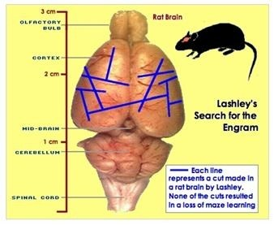
Localization
Lashley (1950s)
Induced brain damage in rats did not result in finding a memory area
Memory is distributed throughout the cortex

Slide 32
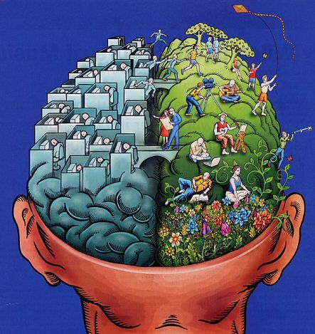
Localization
Lateralization
Divisions of functions between the two hemispheres of the cortex

Slide 33
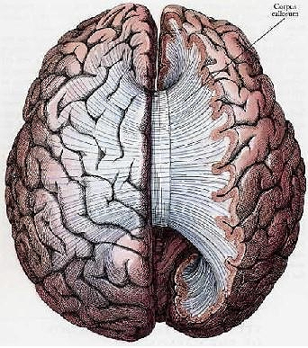
TASK
Read pages 52-54
What were the aim, procedure and results of Sperry’s (1968) and Gazzaniga’s (1967) split-brain studies?
Do the results support localization?

Slide 34

TASK
Watch the CGP Grey video about split-brain patients, lateralization and their connection to consciousness

Slide 35
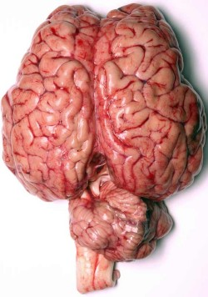
Localization
Limitations of localization
Some functions are localized weakly
Some functions are widely distributed
Some components of a functions are localized while other components of the same function are distributed
Localization is not static
RELATIVE LOCALIZATION

Slide 36
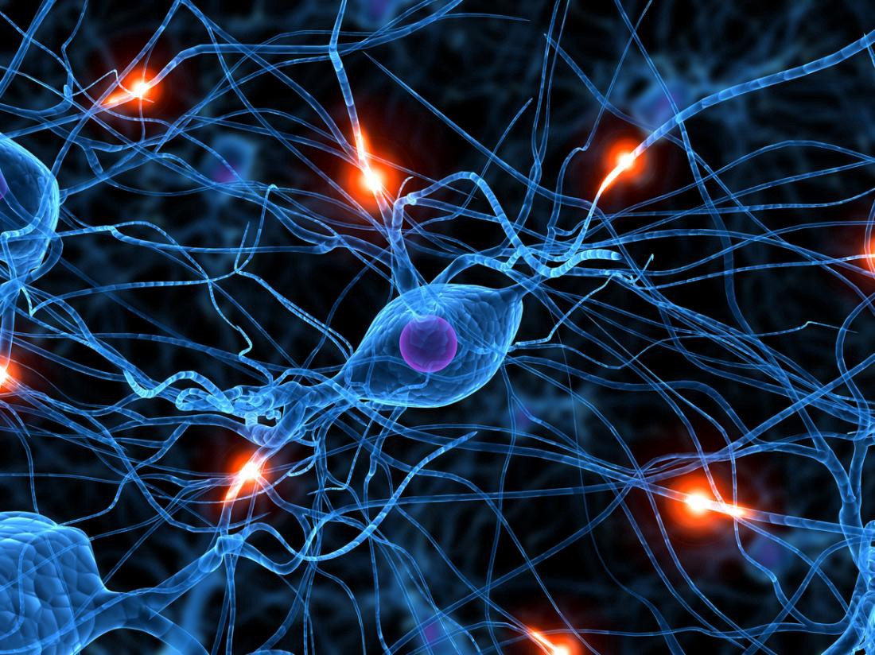
Neural networks
Synaptic connections between neurons form neural networks
Developed by making and breaking of synaptic connections

Slide 37
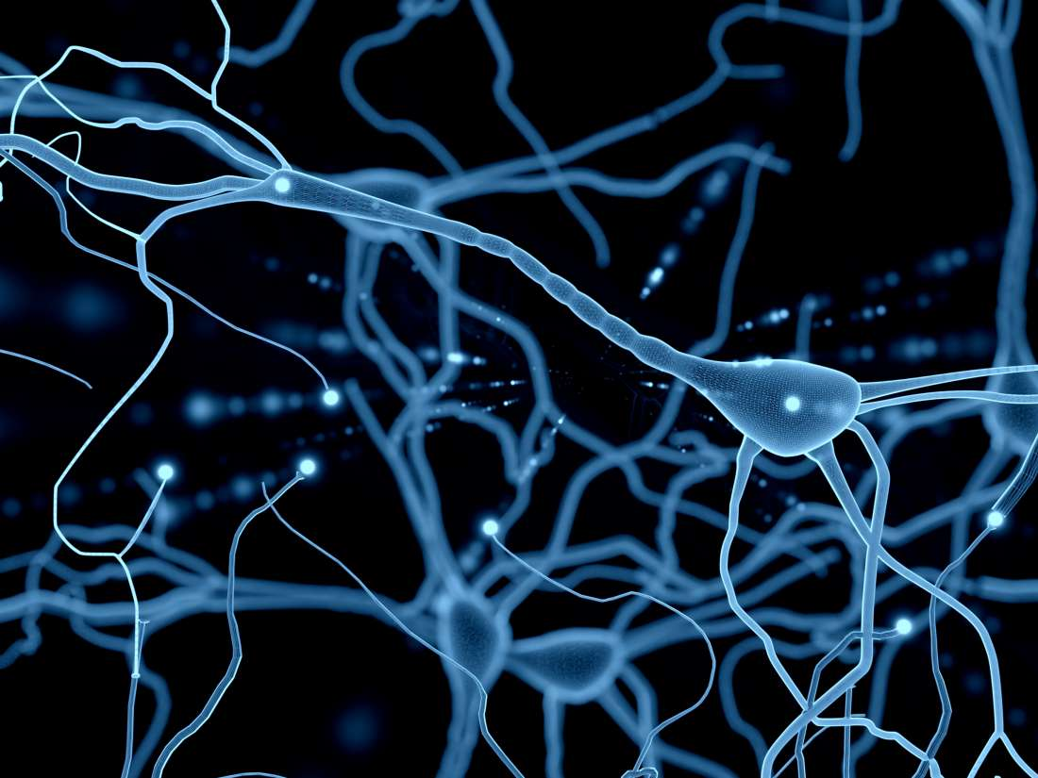
Neuroplasticity
Changes in neural networks is termed neuroplasticity
Changes can occur from genetic and/or environmental factors

Slide 38
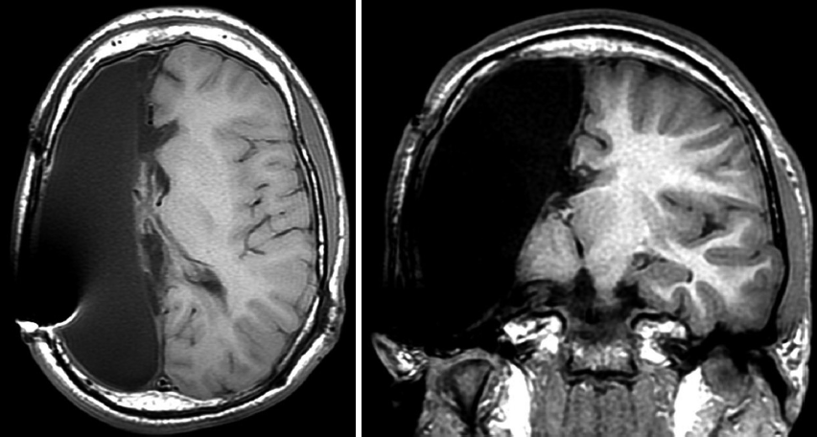
TASK
Watch this video about the amazing case of Cameron Mott
What does this case tell you about neuroplasticity?

Slide 39
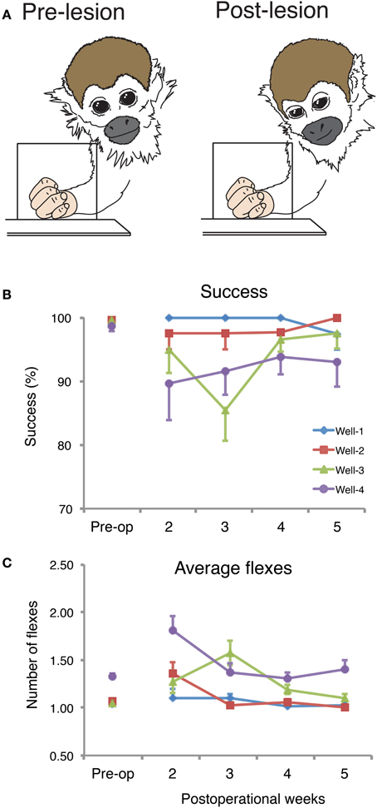
TASK
Read pages 57-59
What were the aim, procedure and results of Merzenich et al (1984) and Draganski et al (2004) studies?
What do the studies tell about neuroplasticity?
Try to analyse the studies with MAGEC/GRENADE

Slide 40
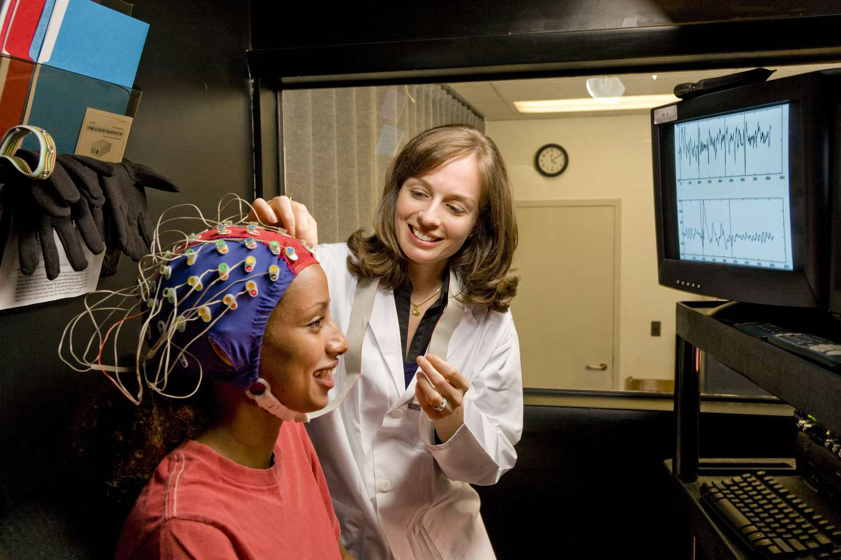
RESEARCH: Types of experiments
True experiment
Allocation into experimental groups is done randomly
Researchers manipulate the IV
Cause-effect inferences can be made

Slide 41

TASK
Watch the Vilayanar Ramachandran TED-Talk ”3 clues to understanding your brain”
What does this video tell you about neuroplasticity and localization?

Slide 42

TASK
Watch the Daniel Kish TED-Talk ”How I use the sonar to navigate the world”
What does this video tell you about neuroplasticity?

Slide 43
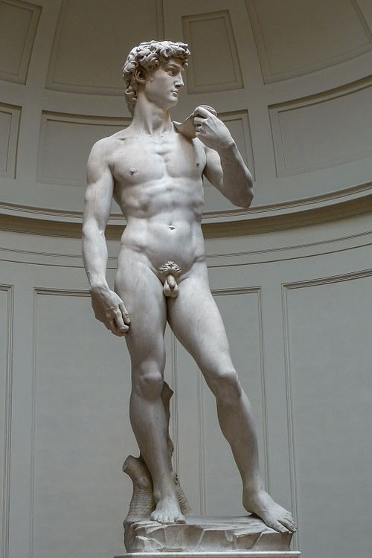
Neural pruning
Neural pruning
A programmed mechanism of cell death; selective cell death
Neurodevelopmental process where neural networks are “sculped”

Slide 44
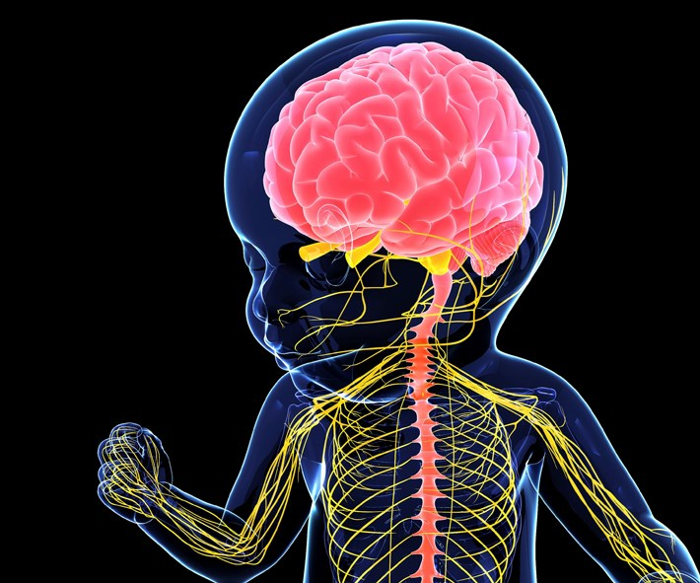
Neural pruning
During early brain development, number of neurons and numbers of synapses decrease

Slide 45
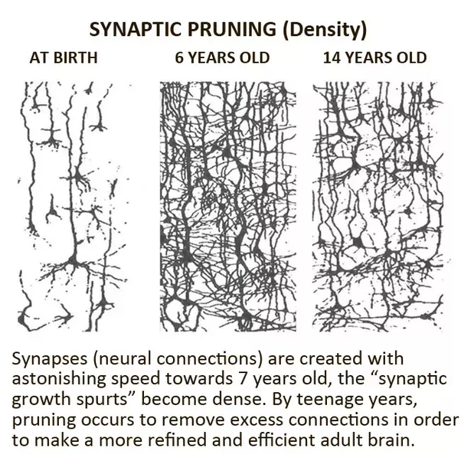
Neural pruning
Neural pruning happens through a process called synaptic pruning
”Death” of the synapses lead to the death of the neurons

Slide 46
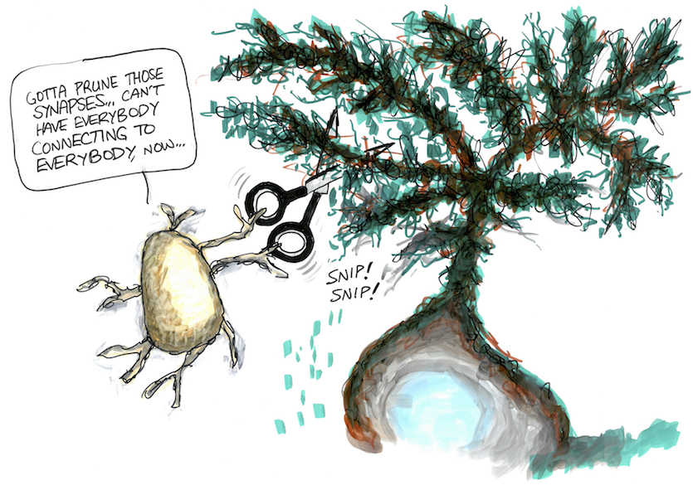
TASK
Watch the Alila Medical Media video about synaptic pruning

Slide 47

TASK
Find the gist of Werker et al (1981) study from the teacher’s extra materials
How does neural pruning manifest itself in the discrimination of phonemes?
Werker et al (1981) study relates to a phenomenon called perceptual narrowing

Slide 48
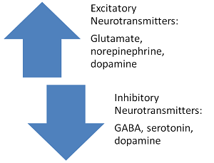
Neurotransmitters
Neurotransmitters are chemical messengers
Excitatory neurotransmitters increase the likelihood of action potential in the receiving neuron
Inhibitory neurotransmitters do the opposite => decrease

Slide 49
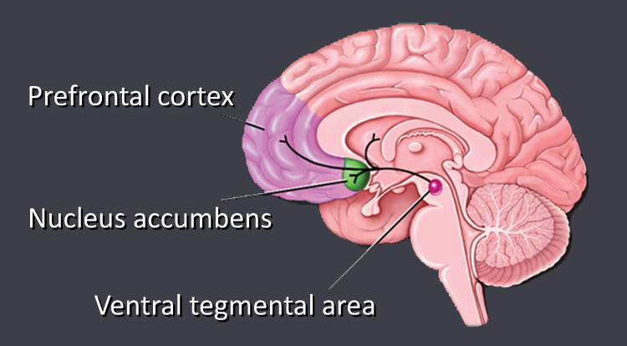
Neurotransmitters
Dopamine
A neurotransmitter involved in motivational behaviour like pleasure seeking, control of movement, emotional response and addictive behaviour
Released in the brain’s reward system

Slide 50

TASK
Read pages 68–69
Find out the aim, procedure and results of Fisher, Aron and Brown (2005) study on dopamine and romantic love
What role does dopamine play in romantic love?

Slide 51
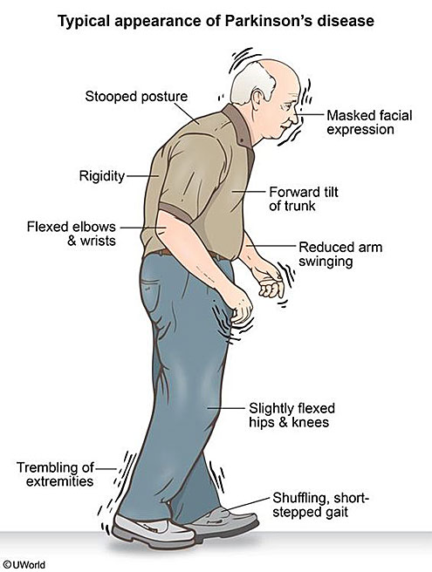
TASK
Form groups
Carefully read the Freed et al (2001) study about Parkinson’s disease and dopamine on page 70
Would you approve the study if you were a member of the ethics committee?
Try find arguments for and against the study

Slide 52
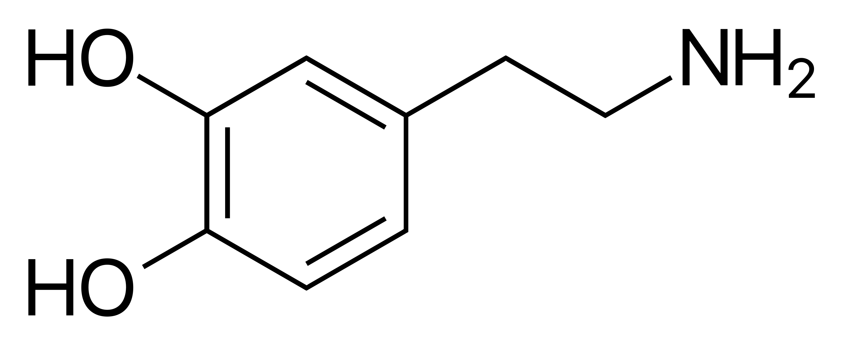
EXTRA TASK
Find the gist of Berridge and Kringelbach (2009) study from the teacher’s extra materials
What role does dopamine play in pleasure seeking?

Slide 53

Neurotransmitters
Dopamine hypothesis of schizophrenia
High levels of dopamine in the brain causes psychosis

Slide 54
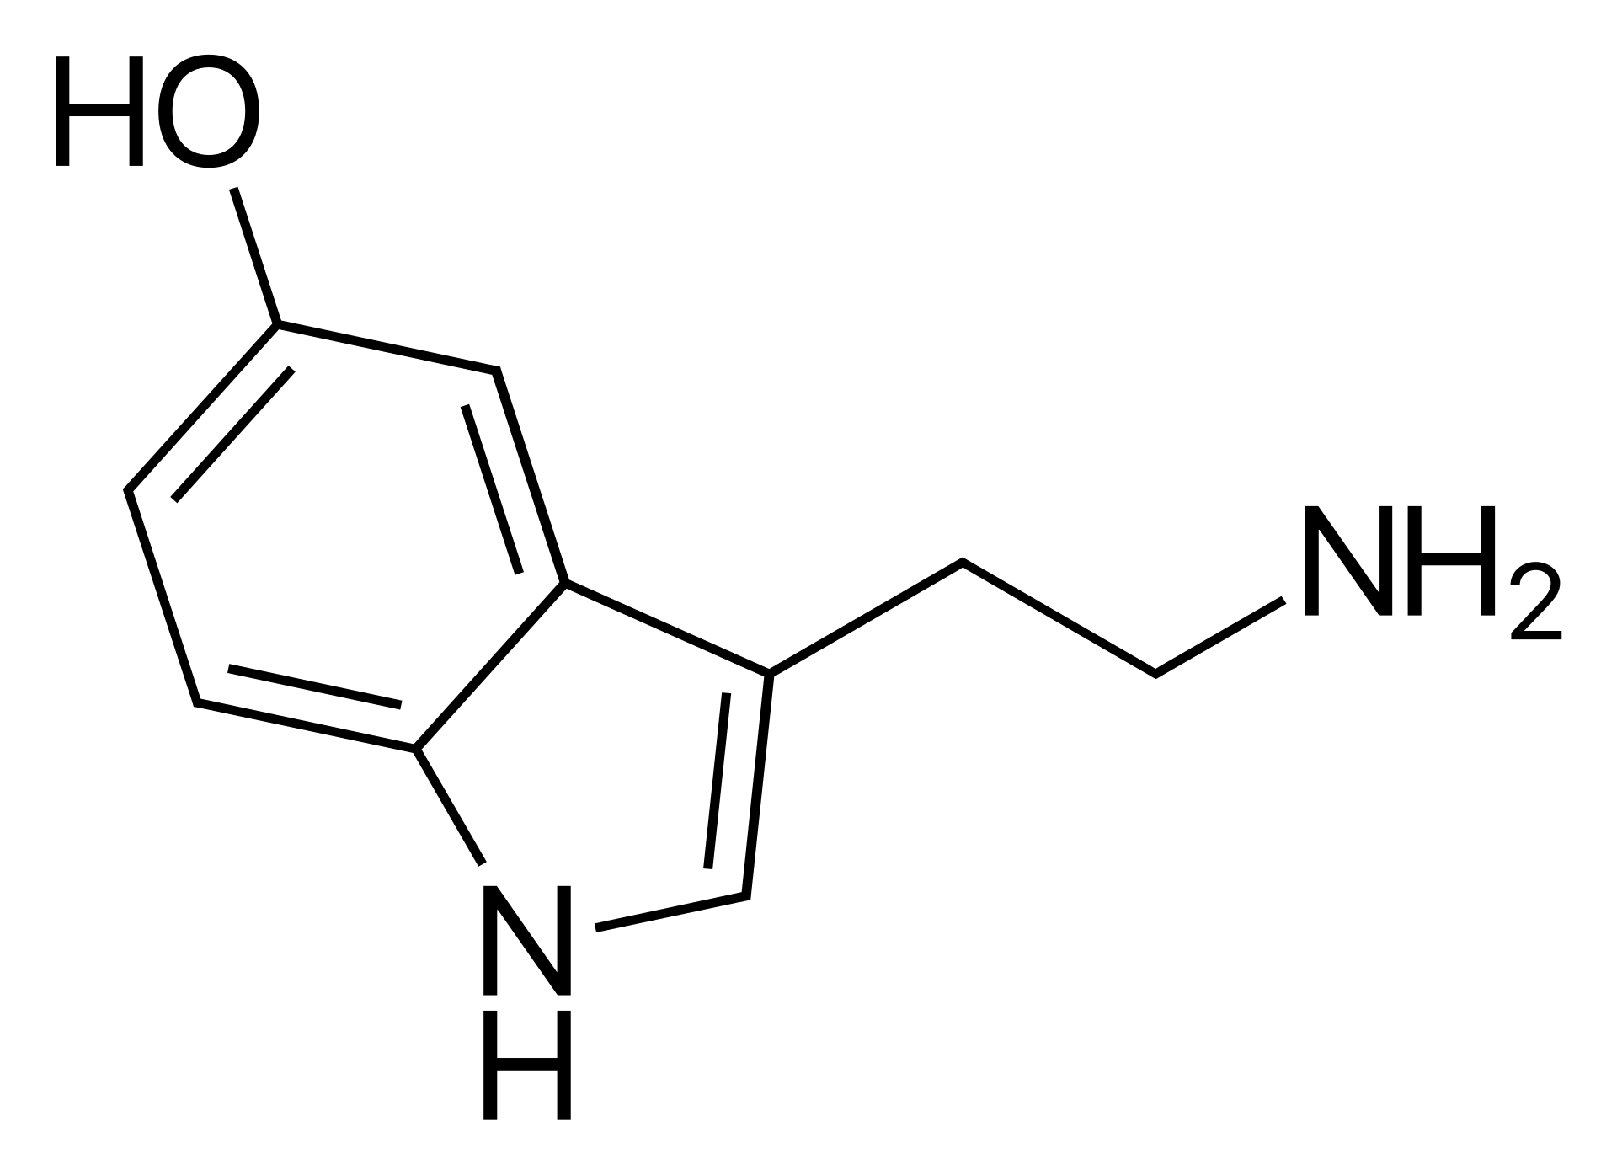
Neurotransmitter
Serotonin
A neurotransmitter related to mood, well-being and happiness, sleep cycle, digestive system and sexual behaviour
Most of the serotonin within the human body is produced in the intestines

Slide 55
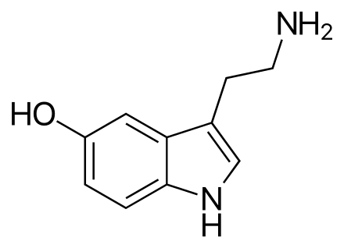
TASK
Read pages 67-68
What are the aim, procedure and results of Crockett et al (2010) study on the effect of serotonin on prosocial behaviour?
In addition, try to do a MAGEC/GRENADE analysis of the study

Slide 56

Neurotransmitters
Serotonin hypothesis of depression
Low levels of serotonin in the brain causes depression

Slide 57
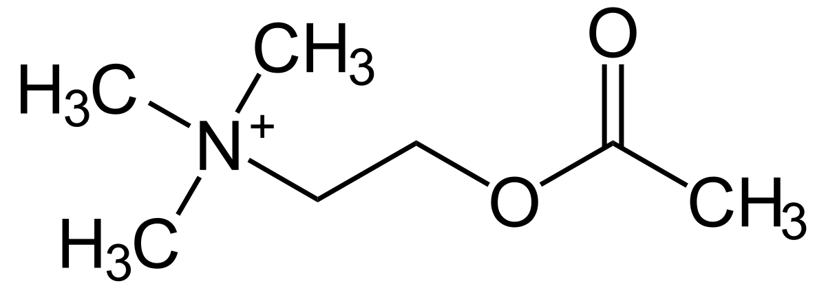
Neurotransmitters
Acetylcholine
A neurotransmitter involved in learning, memory, attention and muscle action
One of the most abundant neurotransmitter within the body

Slide 58
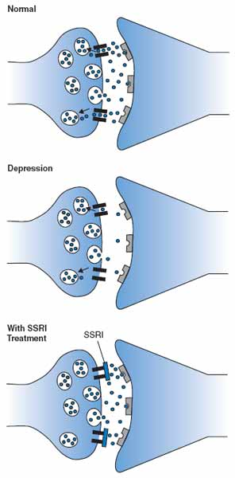
Neurotransmitters
Agonist is a chemical that enhances the action of a neurotransmitter
Antagonist is a chemical that inhibits the action of a neurotransmitter

Slide 59
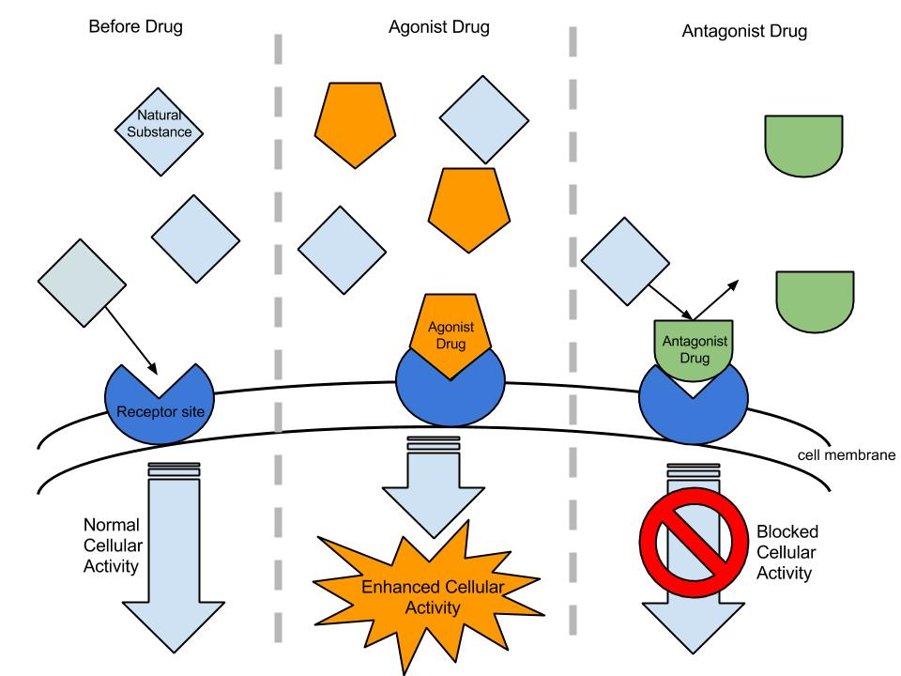
Neurotransmitters

Slide 60
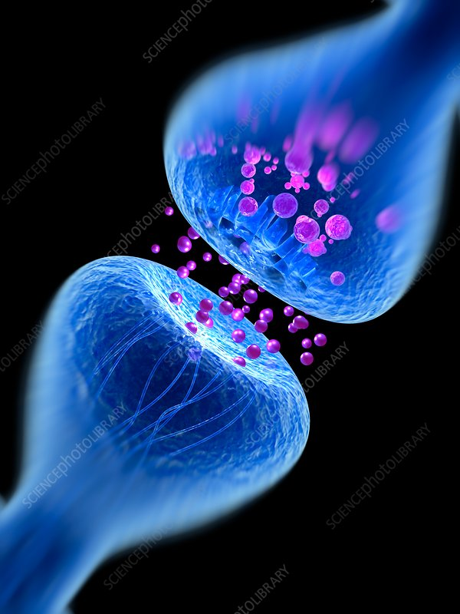
TASK
From three groups
Each group have a different study related to agonists and antagonists
After a while three person groups are formed, and information is exchanged

Slide 61
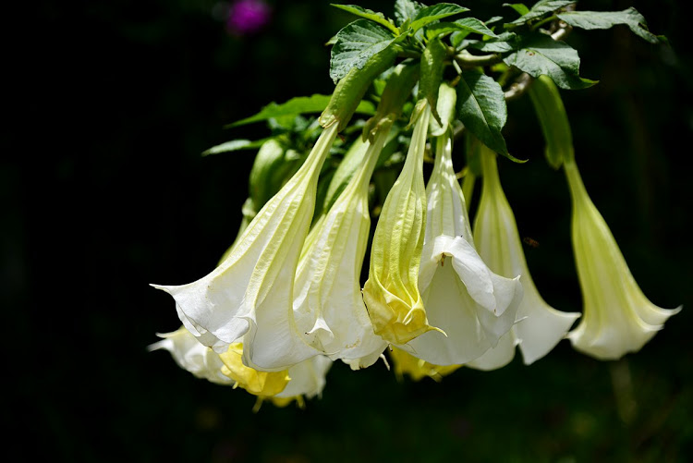
TASK
What were you able to learn from:
Rogers and Kesner (2003)
Antonova et al (2011)
Troster and Beatty (1989)
Acetylcholine (agonist) in the formation of memories with scopolamine (antagonist)

Slide 62
TASK
Read at least one set of sample responses, both SAQs and ERQ/essays, in peda.net concerning brain imaging technology, localization, neuroplasticity and neurotransmission
Pay attention to the examiner’s comments!
What were you able to learn from these responses?

Slide 63
Sources
Crane, J. & Hannibal, J. (2009). Psychology Course Companion. Oxford: Oxford University Press.
Eagleman, D. (2018). Aivot. EU: Atena
Gray, P. & Bjorklund, D. (2014). Psychology (7th edition). New York: Worth Publishers.
Musolino, J. (2015). The Soul Fallacy. New York: Prometheus Books.
Paavilainen, P. (2016). Toimivat aivot – Kognitiivisen neurotieteen perusteita. Helsinki: Edita.
Popov, A., Parker, L. & Seath, D. (2017). IB Psychology Course Companion (2nd Edition). Oxford: Oxford University Press.

Slide 64
Picture sources
Rotating body <https://www.collegedrinkingprevention.gov/specialfeatures/interactivebody.aspx> Accessed 26th of August 2017.
Natuer vs. nurture <http://psychrod.com/nature-vs-nurture-a-a-gender-debate-on-gender-differences/> Accessed 26th of August 2017.
Purity os sciences <https://www.millennialstar.org/what-is-science-is-science-about-reductionism-or-holism-2/> Accessed 4th of Augusto 2018.
Phrenology head <https://en.wikipedia.org/wiki/Mind> Accessed 4th of August 2018.
”Mind” <http://brainpages.org/whats-the-difference-between-the-mind-and-the-brain/> Accessed 26th of October 2015.
”Mind and body” <http://www.patheos.com/blogs/fareforward/2013/09/what-we-are-mind-body-and-the-dangers-of-dualism/> Accessed 26th of October 2015.
Brain 1 <http://science.nationalgeographic.com/science/photos/brain/#/human-brain_1001_600x450.jpg> Accessed 26th of October 2015.
Knowledge questions. TOK Guide for First Assessment 2022. Published in February 2020.
”Cosmic brain” <https://www.pillaicenter.com/mindscience.aspx> Accessed 29th of August 2017.
Central and peripheral nervous systems <https://askabiologist.asu.edu/parts-nervous-system> Accessed 29th of August 2017.

Slide 65
Picture sources
Drawing a tree < http://www.wikihow.com/Draw > Accessed 29th of August 2017.
Types of neurons <http://www.mind.ilstu.edu/curriculum/neurons_intro/neurons_intro.php> Accessed 29th of August 2017.
Action potential 1 <http://www.apstherapy.co.nz/action%20potentials.html> Accessed 26th of October 2015.
Action potential 2 <http://www.apstherapy.co.nz/action%20potentials.html> Accessed 26th of October 2015.
Synapse 1 <http://163.178.103.176/CasosBerne/1aFCelular/Caso4-2/HTMLC/CasosB2/Receptor/Ch6.html> Accessed 30th of August 2017.
Synapse 2 <https://psychlopedia.wikispaces.com/synapse?responseToken=0729771e90fda80437ef2e80bdaddf464> Accessed 30th of August 2017.
Synaptic transmission <http://www.vce.bioninja.com.au/aos-2-detecting-and-respond/coordination--regulation/nervous-system.html> Accessed 26th of October 2015.
Structures of neurotransmitters <http://www.compoundchem.com/2015/07/30/neurotransmitters/> Accessed 31st of August 2017.
Comic brain 1 <https://changeactivation.com/activate/brain-and-change/> Accessed 10th of September 2018.
Comic brain 2 <http://bowperson.com/2016/12/5-brain-myths-by-asap-science/> Accessed 29th of August 2017.
Lobes of the brain <http://rantsite.net/2011/03/tyhmentaako-hakukoneiden-kaytto-ihmisia/> Accessed 15 of November 2017.

Slide 66
Picture sources
Limbic system < https://risetoshinetoday.org/limbic-system/ > Accessed 17th of September 2018.
Lashely cuts <https://www.quora.com/What-percentage-of-his-brain-did-Einstein-use> Accessed 5th of January 2018.
Lateralization <https://martygumblesworth.wordpress.com/tag/hemispheric-lateralization/> Accessed 17th of September 2018.
Corpus callosum <http://www.neuwritewest.org/blog/2014/2/6/split-brains> Accessed 17th of September 2018.
CGP Gray logo <https://en.wikipedia.org/wiki/CGP_Grey> Accessed 25th of November 2018.
Fresh brain <http://www.human-memory.net/brain.html> Accessed 17th of September 2018.
Blue brain cells 1 <https://medium.com/predict/artificial-neural-networks-mapping-the-human-brain-2e0bd4a93160> Accessed 10th of February 2020.
Blue brain cells 2 <https://www.medicalnewstoday.com/articles/320289.php> Accessed 10th of Februry 2020.
Cameron Mott’s hemispherectomy <https://www.brainstem.education/case-studies/the-girl-who-lost-half-her-brain/> Accessed 23rd of August 2019.
Merzenich et al 1984 <https://www.semanticscholar.org/paper/Functional-reorganization-of-primary-somatosensory-William-M./b2a28d6ac45b3e6bdcd4149f1b4062b096ef7169> Accessed 10th of February 2020.
EEG experiment <https://www.verywellmind.com/how-to-conduct-a-psychology-experiment-2795792> Accessed 11th of August 2023.
Vilayanur Ramachand <http://alchetron.com/Vilayanur-S-Ramachandran-350014-W> Accessed 3rd of January 2017.
Daniel Kish <https://en.wikipedia.org/wiki/Daniel_Kish> Accessed 24th of September 2018.
Michelangelo’s David <https://fi.wikipedia.org/wiki/Daavid_(veistos)> Accessed 10th of Februry 2020.
Child’s brain < https://www.fhi.no/en/studies/neurotox/contaminants-brain-development/ > Accessed 10th of February 2020.
Synaptic pruning 1 <https://www.quora.com/How-much-can-our-brains-be-altered-after-we-enter-adulthood> Accessed 10th of February 2020.
Synaptic pruning 2 <https://goodsciencewriting.wordpress.com/2017/04/11/zen-and-the-art-of-synaptic-pruning-new-cartoons/> Accessed 10th of February 2020.
Hindi <https://en.wikipedia.org/wiki/Hindi> Accessed 21st of February 2020.
Excitatory and inhibitory neurotransmitters <https://study.com/academy/lesson/types-of-neurotransmitters.html> Accessed 11th of February 2020.

Slide 67
Picture sources
Brain’s reward system <https://knowingneurons.com/2012/10/31/the-reward-pathway-reinforces-behavior/> Accessed 16th of September 2020.
Helen Fisher <http://www.greatthoughtstreasury.com/author/helen-fisher> Accessed 16th of April 2018.
Symptoms of Parkinson’s disease <http://www.tpgonlinedaily.com/new-developments-parkinsons-disease/> Accessed 24th of September 2018.
Dopamine <https://en.wikipedia.org/wiki/Dopamine> Accessed 17th of September 2020.
Schizophrenia <https://www.curejoy.com/content/natural-treatment-for-schizophrenia/> Accessed 24th of September 2018.
Serotonin 1 and 2 <https://fi.wikipedia.org/wiki/Serotoniini> Accessed 15th of August 2020.
Depression <https://showcase.laurea.fi/tag/depression/> Accessed 22nd of September 2021.
Acetylcholine <https://en.wikipedia.org/wiki/Acetylcholine> Accessed 15th of August 2021.
SSRI <https://neurosciencenews.com/neuropharmacology-decynium-22-ssri-serotonin-248/> Accessed 11th of February 2020.
Agonists and antagonists <https://fi.m.wikipedia.org/wiki/Antagonisti_(lääketiede)> Accessed 11th of February 2020.
Blue synapse <https://www.sciencephoto.com/media/844170/view/synapse-illustration> Accessed 30th of August 2024.
Scopolamine / Devil’s Breath: <https://www.the-star.co.ke/sasa/lifestyle/2019-06-08-devils-breath-used-to-hypnotise-rob-victims/> Accessed 9th of March 2021.

