Slide 1
RESEARCH METHODOLOGY FOR PAPER 3
IB Psychology LAJM

Slide 2

TASK
Familiarize yourself with the sample P3
Stimulus material
Fixed questions concerning psychological research

Slide 3

REVIEW
What was meant by:
Research design?
Research setting?
Quantitative and qualitative research?

Slide 4

Research design
The way how the research is conducted

Slide 5
EXPERIMENTS
- Cause and effect relationships between phenomena
CORRELATIONAL STUDIES
- Relationships between phenomena
DESCRIPTIVE STUDIES
- Reliable generalizations
CASE STUDIES
- New research ideas and hypothesis

Slide 6

Research setting
Where the research is conducted
Laboratory study
Carefully controlled environment
Field study
Natural environment

Slide 7
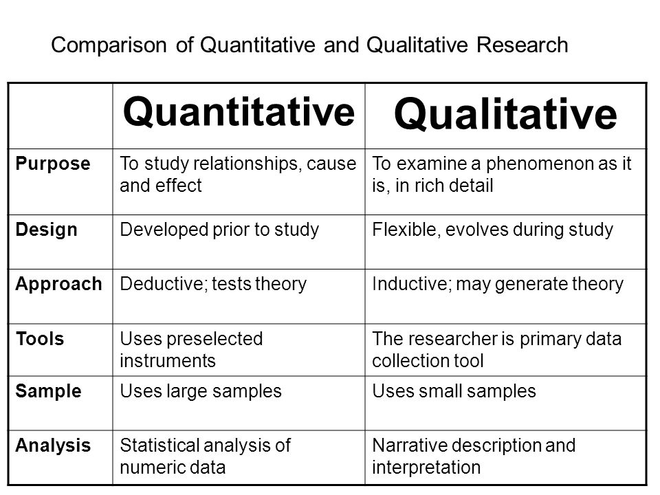

Slide 8
Quantitative and qualitative research
Nomothetic approach
Scientific orientation on deriving universal and generalizable laws
Idiographic approach
Scientific orientation on a particular case or phenomenon; in-depth study of a particular phenomenon
Interpretation of human experiences, interpretations and meanings

Slide 9
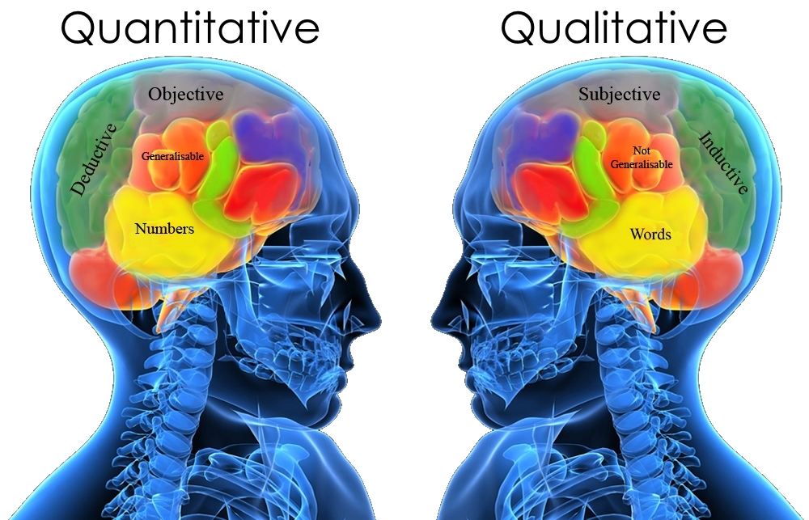
TWO APPROACHES SHOULD NOT BE SEEN AS COMPETING, BUT AS COMPLEMENTARY TO DIFFERENT TYPES OF RESEARCH QUESTIONS

Slide 10
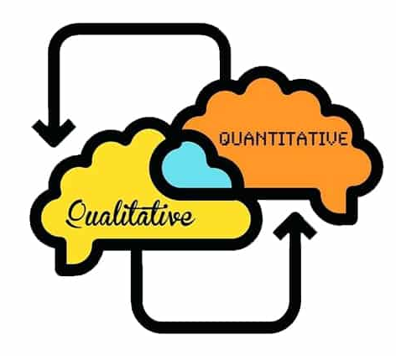
Quantitative and qualitative research
Please note!
In Paper 3, the stimulus material can be either quantitative or qualitative or both

Slide 11

TASK
Read the May 2019 P3 stimulus material and try to create sketch responses with your pair or with your group to question 1. (a)

Slide 12
REVIEW
Read pages 12–14
What was meant by:
Independent measures design?
Matched pairs design?
Repeated measures design?

Slide 13
Experimental designs
Independent measures design
Random allocation of groups and comparison between these groups
The larger the sample, the higher the chance of the groups being equivalent
EXPERIMENTAL GROUP
IV => DV
CONTROL GROUP
Same setting,
but without IV

Slide 14
Experimental designs
Matched pairs design
Researcher controls the equivalence of groups manually by ranking the participants and matching similar pairs randomly
Ranked
participants
1
Matched pair 1
2
Initial
test
3
Random allocation into groups
Matched pair 2
4
5
Matched pair 3
6
etc.
etc.

Slide 15
Experimental designs
Repeated measures design
Compares conditions rather than groups
Same group of participants are exposed to different conditions
PARTICIPANTS
NOISE
SILENCE
RESULTS

Slide 16
Types of experiments
True experiment
Allocation into experimental groups is done randomly
Researchers manipulate the IV
Cause-effect inferences can be made
Quasi-experiment
Allocation into groups is done on the basis of pre-existing differences
Researchers do NOT manipulate the IV
Cause-effect inferences CANNOT be made
E.g. Bransford and Johnson (1972)
E.g. Maguire et al. (2000)

Slide 17

Types of experiments
Laboratory experiment
Conducted in highly controlled, artificial conditions
E.g. Bandura, Ross and Ross (1961)

Slide 18

Types of experiments
Field experiment
Conducted in real-life setting
E.g. Sheriff et al. (1961)

Slide 19
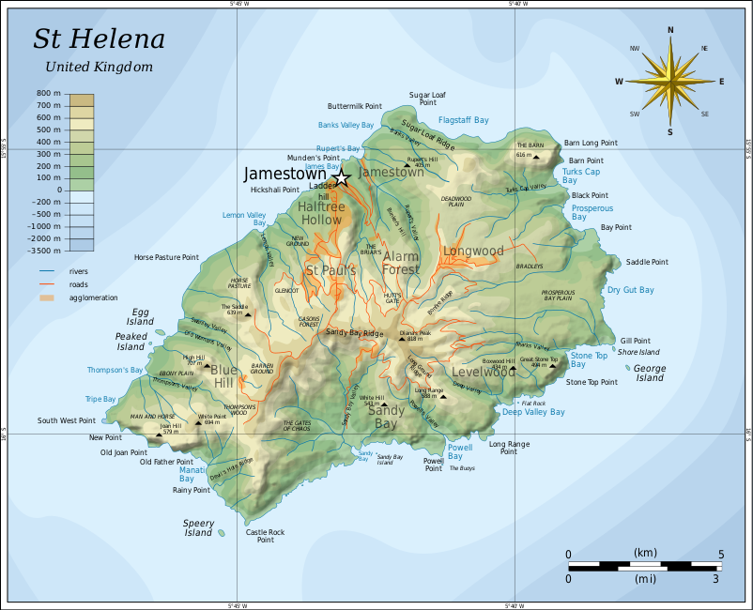
Types of experiments
Natural experiment
Conducted in the participants’ natural environment
IV is NOT manipulated by the researcher but occurs naturally
E.g. Charlton et al. (2002)

Slide 20
TASK
Return to the May 2019 P3 stimulus material and try to create sketch responses with your pair or with your group to question 1. (b)

Slide 21
REVIEW
What was meant by:
Sample?
Sampling?

Slide 22
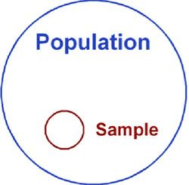
Sample and sampling
Sample
Group of participants taking part in a study
Sampling
The process or technique of selecting participants for a study

Slide 23
Sample and sampling
A good sample:
Represents the target population
Allows reliable generalizations

Slide 24
REVIEW
Read pages 10–12
What was meant by
Random sampling?
Stratified sampling?
Convenience (opportunity) sampling?
Self-selected sampling?

Slide 25
Sample and sampling
Random sampling
Random sub-set of the members of the target population
Requires sufficient sample size
Stratified sampling
Decide essential characteristics of the population
Study the distribution of the characteristics within the target population
Recruit participants randomly, but keep the proportions

Slide 26

Sample and sampling
Convenience (opportunity) sampling
Recruiting participants that are easily available
Self-selected sampling
Recruiting volunteers

Slide 27
TASK
Read the P3 sample response with stimulus material and examiner’s assessment

Slide 28

TASK
Read the InThinking example stimulus material related to correlation and try to create sketch responses with your pair or with your group

Slide 29
REVIEW
Read pages 20–22
What was meant by
Correlation?
Effect size (r)?
Statistical significance?

Slide 30
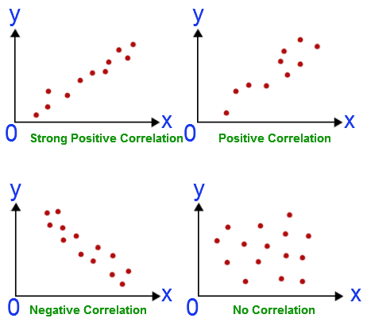
Correlational studies
Correlation
Measure of linear relationship between two variables
NO manipulation of variables
CANNOT determine the cause-and-effect relationship

Slide 31
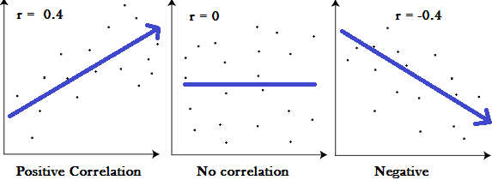
Correlational studies
Effect size (r)
The absolute value of correlation coefficient

Slide 32
Correlational studies
Statistical significance
The results cannot be explained by chance alone; The effect size (r) in correlational studies is not obtained by chance
p-value or probability value has to be less than .05 (5%) in order to be statistically significant
=> there is a 95% probability that the obtained correlation is NOT due to chance

Slide 33
Correlational studies
Good correlational study has large effect size (r) and small p-value

Slide 34
REVIEW
Read pages 14–15
What was meant by
Validity in general?
Construct validity?
Internal validity?
External validity?

Slide 35

Validity
Expresses the relationship between the reality and the quantitative research
Do the research methods used in the study correspond to the phenomenon that is being researched?

Slide 36

Validity
Construct validity
Describes the quality of operationalisations
Can the results be linked back to constructs (phenomena/variable)?
Can heartbeat rate be interpreted as a good operationalization of love?

Slide 37
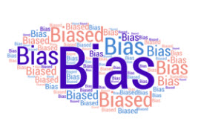
Validity
Internal validity
Describes the methodological quality of the experiment
The less bias, the higher the internal validity

Slide 38
Validity
External validity
Describes the generalizability of the findings in the quantitative reserach
Population validity
Can the findings be generalized to wider population?
Ecological validity
Can the results be generalized to real-life setting?

Slide 39
REVIEW
What was meant by
Reliability?

Slide 40
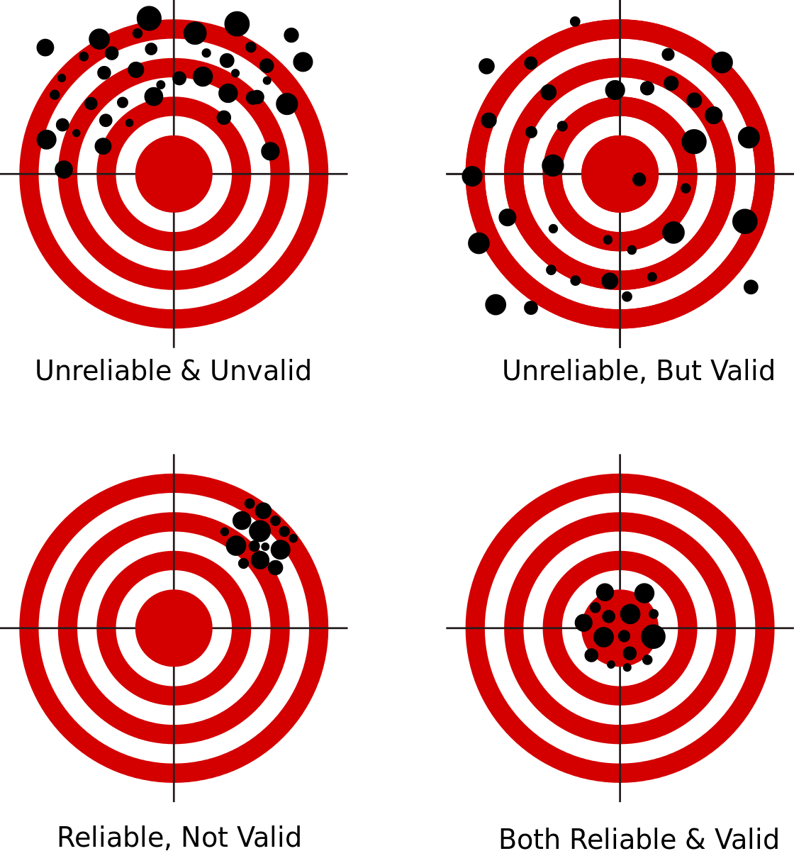
Reliability
Refers to the consistency of the results
Are the results of the experiment repeatable?

Slide 41
REVIEW
What was meant by
Bias in general?
Sampling bias
Participant bias?
Researcher bias?

Slide 42
Bias
Factor or factors that might skew the research
Sampling bias
Sample is not representative of the target population
Participant bias
Participants act according to the researches’ wishes
Researcher bias
Researcher acts differently towards different participants

Slide 43
Bias
Experimental research | Qualitative research
Selection | Acquiescence bias
History | Social desirability bias
Maturation | Dominant respondent bias
Testing effect | Sensitivity bias
Instrumentation | Confirmation bias
Regression to the mean | Leading questions bias
Experimental mortality | Question order bias
Demand characteristics | Sampling bias
Experimenter bias | Biased reporting
Quickly review the
basics of the biases
on the right (see ManageBac)

Slide 44

TASK
Skim through the teacher’s handout on qualitative research methods
You may read pages 343–353, but otherwise skimming is fine

Slide 45
TASK
Read the InThinking example stimulus material related to structured interview and try to create sketch responses with your pair or with your group
Implement the teacher’s handout (Crane 354-355)

Slide 46
TASK
Read the InThinking example stimulus material related to unstructured interview or narrative interview and try to create sketch responses with your pair or with your group
Implement the teacher’s handout (Crane 356-360)

Slide 47
TASK
Read the InThinking example stimulus material related to focus group and try to create sketch responses with your pair or with your group
Implement the teacher’s handout (Crane 355-356)

Slide 48
Inductive content analysis
Qualitative analysis of interview transcripts
Aim is to generate new theory based on the data; Theory can emerge from the data
Interpretive phenomenological analysis (IPA)
Focuses on interpreting the participants experiences; How individuals explains and perceives a phenomenon?
See Crane 360–363 for further details and examples

Slide 49
TASK
Read the InThinking example stimulus material related to observations and try to create sketch responses with your pair or with your group
Implement the teacher’s handout (Crane 364-372)

Slide 50
REVIEW
Read pages 28–29
What was meant by:
Quota sampling?
Purposive sampling?
Theoretical sampling?
Snowball sampling?
Convenience (opportunity) sampling?

Slide 51
Sampling in qualitative research
Quota sampling
Number AND the main characteristics of the participants are decided before the research
Purposive sampling
ONLY main characteristics of the participants are decided before the research
Theoretical sampling
Type of purposive sampling that ends when data saturation is reached
Data saturation is reached when no new evidence cannot be added to the background theory

Slide 52

Sampling in qualitative research
Snowball sampling
Small number of participants are invited and asked to invite other people to the research
Convenience (opportunity) sampling
Using a sample that is easily available

Slide 53
Sampling in qualitative research
Samples in qualitative research are NOT statistically representative of the target population
Findings are NOT generalizable
Transferability
Generalizing the results to a group of people who are close to the qualitative sample
H O W E V E R !

Slide 54
REVIEW
What was meant by:
Credibility or trustworthiness in qualitative research?

Slide 55

Validity in qualitative research
Credibility or trustworthiness in qualitative research is an equivalent of internal validity in the experimental studies

Slide 56
Validity in qualitative research
Reread pages 25–26 and quickly review the gist of the terms below

Slide 57
Validity in qualitative research
Triangulation
Combining different approaches to collect and interpret data
Rapport
Establishing trust and honesty between researchers and participants
Reflexivity
Thinking about the strength and limitations of the selected research methods and personal expectations

Slide 58
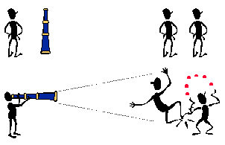
Bias in qualitative research
Bias is an integral part of qualitative research
Some types of biases can be eliminated while some others need to be recognised and taken into account

Slide 59
QUALITATIVE PROJECTS
The point of the following projects is NOT to do a full-scale scientific qualitative research, but to familiarise ourselves with the essential features of observation and interview for Paper 3
Have fun with observation and interview with Paper 3 in mind

Slide 60

OBSERVATION PROJECT
Plan and implement a small scale observational study with the help of the teacher’s instructions
This project can be done alone, but is probably easier in groups

Slide 61

INTERVIEW PROJECT
Plan and implement a small scale interview with the help of the teacher’s instructions
Try to connect your idea to a covered topic from IB psychology syllabus
Interview can be done in groups, but is probably easier when done individually
Focus group is probably easier as a group project

Slide 62

Case study
In-depth investigation of human experience
Individual, group, event, organization etc.
Can be thought as a research strategy that combines several research methods

Slide 63
Case study
Triangulation in case study produces rich data
Qualitative
Descriptions and interpretations of experiences, feelings, symptoms etc.
Interviews, diaries, observation etc.
Personal artefacts
Official documents
Quantitative
Blood tests
IQ scores
Survey data
School grades
Etc.

Slide 64

TASK
Complete the teacher’s handout with the help of Crane 373–375

Slide 65
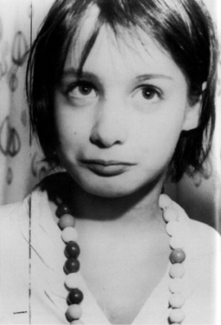
TASK
Go online and find examples of famous case studies in psychology
Bear in mind the ethical considerations

Slide 66
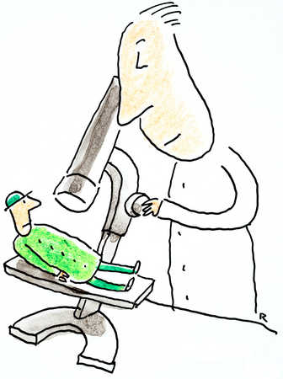
TASK
Can findings be generalized from a single case study?

Slide 67

REVIEW
Reread pages 38–41 and your memos on ethical considerations in conducting the study and ethical considerations in reporting the results

Slide 68

TASK
Compare two codes of ethics
APA
BPS
What are the similarities and differences?
Did you come up with any new findings in comparison to the textbook?

Slide 69
TASK
Reread IBO’s ethical guidelines for IA-task
Are the IBO’s guidelines in line with the general ethical guidelines you have been studying?
Can you find any similarities, differences and overlaps?

Slide 70
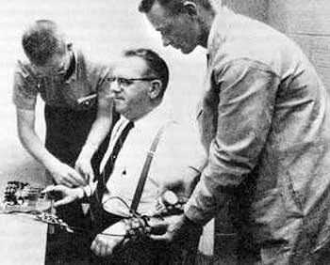
Ethics in Paper 3
Please remember!
You need to have SIX different ethical considerations in question 2, one consideration per each mark

Slide 71

TASK
Practise Paper 3 answering with the teacher’s handouts

Slide 72
Picture sources
Researching the mind <https://www.netsuite.com/portal/business-benchmark-brainyard/industries/articles/cfo-central/psychological-pricing.shtml> Accessed 14th of December 2022.
Review <http://ajslp.pubs.asha.org/article.aspx?articleid=2204333> Accessed 22nd of November 2017.
Research <http://research.southwales.ac.uk> Accessed 25th of September 2017.
People in train <http://www.slate.com/articles/life/transport/2009/11/underground_psychology.html> Accessed 18th of August.
Comparison of quantitative and qualitative research <https://www.google.fi/url?sa=i&rct=j&q=&esrc=s&source=images&cd=&cad=rja&uact=8&ved=0ahUKEwi79OaCp-XVAhXnQZoKHeQbAj8QjB0IBg&url=https%3A%2F%2Fueassignmentmccb.formation-conseil.info%2Fqualitative-research-case-study-approach.html&psig=AFQjCNF7xcd5d0nJibDVUc0iQ8bWo6HAsw&ust=1503300805080393> Accessed 18th of August 2017
Quantitative and qualitative heads <http://www.cdsmr.com/newsworthy/qualitative-quantitative-research-the-cds-way> Accessed 18th of August 2017
Quantitative and qualitative brains <https://logitgroup.com/combining-quantitative-and-qualitative-research/> Accessed 11th of January 2023
Laboratory <http://ed-psych.utah.edu/learningandcognition/lab-facilities.php> Accessed 17th of August 2017.
Robbers Cave <https://www.explorepsychology.com/robbers-cave-experiment/> Accessed 11th of August 2023
St. Helena map <https://en.wikipedia.org/wiki/Saint_Helena> Accessed 20th of August 2018.
IB Diploma Programme <http://www.yis.ac.jp/page.cfm?p=763> Accessed 10th of August 2017.
Sampling <https://www.verywellmind.com/what-is-a-representative-sample-2795798> Accessed 10th of January 2023
InThinking <https://inthinking.net/think-ins> Accessed 10th of January 2023
Correlation 1 <http://math.tutorvista.com/statistics/correlation-and-regression.html> Accessed 16th of August 2015
Correlation 2 <http://www.statisticshowto.com/probability-and-statistics/correlation-coefficient-formula/> Accessed 1st of February 2018.
Correlation 3 <http://math.tutorvista.com/statistics/correlation-and-regression.html> Accessed 16th of August 2015
Target <https://ljcdspalette.org/1135/showcase/pros-and-cons-of-new-schedule/> Accessed 30th of January 2018.
Heartbeat <https://www.silhouettedesignstore.com/view-shape/179458> Accessed 30th of January 2018.
Bias <https://www.trainingdr.com/better-decision-making-reduced-bias/> Accessed 30th of January 2018.
Reliability and validity <https://commons.wikimedia.org/wiki/File:Reliability_and_validity.svg> Accessed 17th of August 2017
Snowball sampling <https://dollarcents.org/infographics/compound-interest-snowball-effect/> Accessed 7th of August 2018.
Experiment <http://blog.stridekick.com/matchup-experiment-what-inspires-behavior-change/> Accessed 30th of January 2018.

Slide 73
Picture sources
Two kinds of thinking <https://www.pinterest.ca/pin/395542779751940516/> Accessed 26th of November 2015.
Trust and credibility <https://www.tes.com/lessons/CN7qOjEDZ_0-Zw/credibility> Accessed 6th of August 2018.
Sampling bias <http://psychtutor.weebly.com/research-methods.html> Accessed 22nd of August 2017.
Got Ethics? <https://sites.psu.edu/leadership/2014/10/26/should-employer-ethics-policies-extend-to-employee-personal-lives/> Accessed 24th of August 2015.
BPS <https://fi.pinterest.com/pin/489766528199215312/> Accessed 7th of October 2018.
IB Diploma Programme <http://www.yis.ac.jp/page.cfm?p=763> Accessed 10th of August 2017.
Milgram <http://listverse.com/2008/09/07/top-10-unethical-psychological-experiments/> Accessed 31st of August 2018.
Observation <https://pngimage.net/observation-png/> Accessed 7th of October 2018.
Interview <https://au.hudson.com/career-advice/interview-preparation> Accessed 7th of October 2018.
Human experience <https://computingthehumanexperience.com> Accessed 4th of December 2017.
Hikers <http://www.destination360.com/travel/adventure-travel> Accessed 4th of December 2017.
Genie <https://en.wikipedia.org/wiki/Genie_(feral_child)> Accessed 13th of November 2018.
Case study and microscope <http://www.psychologywizard.net/case-studies-ao1-ao2-ao3.html> Accessed 4th of December 2017.
Old books and quill <https://www.themantic-education.com/ibpsych/2017/09/10/how-to-write-a-paper-3-exam-answer/> Accessed 7th of October 2018.

