Slide 1
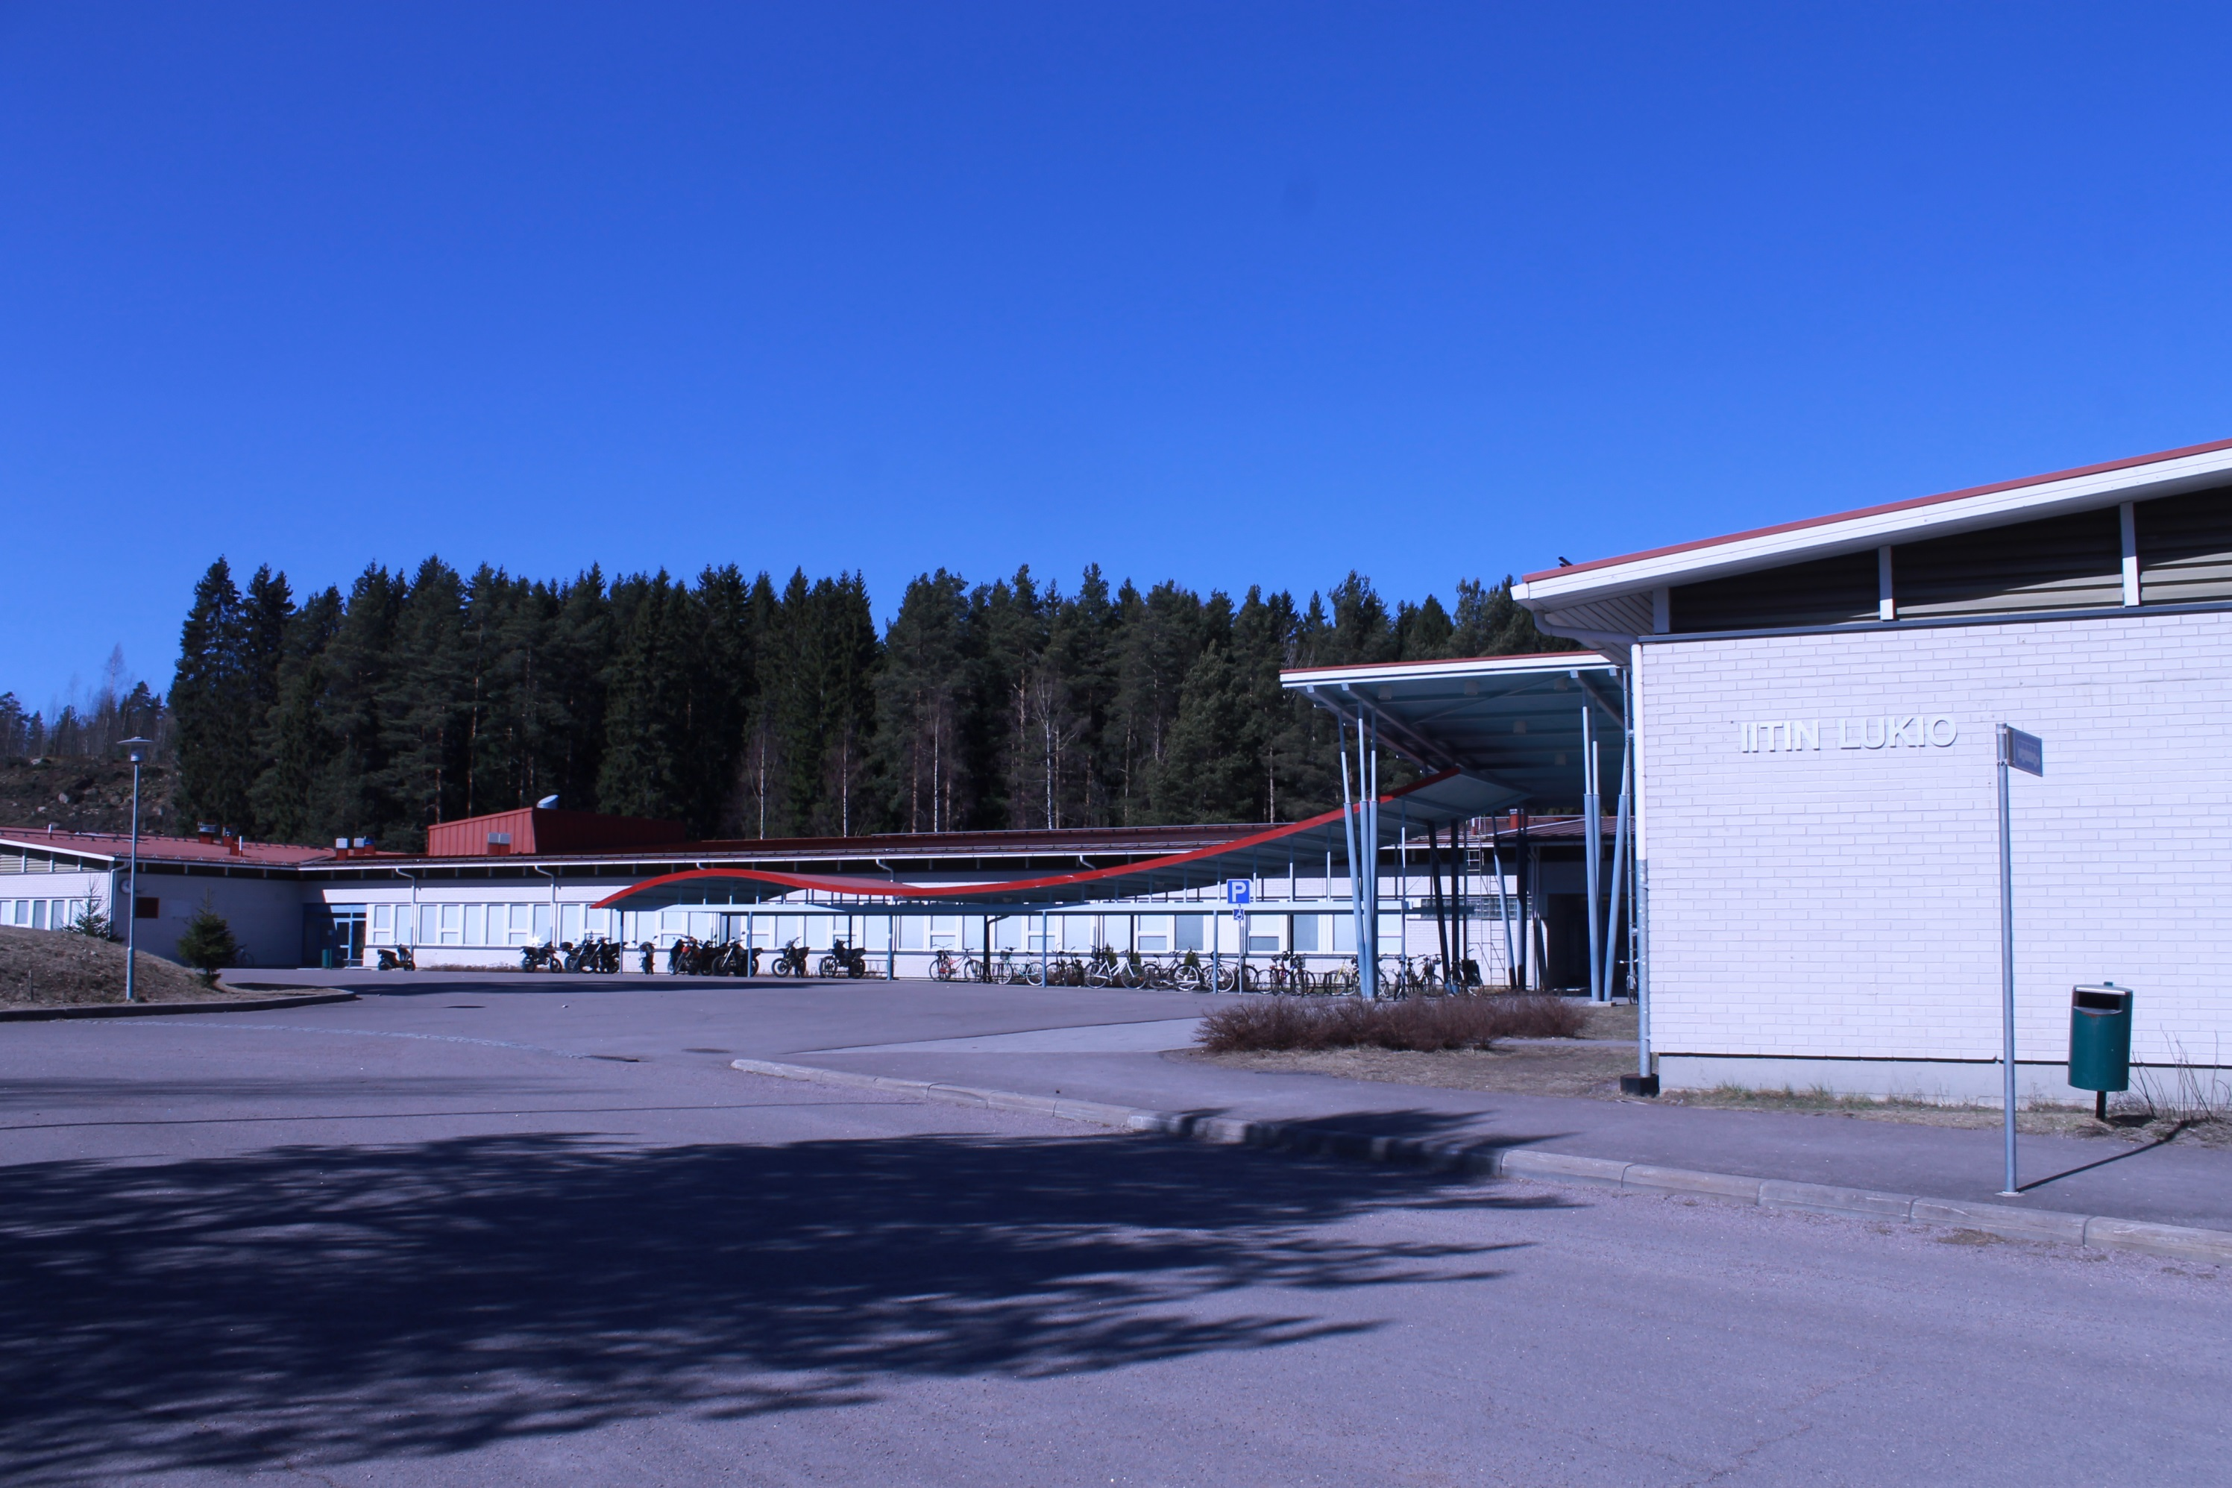
Iitin Lukio

Slide 2
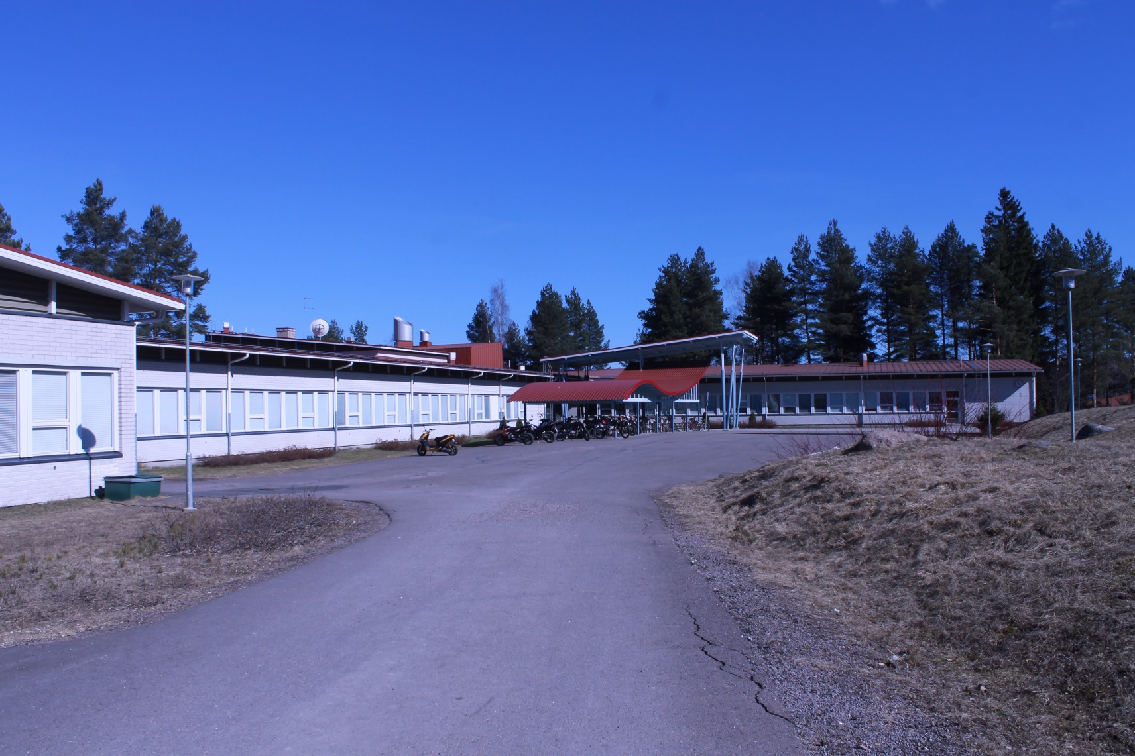
basic informations
Location: near of the center of Iitti
Students: about 130
Teachers: about 15

Slide 3
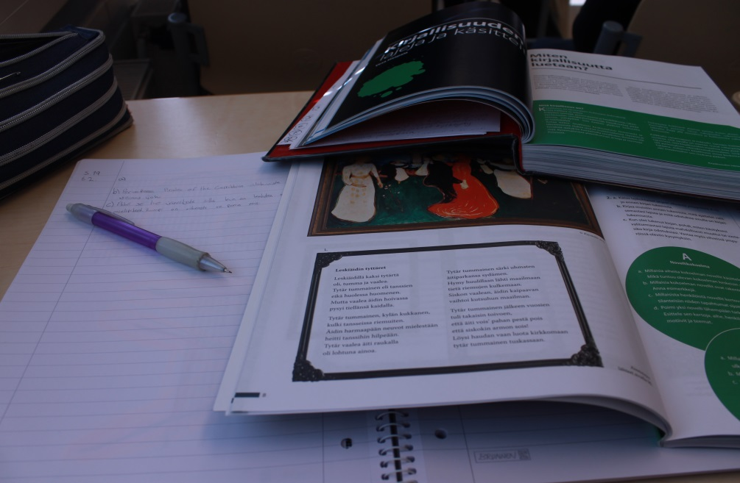
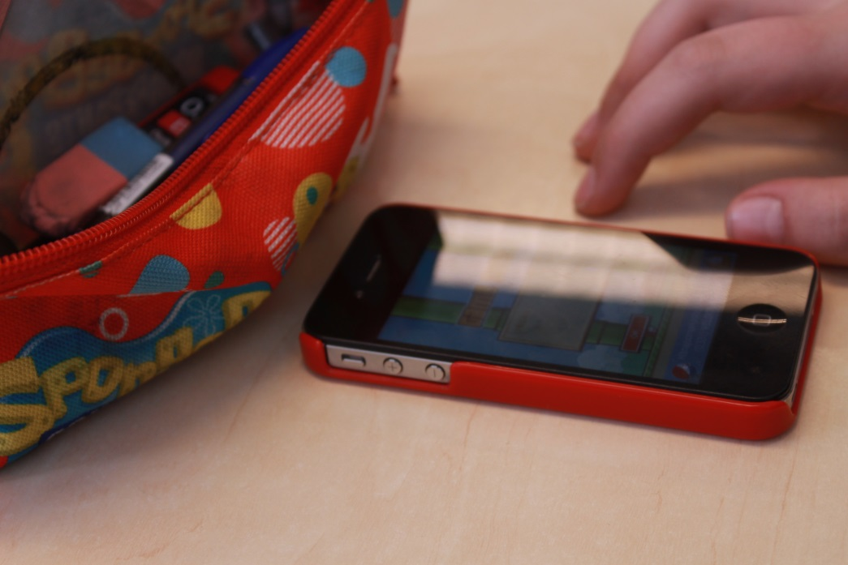
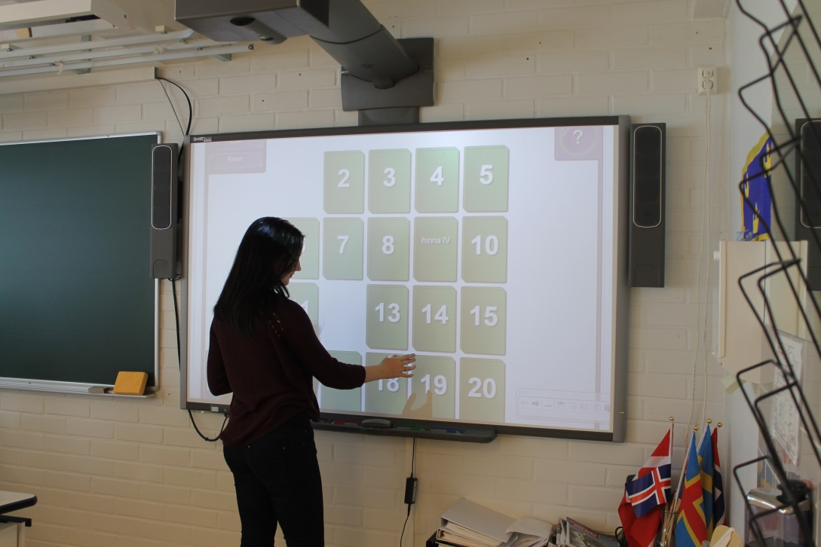
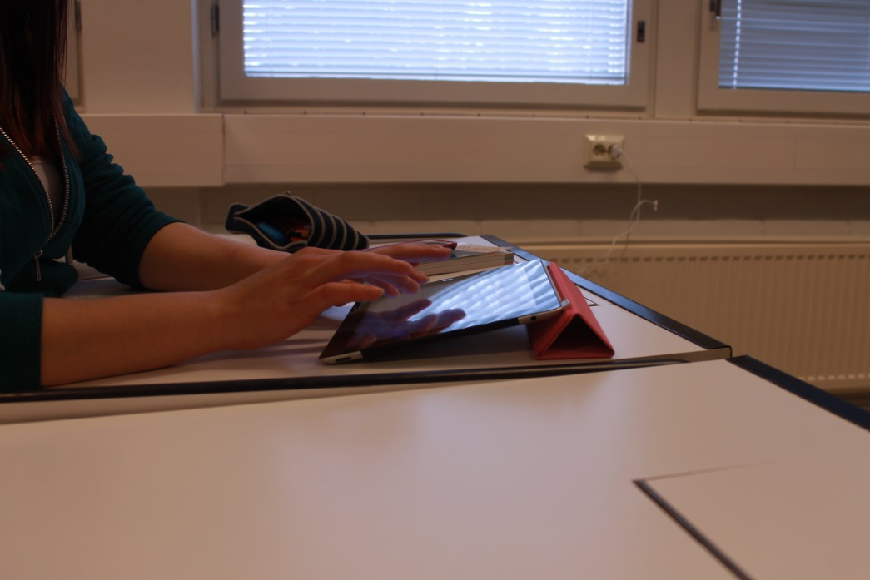
Lessons
Normally we have textbooks and notebooks. Someones are also using electronic books.
In lessons we are also using smartboards, iPads or other tablets and phones. Somebodies just feel that Flappy bird is more important than studying ;)
Our lessons are 45 mins and breaks 15 mins.
We have about 6-7 lessons in a day. (à 45 mins)

Slide 4
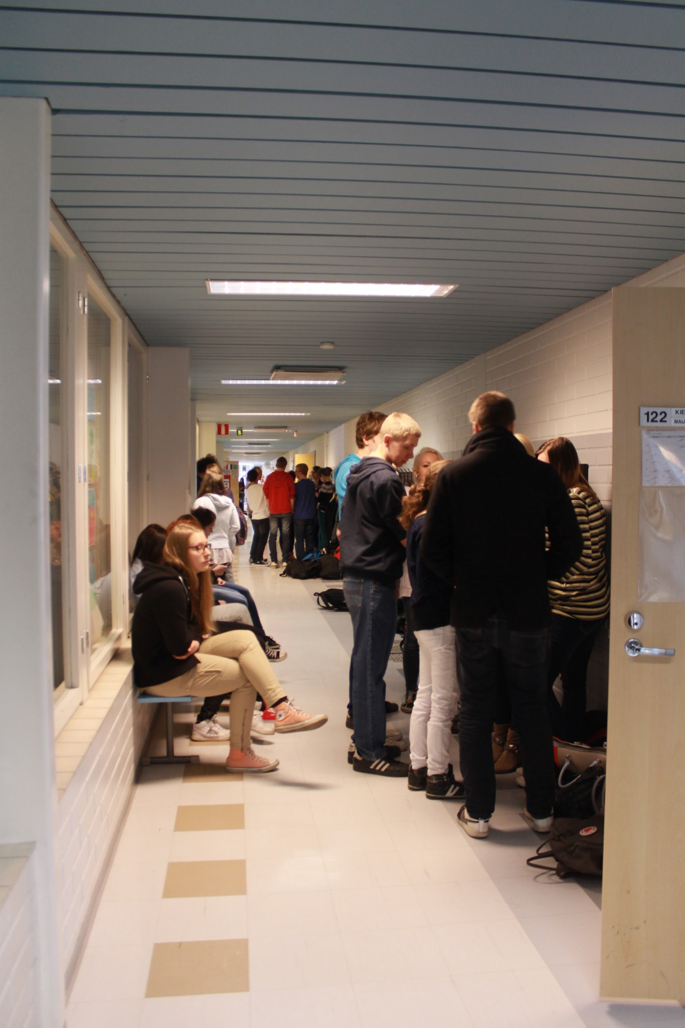
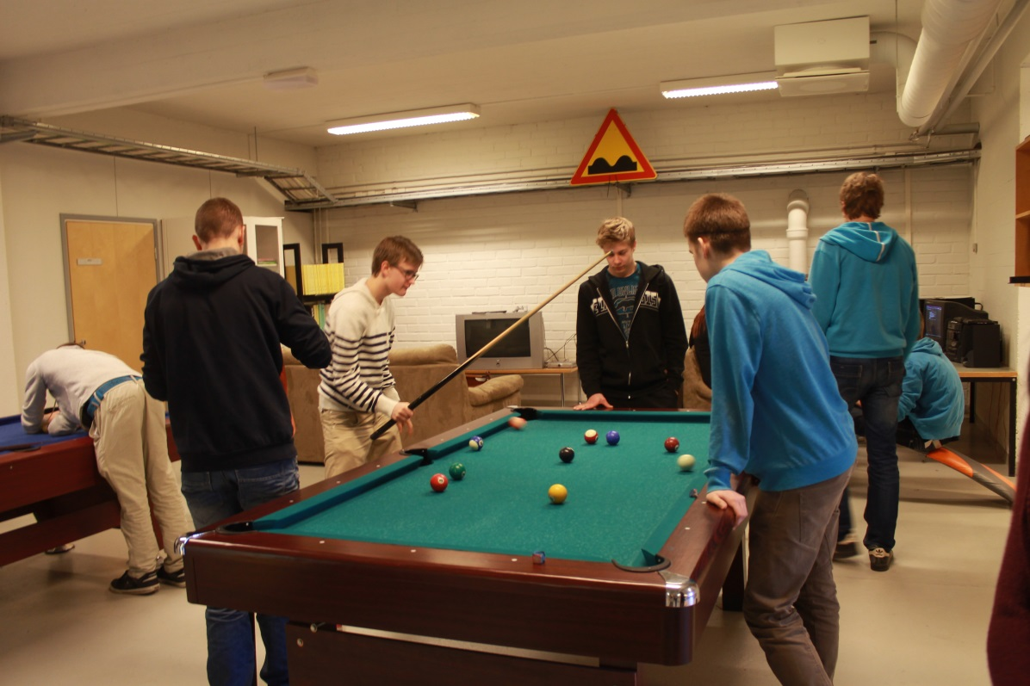
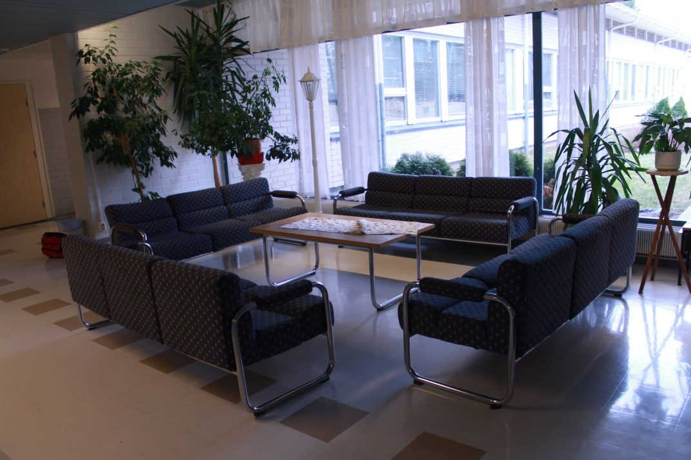
Breaks and free lessons
Usually we spend our breaks in the hallways.
Others spend their free time in a place called Monttu.
In Monttu we can play billiards or ping-pong,
listen to music or just relax.
Our high schools oldest pupils aka Abit have taken over
the sofas on the hallways.

Slide 5
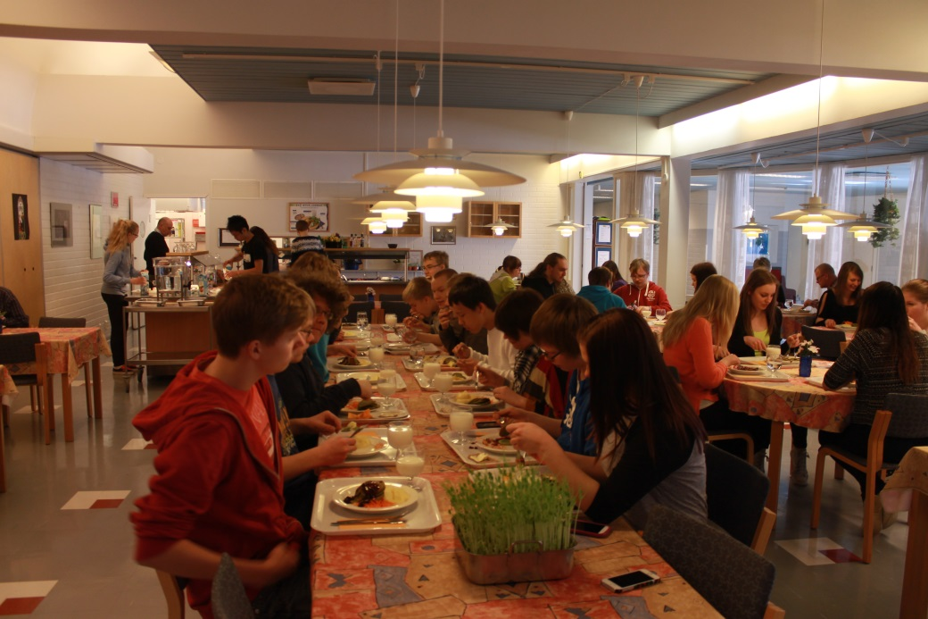
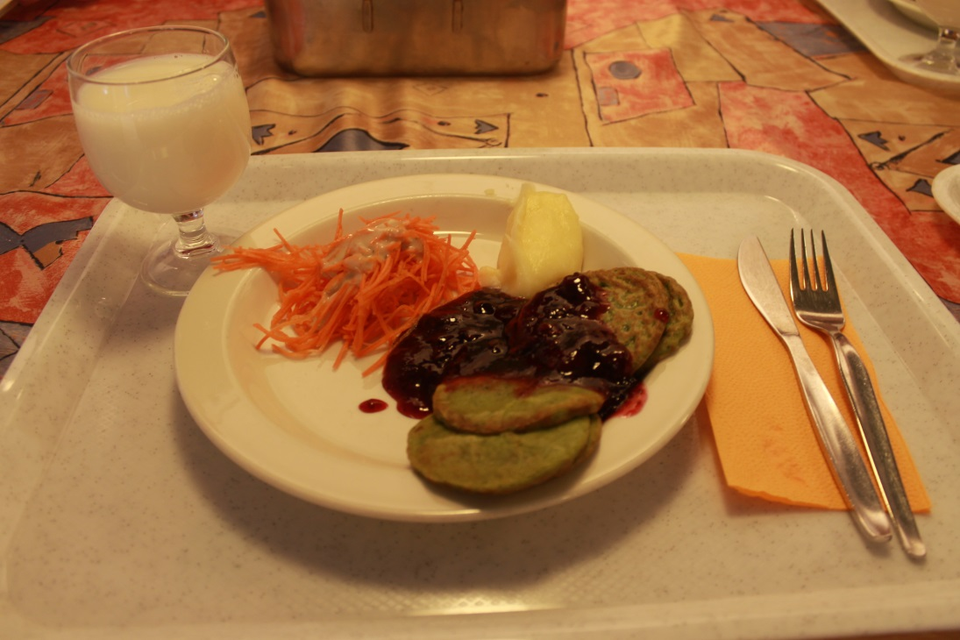
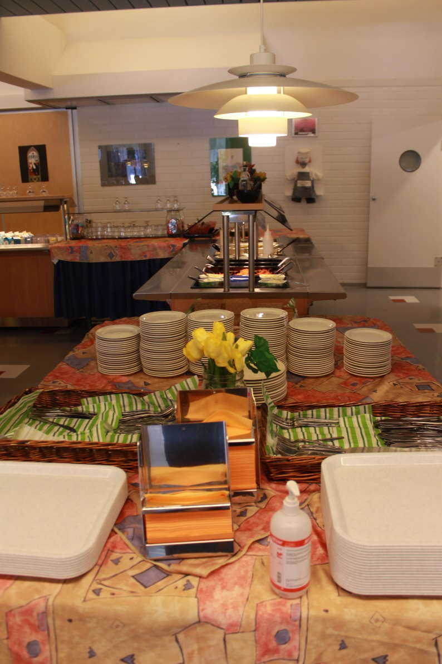
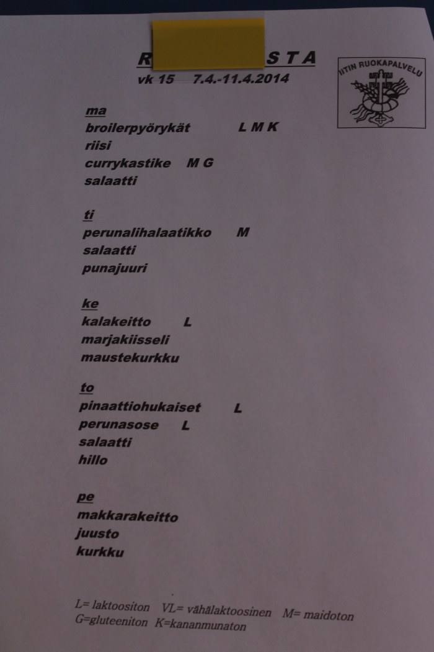
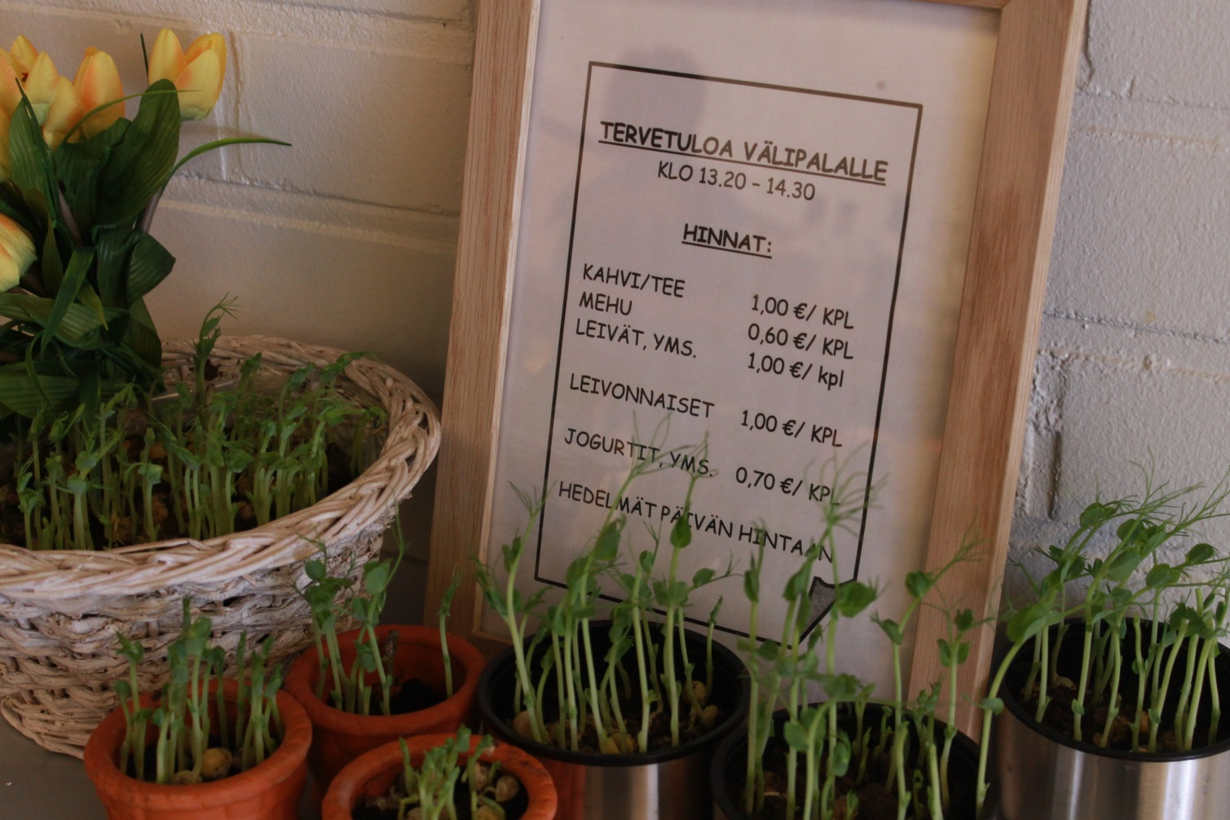
Lunch
Our lunch is in fourth lesson about 12 o’clock.
Our lunch is free and usually it’s very good. We also have snacks what costs about two euros.

Slide 6
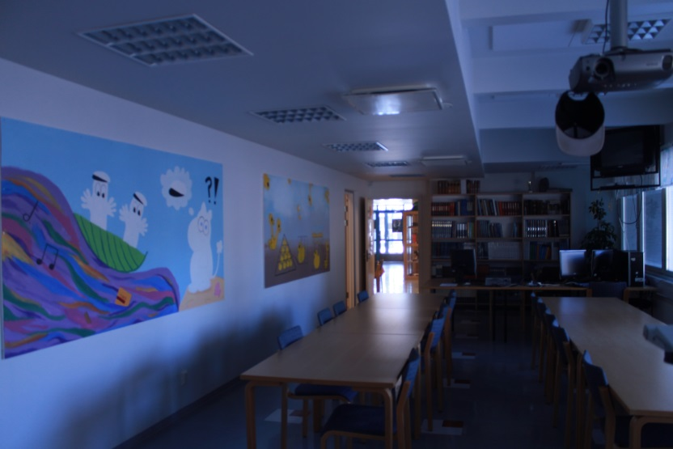
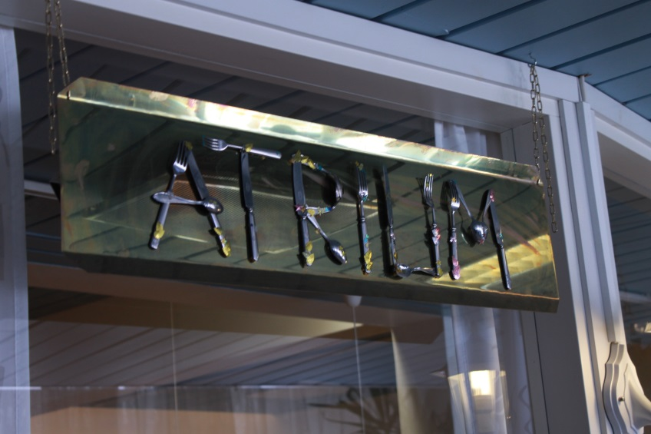
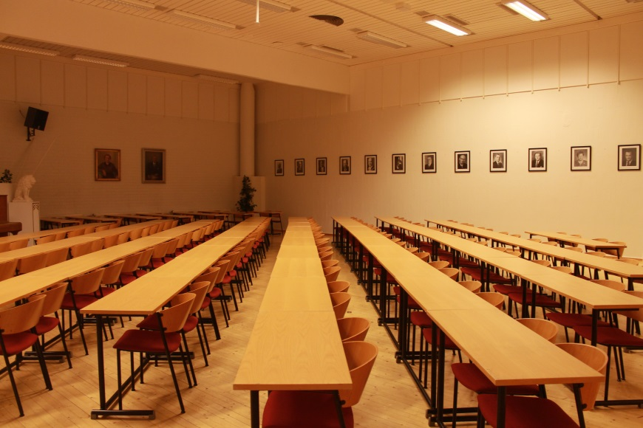
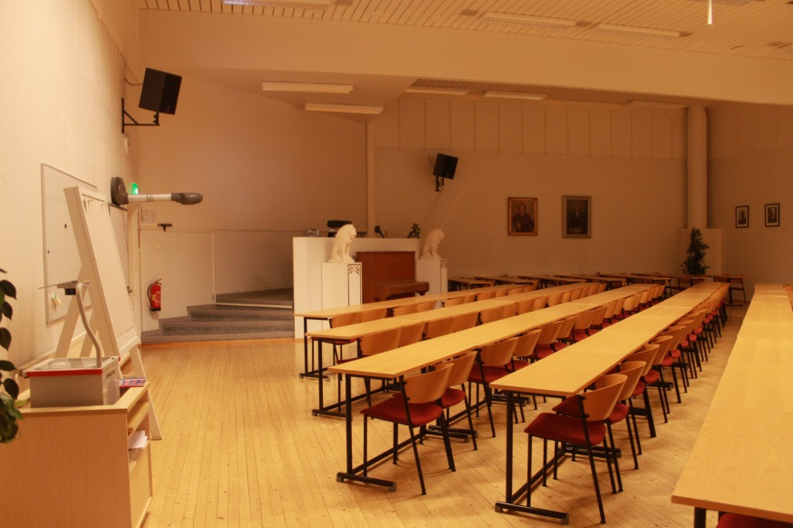
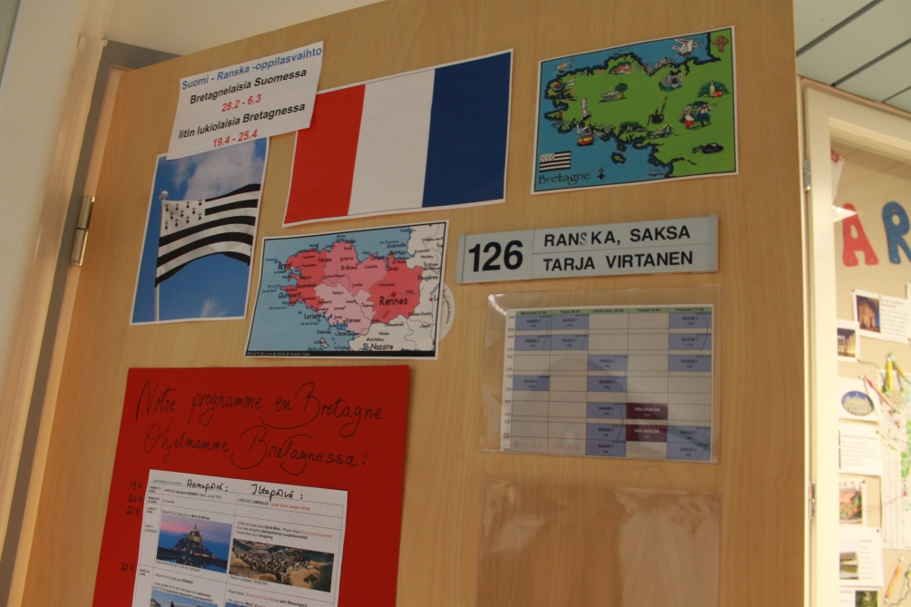
Places
Library
Dining hroom
Auditorium
Classrooms
Monttu (kind of a bomb shelter, random being place)
Library and dining room
Auditorium

Slide 7
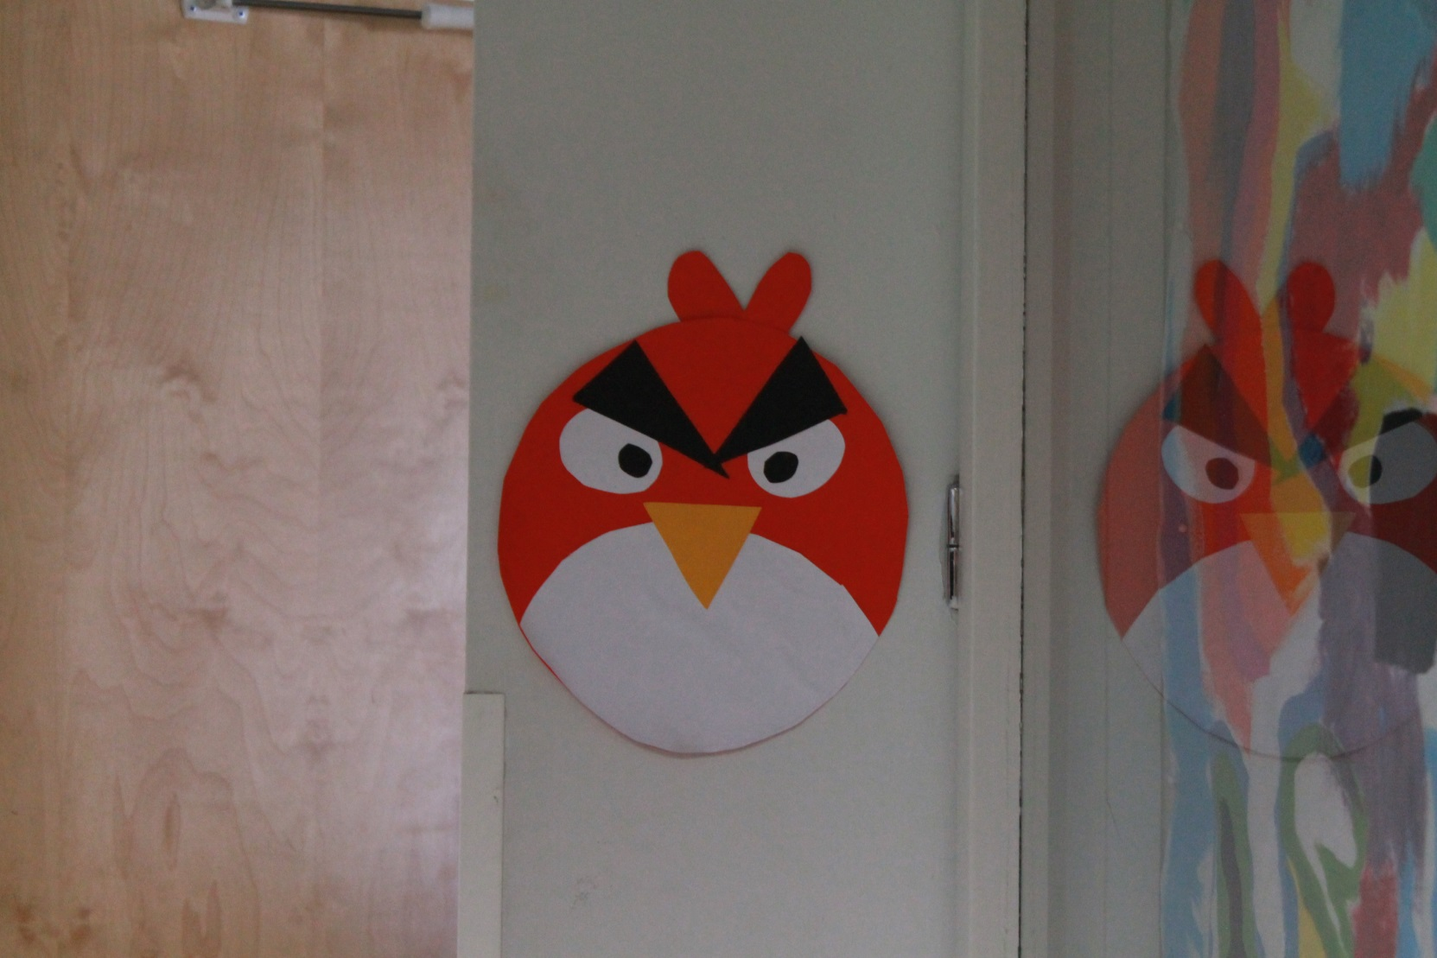
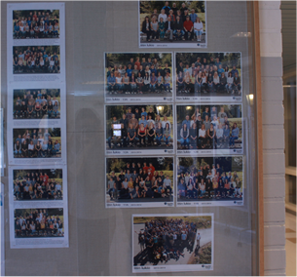
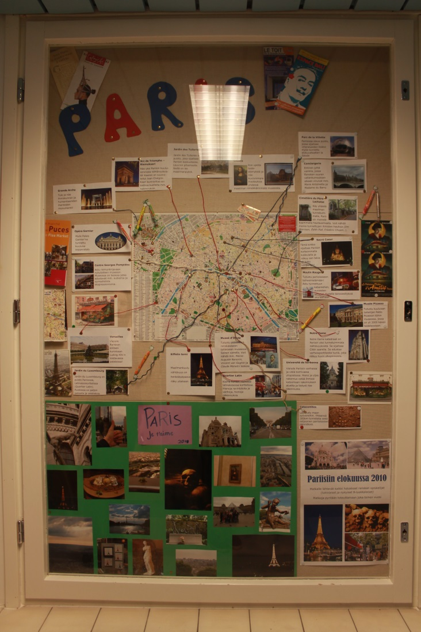
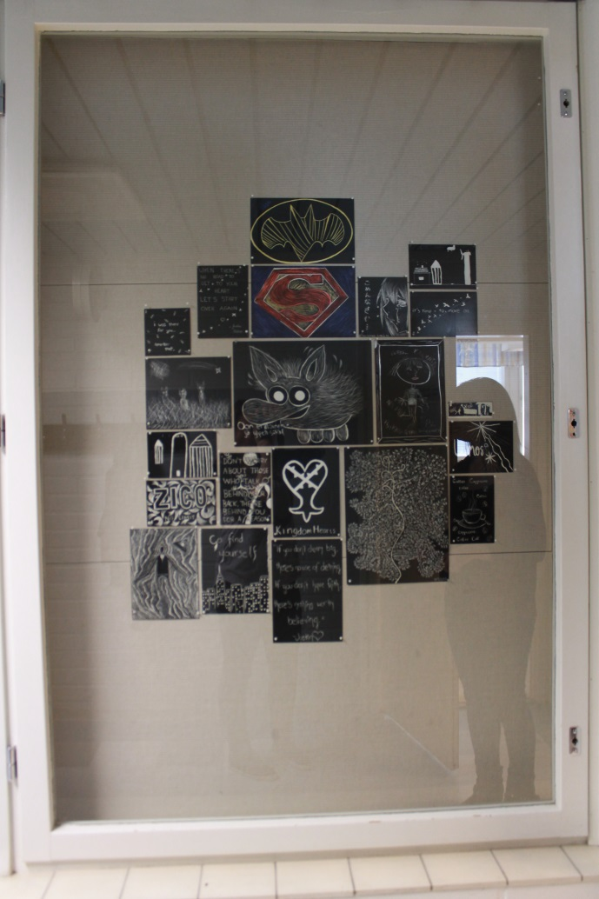
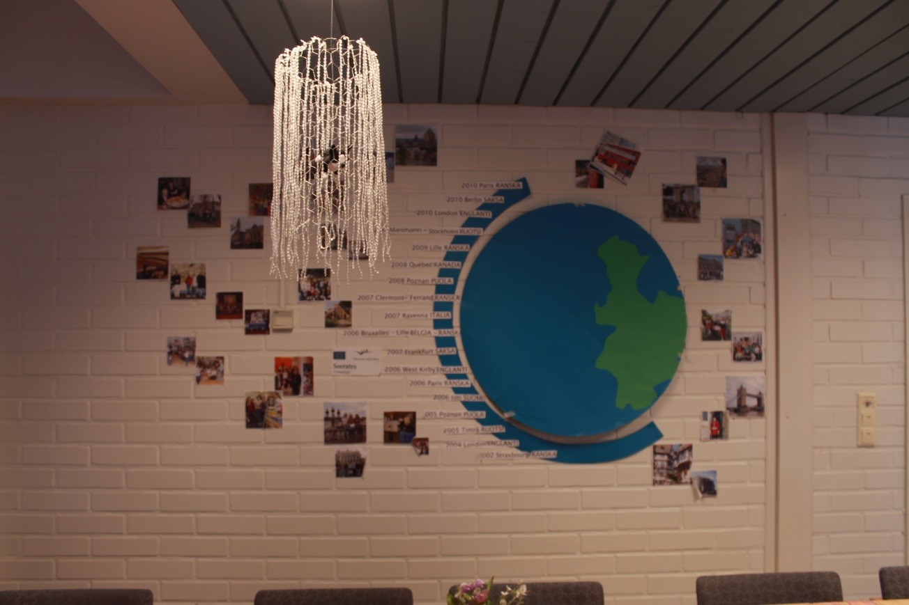
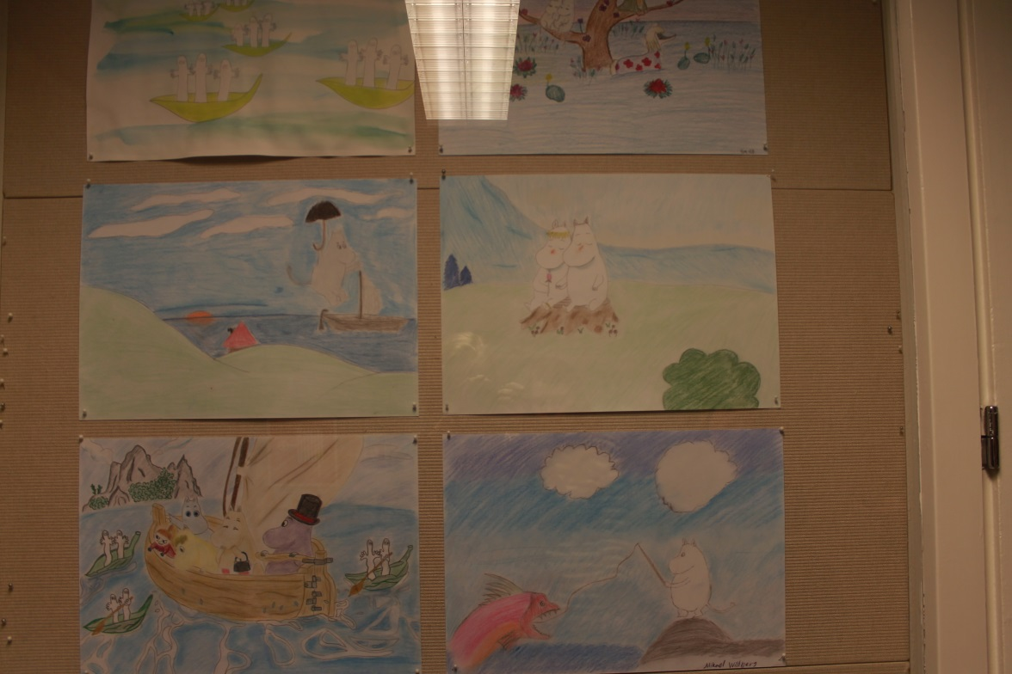
Hallways
A lot of works from the art lessons. In the pictures you can see famous finnish game Angry Birds and the story of Moomins.
Down below is a picture of different study trips.
There’s also pictures of every class’s students.

Slide 8
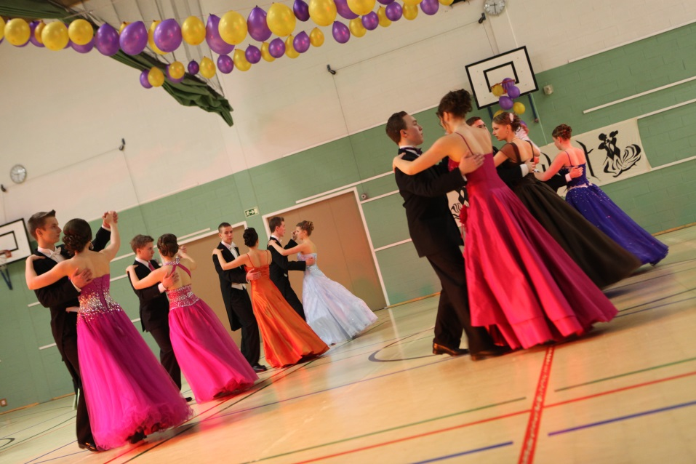
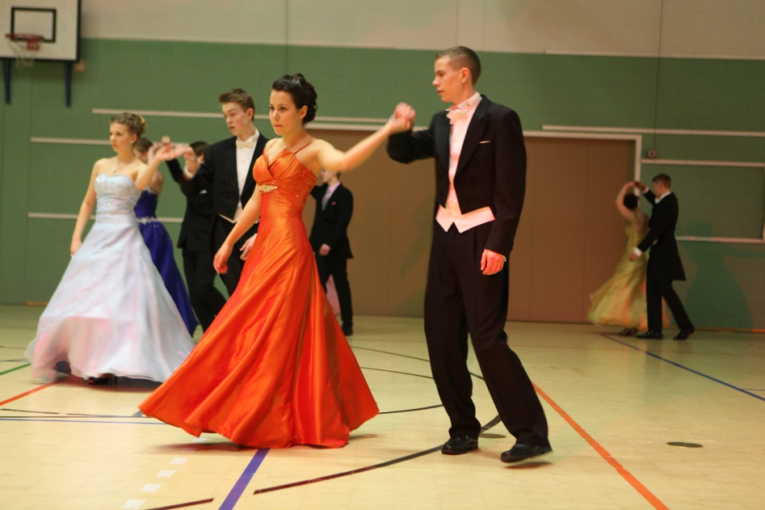
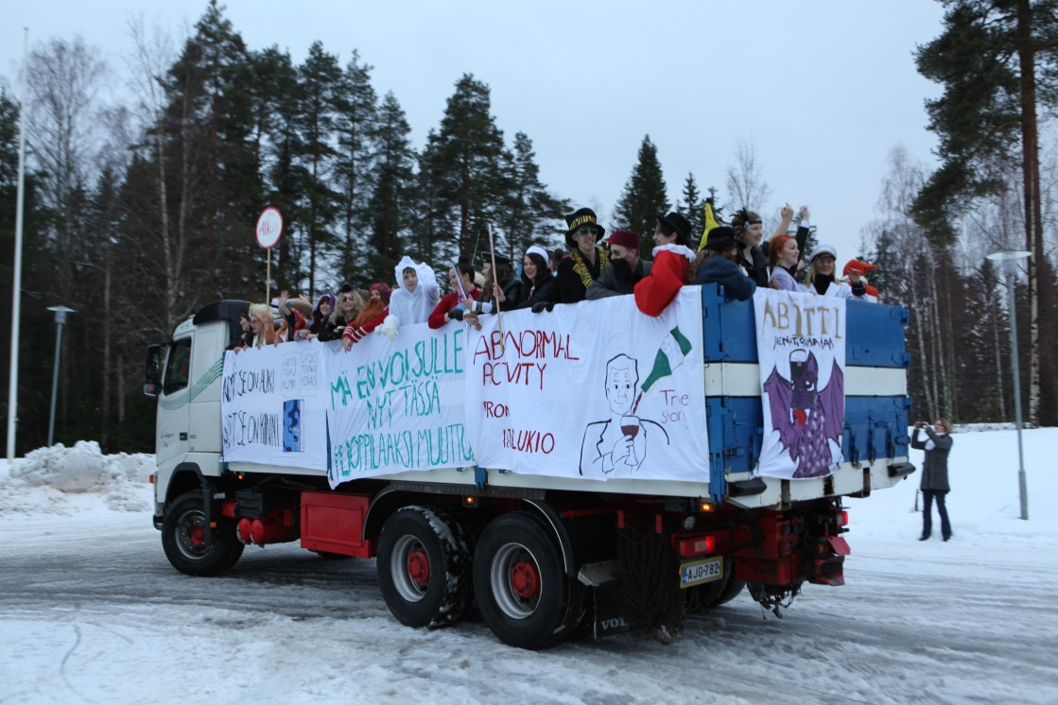
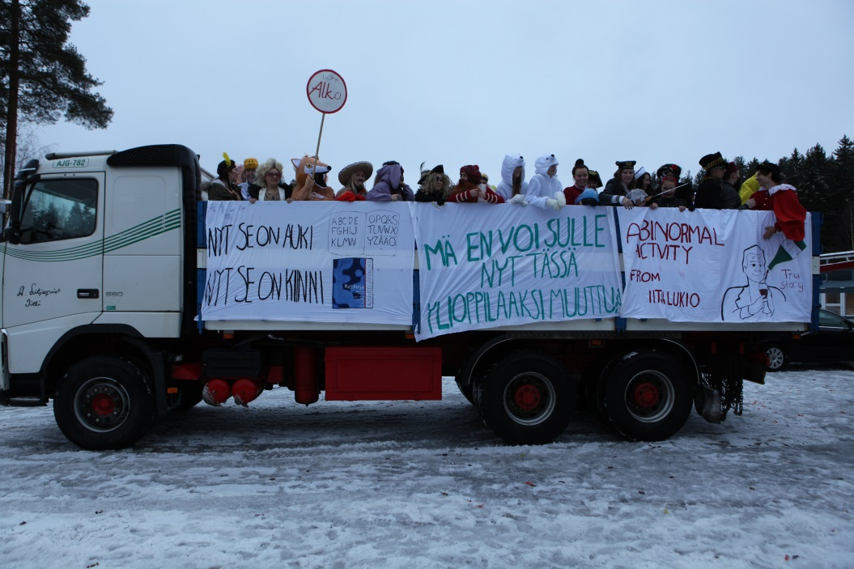
celebration time
Every year second-graders are dancing seniordances.
And third-graders are celebrating the end of the school,
dressing up in funny clothes and throwing candy.

Slide 9
Iittis other schools
Iitti also has elementary schools, the biggest of them is known as Kausalan koulu.
People start school at age of 7 and the elementary school lasts 6 years.
Iitti has only one junior high school and people study there 3 years.
After that the students will continue their studies wherever they want to or just stop studying.

Slide 10
Merci !

