Slide 1
Scuola di musica di fiesole
Italian Learning Music Program

Slide 2
Mission
FOUNDING VALUES
To uphold the value of music as an integral part of culture To spread the love of music as an active practice in society To uphold the value of music as a factor in social and individual growth and as a stimulus for intelligence, creativity and responsibility To support musical education in schools from an early age To share the results of our experiences with the community To favour methodical and lasting activities over short-term projects To enrich ensemble education by working with renowned professionals To develop performance experience which is both a fundamental element of education and training, as well as a public service

Slide 3
Funding
The Scuola di Musica di Fiesole is a private institution. It is a foundation and is no-profit.
SMF is one of the 27 italian private Institutions of the AFAM (High Musical and Artistic Education) authorised by the Italian Education Ministry to issue academic degrees with legal value
Funding of the Foundation Scuola di Musica di Fiesole Onlus:
Students Fees
Public funding (Ministries)
Private funding ( private citizens or entities which supports the activities of the School)
Revenues from concerts and productions
Donations and crowd funding

Slide 4
Some numbers
Student | 1509
Children Music Education | 170
Training for bachelor (preacademic course) | 493
Bachelor | 180
Master | 13
Postgraduated | 350
Orchestra Giovanile Italia (postgraduated course) | 55
Voice | 155
Adult education | 165
Masterclass and workshop | 520

Slide 5
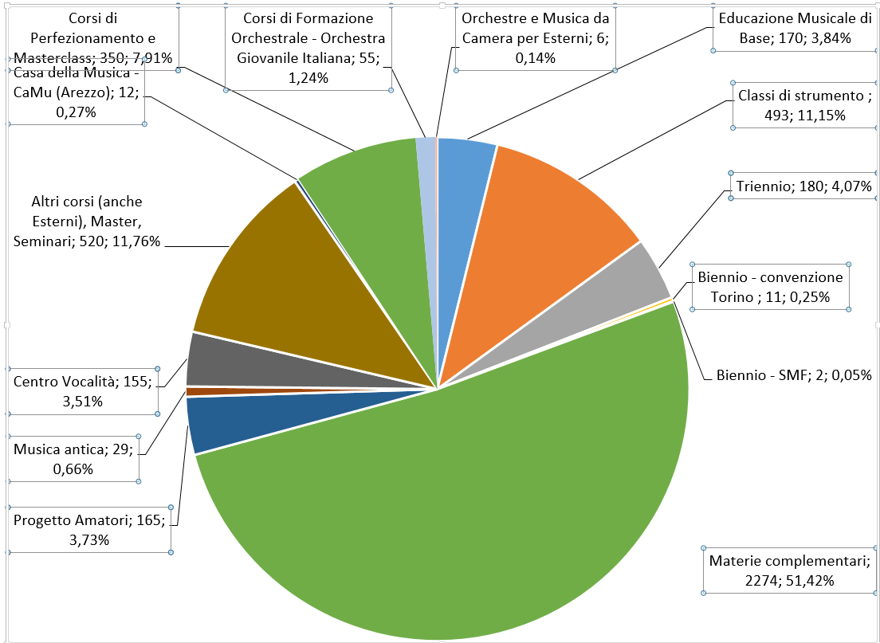
Graphic organization

Slide 6
Comparison:Italian School study program and Scuola di Fiesole study program
ITALIAN SCHOOL PROGRAM | DURATION (year) | AGE | SCUOLA DI FIESOLE MUSIC PROGRAM | DURATION (year) | AGE
 |  |  | Gordon Method | 1-2 | 0-3
 |  |  | Propedeutica musicale/ Rythm and singing | 3 | 3-6/9
Scuola Primaria/Primary School: 5 YEARS (from 6-11) | 5 | 6-11 | Preaccademico Base / Training for Bachelor: Base Level | 4-5 | It depend from instrument (6-10)
Scuola Media Inferiore/Intermediate School: from 11-14 y.o. | 3 | 11-14 | Preaccademico Medio / Training for Bachelor: Intermediate Level | 2-3 | 11-14
Liceo o Scuole Superiore/High School | 5 | 14-19 | Preaccademico Avanzato / Training for Bachelor: Advanced/High Level | 3-4 | 14-18
Esame di maturità/High School Exam |  |  | Bachelor Admission Exam
Università – Triennio I° Livello, AFAM, ITS/University Bachelor | 3 | 19-22 | AFAM – Triennio I° Livello/ Bachelor | 3 | 19-22
Diploma di Laurea di I° Livello/Graduate Bachelor |  |  | Diploma di Laurea di I° Livello/ Bachelor Degree
Università – Biennio/University Master | 2 | 22-24 | AFAM – Biennio II° Livello/ Bachelor | 2 | 22-24
Diploma di Laurea di II° Livello/Graduate Master |  |  | Diploma di Laurea di II° Livello/Master Degree
Master, Dottorato post-laurea Ricerca/Phd, Research, postgraduate | 3- |  | Corsi di perfezionamento/Postgraduate course (without degree at SMF) | 1-2

Slide 7
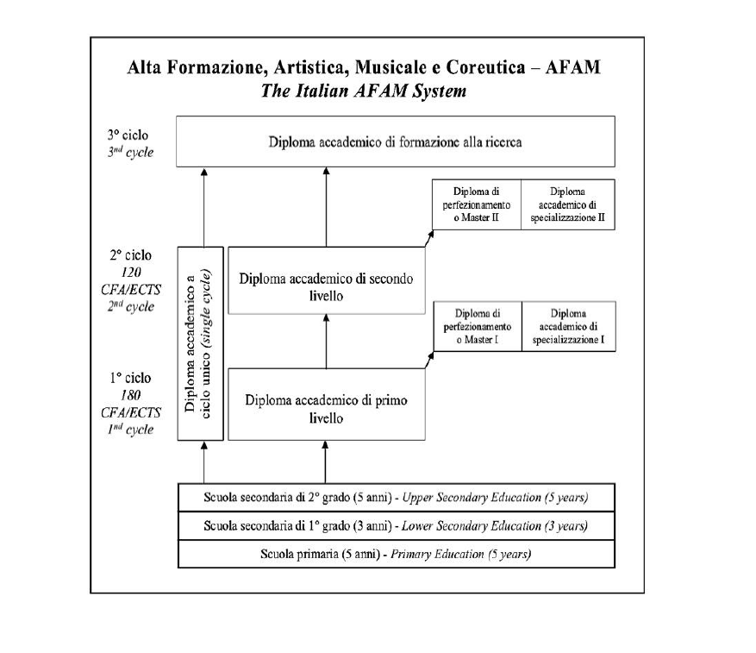
Music: The Italian AFAM System

Slide 8
International Students from all over than 40 countries in the world

Slide 9
Ciao!

