Slide 1
Paljoussanat – Kooste
New Insights
Module 5 Grammar

Slide 2
A little – little
We should have spent a little money on getting new plants.
If a garden gets little love, the plants will suffer.
There’s only a little beauty in the world but my garden has it!
Sanoja a little ja little käytetään yksiköllisten (= ei-laskettavien) substantiivien kanssa.
A little love = some love; little love = hardly any love
Only-sanan kanssa a little

Slide 3
A few – few
I've checked the text a few times.
Writing a text with few typos makes a good impression.
I made only a few mistakes last time.
Sanoja a few ja few käytetään monikollisten (= laskettavien) substantiivien kanssa.
A few typos = some typos; few typos = hardly any typos
Only-sanan kanssa a few

Slide 4
Much – many
How much effort did you put into this?
How many errors did you spot?
Did you need a lot of help with it?
Much + yksiköllinen substantiivi
Many + monikollinen substantiivi
Korvaavia muotoja on paljon (a lot of, plenty of jne.).

Slide 5
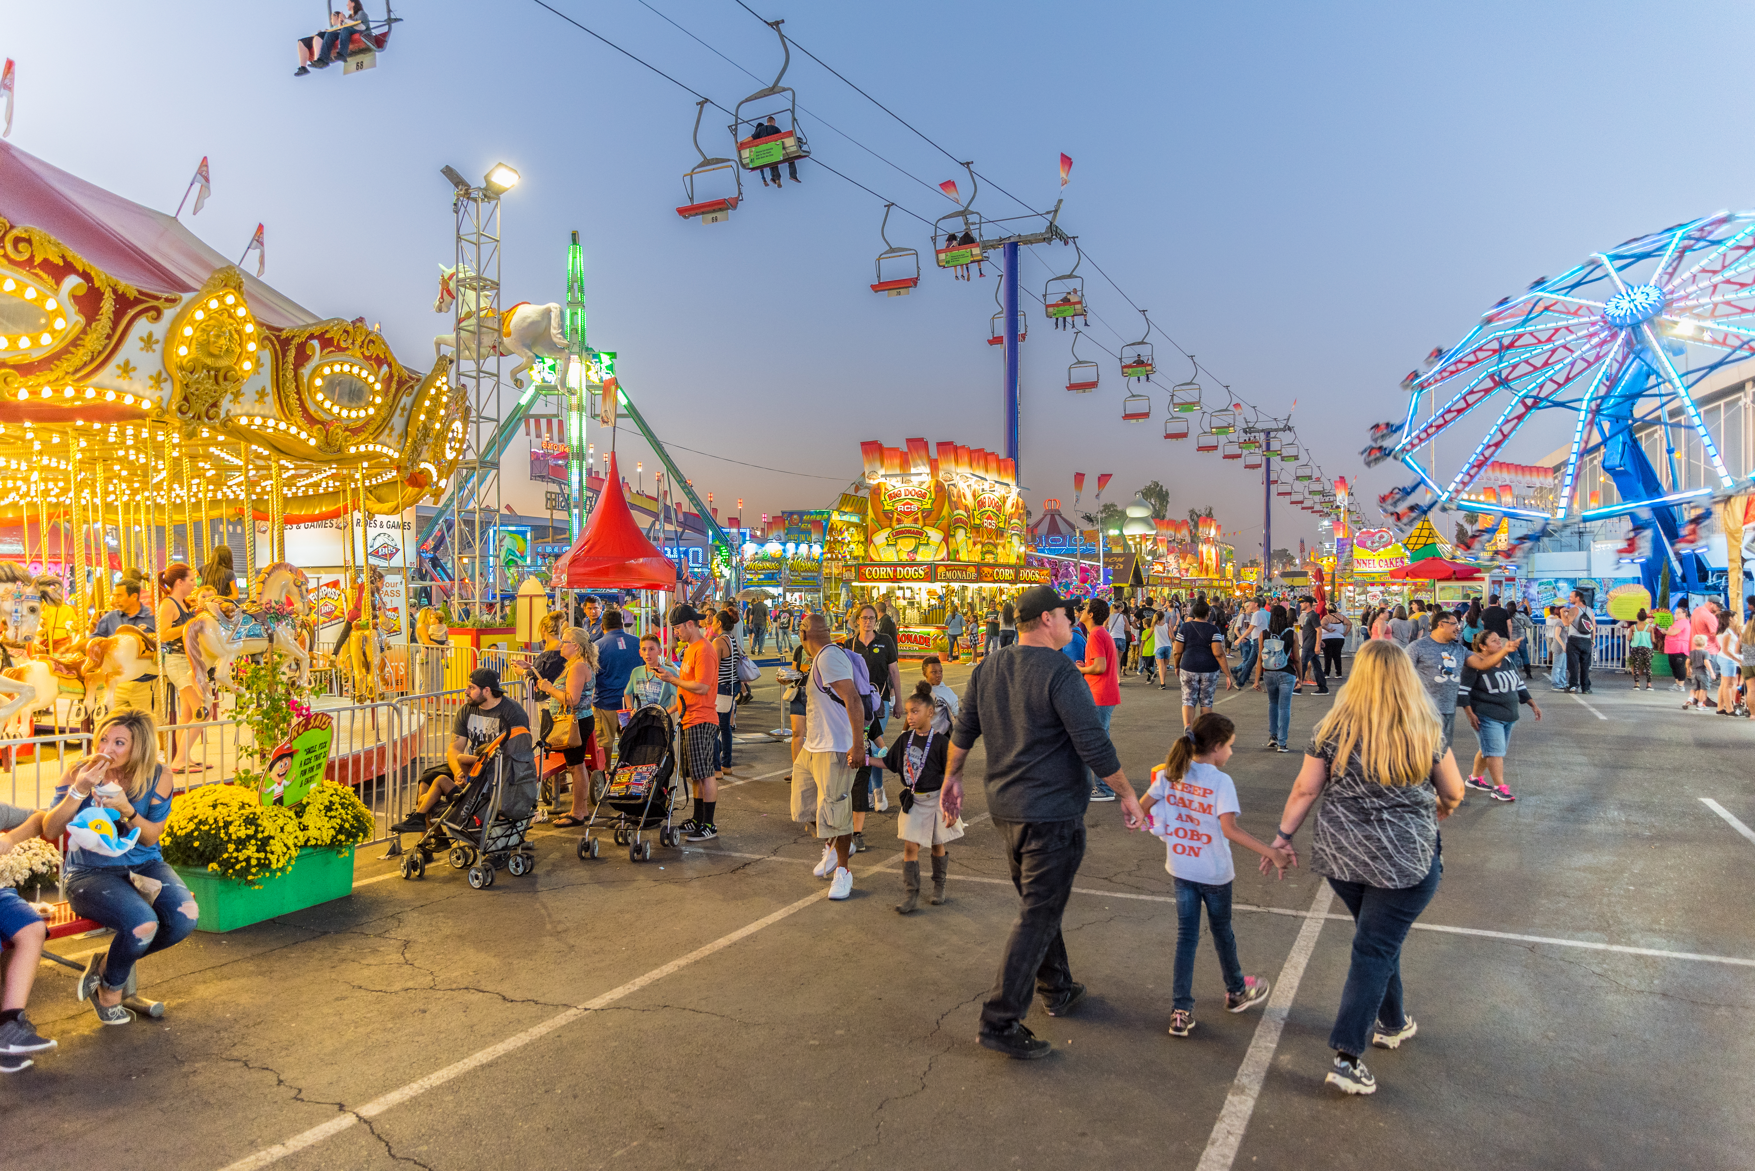
Practise. Take turns describing what you see in the picture. Use the given expressions.
Luckily there is a lot of …
Unfortunately there are also a few …
Surprisingly there is less …
There are only a few …
There might be many more …
I'd like to see much more …
iStock.com/Gregory Clifford

