Slide 1

Academie Bornem
17 februari 2023

Slide 2

Agenda
Position of the Academy in Education
Goals
Finance
Structure
Various
Questions?

Slide 3
Position of the Academie

Slide 4
Compulsory education | Non-compulsory education | Higher education
Pre school (2,5-5y) | adults (from 15y) | Graduate school (from 18y)
Primary school (6-11y) | societies (from 0y) | University (from 18y)
Secundary school (12-18y) | Academies (vanaf 6y)
Different Academies
Visual and Audiovisual Arts | Performing Arts (Music, Drama, Dance) | Art schools
Organizing powers of Academies
Urban and municipal education(150) Flanders: 185 691 students Bornem: 1000 students | community education (15) Flanders: 14 663 students | Free education (2) Flanders: 886 students

Slide 5
The organizing power is responsible for:
Infrastructure
Appoint staff
Educational program
Supervision of the Academy is done by:
Verification (2x/schoolyear)
Inspection (on average every 2 to 3 years)
Support for Urban and Municipal Academies:
OVSG (= Educational Association for Cities and Municipalities). They provide legal and pedagogical support.

Slide 6
Goals

Slide 7
The decree on part-time art education (2018) stipulates that part-time art education develops the artistic aptitude and competences of the students by practicing, creating, experiencing and contemplating art so that they can be encouraged to practice or experience art in their spare time or as employment or as a foundation to higher art education.
An academy carries out the following assignments
Organizing artistic education for a wide audience
Guiding students in their choices during their course of the learning path so that they acquire independence in their artistic development
Assess and certify acquired competences
New decree also offers the possibility to collaborate with compulsory education, to offer particular learning paths, to expand the range, to work in a modular way, to work with guest professors, to offer custom made learning activities.

Slide 8
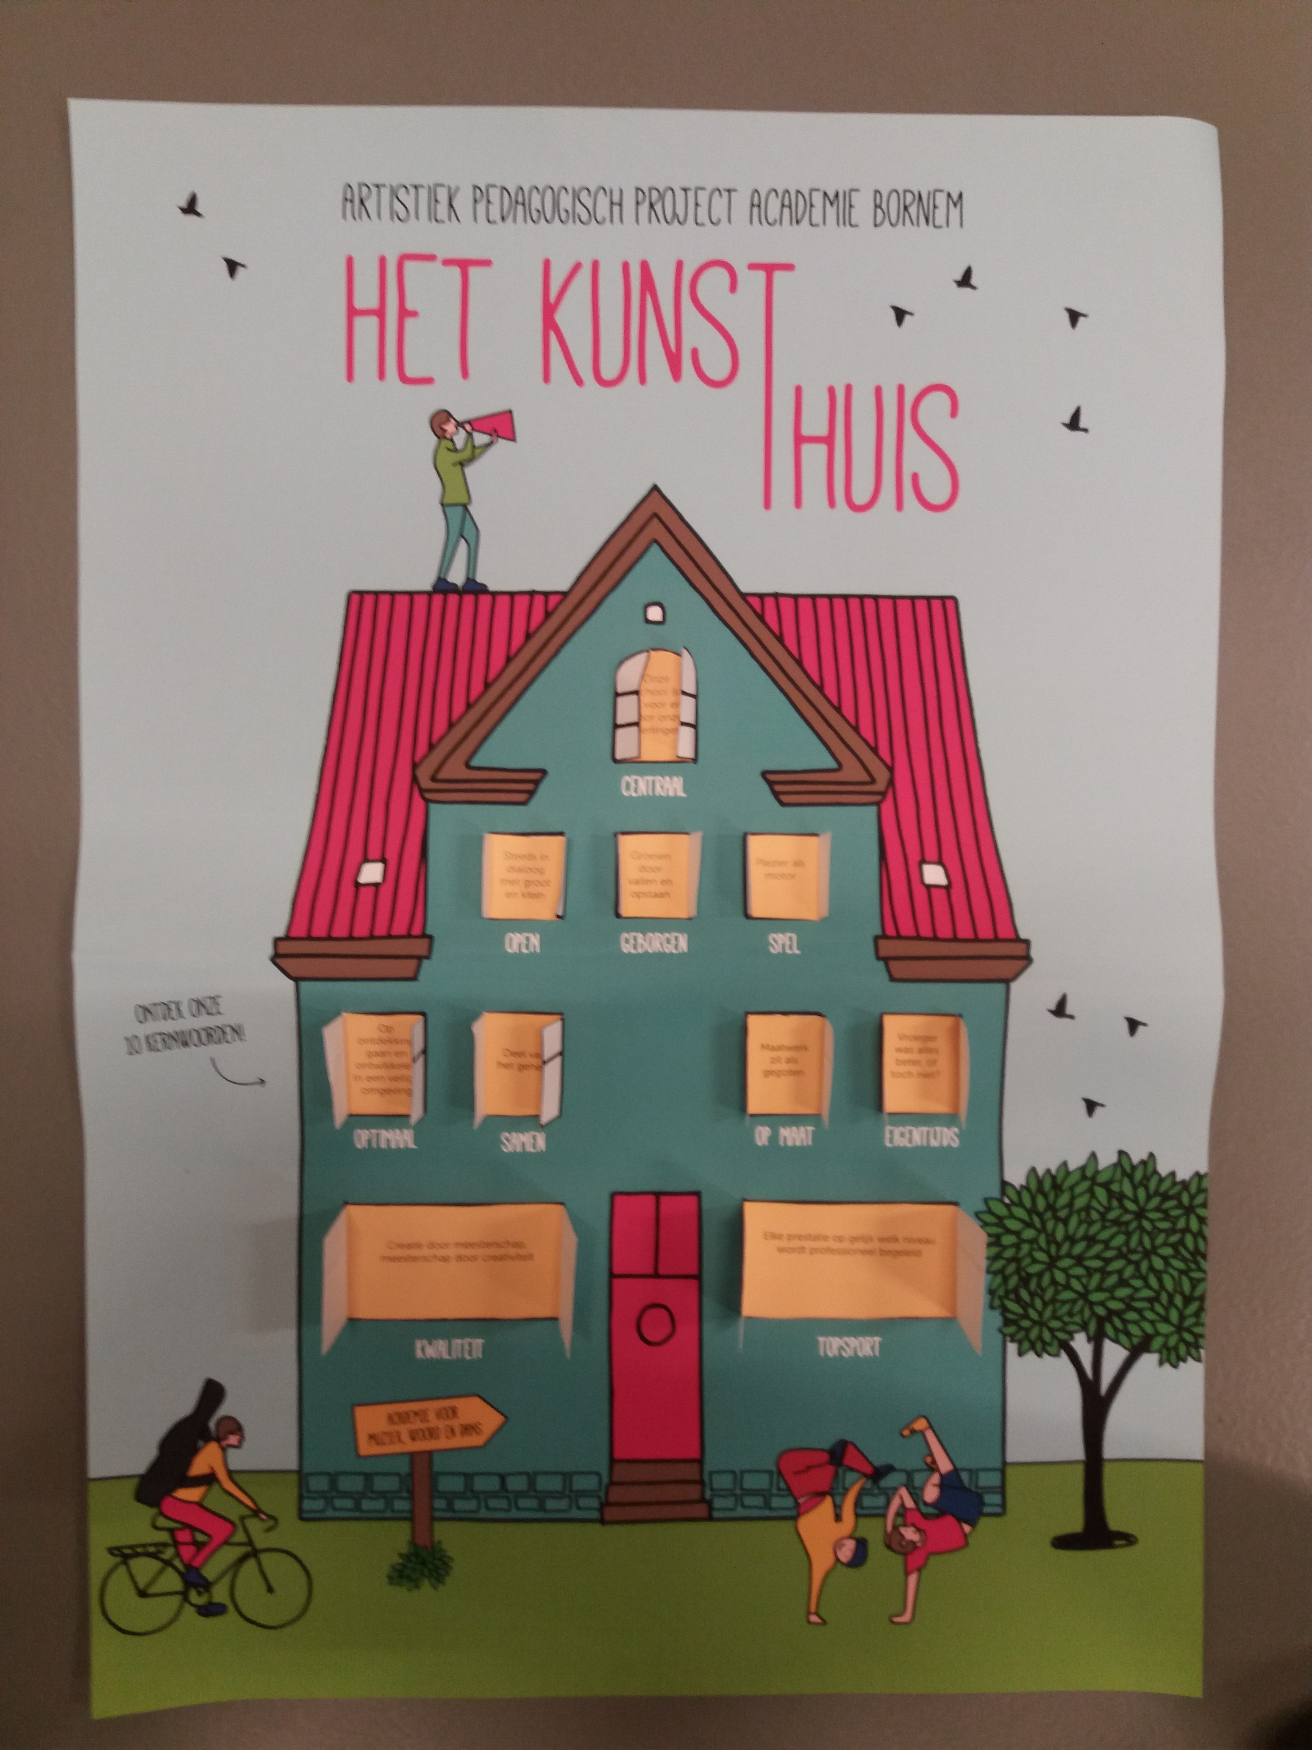

Slide 9
Finance

Slide 10
Financial support from the government:
Full teacher’s wage costs
Limited wage cost administrative employees
Limited budget for resources
Financial support from the municipality:
Infrastructure
Limited wage cost teachers
Main part of wage cost administrative employees
Big budget for resources
What’s the costs for a student?
Youth (6-18j): 74€
Youth (18-24j): 145€
Adults (+24j): 343€

Slide 11
 | Section | Total of students | Government hours | Municipality hours | Teachers | Administrative employees
 | Music | 709 | 465 |  | 56
 | Drama | 122 | 39 |  | 2
 | Dans | 218 | 61 |  | 9
 | CDI | 57 | 4 |  | 2
Total |  |  | 569 | 7 | 69 | 2,75 VTE
Students |  | 1106
Factual students |  | 1012
Initial guidance |  |  | 3
Union |  |  | 1
Core tasks |  |  | 4
Grand total |  |  |  | 584

Slide 12
Structure

Slide 13
See website: Academie Bornem

Slide 14
Various

Slide 15
Pedagogical comfort
Rental instruments
New courses
DJ
Hiphop/Breakdance
Custom made music course

Slide 16
Questions?

Slide 17




Thank you!

