Slide 1
HORMONES AND PHEROMONES AND THEIR EFFECTS ON BEHAVIOUR
IB Psychology LAJM

Slide 2
KISS
Neurotransmitters for you:
  Dopamine (excitatory neurotransmitter)
  Serotonin (inhibitory neurotransmitter)
  Acetylcholine (endogenous agonist)
  (Scopolamine (exogenous antagonist))
Hormones for you:
  Oxytocin
Pheromones for you:
  Human sex pheromone(s) (androstadienone and estratetraenol)

Slide 3
TASK
“Hormones and their effects on behaviour: Study one hormone and its effect on behaviour”
Review hormones in general and oxytocin
Review at least TWO studies (80–86) that possibly cast a different light on the topic
  Use the whole syllabus

Slide 4
TASK
Can you answer the following SAQ question?
  Describe one effect of one hormone on behaviour, with reference to one relevant study (M22 TZ1)
Can you answer the following ERQ/essay question?
  Discuss one or more hormones and their effects on behaviour (M23 Z1,Z2 and Z3)

Slide 5
TASK
“Pheromones and their effects on behaviour: Study one pheromone and its effect on behaviour”
Review pheromones
in general
Review at least TWO studies related to the alleged human sex pheromone(s) (89–93) that possibly cast a different light on the topic
  Use the whole syllabus

Slide 6
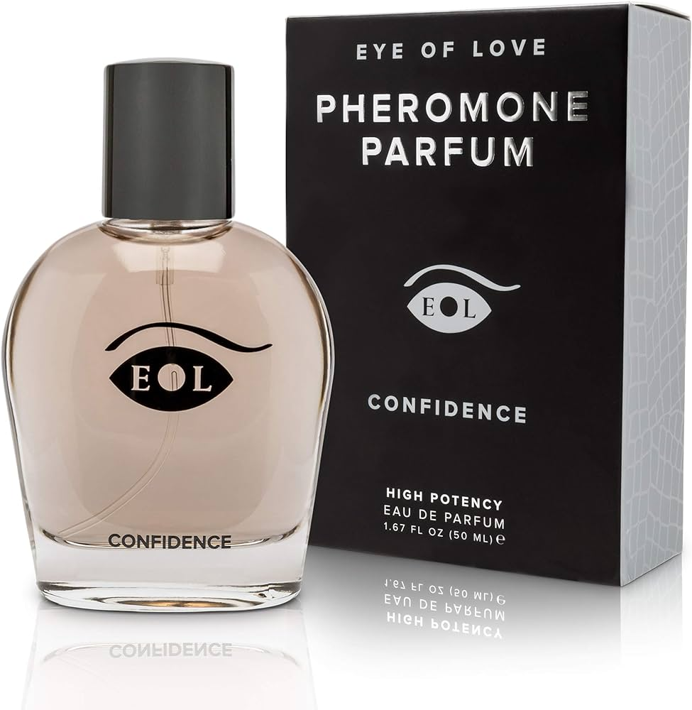
TASK
Can you answer the following ERQ/essay questions?
  Discuss the effect of pheromones on human behaviour (M19 TZ2)
  Discuss the effect(s) of one or more pheromones on behaviour (N22)

Slide 7

TASK
Can you answer the following ERQ/essay question?
  Discuss how one or more hormones and/or one or more pheromones affect human behaviour (N21)

Slide 8
Picture sources
Pheromone parfume 1 <https://www.amazon.com/Eye-Love-Confidence-Pheromone-Cologne/dp/B07CWY2V3K> Accessed 12th of February 2024.
Pheromone parfyme 2 <https://www.fruugo.fi/10ml-venom-pheromone-fragrance-hajuvesi-miehillenaisille-pitkakestoinen-stimuloiva/p-163370938-347374114> Accessed 12th of February 2024.

