Slide 1
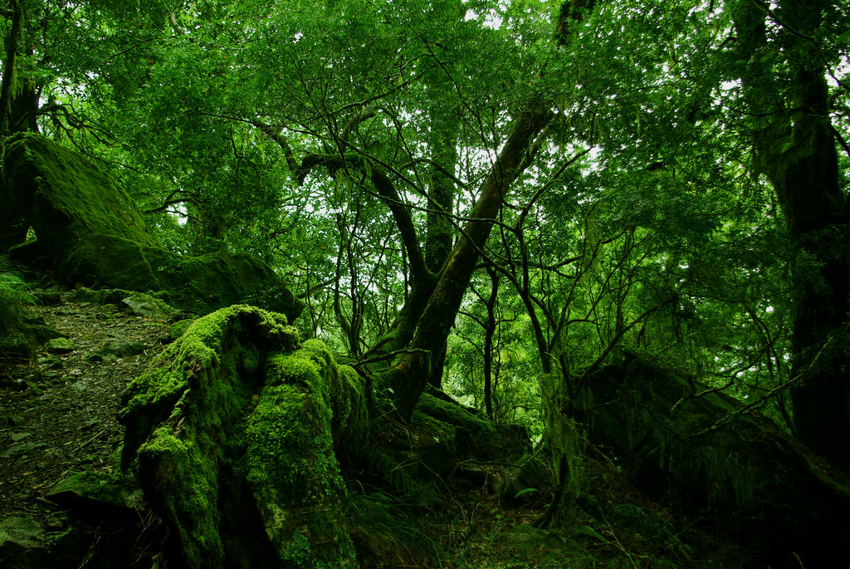
Rainforests

Slide 2
Basic information
Characterized by high rainfall (rains over 1500 mm a year)
Rainforests contain up to 70% of all biological species
rainforests produce about 30% of all oxygen
The trees placed dense and there is many different species, and the undergrowth is little bit less.

Slide 3
Fun facts
There is actually four different rainforest areas
Tropical rainforest, which are mainly located in the low-pressure zone.
Subtropical rainforest, , which is mainly located near the tropics.
The temperate rainforest, which lies mainly in north.
Mountain Rainforest, which is located in tropical and subtropical zones on mountain slopes.
Every year researchers find new animal and plant species. Even if they have investigated them for many years.

Slide 4
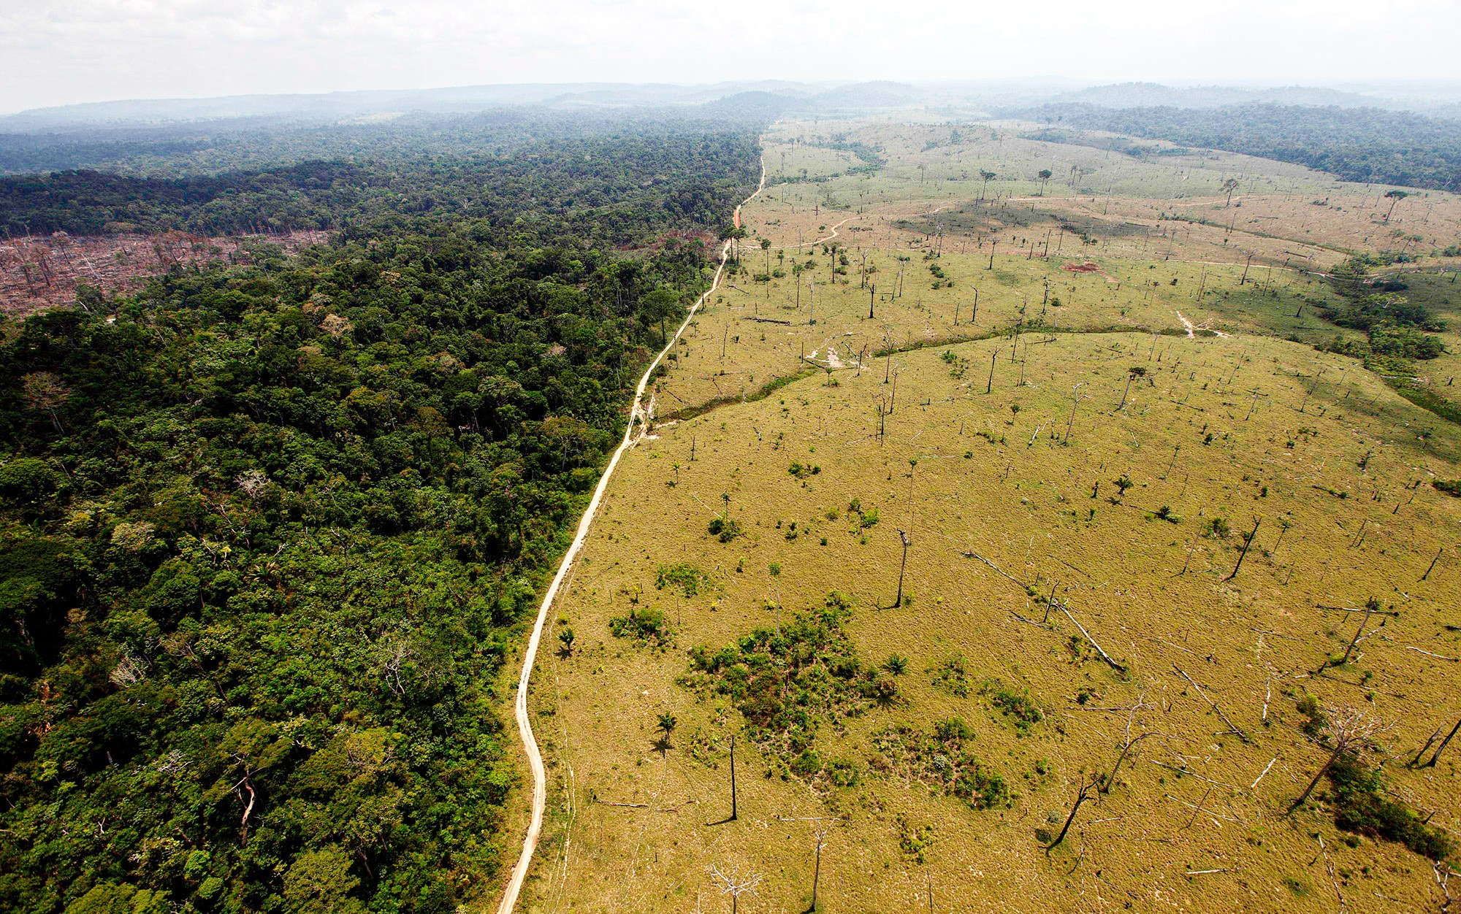
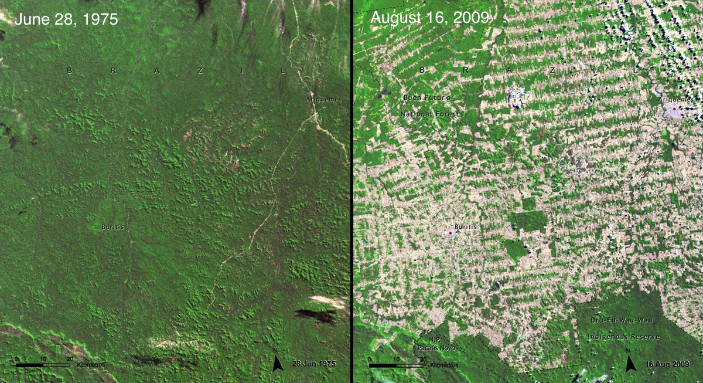
Future

Slide 5
Future
As can be seen from the pictures, rainforests have decreased significantly only in a small amount of time.
The lower picture is a satellite image from Brazil. First one is from 1975 and second is from 2009.
My guess is that after 50 years, only 1/4 of the rainforest is left if humans don't stop destroying them.
And if I hit it right, it’s going to effect a lot. We will definitely have less oxygen in the air. The Earth also releases more greenhouse gas into the air.

Slide 6
Thank you

