Slide 1
Open Educational Resources
– Themes and recent developments
29.09.2015
Henri Pirkkalainen
Project Researcher (PhD), Jyväskylän Yliopisto

Slide 2
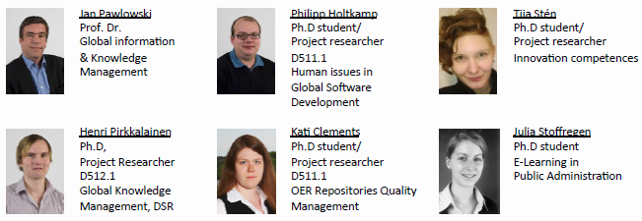

Global Information Systems
at the University of Jyväskylä
Focus areas
Global Information Systems
Supporting globally distributed workgroups
Open Educational Resources
Reference Modeling
Projects
Open Educational Ideas and Innovations
IMAILE
Open Discovery Space
BOLDIC OLRO
Nordic OER
…

Slide 3
Agenda
OER and related topics
Examples and Lessons learnt from the ODS and OEI projects
Discussion
Nordic / Baltic cooperation networks for OER

Slide 4

OER?

Slide 5





Licensing: Creative Commons
You are free:
  to Share — to copy, distribute and transmit the work
  to Remix — to adapt the work
Under the following conditions:
  Attribution. You must attribute the work in the manner specified by the author or licensor (but not in any way that suggests that they endorse you or your use of the work).
  Noncommercial. You may not use this work for commercial purposes.
  Share Alike. If you alter, transform, or build upon this work, you may distribute the resulting work only under the same or similar license to this one.
http://creativecommons.org/licenses/by-nc-sa/3.0/
http://www.slideshare.net/jan.pawlowski
Notes:
5

Slide 6
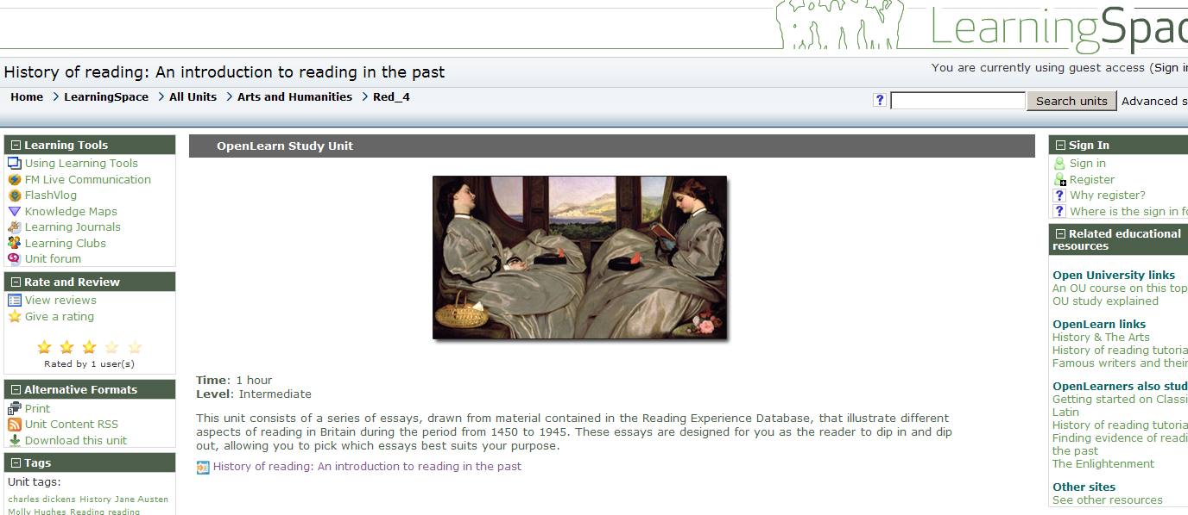
Examples
http://openlearn.open.ac.uk/course/view.php?id=4387
Full courses

Slide 7
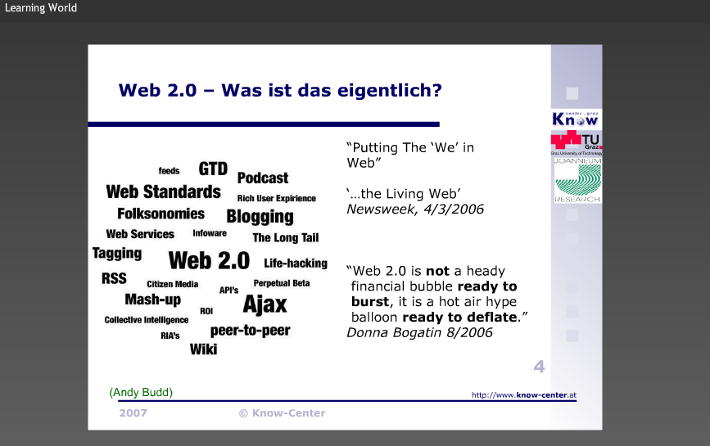
Examples
Slidesets etc
http://slidestar.de/main.html#slideware/view:10

Slide 8
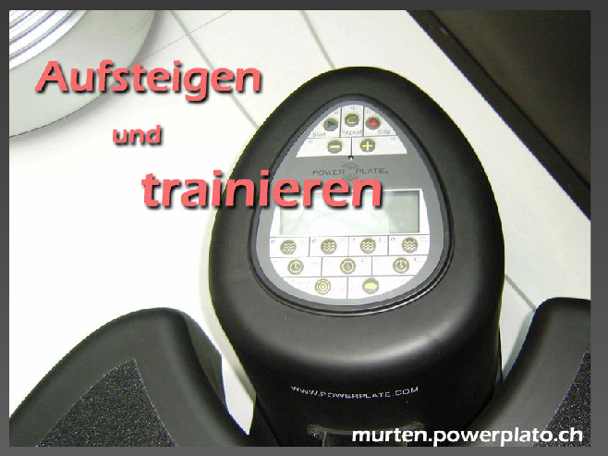
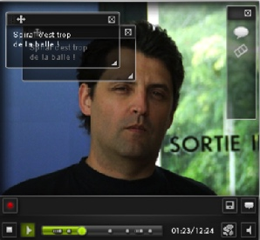

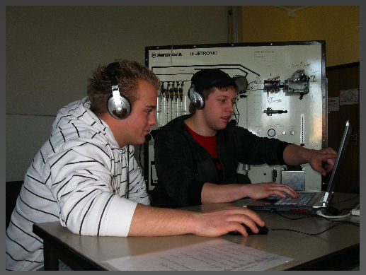
Examples
Videos, images
http://slidestar.de/main.html#slideware/view:1051
http://slidestar.de/main.html#slideware/view:1013
http://slidestar.de/main.html#slideware/view:1076

Slide 9
Most importantly
Open Educational Practices and shared experiences are in the center of Open Education
Lesson plans
Learning scenarios
Using ICT in a transparent manner
Exchange of knowledge and best practice!

Slide 10
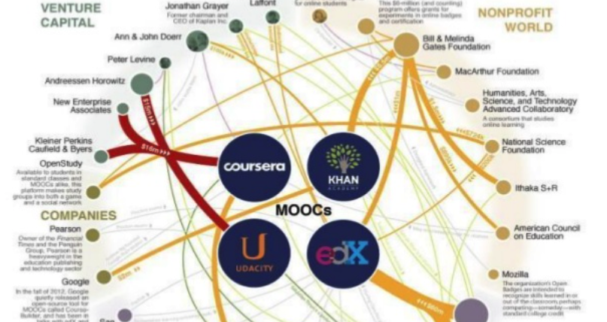
MOOCs
…Extending the OER landscape

Slide 11







Examples where to find OERs
ODS – for schools
OSR – natural sciences
LRE – various topics
OER Commons – various topics
OpenScout – Business & management
LEMILL – various topics
Discover the Cosmos - Astronomy

Slide 12
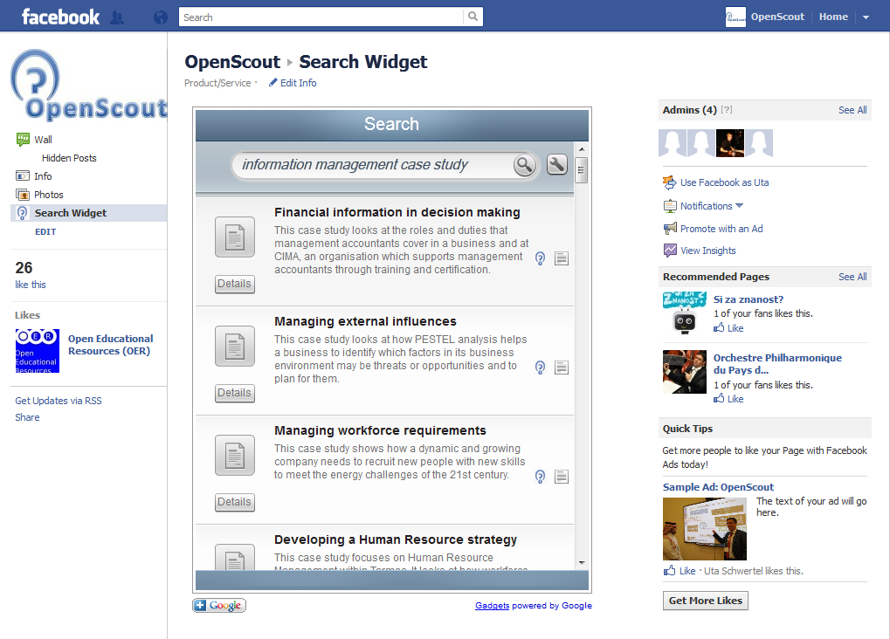
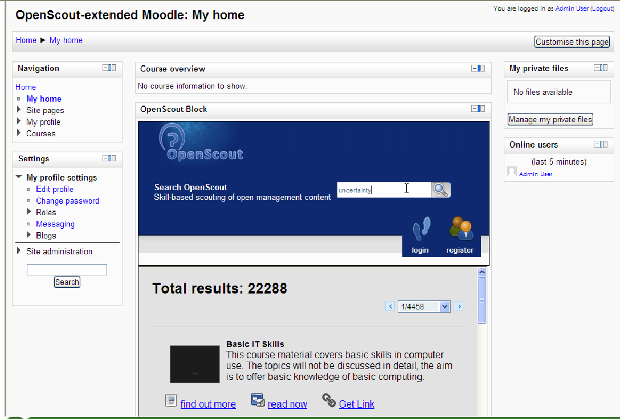

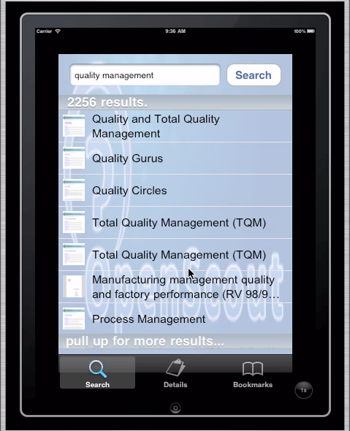



Integrating OER solutions
Extending functionalities and integrating OERs to LMS’s of schools
Notes:
NÄYTÄ ENNEMMIN LIVENÄ

Slide 13
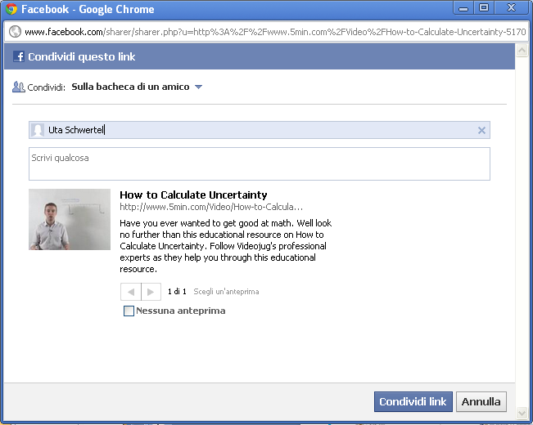
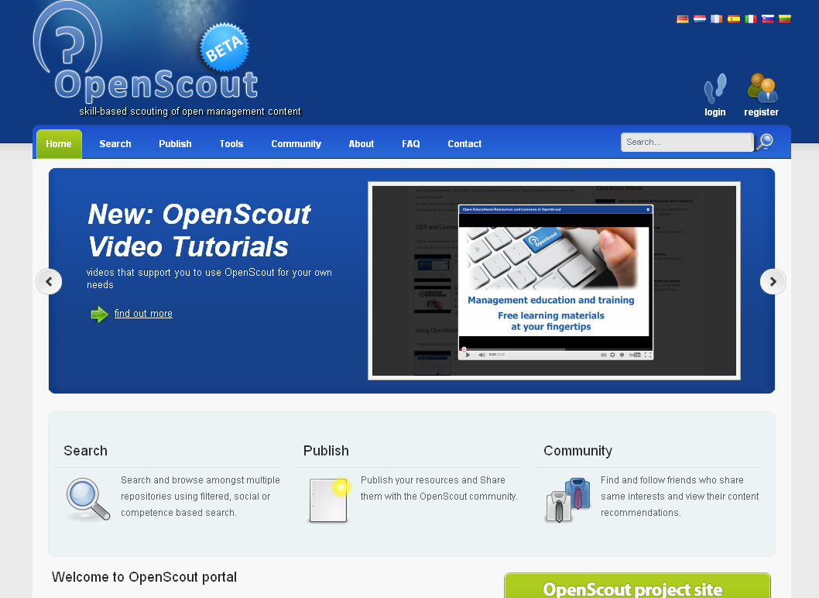
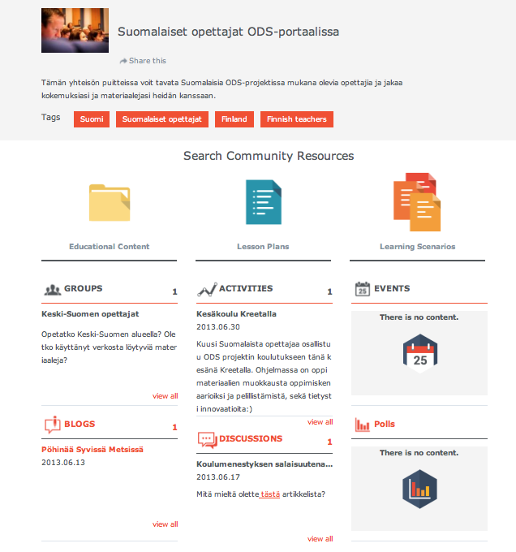
OER goes social and collaborative

Slide 14

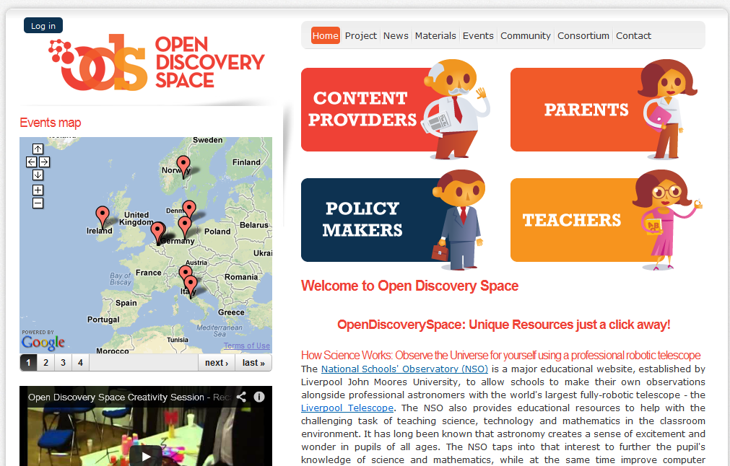

Open Discovery Space
Portal that integrates existing materials and services:
-OERs for science education
-lesson plans
-teacher communities
-authoring tools for schools
-Local portals for schools
(open or closed)
http://portal.opendiscoveryspace.eu/

Slide 15
Setting up a community
International /thematic
Regional and local
Within a school,
For techears
For students
For a class
For a course

Slide 16
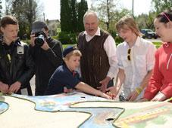
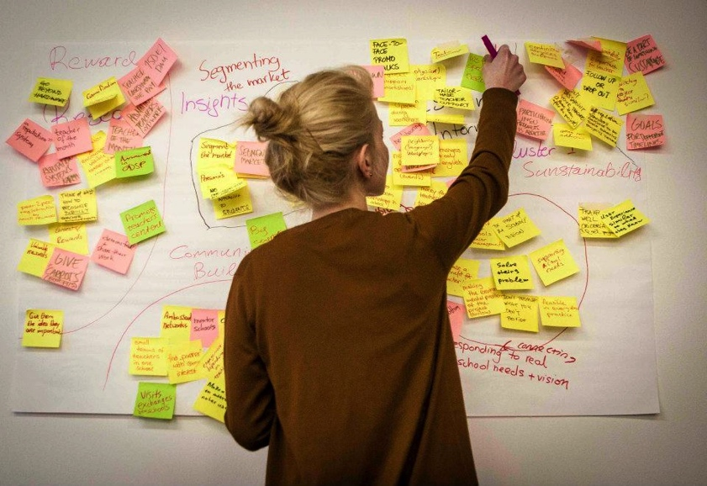
Basic user and usage experience
Exploring new teaching practices and ideas
Exploring resources for teaching as well as lesson plans
Sharing own resources
Exchanging experiences and ideas
Community-driven
e.g. how to beam wireless with an iPad.

Slide 17
Findings
Positive as well as worrying results
First of all, culture of sharing often missing. Technology can only play a role when it serves a real need
Differences in educational systems even within country. Therefore, the solutions are different
Notes:
..voisi alleviivata kyselyä tässä vaiheessa

Slide 18
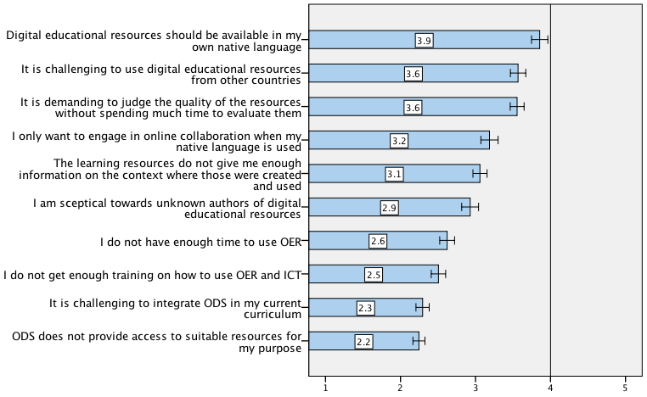
Findings
Positive as well as worrying results
1= Strongly disagree, 3= neutral, 5= Strongly agree
Notes:
..voisi alleviivata kyselyä tässä vaiheessa

Slide 19
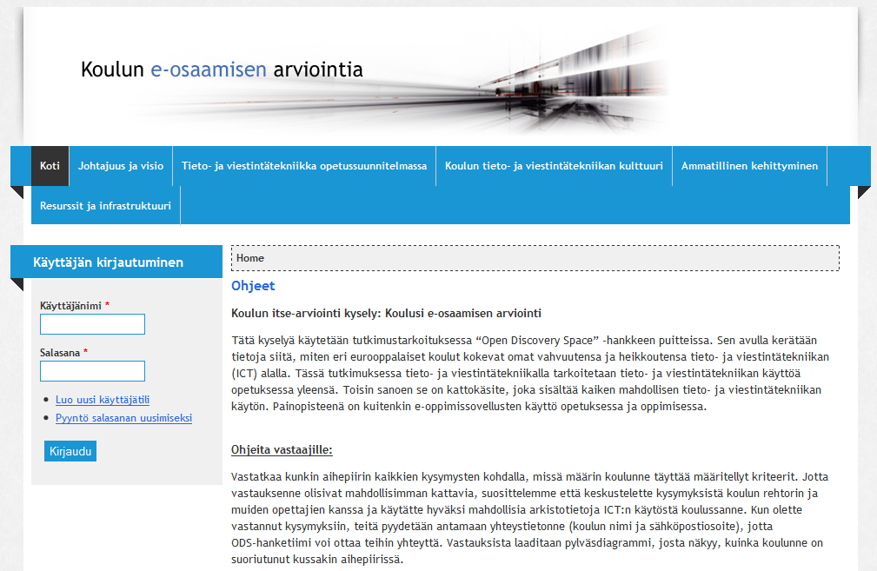
Findings
Participation and exchange in local and international teacher communities boosts enthusiasm
The higher the maturity of schools OER and ICT practice, the less teachers engage to exchange their ideas and knowledge!
Why so?
Notes:
..voisi alleviivata kyselyä tässä vaiheessa

Slide 20
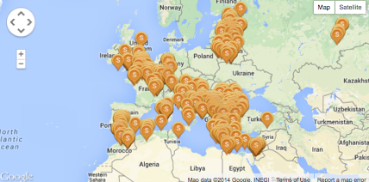
ODS schools

Slide 21
Examples through ODS

Slide 22


Virtual visits to CERN
Collaborative learning activities
and Webinars
ATLAS is a particle physics experiment at the Large Hadron Collider at CERN that is searching for new discoveries in the head-on collisions of protons of extraordinarily high energy.

Slide 23
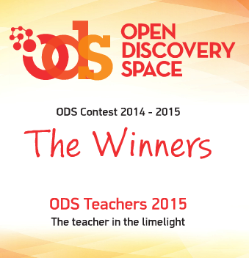
ODS Contest results
http://www.ods-contest.eu
1st stage of ODS Contest Winners
The National Winners’ prize is their participation at the ODS summer school, July 12 – 18, 2015 in Attica, Greece, with all their expenses covered.
2nd stage of ODS Contest Winners
The two PanEuropean winners will be nominated as “ODS Teachers of 2015”, experiencing the publicity related to this nomination.
Also, both winners will receive an iPad.
All participating teachers (National Winners) who will participate on the ODS Contest’s second stage, will receive the ODS certificate of participation.
http://issuu.com/signosis/docs/ods-contest-brochure

Slide 24
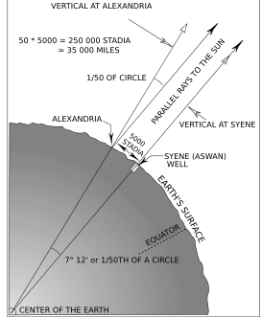
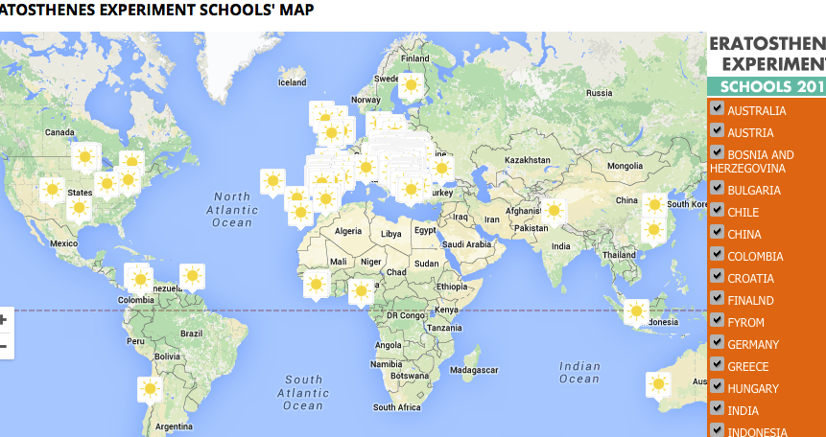
Common learning activities
http://eratosthenes.ea.gr/en/content/experiment
507 schools from 37 countries
- Eratosthenes-experiment for co-learning maths and astronomy
- Calculating the distance between co-operating schools
- To enforce language – and communication skills learning

Slide 25
Connecting schools with Science Centers, using augmented reality equipment and OSR portal pathways- Finland (multiple schools). Video link: http://vimeo.com/61730727

Slide 26
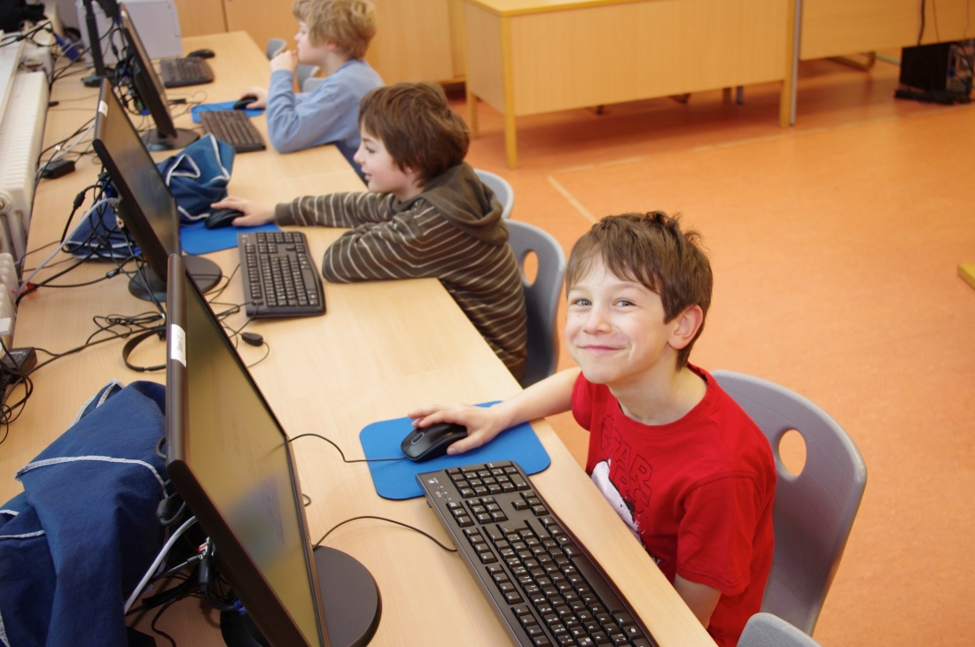
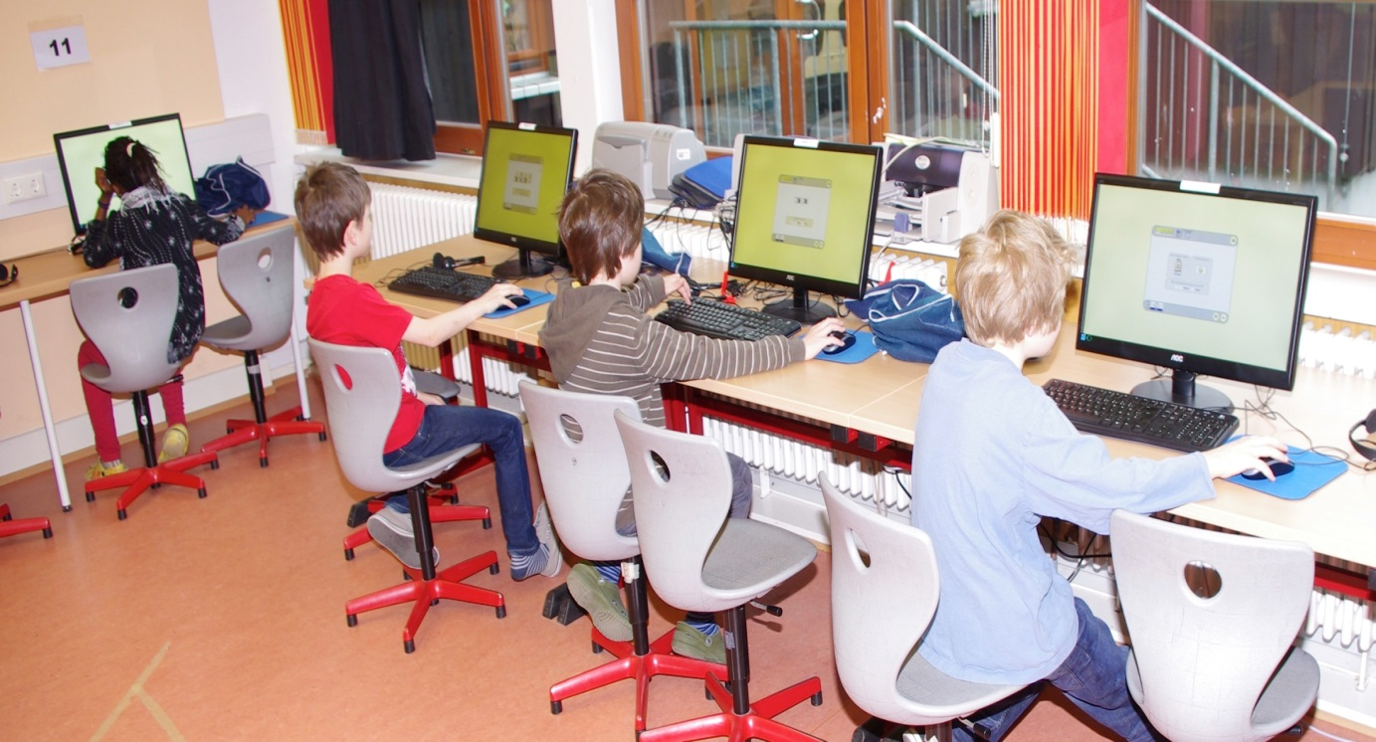
Germany, Grundschule am Homburg – An inspiring story about the role of a teacher acting as change- agent

Slide 27
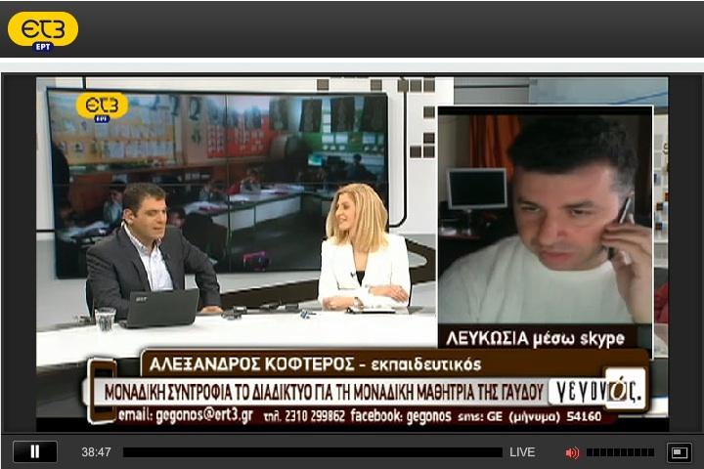
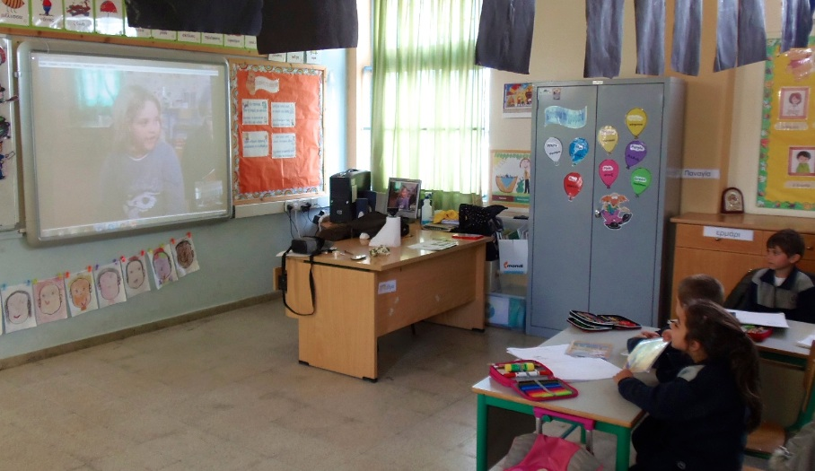
Virtual connection between a single pupil school in the island of Gavdos (the southernmost island) with Aghios Spyridonas school in Cyprus, Nicosia- Science and Environmental Education - more coming...

Slide 28
Problem in practice
Sharing and OER re-use is not yet a common practice in Higher Education, schools and enterprises
Re-use and collaboration around OER very low
Not-invented-here syndrome and similar barriers
“I look at the resources and then build them myself”
Sharing complete (finished) resources might not be the solution…

Slide 29

http://idea-space.eu

Slide 30
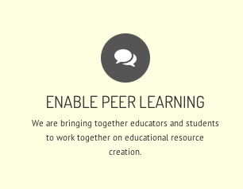
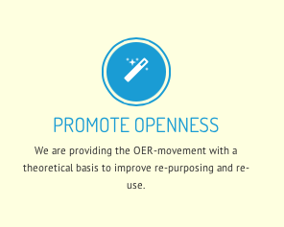
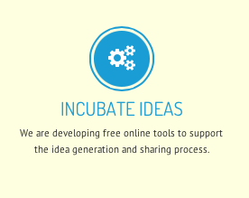
http://idea-space.eu

Slide 31
Implications
Enabling collaborations in an early phase
  – SHARING IDEAS AND BUILDING COLLABORATIONS
Learning from other domains: Open Source, Open Access, Organizational knowledge sharing
Are educators interested on exploring collaboration opportunities around educational ideas and OERs with their peers (locally or even globally)?
Is openness and collaboration around OER more likely to take place when educators feel emotional ownership (Jones & Jordan, 1998) of the knowledge they create?

Slide 32
Idea sharing towards?
Sharing at early stages
  Developing (near) future courses
  Joint projects
  Co-authoring e-textbooks
  Collaborating on research
  Collaborative teaching
  Co-supervision / realization of virtual mobility activities
Development of open scenarios, OER or even MOOCs in collaborative and adaptable ways

Slide 33
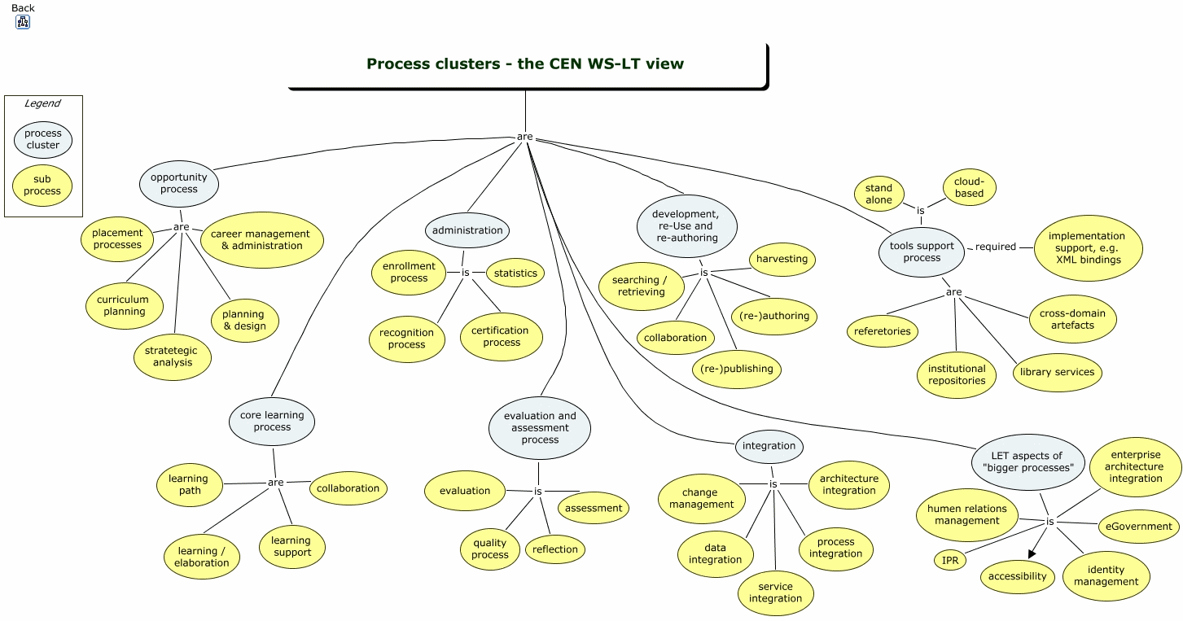
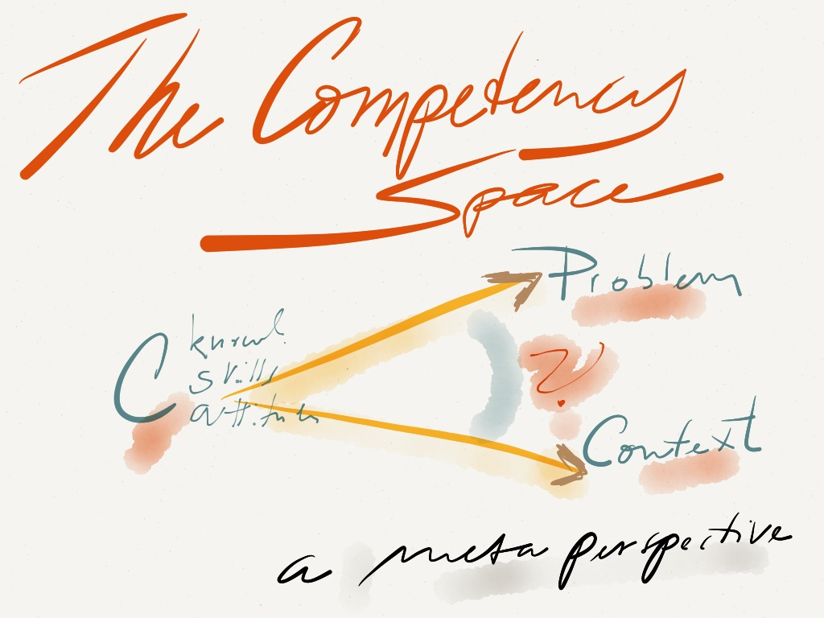
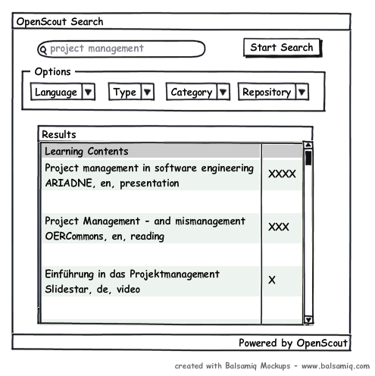
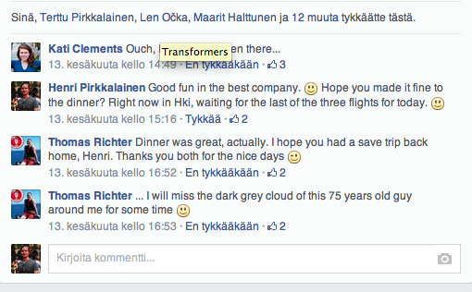
How are ideas shared?
Images: Tore Hoel, http://insulardrafts.tumblr.com/

Slide 34
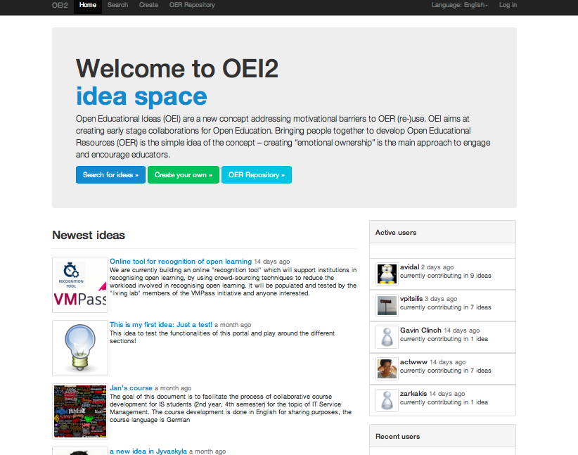

Slide 35
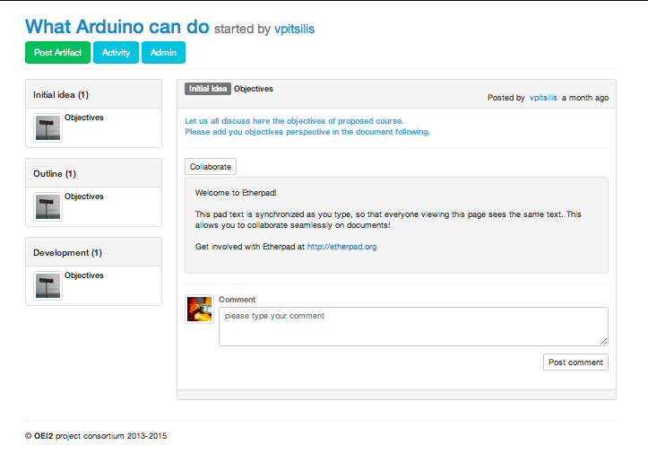

Slide 36
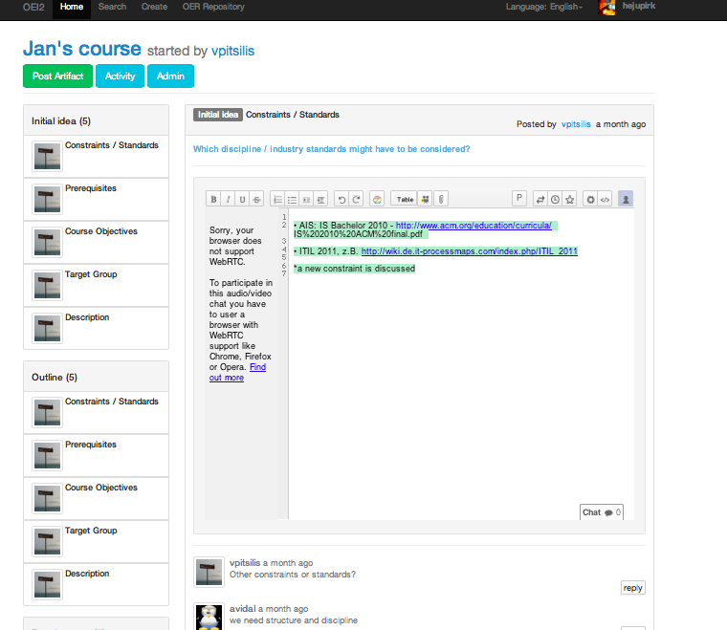

Slide 37
Interested in the Idea Space?
We help you set up a space for your local or international practice and find collaborators
If idea space is something you need internally for your school or municipality/city, happy to support this
http://idea-space.eu

Slide 38
Ongoing with NORDIC OER
Analysis on the OER landscape in Nordic countries.
We need to understand what activities are taking place, what contextual issues enable OER, what barriers exist, how can we overcome those
If you are from:
NORWAY (http://tinyurl.com/OERNorway)
SWEDEN (http://tinyurl.com/OERSweden)
DENMARK (http://tinyurl.com/OERDenmark)
…your input is highly required. Help us in a collaborative document and join later for writing an article
…Feel free to spread this link to colleagues

Slide 39


http://www.boldic.org
Nominating Nordic / Baltic innovations and innovators in Open Education
OSLO, 9th of November
10th of November discussion on the current developments in Nordic and Baltic countries.
JOIN US IN OSLO
With
https://funkon15.wordpress.com

Slide 40

Questions?

