Slide 1
Questionnaire answers

Slide 2
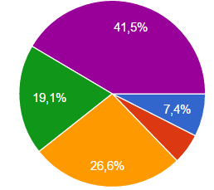
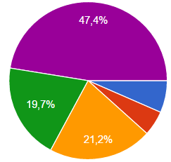
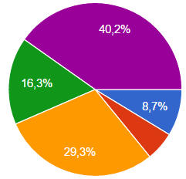
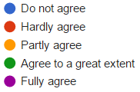
1. An immigrant is someone who was not born in the country she/he lives in.
Il Liceum Ogolnoksztalcace W Gdansku
Karhulan lukio
Ernestinenschule

Slide 3
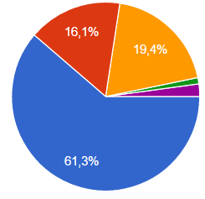
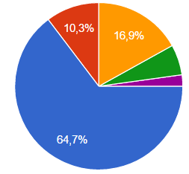
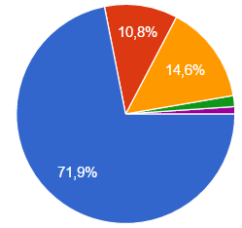
2. An immigrant is someone who has one parent that was not born in the country they live in.
Il Liceum Ogolnoksztalcace W Gdansku
Karhulan lukio
Ernestinenschule

Slide 4
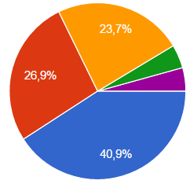
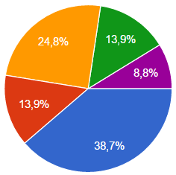
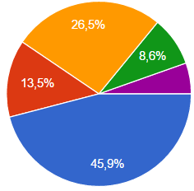
3. An immigrant is someone who has parents that were not born in the country they live in.
Il Liceum Ogolnoksztalcace W Gdansku
Karhulan lukio
Ernestinenschule

Slide 5
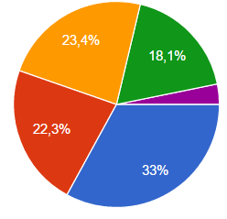
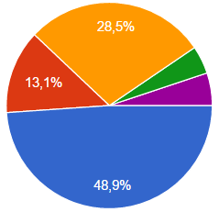
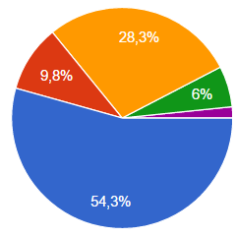
4. An immigrant is someone who does not speak the language properly.
Il Liceum Ogolnoksztalcace W Gdansku
Karhulan lukio
Ernestinenschule

Slide 6
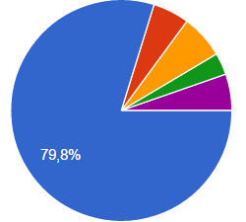
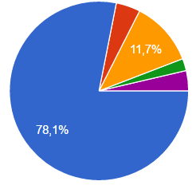
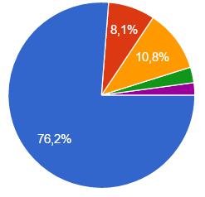
5. An immigrant is someone who does not look European.
Il Liceum Ogolnoksztalcace W Gdansku
Karhulan lukio
Ernestinenschule

Slide 7
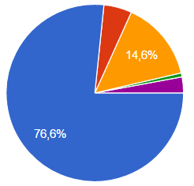
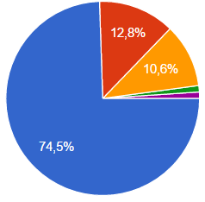
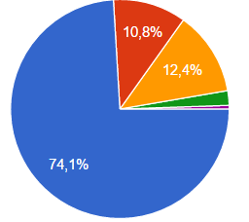
6. An immigrant is someone who has a different religion.
Il Liceum Ogolnoksztalcace W Gdansku
Karhulan lukio
Ernestinenschule

Slide 8
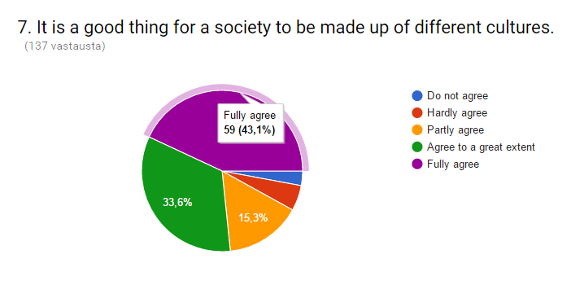
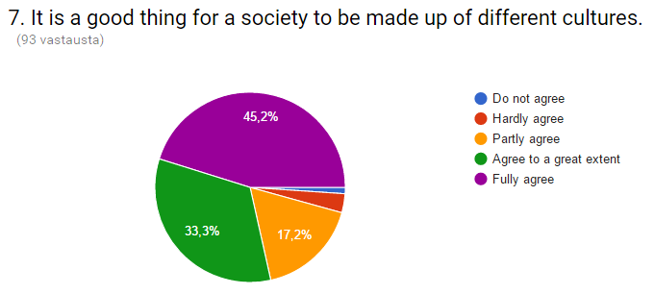
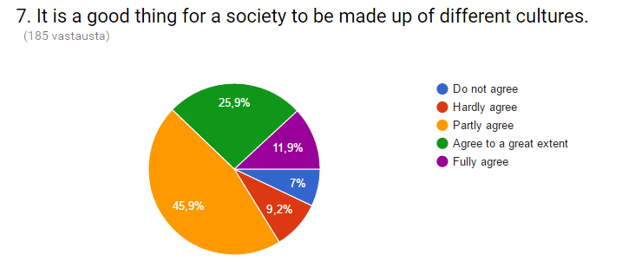
Ernestinenschule
Karhulan lukio
Il Liceum Ogolnoksztalcace W Gdansku

Slide 9
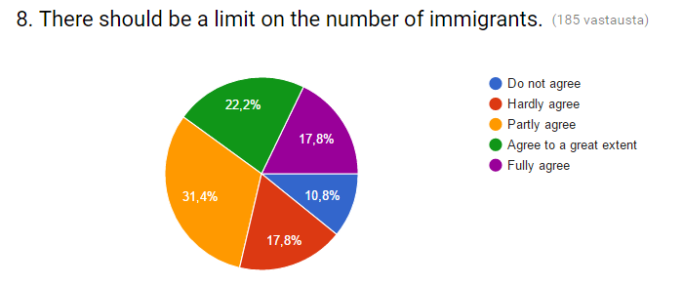
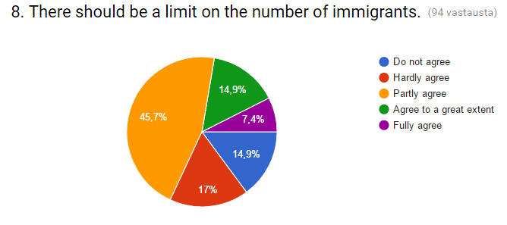
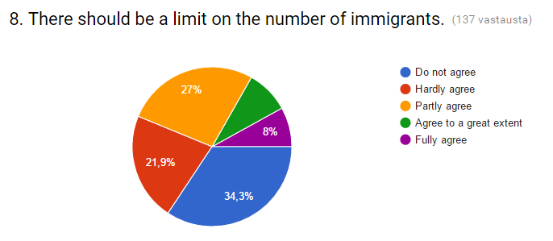
Karhulan lukio
Ernestinenschule
Il Liceum Ogolnoksztalcace W Gdansku

Slide 10
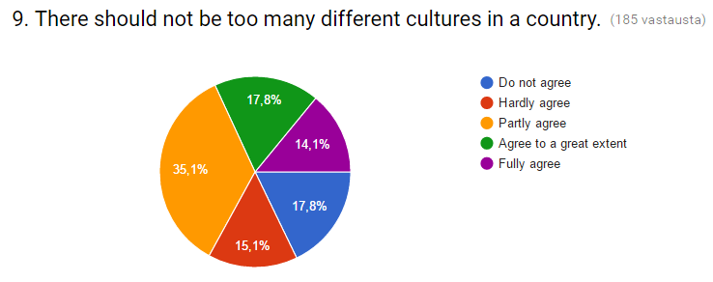
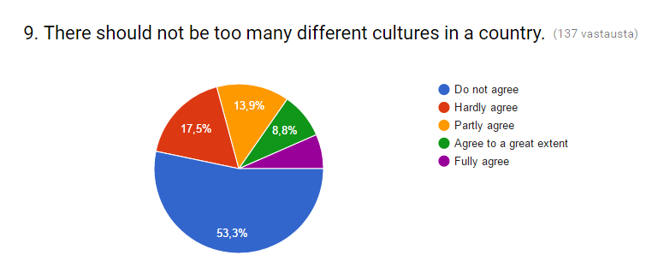
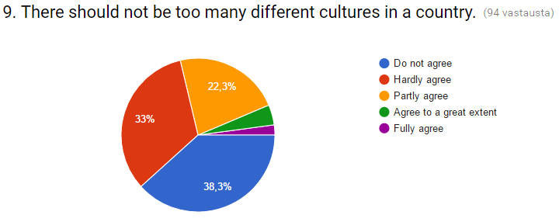
Il Liceum Ogolnoksztalcace W Gdansku
Ernestinenschule
Karhulan lukio

Slide 11
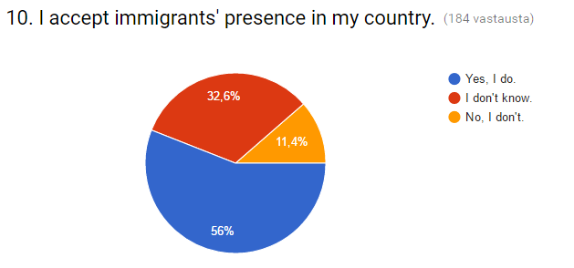
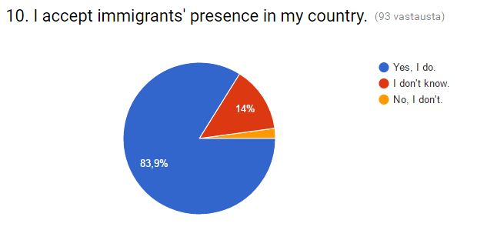
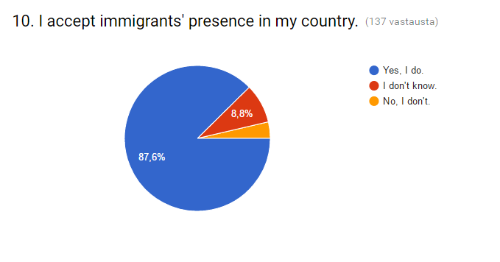
Karhulan lukio
Il Liceum Ogolnoksztalcace W Gdansku
Ernestinenschule

Slide 12
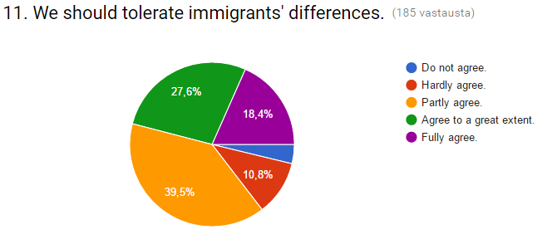
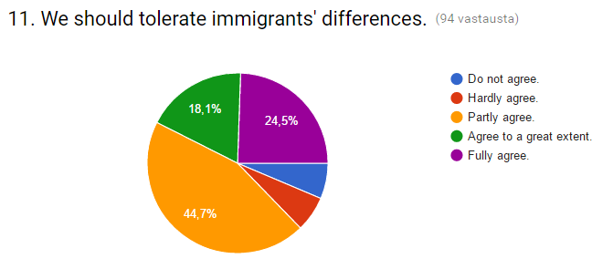
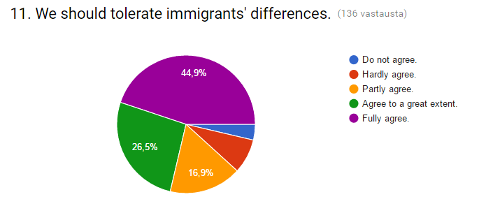
Il Liceum Ogolnoksztalcace W Gdansku
Karhulan lukio
Ernestinenschule

Slide 13
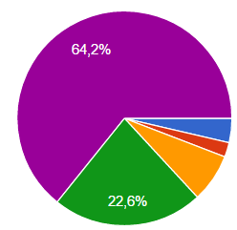
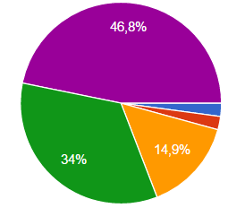
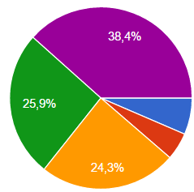
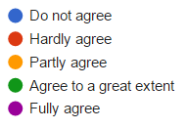
12. Legal immigrants should have the same rights as locals.
Il Liceum Ogolnoksztalcace W Gdansku
Karhulan lukio
Ernestinenschule

Slide 14
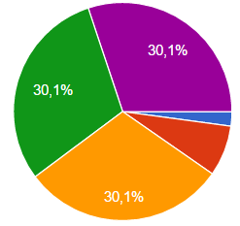
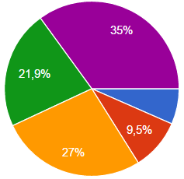
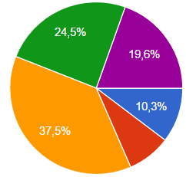
13. Legal immigrants should be allowed to bring their families to the country they stay in.
Il Liceum Ogolnoksztalcace W Gdansku
Karhulan lukio
Ernestinenschule

Slide 15
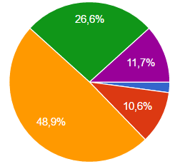
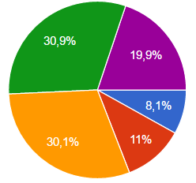
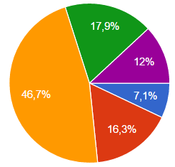
14. Legal immigrants should be able to get the citizenship of the country easily.
Il Liceum Ogolnoksztalcace W Gdansku
Karhulan lukio
Ernestinenschule

Slide 16
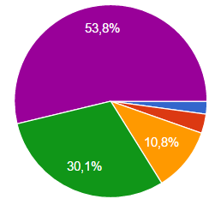
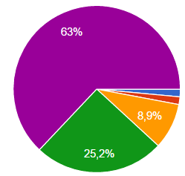
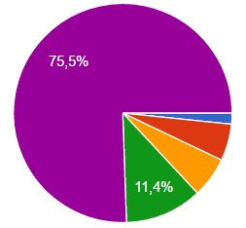
15. Legal immigrants should take up some work.
Il Liceum Ogolnoksztalcace W Gdansku
Karhulan lukio
Ernestinenschule

Slide 17
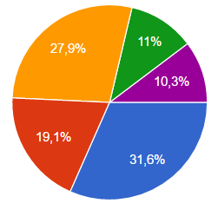
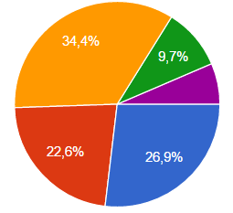
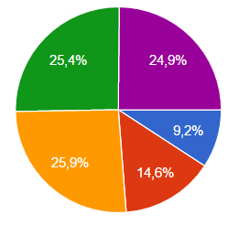
16. Legal immigrants should be sent back if they don´t work.
Il Liceum Ogolnoksztalcace W Gdansku
Karhulan lukio
Ernestinenschule

Slide 18



17. Immigrants should respect customs of the country that they live in.
Il Liceum Ogolnoksztalcace W Gdansku
Karhulan lukio
Ernestinenschule

Slide 19



18. The number of immigrants and refugees should be more equally spread in different European countries.
Il Liceum Ogolnoksztalcace W Gdansku
Karhulan lukio
Ernestinenschule

Slide 20



19. Neighboring countries of the crisis areas should take more immigrants and refugees.
Il Liceum Ogolnoksztalcace W Gdansku
Karhulan lukio
Ernestinenschule

Slide 21




20. Most today's immigrants immigrate because of economic reasons.
Il Liceum Ogolnoksztalcace W Gdansku
Karhulanlukio
Ernestinenschule

Slide 22



21. Immigrants in the past mainly immigrated because of religious reasons.
Il Liceum Ogolnoksztalcace W Gdansku
Karhulanlukio
Ernestinenschule

Slide 23




22. Is there a standardized European immigration policy?
Il Liceum Ogolnoksztalcace W Gdansku
Karhulanlukio
Ernestinenschule

Slide 24



23. A refugee is the same as an immigrant.
Il Liceum Ogolnoksztalcace W Gdansku
Karhulanlukio
Ernestinenschule

Slide 25



24. Multiculturalism helps to end prejudices against people of different origins.
Il Liceum Ogolnoksztalcace W Gdansku
Karhulanlukio
Ernestinenschule

Slide 26



25. There should be a special program to make integration easier for immigrants.
Il Liceum Ogolnoksztalcace W Gdansku
Karhulanlukio
Ernestinenschule

Slide 27



26. EU countries will have an economical benefit from immigration.
Il Liceum Ogolnoksztalcace W Gdansku
Karhulanlukio
Ernestinenschule

Slide 28



Karhulan lukio
Ernestinschule
III Liceum Ogolnoksztalcace W Gdansku

Slide 29



Karhulan lukio
Ernestinschule
III Liceum Ogolnoksztalcace W Gdansku

Slide 30



Ernestinschule
Karhulan lukio
III Liceum Ogolnoksztalcace W Gdansku

Slide 31



Ernestinschule
Karhulan lukio
III Liceum Ogolnoksztalcace

Slide 32



Ernestinschule
Karhulan lukio
III Liceum Ogolnoksztalcace

Slide 33



Karhulan lukio
Ernestinschule
III Liceum Ogolnoksztalcace

