Slide 1
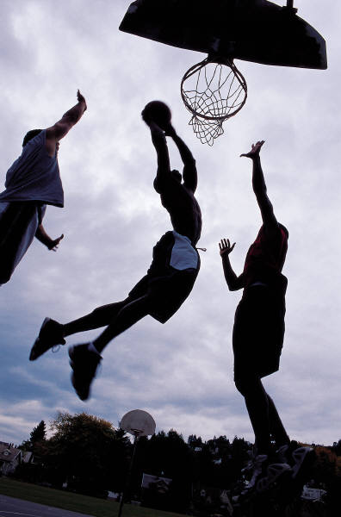
What did they do?

Slide 2


What did they do?

Slide 3
What did he do?

Slide 4
What did he do?

Slide 5

What did he do?

Slide 6
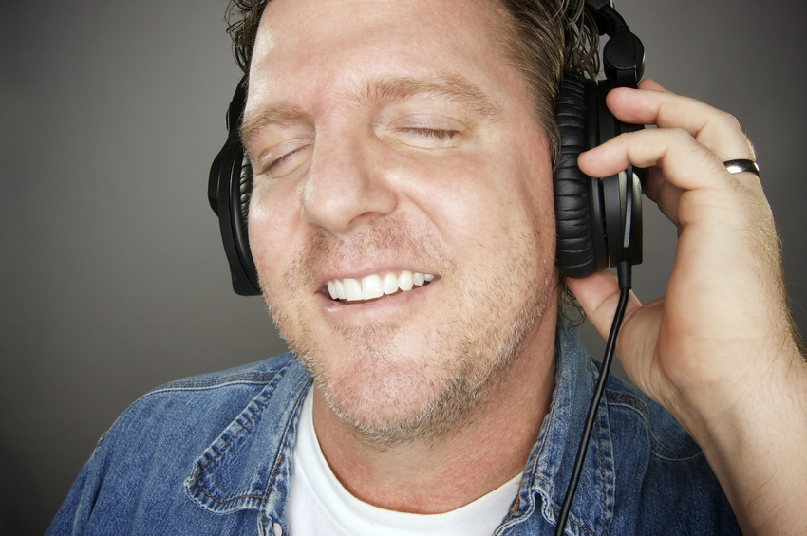
What did he do?

Slide 7

What did he do?

Slide 8
Did he work?

Slide 9
Did he play the guitar?

Slide 10
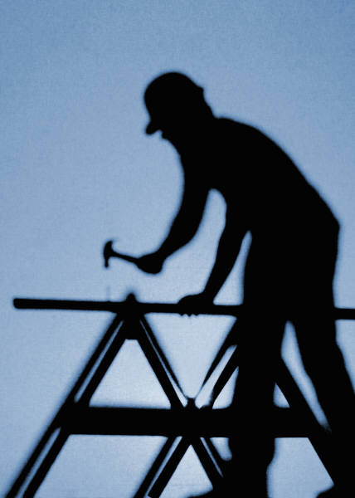
Did he work?

Slide 11
Did she travel?

Slide 12
What did she play?

Slide 13
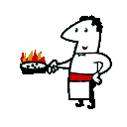
What did he do?

Slide 14
What about you?
Did you work yesterday?
Did you play the guitar?
Did you watch TV?

