Slide 1
THE ETHICS OF KNOWLEDGE
TOK Jyväskylän Lyseon lukio

Slide 2
ORIENTATION
(1) When was the last time you did something morally wrong/bad?
What was the action? What made it wrong/bad?
How do you know it was wrong/bad?
(2) When was the last time you did something morally right/good?
What was the action? What made it right/good?
How do you know it was right/good?

Slide 3
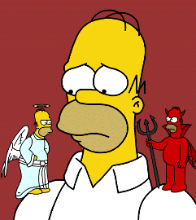
Basic concepts
Morals
Views of right and wrong
Ethics
Study of morals
What should one do?

Slide 4
Basic concepts
RESEARCHES
ETHICS
MORALS

Slide 5
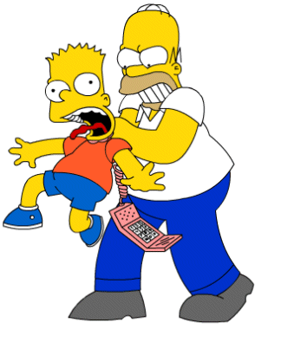
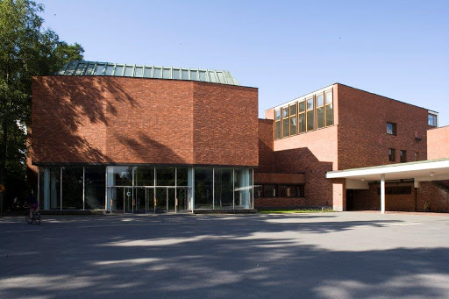

” ”
” ”

Slide 6
Basic concepts
Fact is a state of affair that prevails
Are supported by evidence
Independent from individual opinion, conception or interpretation
Fact is the counterpart for a true belief
The existence of the fact makes the belief true
Belief should correspond with the fact to be true

Slide 7
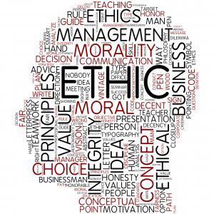
TASK
In what ways do ethical beliefs differ from other kinds of beliefs?
Or do they?
Do moral facts exist in the reality?
How do we know
about right and wrong?

Slide 8

TASK
Briefly return to your knowledge profile
Focus on the question: Where do my values come from?
How do your values influence you as a knower?

Slide 9

Basic concepts
Moral values
Attributes that make some things good and worth pursuing
Goals of our actions
Moral values guide our actions and behaviour

Slide 10
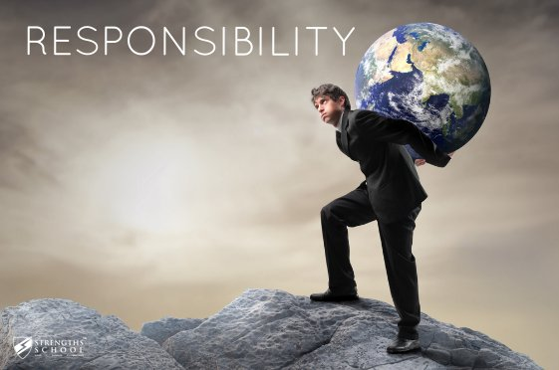
Basic concepts
Responsibility follows, if someone is
Capable of rational judgement
Understands the facts related to an action
Is free to intentionally act or not to act (omission)
What moral responsibilities and
obligations come with the
acquisition of knowledge?

Slide 11
TASK
Teacher divides you into five groups
Each group gets one are of knowledge and four questions
Prepare to present your ideas to others
Areas of Knowledge
Mathematics
The natural sciences
The human sciences
The arts
History

Slide 12
TASK
Are there responsibilities that necessarily come with knowing something or knowing how to do something in this area of knowledge?
Under what circumstances, if any, do we have a moral duty to share what we know in this area of knowledge?
Is there knowledge that a person or society has a responsibility to acquire or not to acquire in this area of knowledge?
Is the pursuit of knowledge in this area of knowledge a subject to ethical constraints?

Slide 13
Summary
Ethics of knowledge as a part of the TOK knowledge framework:
How do we know about right and wrong?
What responsibilities rest on the knower as a result of their knowledge?
How do ethical considerations impact knowledge and vice versa?

Slide 14
Picture sources
Homer Simpson <http://www.wiringthebrain.com/2011/06/where-do-morals-come-from.html> Accessed 15th of November 2015.
The main building of Jyväskylä University <http://www.rky.fi/read/asp/r_kohde_det.aspx?KOHDE_ID=182> Accessed 31st of March 2020.
Homer strangling Bart <https://fi.pinterest.com/pin/444589794451702210/> Accessed 15th of November 2015.
Ethics word head <https://ec.europa.eu/programmes/horizon2020/en/h2020-section/ethics> Accessed 16th of April 2020.
Profile picture <http://baxtercoaching.com/testimonial/anthony-bennett-sport-communications-professional-in-the-cfl/facebook-default-no-profile-pic> Accessed 17th of August 2016.
Value <http://www.arborinvestmentplanner.com/what-is-the-big-deal-about-intrinsic-value/> Accessed 15th of November 2015.
Responsibility <https://www.strengthsschool.com/strengthsfinder-blog/responsibility-talent-theme> Accessed 7th of April 2025.
Areas of knowledge © Christine Stevenage, 2020.

