Slide 1
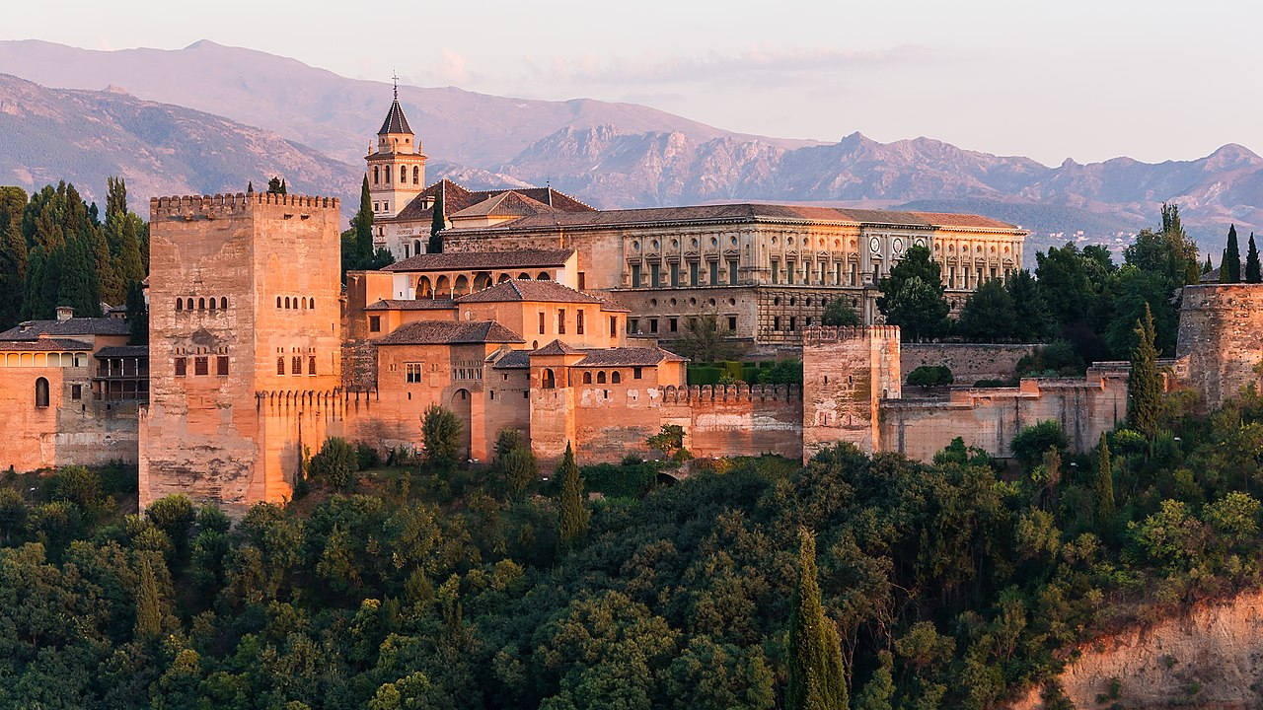
Alhambra
Lina Kanerva and Liina Ylinen

Slide 2
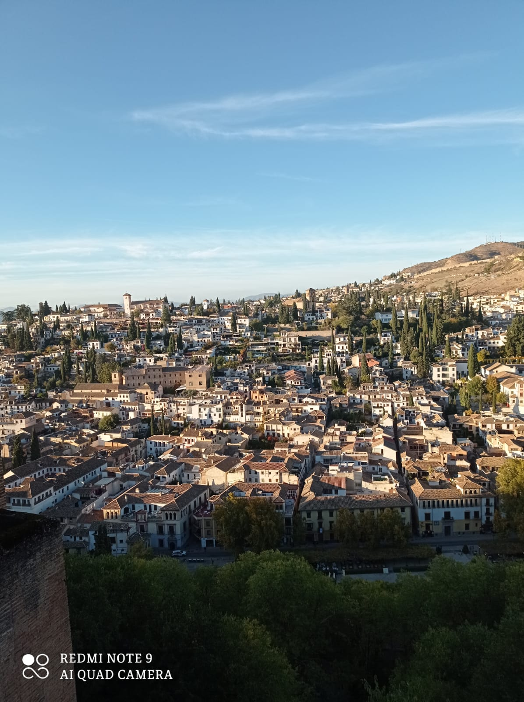
Basic knowledge
- Located in Granada, Andalusia, Spain
- It's a palace and fortress complex
Alhambra - Wikipedia

Slide 3
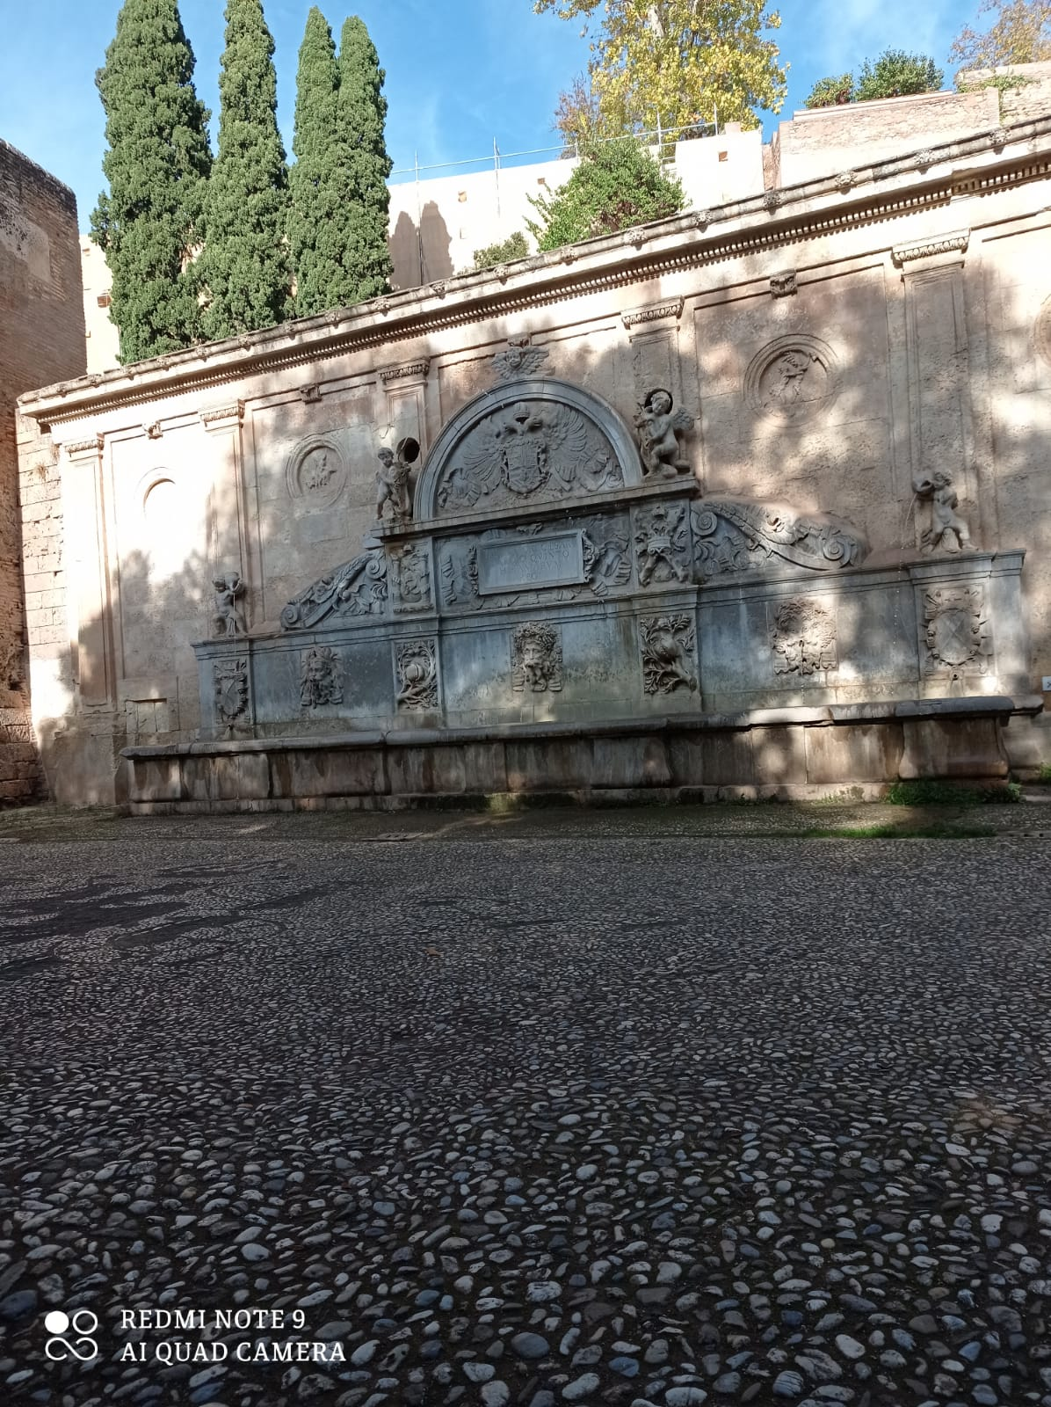
History
Alhambra means "The Red Fortress"
In 1492 the Muslim rulers lost Granada and Alhambra, but without the fortress itself being attacked.
Alhambra - Wikipedia

Slide 4
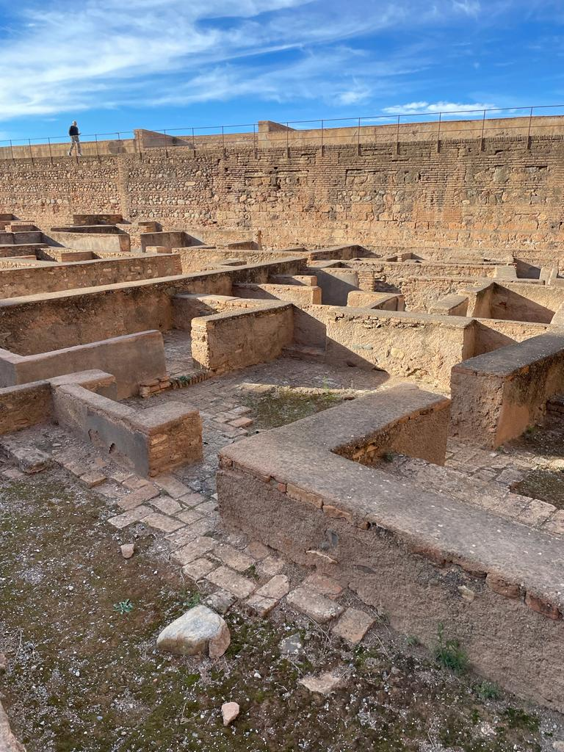
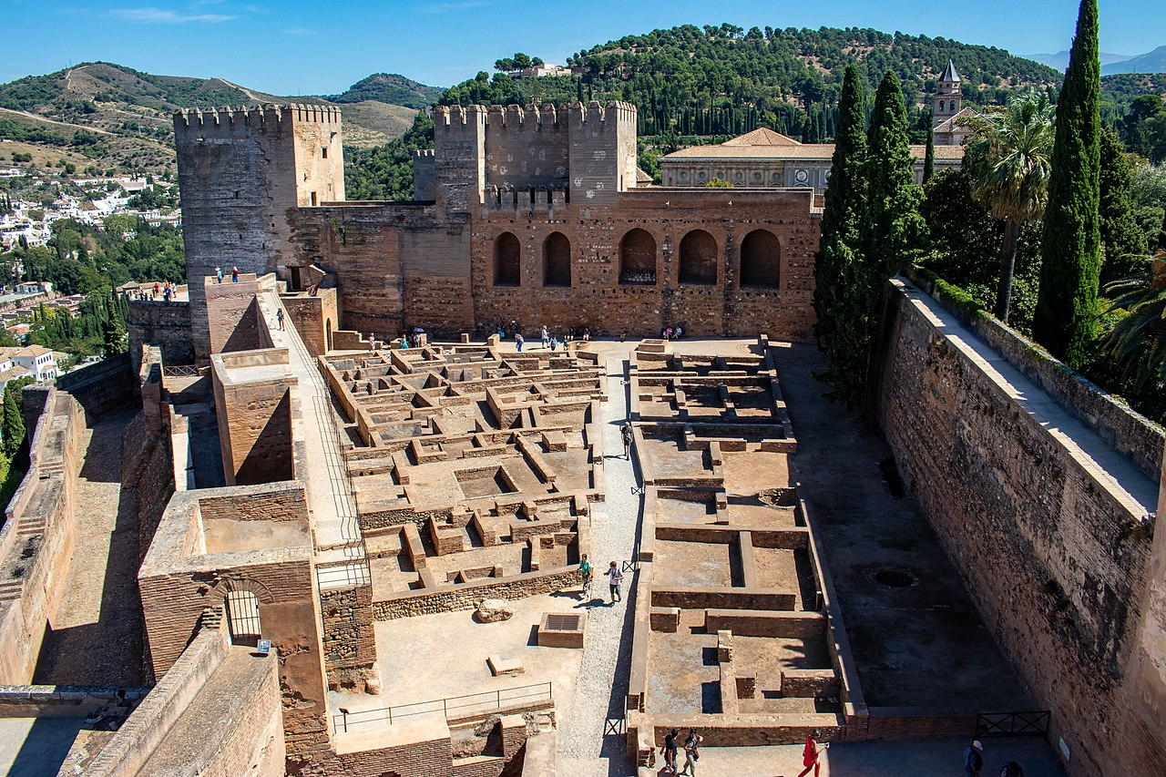
Alcazaba
= the military fortress
The ruin of the houses in where the soldierswereliving
Alhambra - Wikipedia​

Slide 5
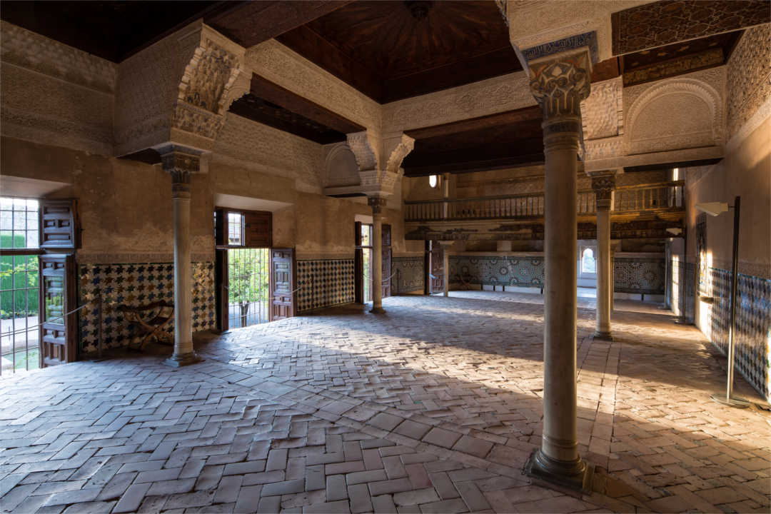
The Mexuar
Served as the entrance wing of the Comares Palace, the official palace of the sultan and the state.
Alhambra - Wikipedia​

Slide 6
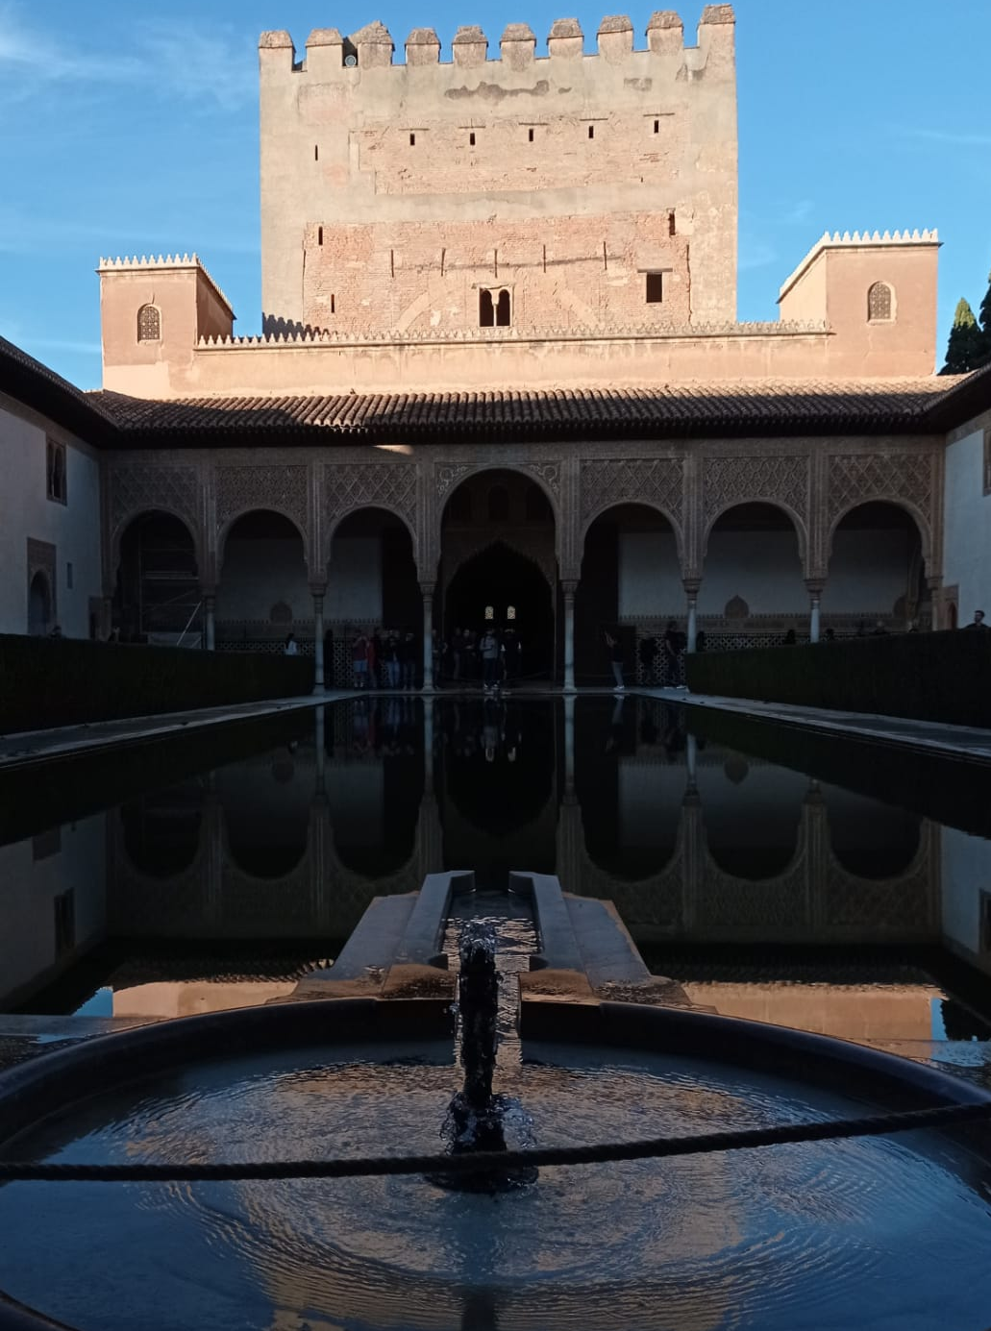
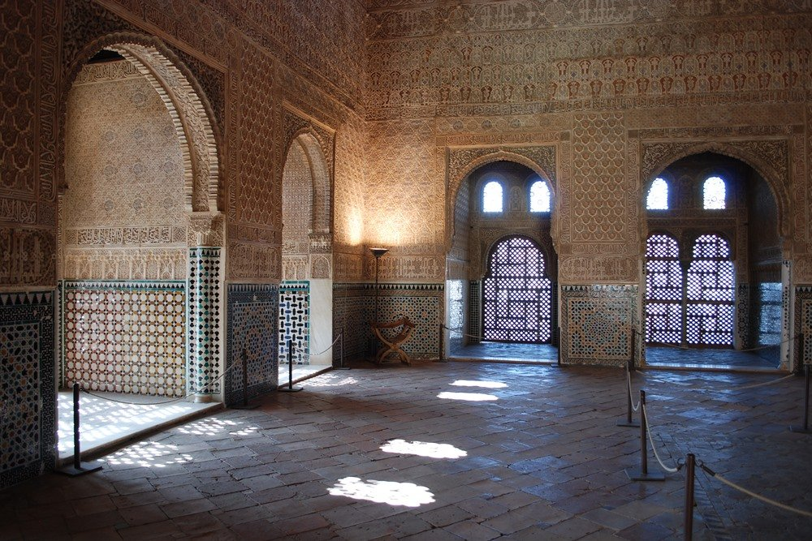
The Comares palace
Hall of the Ambassadors
Court of the Myrtles
Alhambra - Wikipedia​

Slide 7
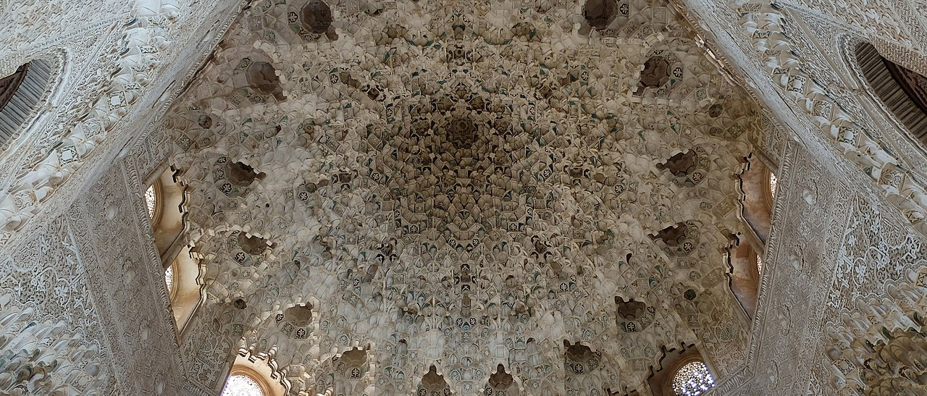
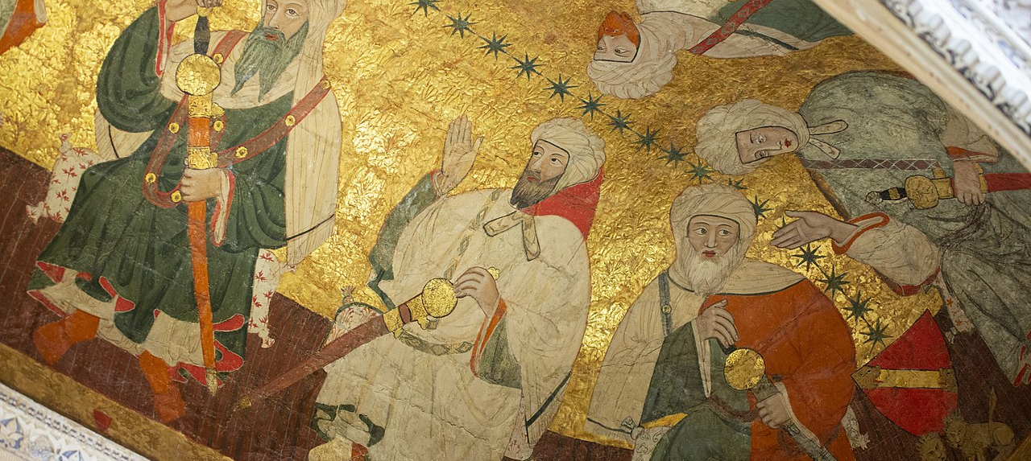
Palace of the Lions
Lions were one of the most famous architecture desgins. The 12 lions are a symbol of total power.
Alhambra - Wikipedia​

Slide 8
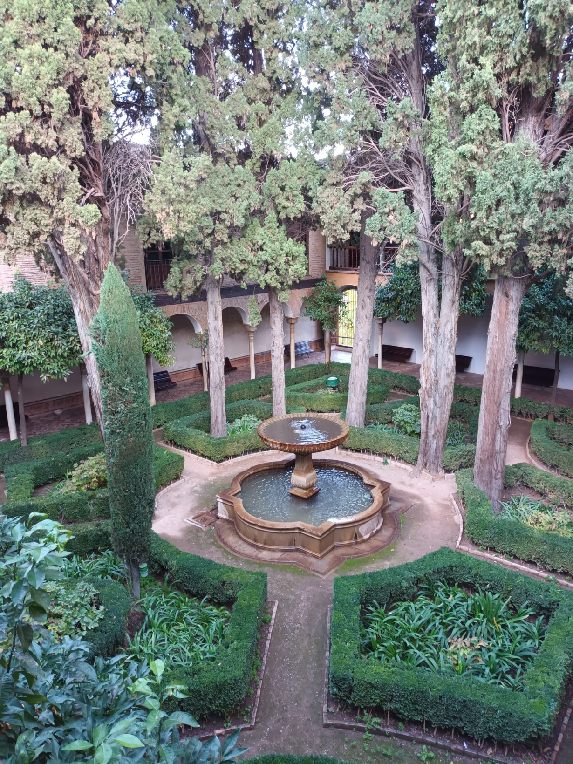
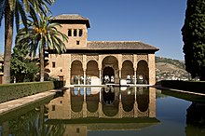
The Gardens
Alhambra has lots of different renaissance gardens and courtyards. Forexample, Patio de Lindaraja (Lindaraja Courtyard), which shown in the picture.
Alhambra - Wikipedia

Slide 9
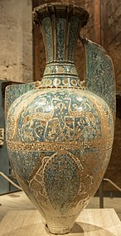
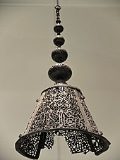
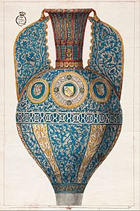
Historic Objects
Originally Alhambra was filled with many kind of carpets, tapestries, floor cushions and other objects like the "Alhabra vases" which is shown in the picture or a bronze lamp from the other picture.
Alhambra - Wikipedia

