Slide 1
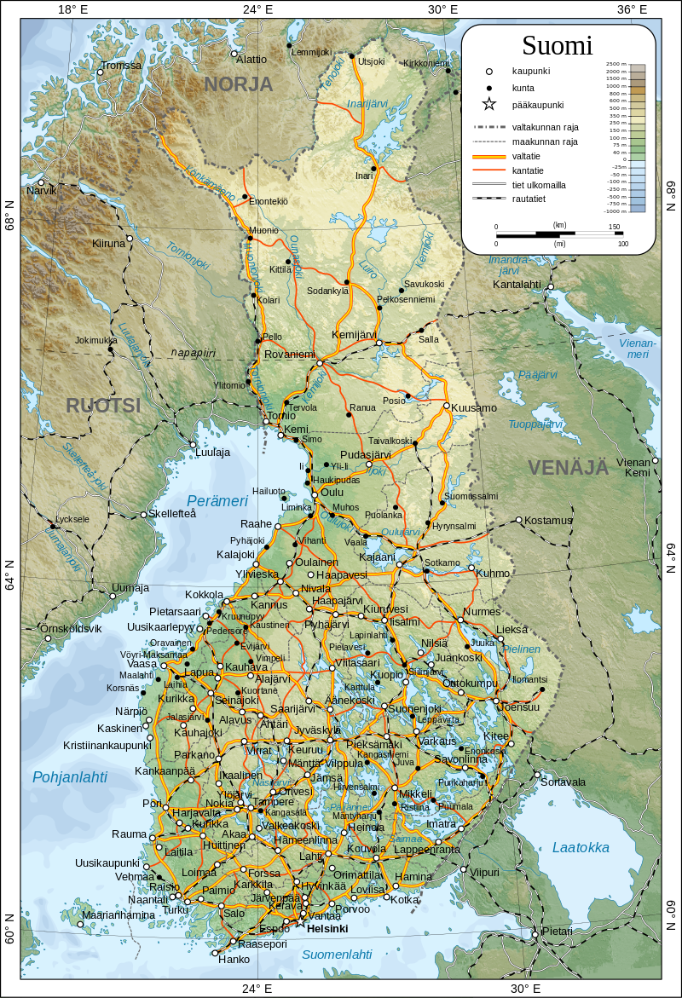
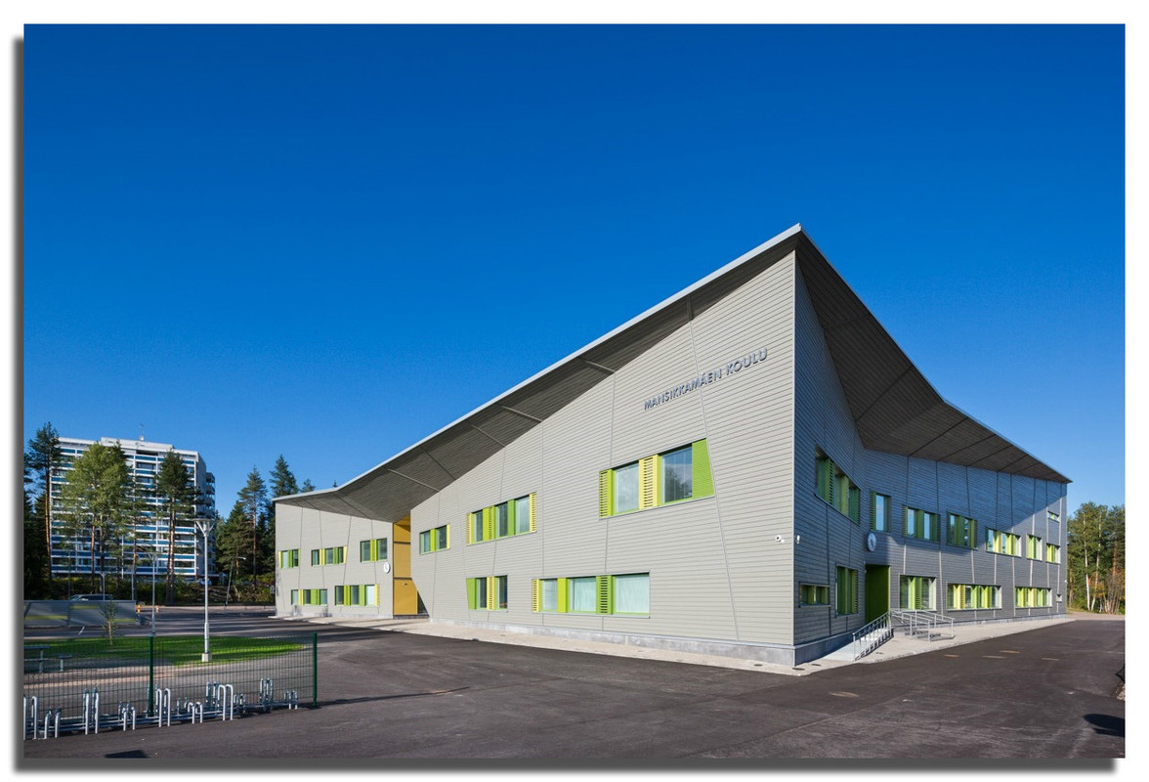
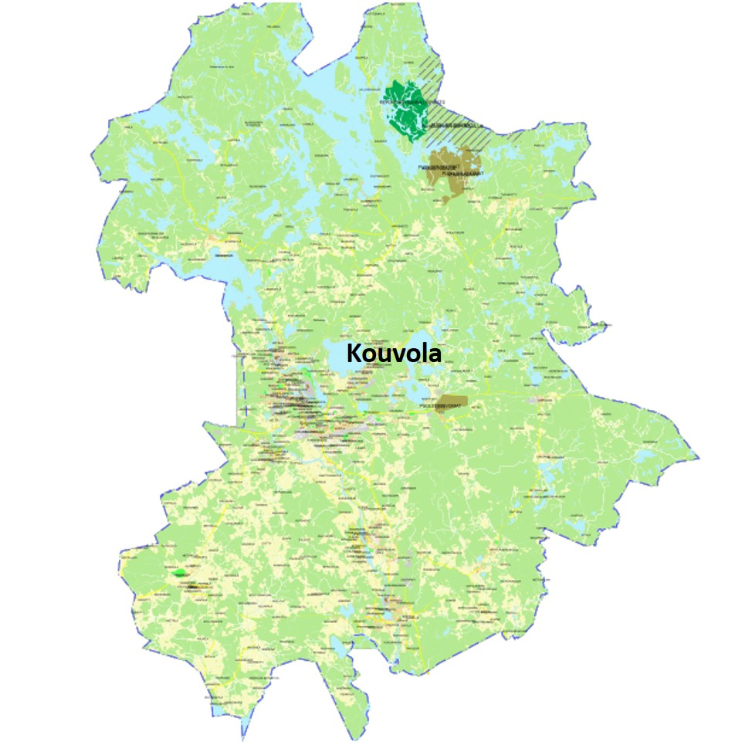
Mansikkamäki School
Our Finland

Slide 2
Five facts about Finland
Sauli Niinistö is the President of Finland.
There are 5.5 million people living in Finland.
The capital city is Helsinki.
There are two official languages: Finnish and Swedish
The currency in Finland is euro.

Slide 3
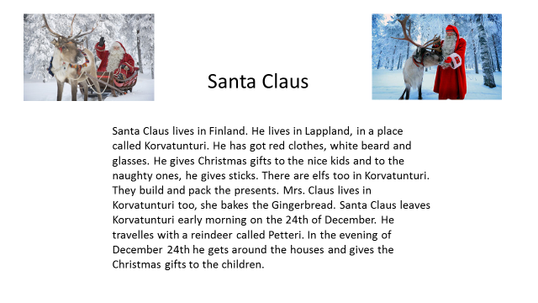
Santa Claus

Slide 4
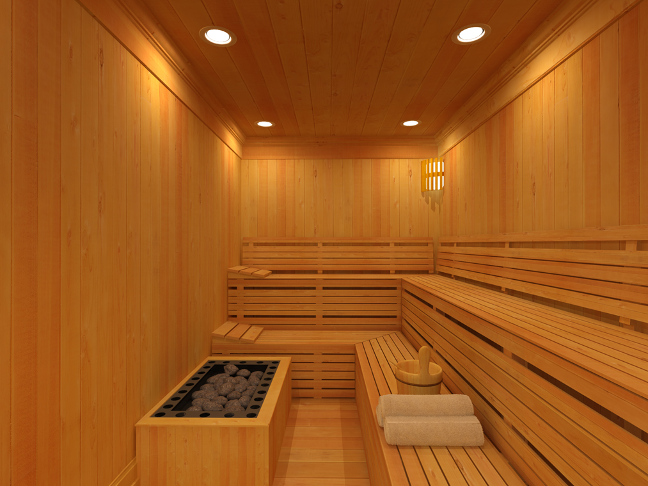
Sauna
WHAT IS IT?
Finnish sauna is usually made of wood. In sauna we don’t usually wear clothes.
WHAT CAN YOU DO IN SAUNA?
It is a place for bathing and relaxation. To get more heat and steam, you throw some water on the stones.
WHEN IS IT USED?
In Finland sauna is used weekly. It also has an important role during Christmas and Midsummer.

Slide 5
Kouvola, our hometown

Slide 6
Kouvola is situated in Southern Finland, located 134 km northeast of the capital city Helsinki.
There are 35 schools and 8493 pupils in Kouvola. There are about 86 000 people living in our town. The town originally grew up around the junction of the north-south and east-west rail tracks. It was also a major road transport junction. Kouvola is the 10th largest city in Finland by population. Kouvola's mayor´s name is Lauri Lamminmäki.
My Kouvola
I' m Emily. I was eleven years old when I moved to Kouvola, it was about two years ago. I am from Estonia. Kouvola is a small town. I like Veturi, the biggest shopping mall in Kouvola. My favorite lake is Käyrälampi. Near Käyrälampi is Aquapark and an amusement park called Tykkimäki and oh, I almost forgot, there is a canteen in Aquapark. I always like to buy soft ice when I'm there.
I'm Liza. When I moved to Finland, Kouvola, I was scared a bit, because I came from Estonia, a very small town called Narva. But now I like this town a lot! It's really quiet and peaceful here. I also like Kouvola's nature, sometimes I go to the forest near my home to take some pictures.
I walk to school every day, because it's very close to the place, where I live. It's very difficult to live here without a car and when we came from Estonia, sometimes I needed to walk about 8 kilometers. Don't forgot to rent a car or a bike when you come here. Welcome to Kouvola!

Slide 7
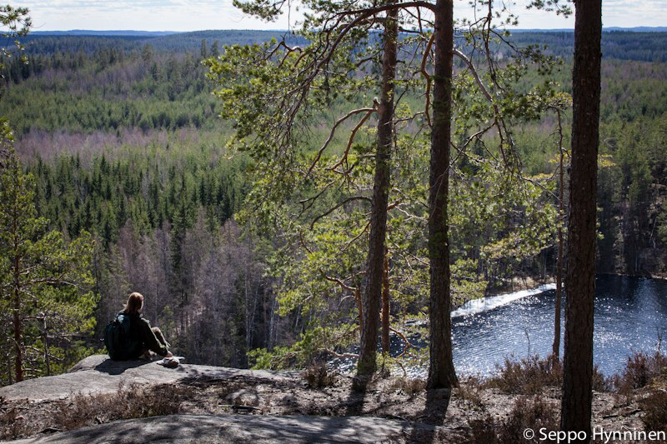
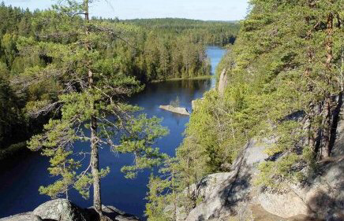
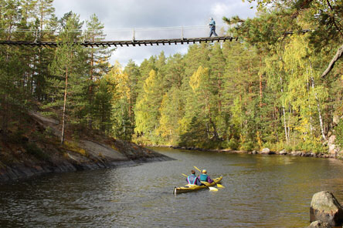
Repovesi
Repovesi is a National Park in Kouvola .
The deepest lake in Repovesi is 75,51 meters deep.
The highest rock is 168 meters high.
If you want to rent a cabin for a night, it costs 100 euros.
The cabins are rated with 4.8 stars.
There is a 45km marked track in the summer.
You can tent and swim there.

Slide 8
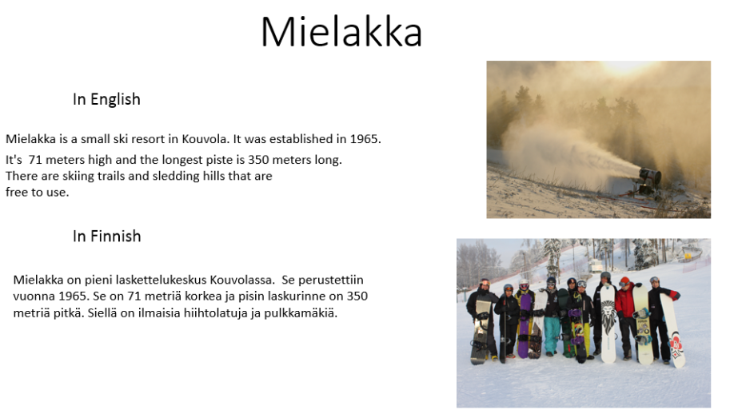
Mielakka, skiing center

Slide 9
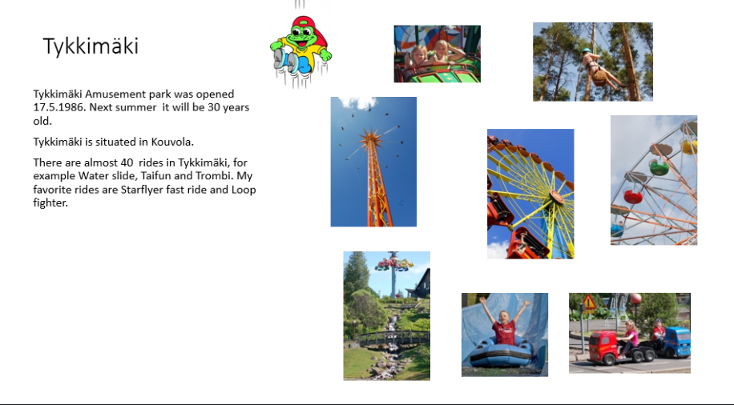
Tykkimäki, Amusement Park

Slide 10
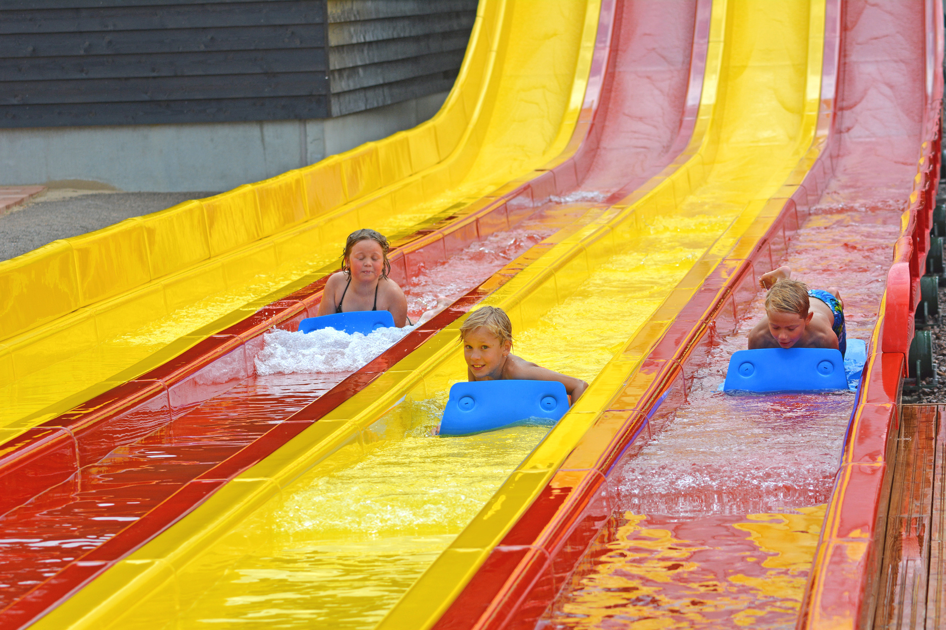
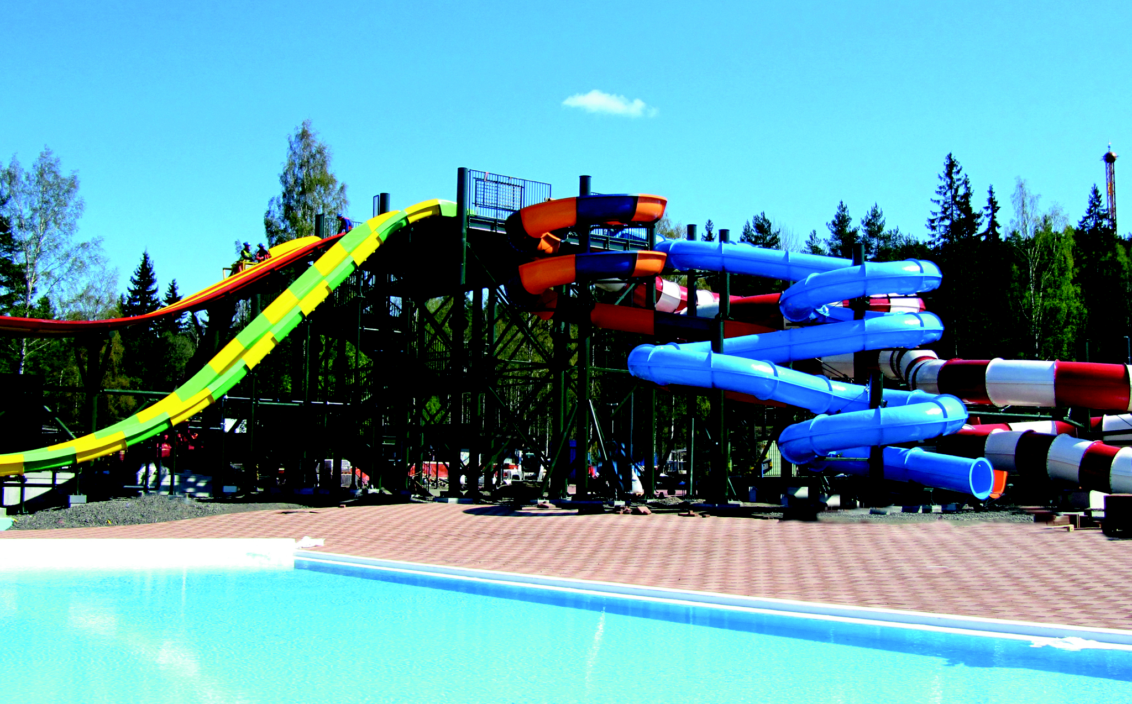
Aquapark
There are seven waterslides and three pools in Aquapark. It was built in the year 2014.
One wristband costs 15-23€
Aquapark was built in Kouvola near the amusement park Tykkimäki and lake Käyrälampi to offer citizens joy and pleasure during the summer.
Aquapark was built in 2014 near the amusement park Tykkimäki and lake Käyrälampi to offer citizens joy and pleasure during the summer.
There are seven waterslides and three pools in Aquapark. One wristband costs 15-23 euros.

Slide 11
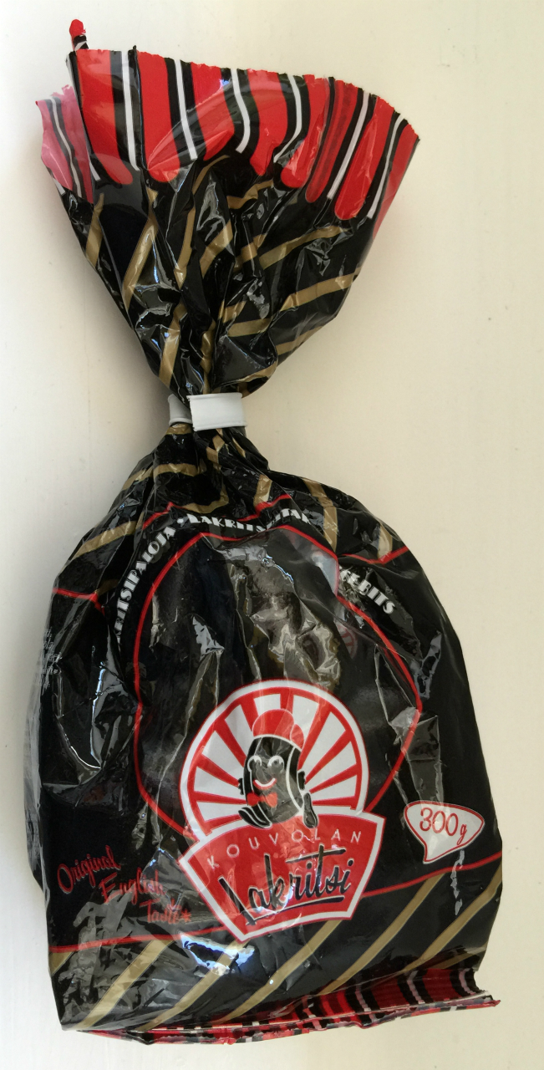
Kouvolan Lakritsi
"
Kouvolan Lakritsi
Kouvolan Lakritsi, the licorice factory in our hometown, was established in 1945.
Licorice
Licorice has been used as medicament in Assyria and Egypt. Nowadays the most important farmlands are Turkey, Iran, China and Afghanistan. First licorice was made in 1670, when George Dunhill accidentally added sugar and liquorice flour.

Slide 12


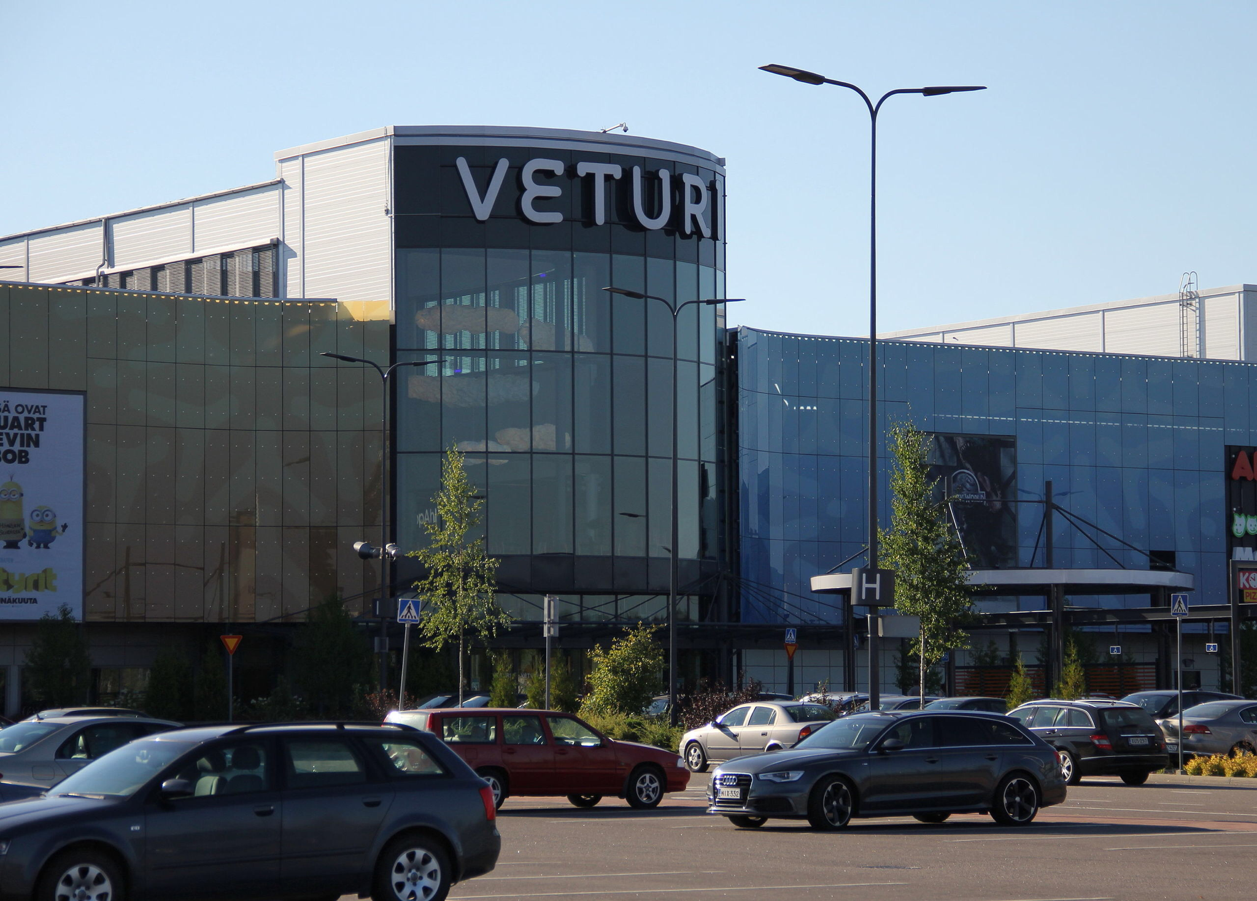


Veturi, the shopping mall
Mall Veturi is the biggest mall in Kouvola. It is located on Kuusaantie.You can get there by car or by bus. It has 75 stores and a couple of restaurants.

Slide 13
Mansikkamäki School

Slide 14
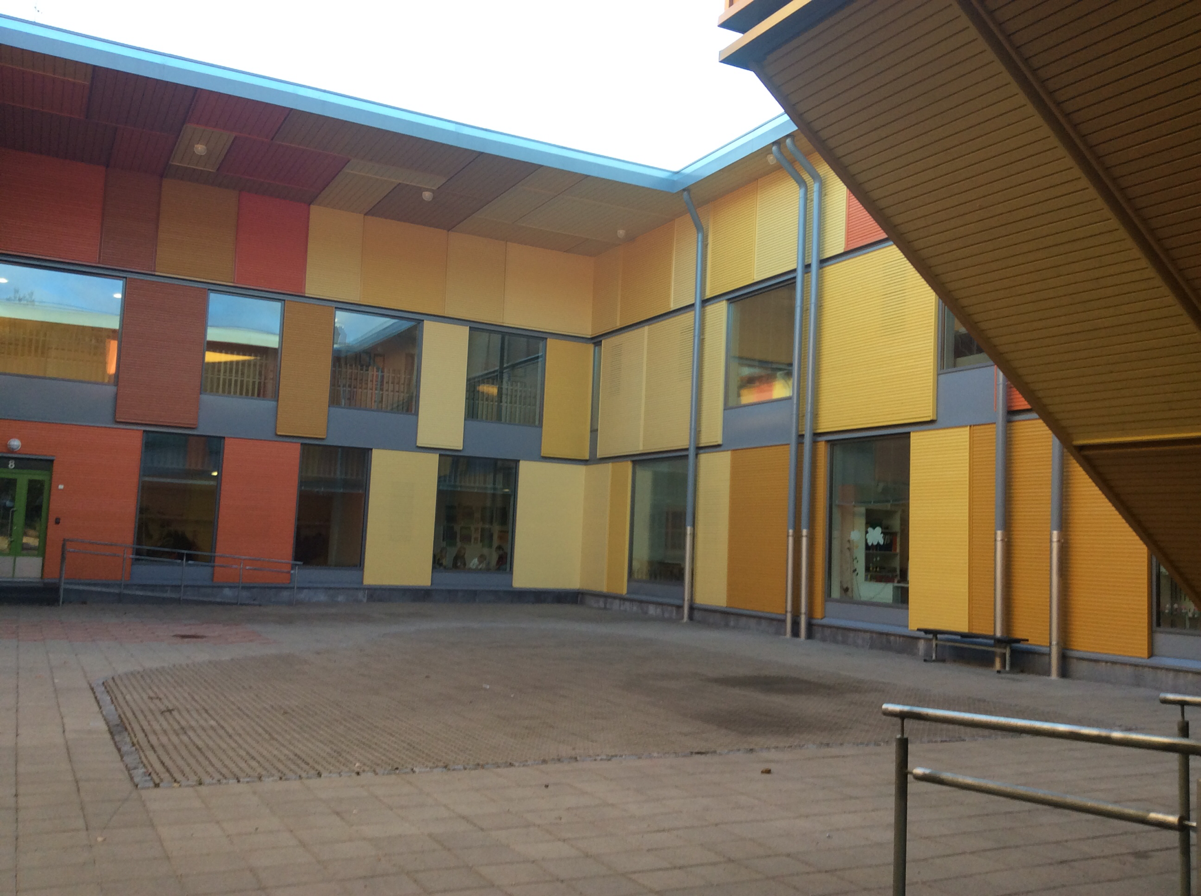
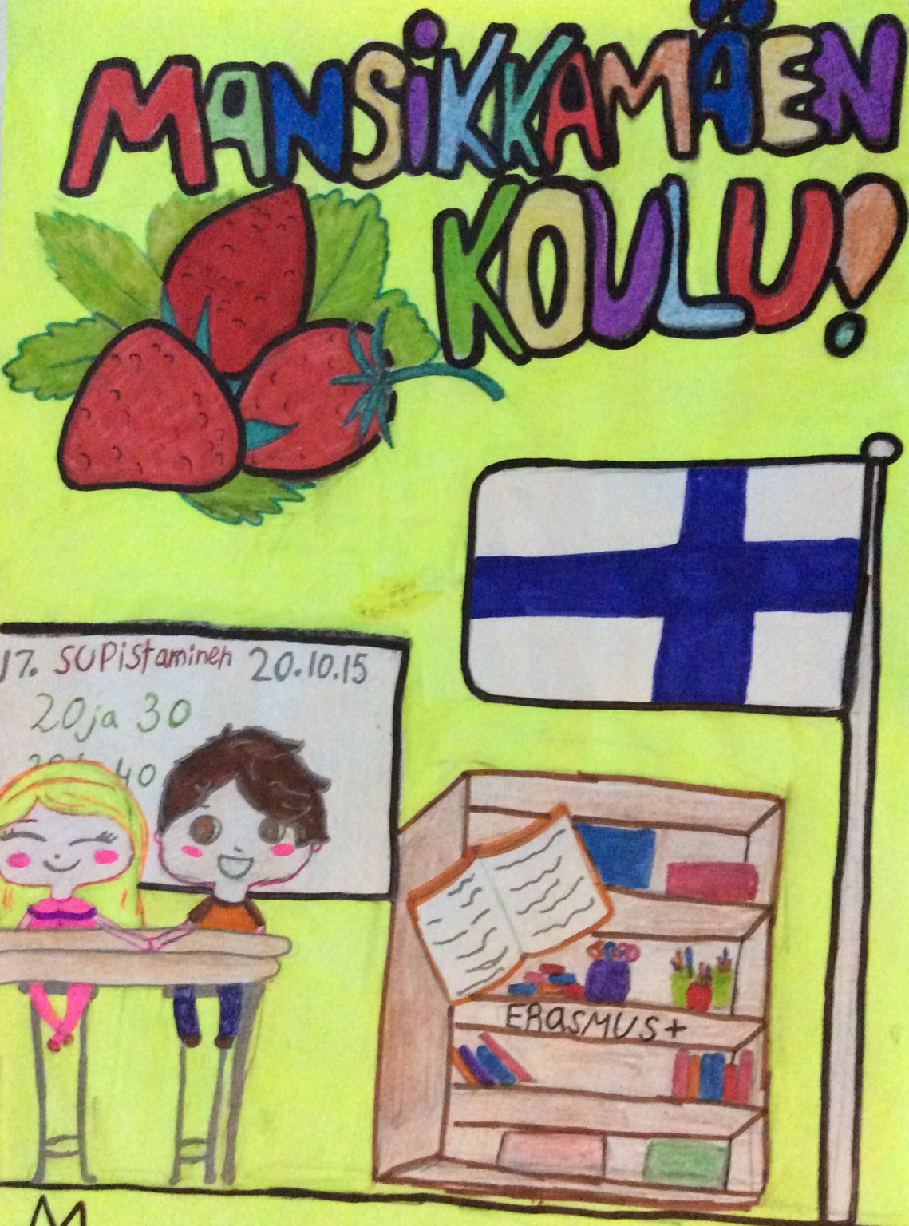
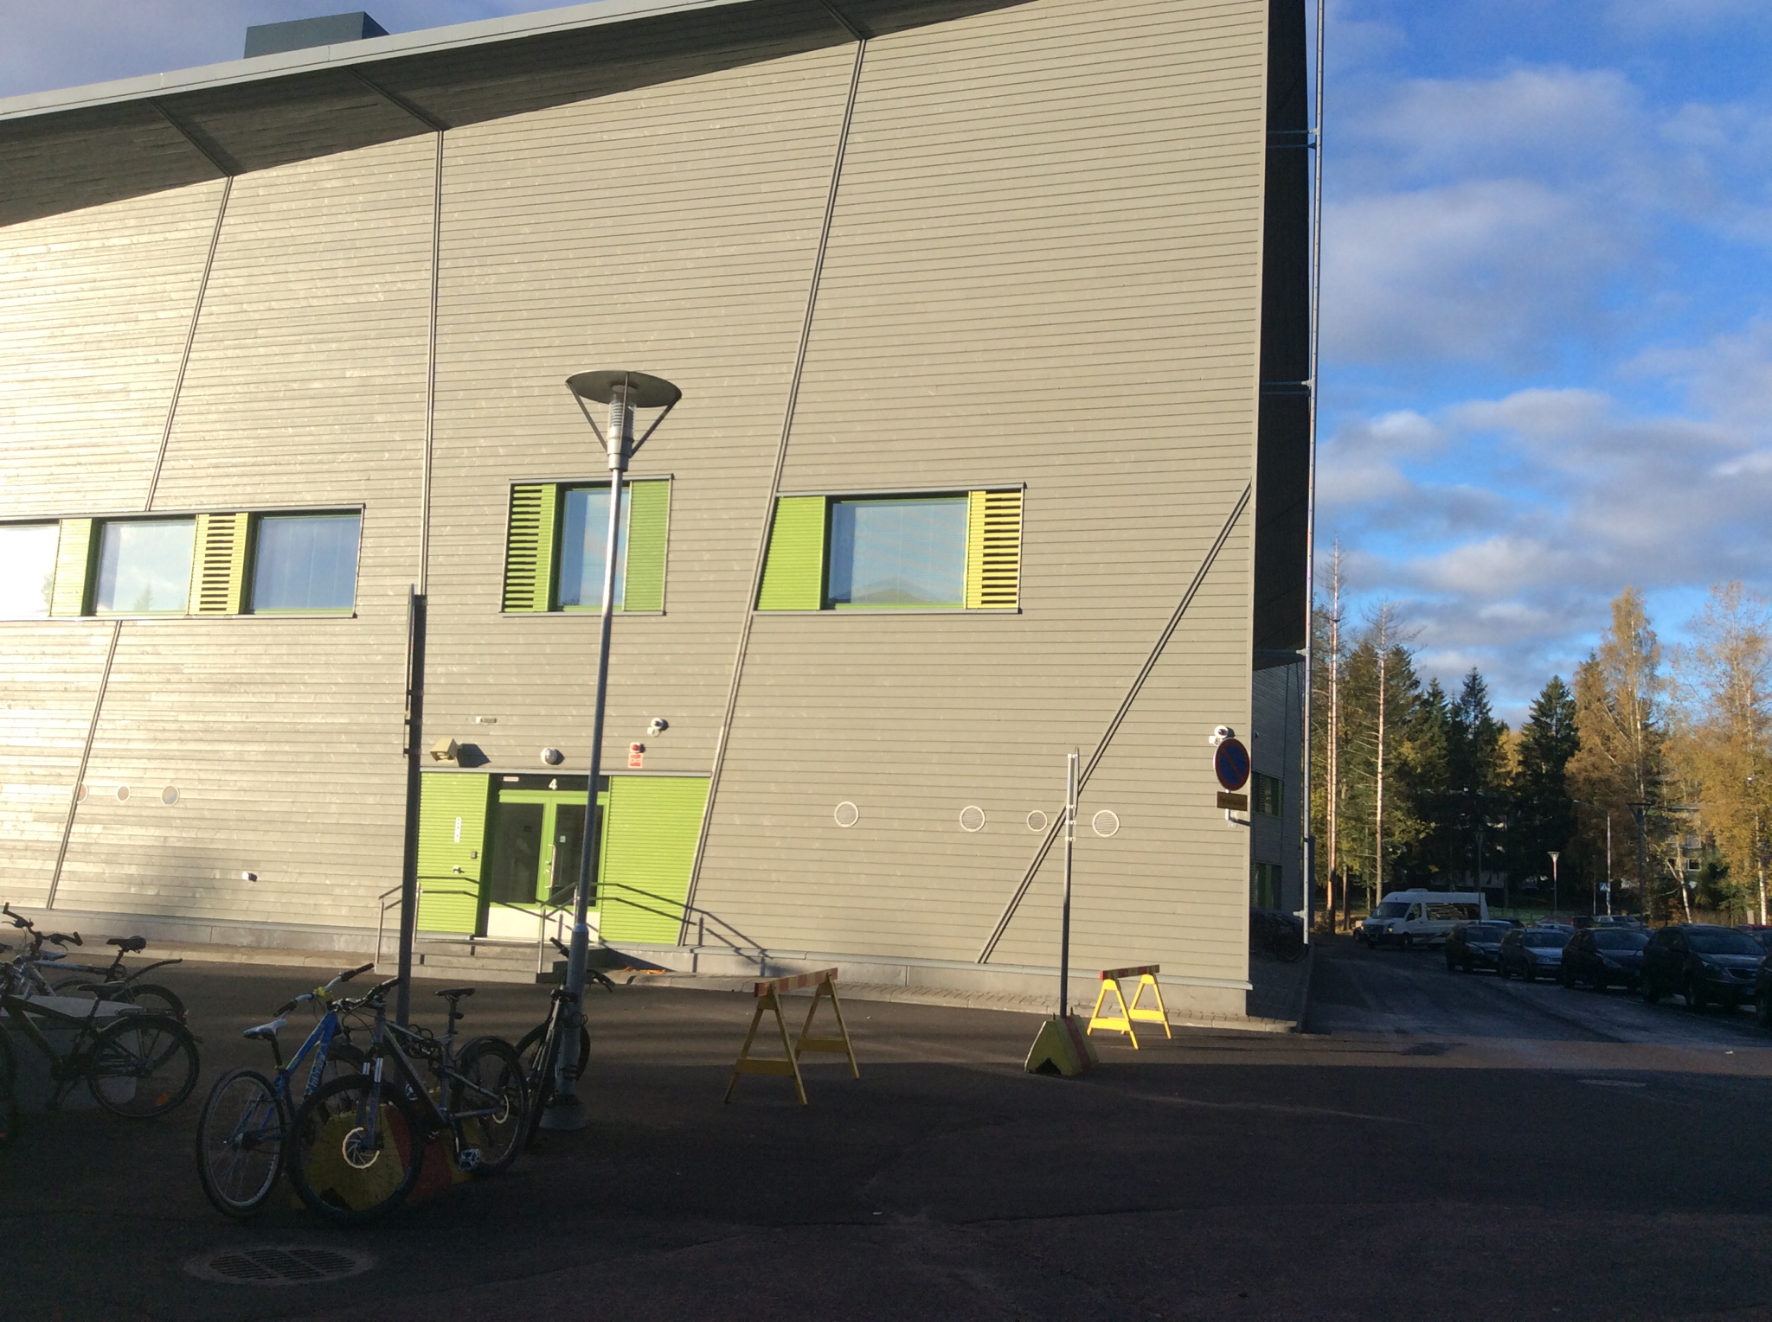
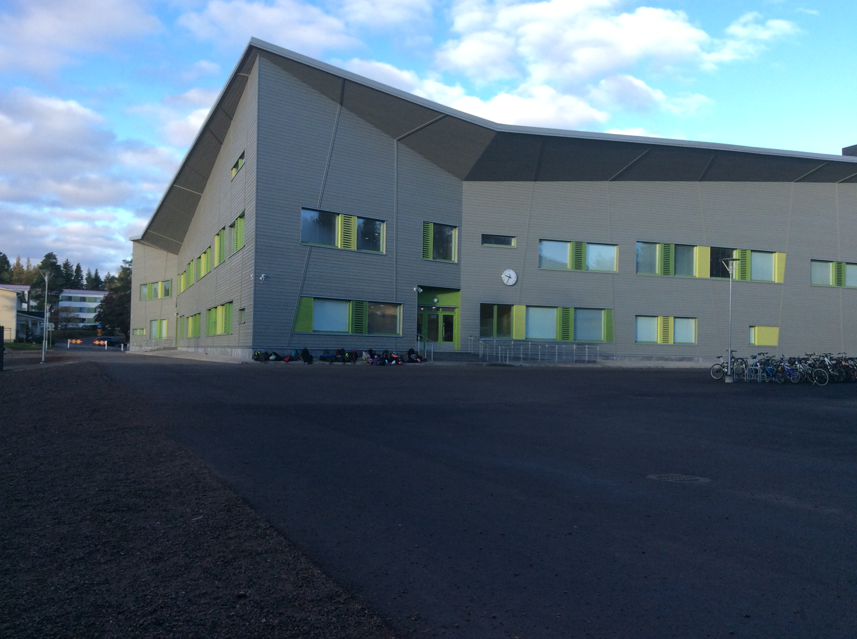
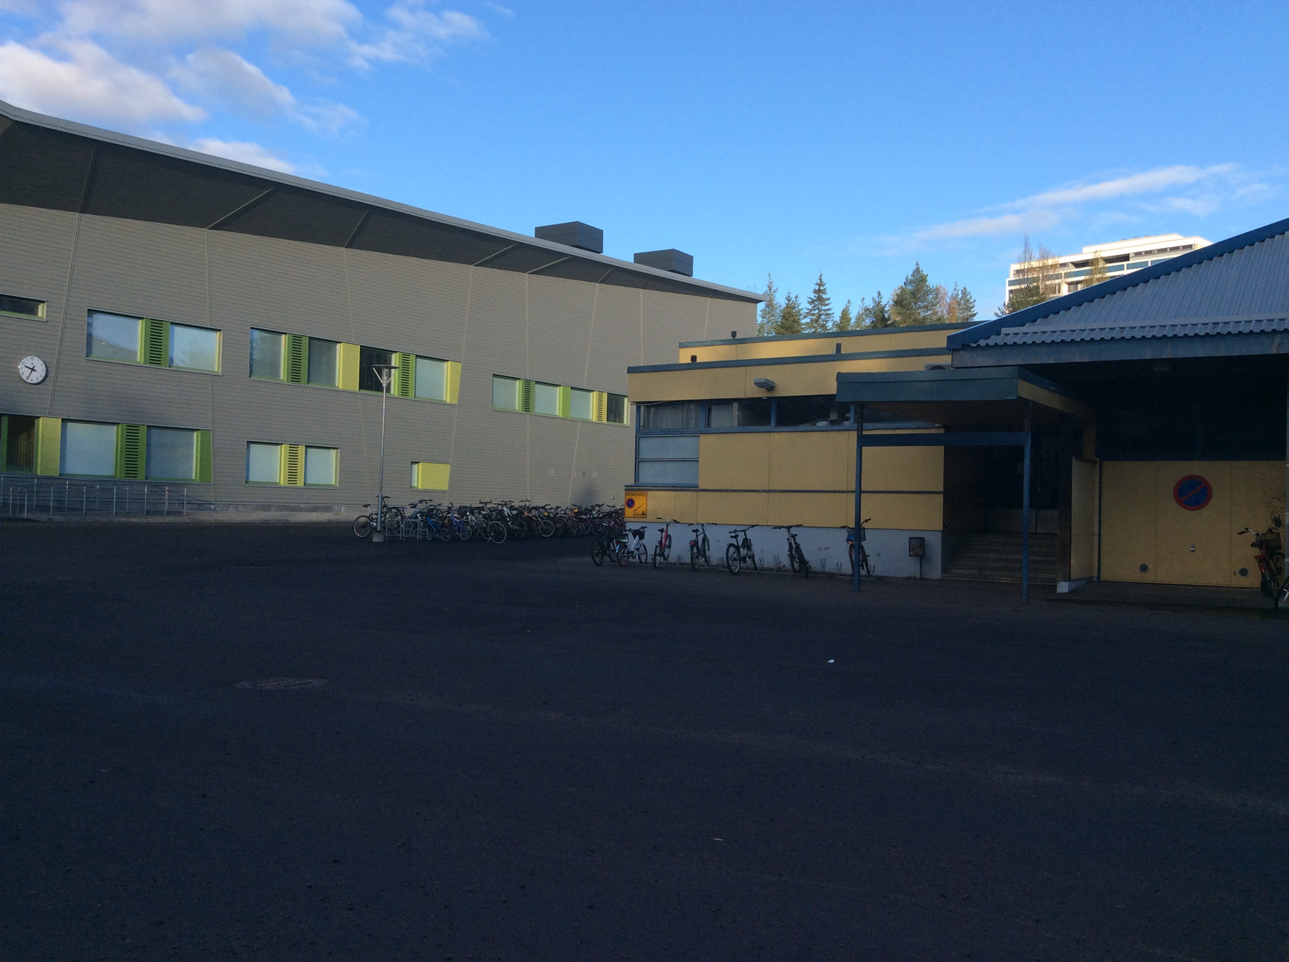
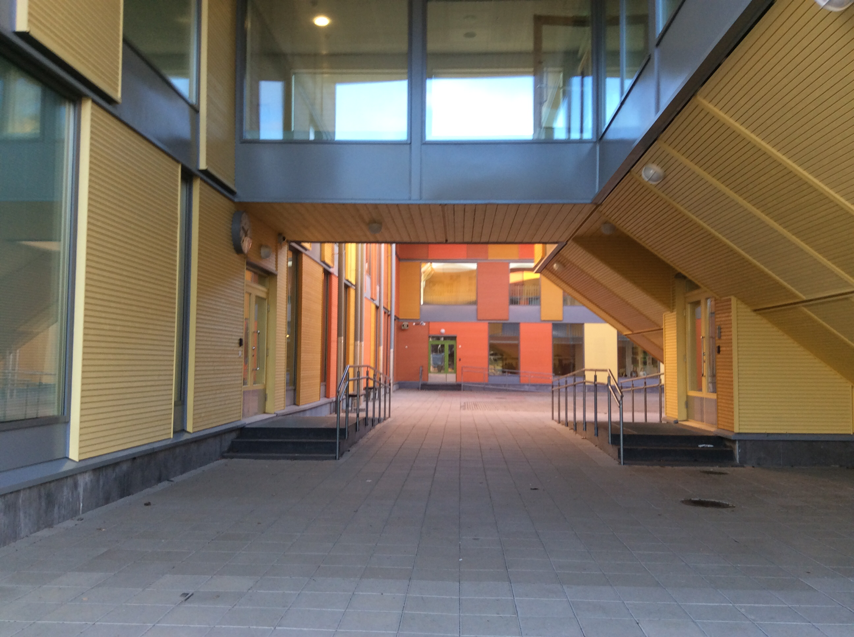
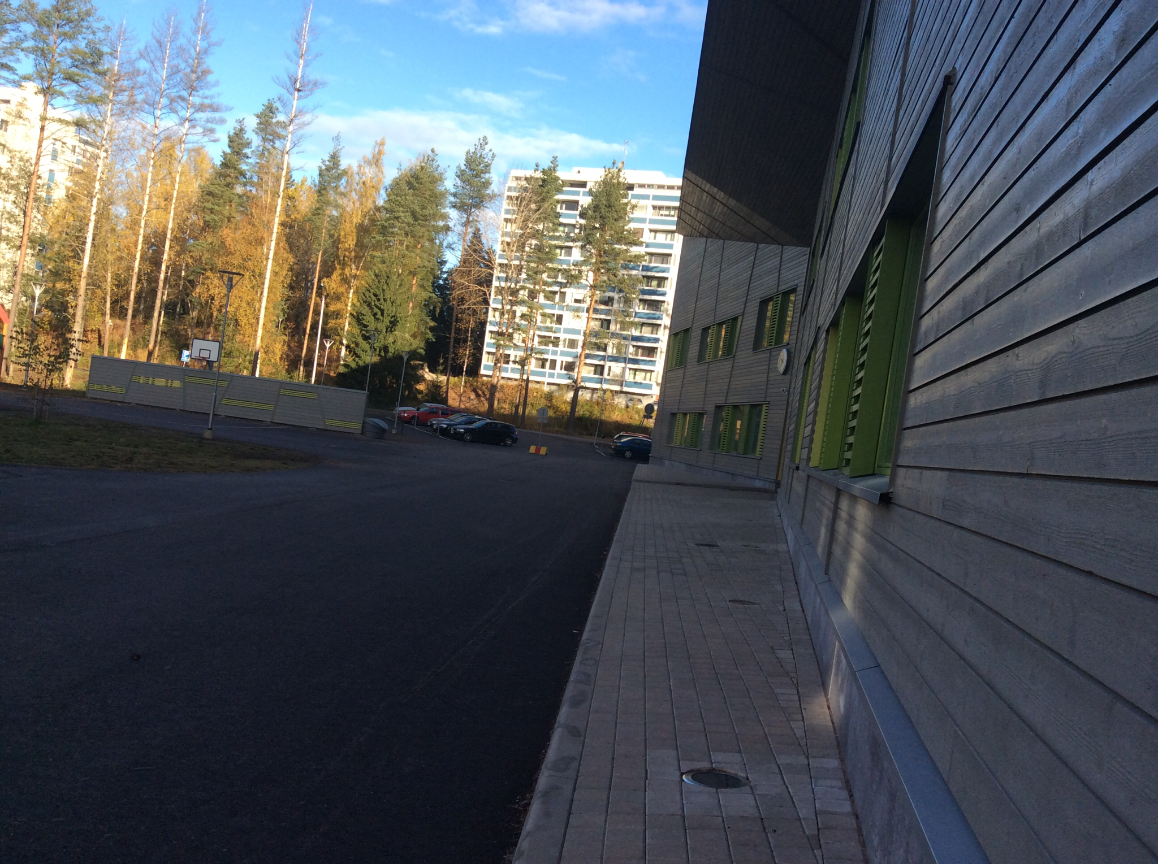
The school in pics

Slide 15
My school day
Hi! My name is Elisa. I'm 12 years old and I am in the 6 th grade. I go to school in Mansikkamäki. I live in Kouvola, Finland. My day starts usually at 7.30 because the school starts at 8.30 or 9.15. I go to school by bike or then I walk. My school day ends at 12.15, 13.30, 14.15 or 15.15. There are 560 pupils and 80 employees in Mansikkamäki School. The school staff includes teachers, a headmaster, a vice head, a school secretary, a nurse, a school psychologist, a curator, cleaners and cooks. The school was built in 2014. It's a primary school. There are grades from 1 to 6. We have letters B,C,D and F for the regular classes. The letter A is for the autist classes. The letter L is for the sport classes, Z is for the special classes ( for students who benefit from smaller classes), V is for the classes for foreign pupils who can't speak Finnish well.
The Finnish school day
8.30-10.00 1. and 2. lesson
10.00-10.30 First break
10.30-12.15 3. and 4. lesson
12.15-12.45 Second break
12.45-14.15 5. and 6. lesson
14.15-14.30 Third break
14.30-15.15 7. lesson

Slide 16
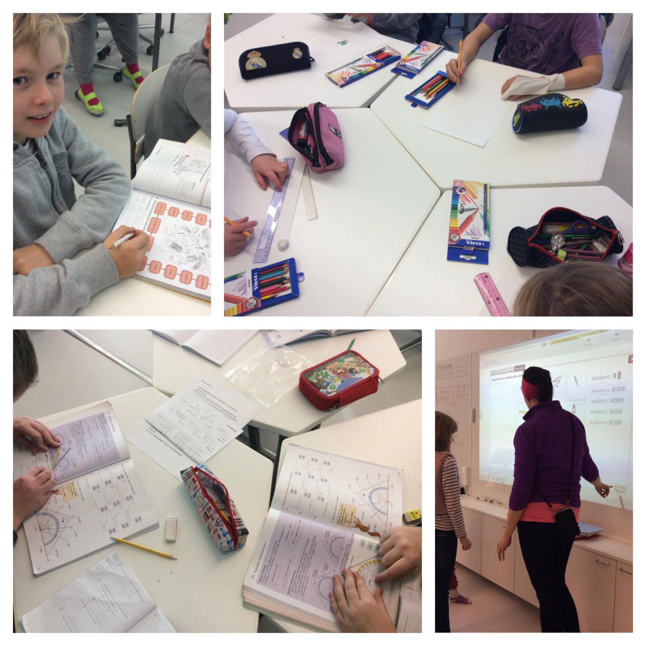
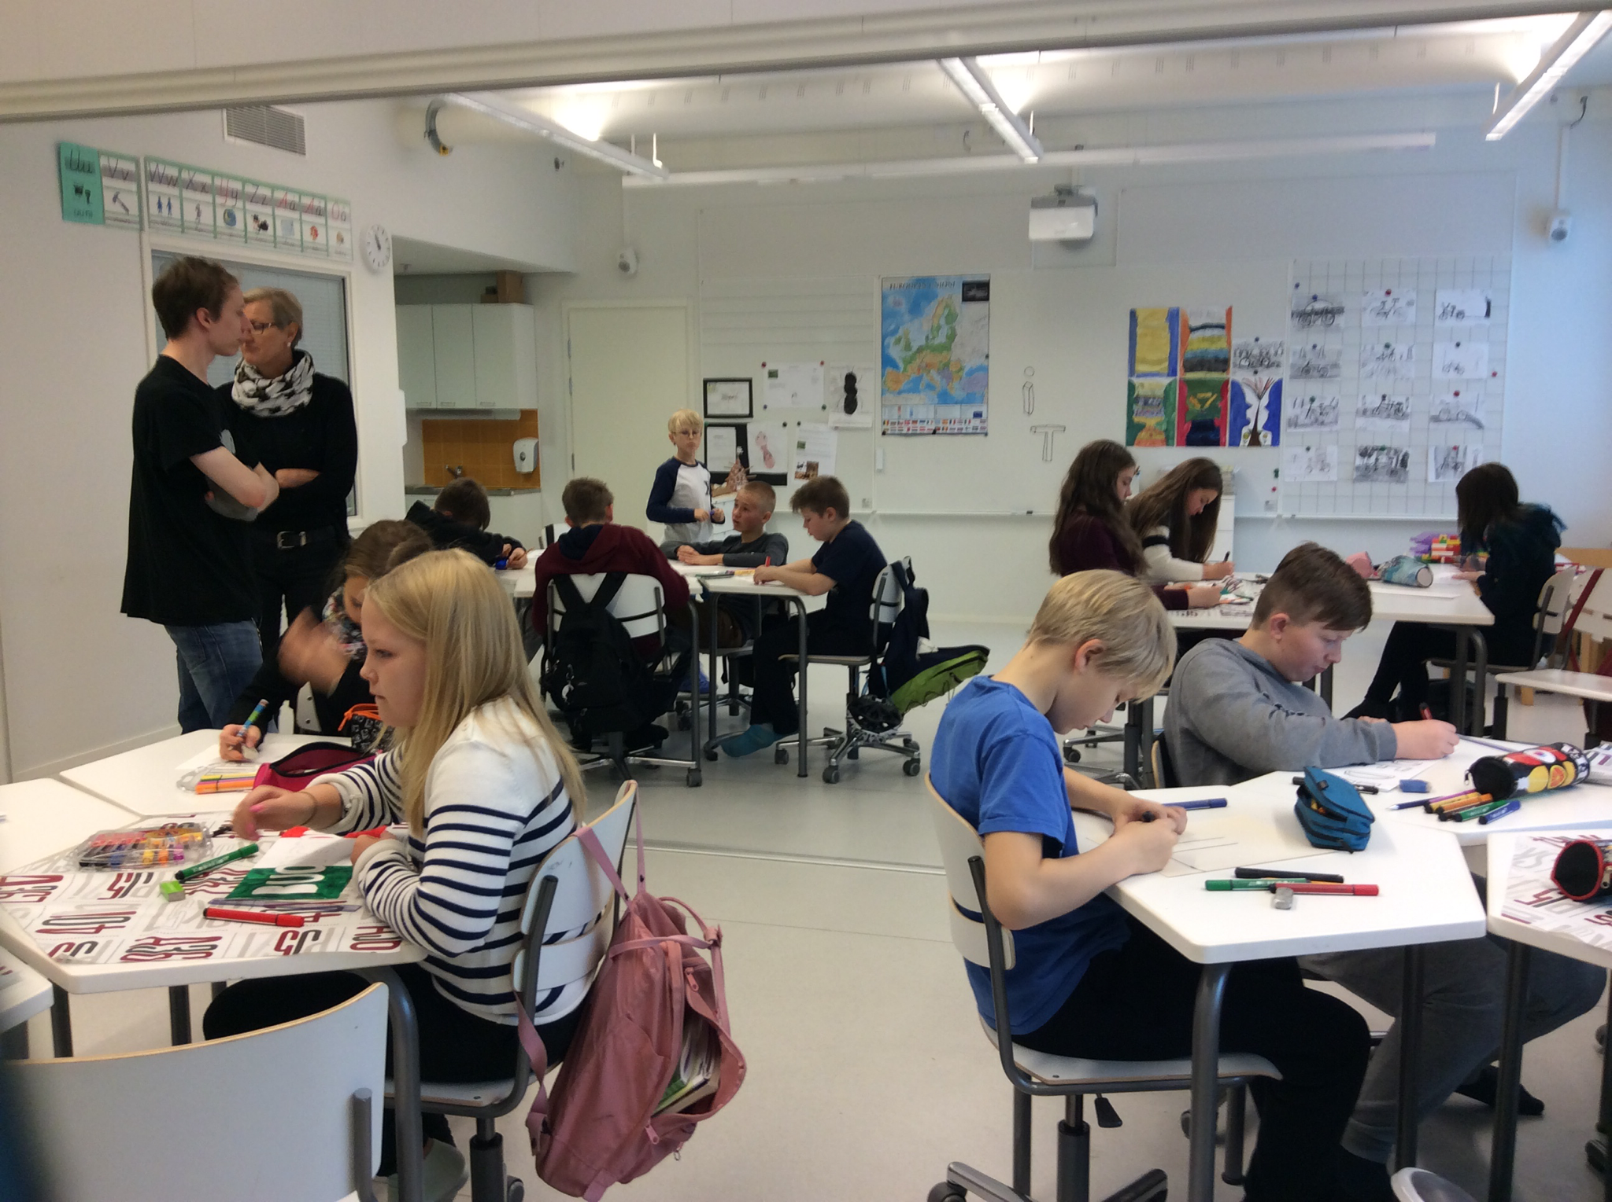
Subjects
Maths, P.E., art, textile and technical work, religion, Finnish, English, French, Russian, German, physics, chemistry, history, music, biology and geography.

Slide 17
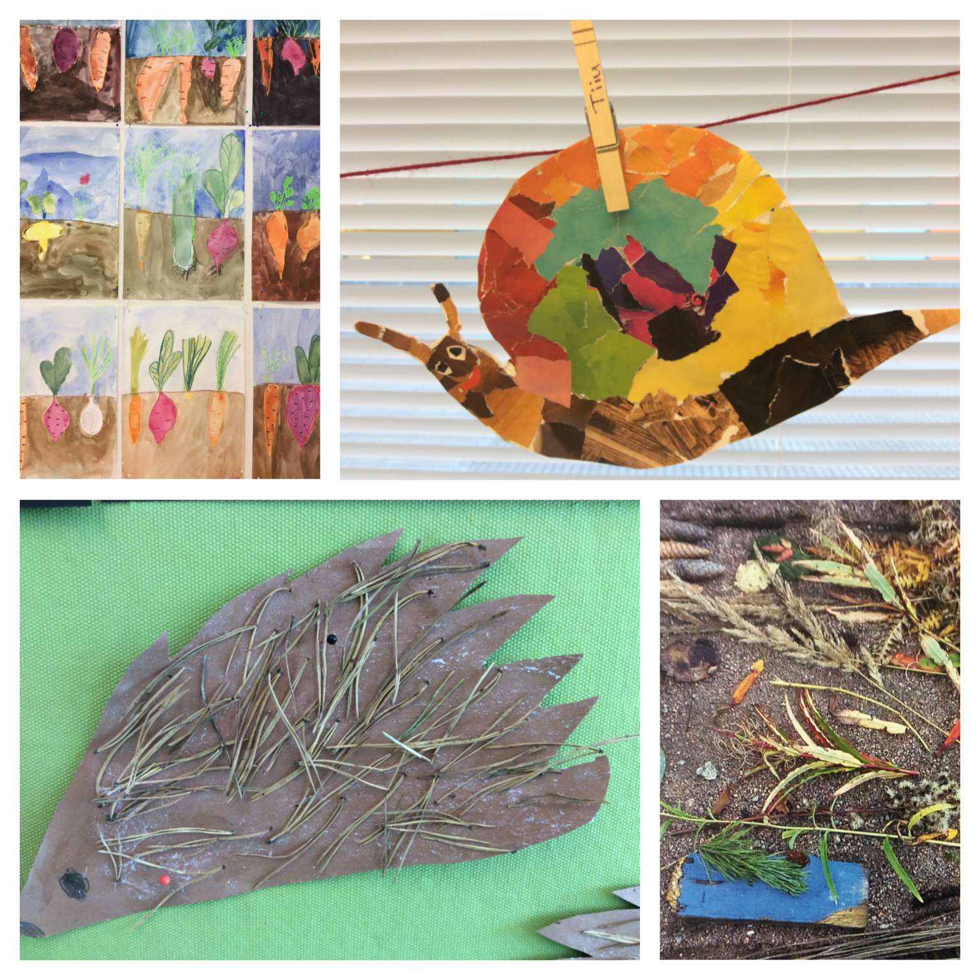
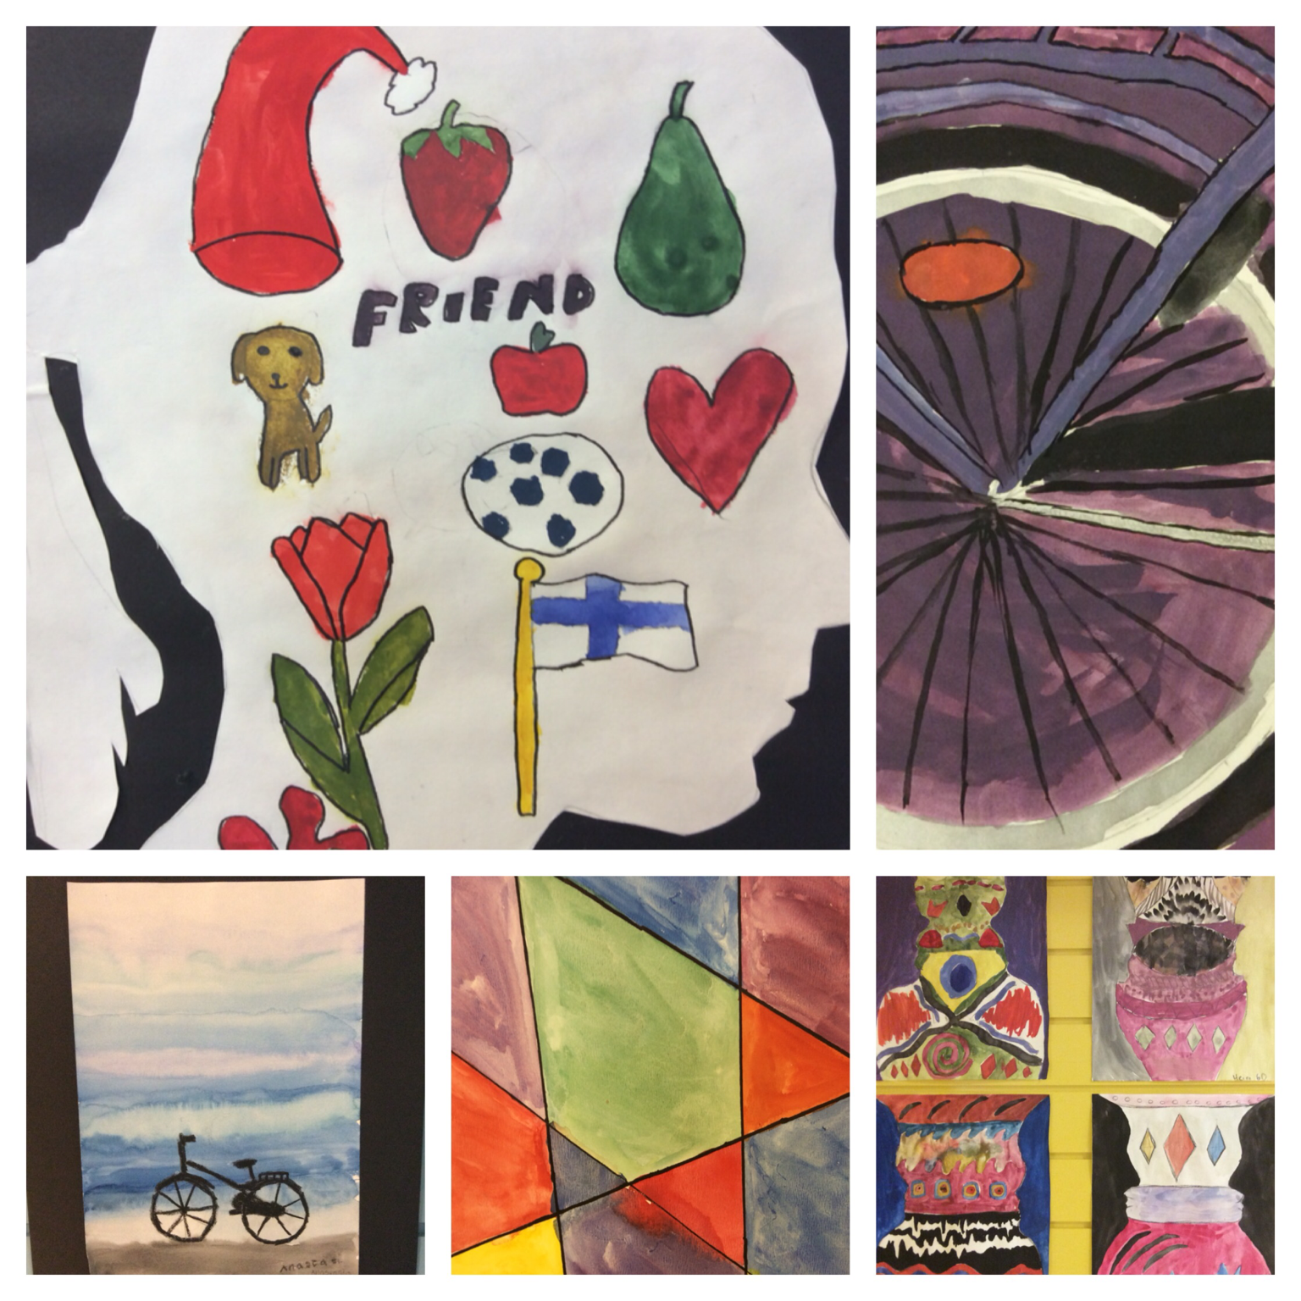
Art by pupils

Slide 18
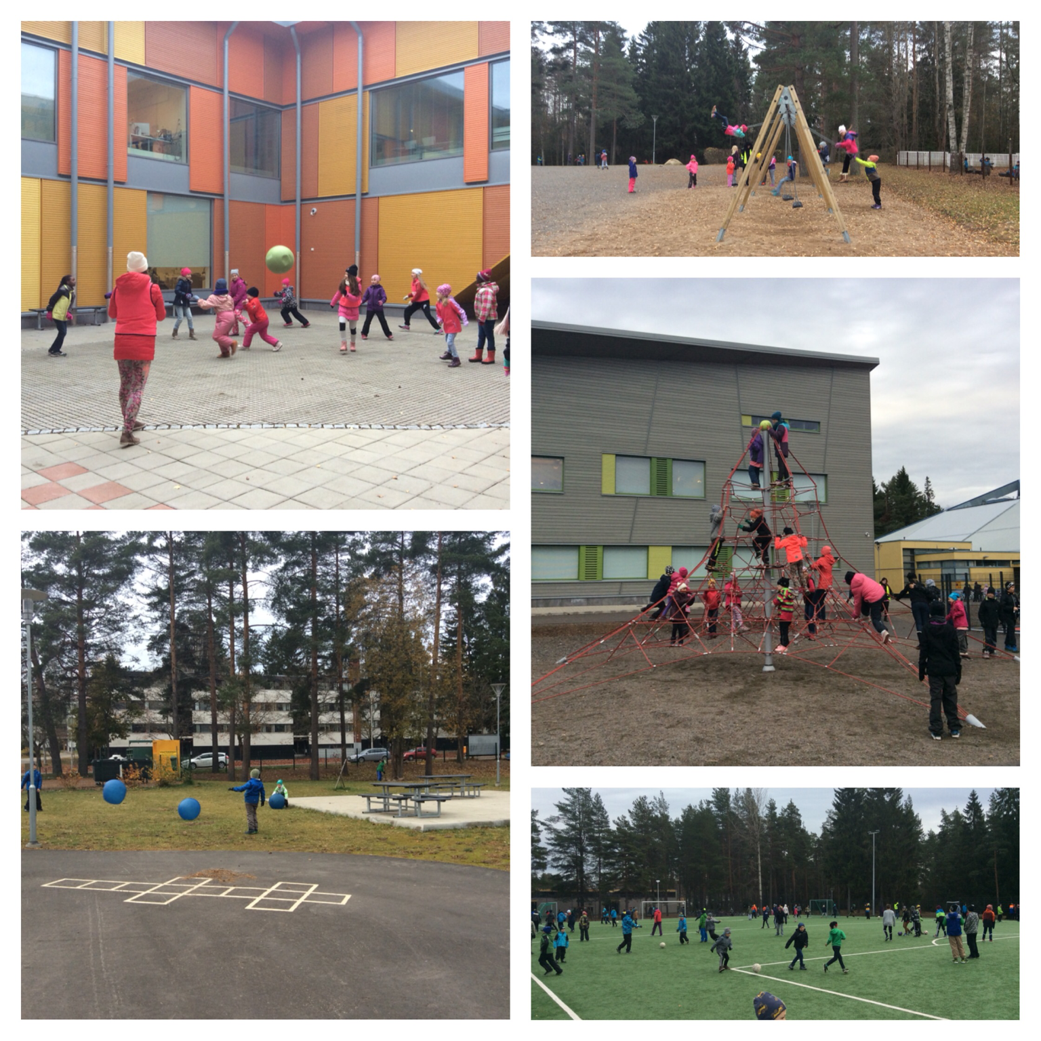
"Finnish schools on the move" program
In the Mansikkamäki School voluntary 6th grades organize different games for pupils as well as run a "rental shop" for sport equipment during the breaks. In the rental shop the 6th graders work in pairs or in a group of three and lend out for example skipping ropes, regular and large footballs, as well as goalposts for floorball and football. The school on the move program is good since the pupils get lots of exercise and are in good spirits. There are two breaks of thirty minutes in our school, from 10.00 to 10.30 am and 12.15-12.45 pm. On the first break the pupils usually play different ball games. There are football and basketball fields as well as many other places for playing on our school yard.

Slide 19
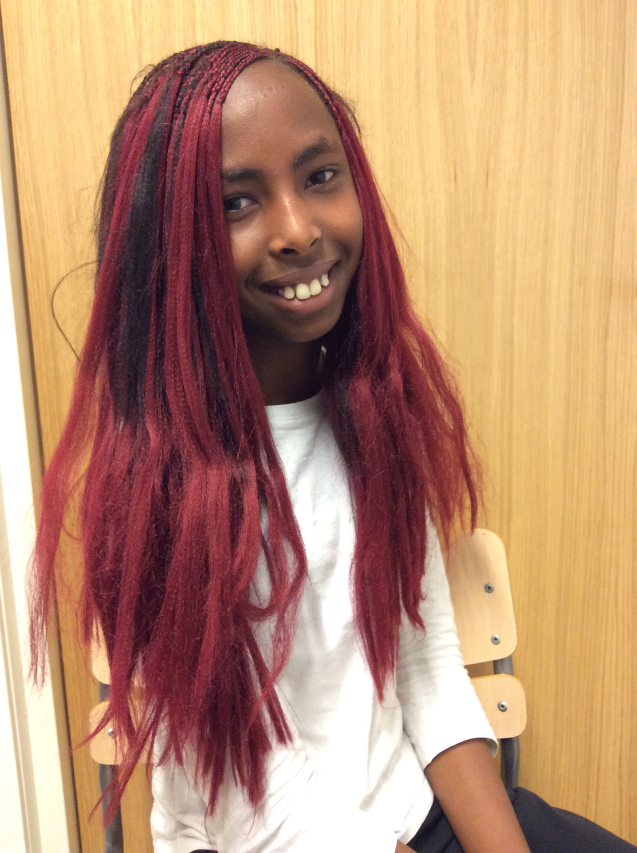
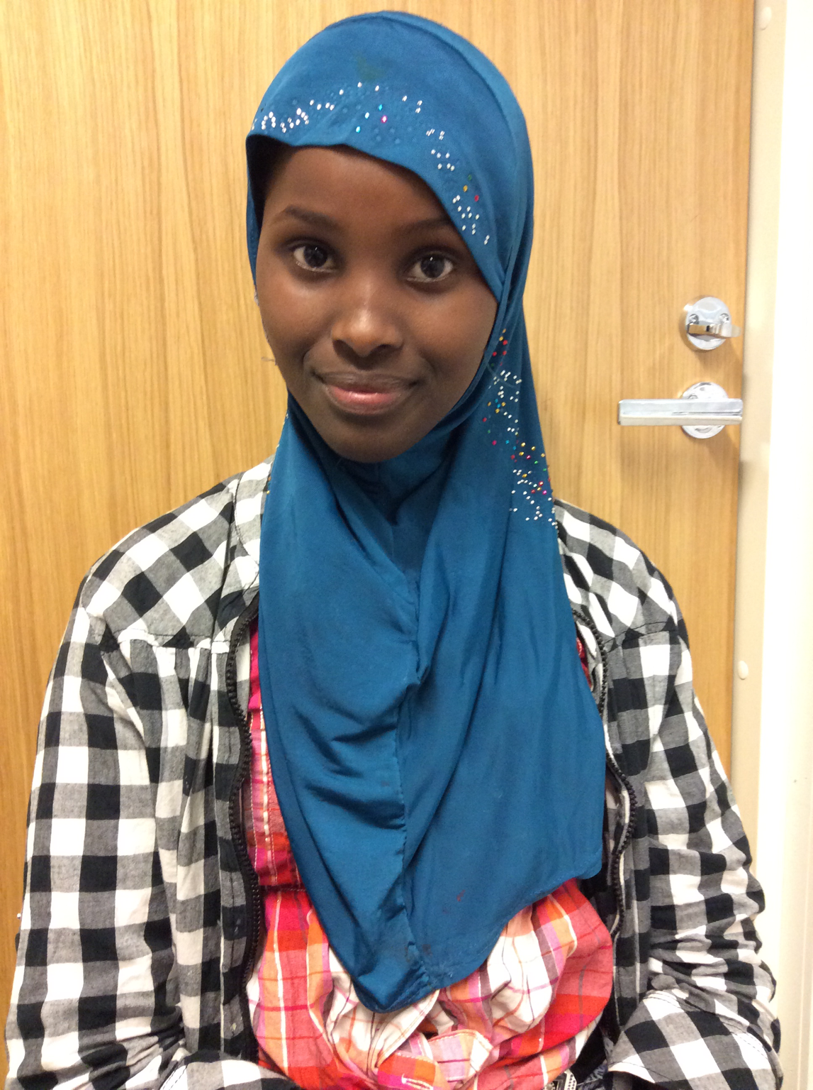
Multicultural interview at Mansikkamäki school
1. What country are you from?
2. Can your parents speak Finnish?
3. When did you come to Finland?
4. What was it like to come to Mansikkamäki school?
5. How old were you when you came to Finland?
6. Could you speak Finnish when you moved to Finland?
7. Do you miss your old home?
8. Is Finnish a hard language?
9. How did you get friends when you couldn't speak Finnish?
Iribagiza 6D
1. I'm from Kongo.
2. A little bit.
3. 2 and 1/2 years ago.
4. It was nice to meet new friends.
5. I was 10.
6. I could only say hello in Finnish ( Moi ).
7. Yes, I do.
8. A little bit.
9. We went to swing with our sister and got new friends.
Maryam 6D
I'm From Somalia.
2. Yes, they can.
3. 4 years ago.
4. It was nice.
5. 9.
6. No, I couldn't.
7. Mm... A little bit.
8. No, it isn't.
9. I used signs.
Iribagiza
Maryam

Slide 20
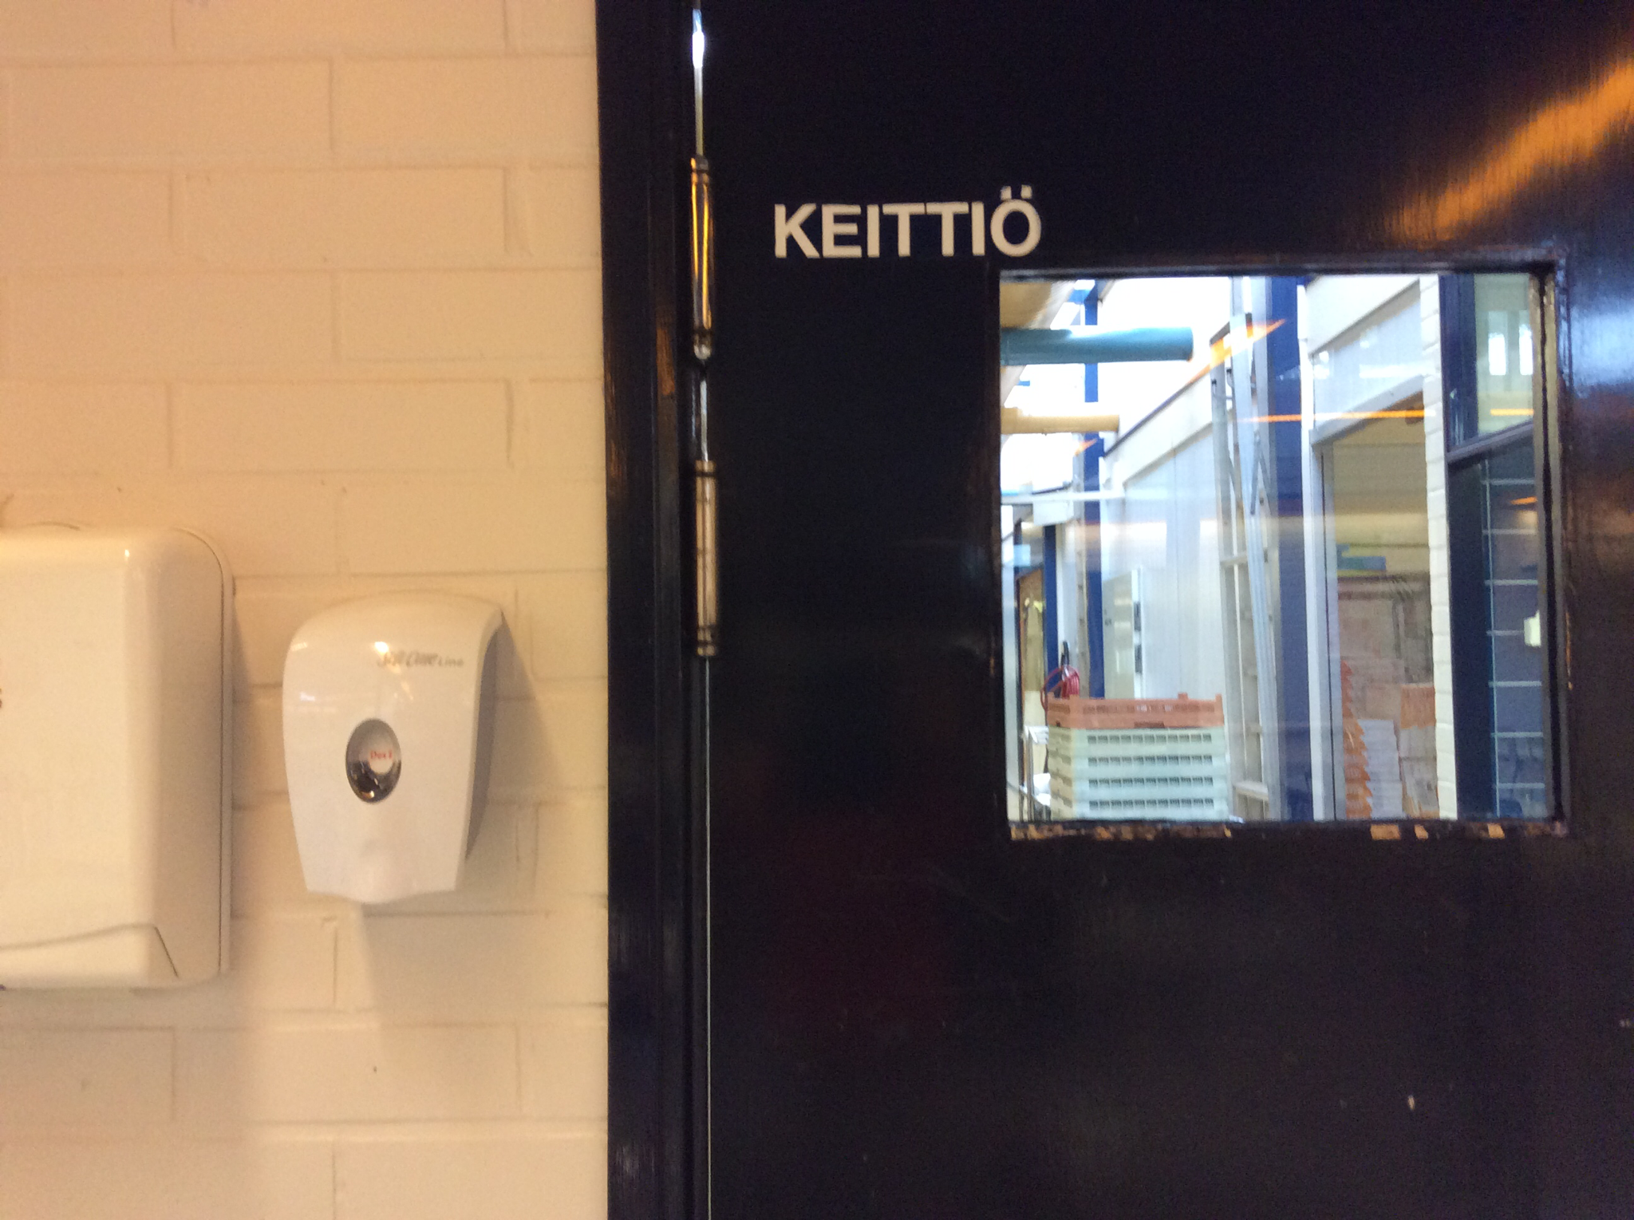
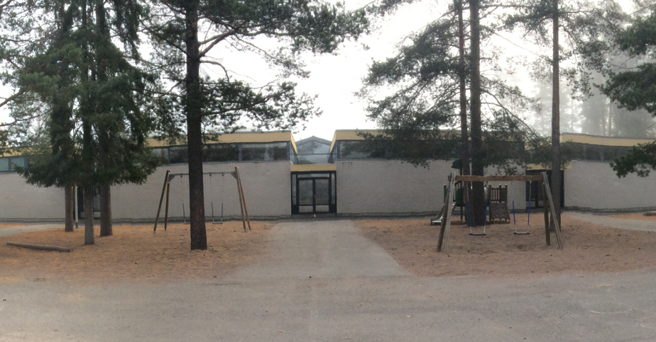
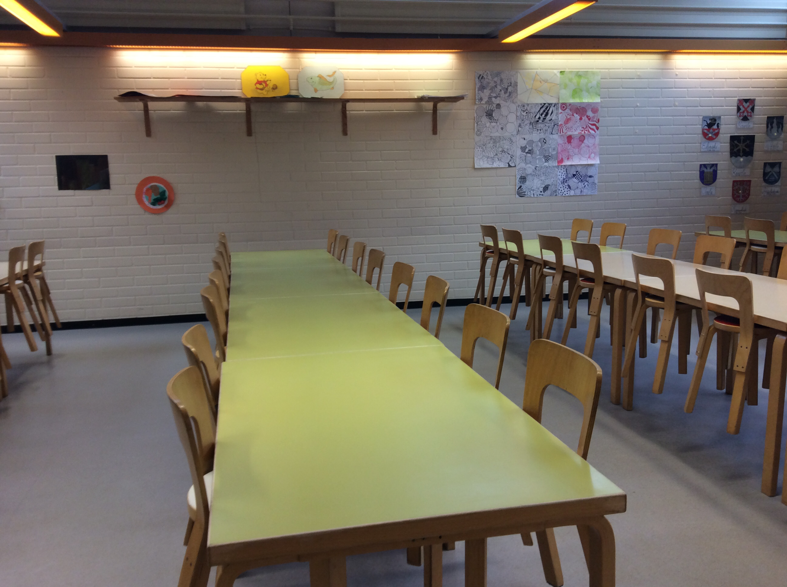
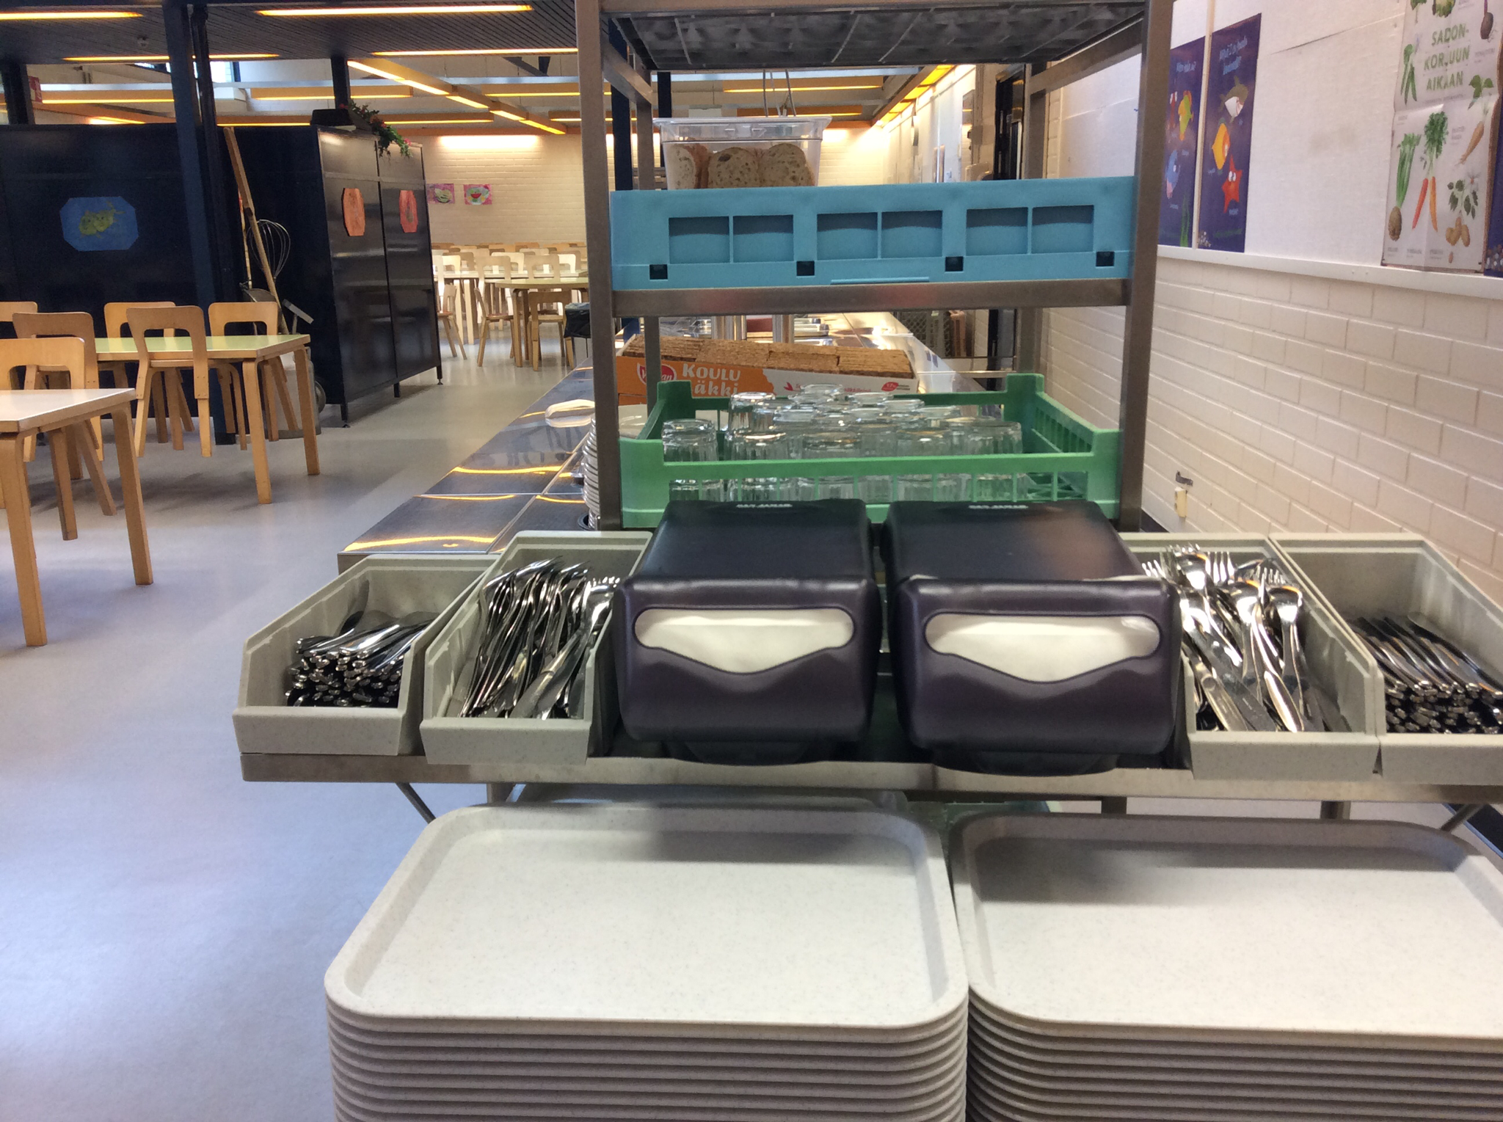
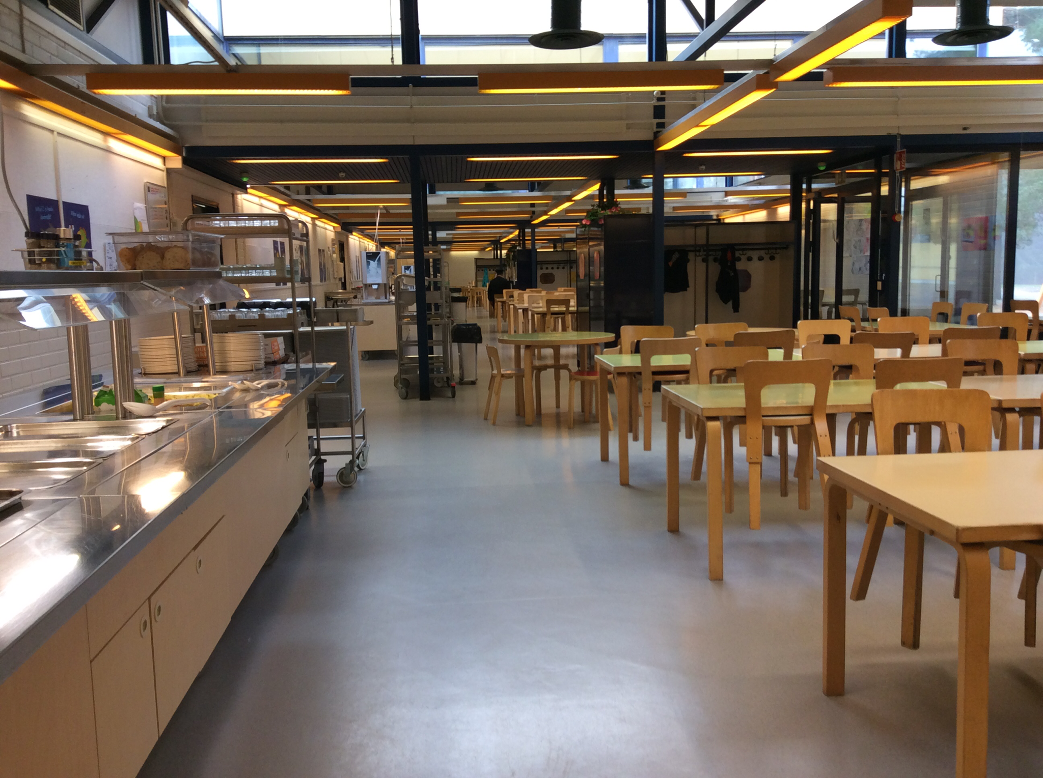
The food in our school
The school lunch in Finland is good and free. We also have a snack in the afternoon if you are at school until 3:15 pm. For lunch we have salad, meat, potatoes or pasta, vegetables and bread. We drink milk or water. The lunch is between 10.30 am and 12.00 pm.
If we go to snack, there is some bread and milk or water. If there is leftover fruit from lunch, we eat them too.
The school canteen is big, but we have about 560 pupils and about 40 teachers and 35 assistants. Sometimes it's hard to find a vacant seat.
The school canteen is not in the school building. We have to walk about 50 meters to get there. The canteen has four sections A,B,C,D. There is the list of favorite foods of 6D class:
Girls: Boys:
1. Pea soup 1. Macaroni casserole
2. Mashed potatoes 2. Spinach Pancakes
3. Porridge 3. Pea soup

