Slide 1
Lewis acids and bases
A Lewis acid is a lone pair acceptor (H⁺)
A Lewis base is a lone pair donor (OH⁻ , NH₃)
Lewis base + Lewis acid → coordinate bond

Slide 2
Calculations
pOH = -log[OH⁻], [OH⁻] = 10^{-pOH}
K_{a} x K_{b} = K_{w} (consider that this equation can be manipulated)
pK = -logK
-log₁₀K_{b} = PK_{b} (and substitute a for acids)
K_{a} = 10^{-pKa} (and substitute b for bases)
Understand relative strengths of acids and bases using K and pK values…

Slide 3
Conjugate acid-base pairs
The larger the K_{a}, the stronger the acid and the smaller the K_{b} of the conjugate base (which is weaker)
The larger the K_{b}, the stronger the base and the smaller the K_{a} of the conjugate acid (which is weaker)
The larger the pK_{a}, the weaker the acid
The larger the pK_{b}, the weaker
the base
pH is inversely proportional to K_{a}

Slide 4
Key Concepts of HL Acids and Bases
Equivalence point: the point at which exactly the required volume of titrant has been added to provide the amount of substance required to just react completely
Indicators indicate when the point has been reached (as closely as possible)
--Often organic compounds
--Weak acids / bases themselves
When pH = Pk_{a} the two forms (colors) will be in equal concentrations

Slide 5
Key Concepts of HL Acids and Bases
A buffer is a solution that resists a change in pH upon the addition of small amounts of a strong base or strong acid. It also resists a change via dilution in water.
Weak acid and its conjugate base are added in equal molar concentrations.
Changes occur according to LeChâtilier’s principle

Slide 6
Strong Acids-Strong Bases (ph 7, many indicators)

Slide 7
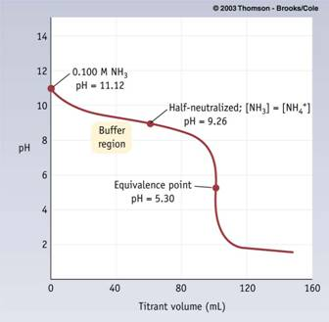
Strong Acids-Weak Bases (ph < 7)
Methyl orange

Slide 8
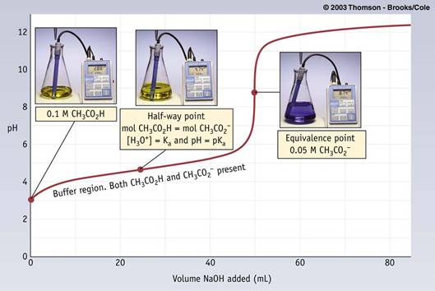
Weak Acid-Strong Base (pH >7)
Phenolphtalein

Slide 9
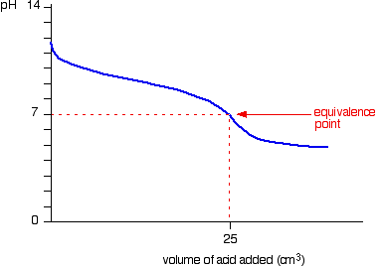
Weak Acid-Weak Base (difficult to find indicator)

Slide 10
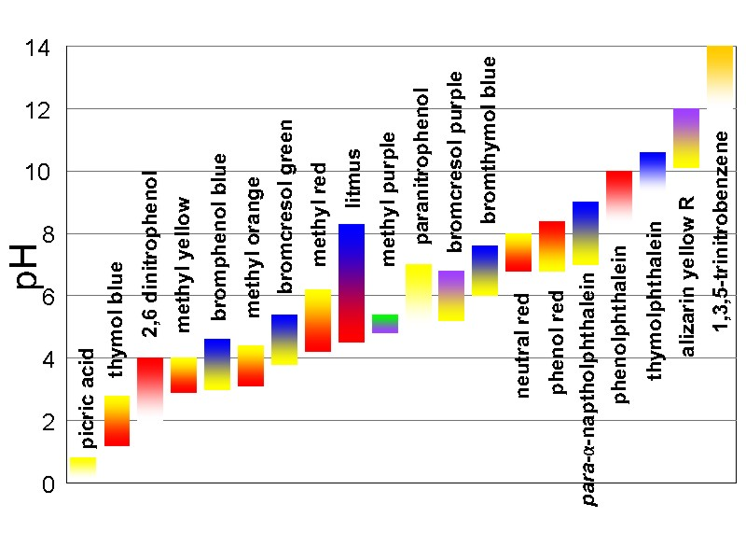
Use of indicators
The midpoint of color changes are often when the concentration of the indicator = the concentration of its conjugate base
Here, [H⁺] = K_{a}
pH = Pk_{a} (color change takes place over a range)
http://www.genchem.net/gif/indicators.jpg

