Slide 1
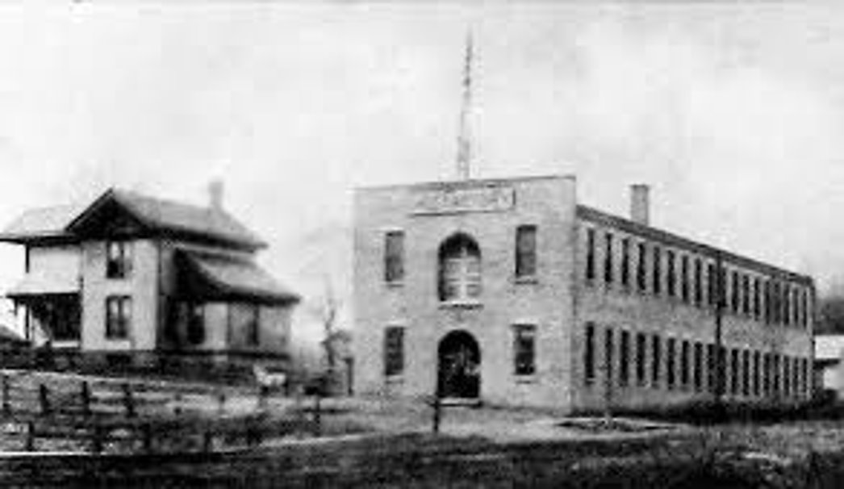
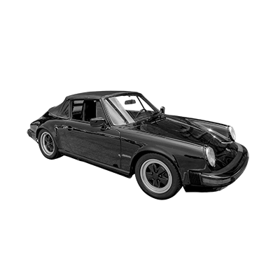
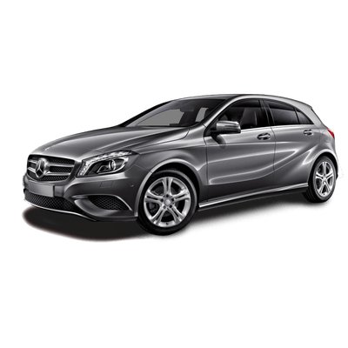
GERMAN CARS

Slide 2
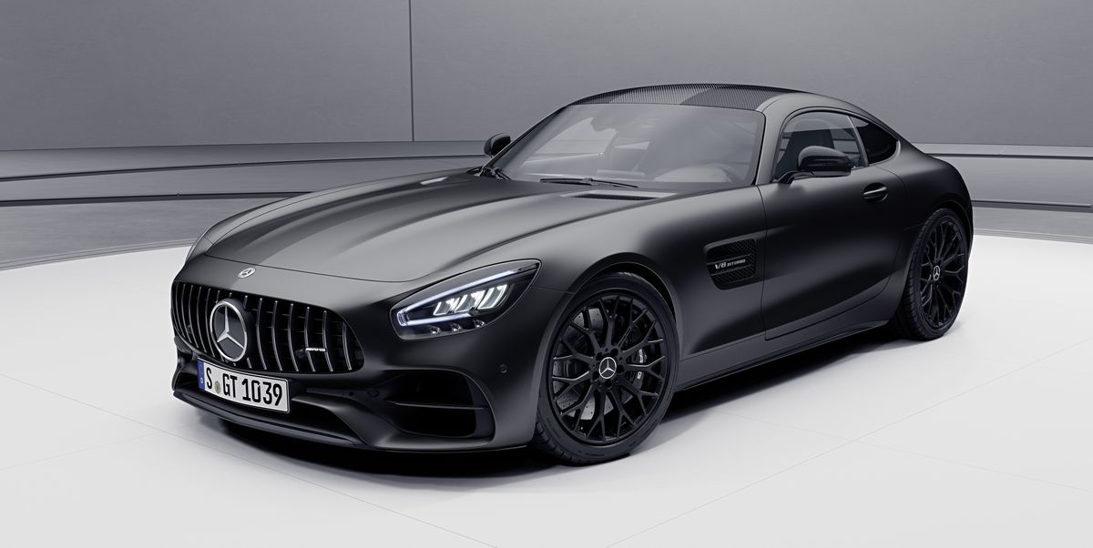
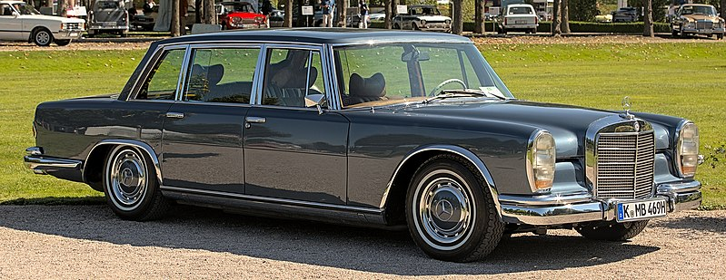
Mercedes-Benz
Mercedes-Benz is a luxury car brand that is known for its sophisticated designs, advanced technology, and high performance. It has a wide range of models including sedans, SUVs (Sports Utility Vehicle), coupes, convertibles, and sports cars.
Name is made up of Carl Benz' last name and Emil Jellineks daughters name
Mercedes-Benz is a collaboration of two different companies (DMG and Benz & Cie)
The first ever car was made by Benz in 1885
The most popular model is Mercedes-Benz C-class

Slide 3
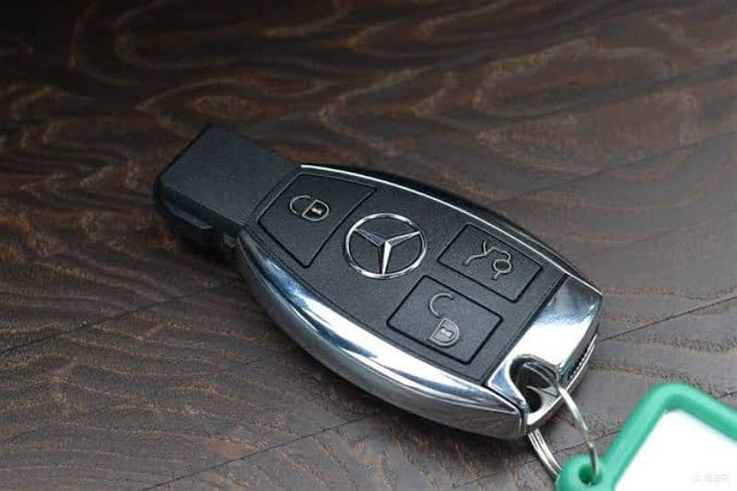
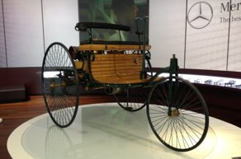
Inventions by Mercedes-Benz
1885
The car
1926
first hydraulic braking system
1936
first diesel passenger car
1989
Infared key
1990
switchblade car key
1998
Smartkey Anti-theft Protection

Slide 4
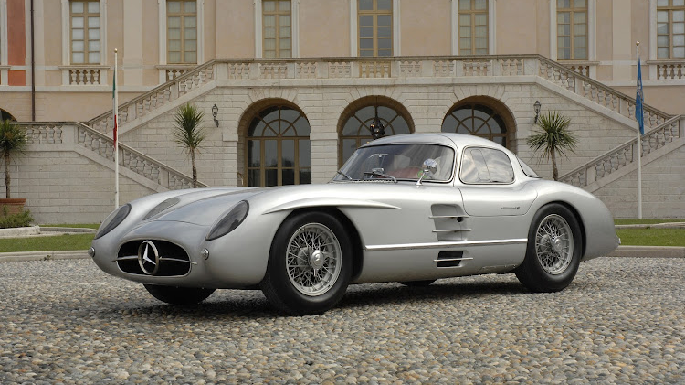
Mercedes-Benz 300 SLR Uhlenhaut Coupé (1955)

Slide 5
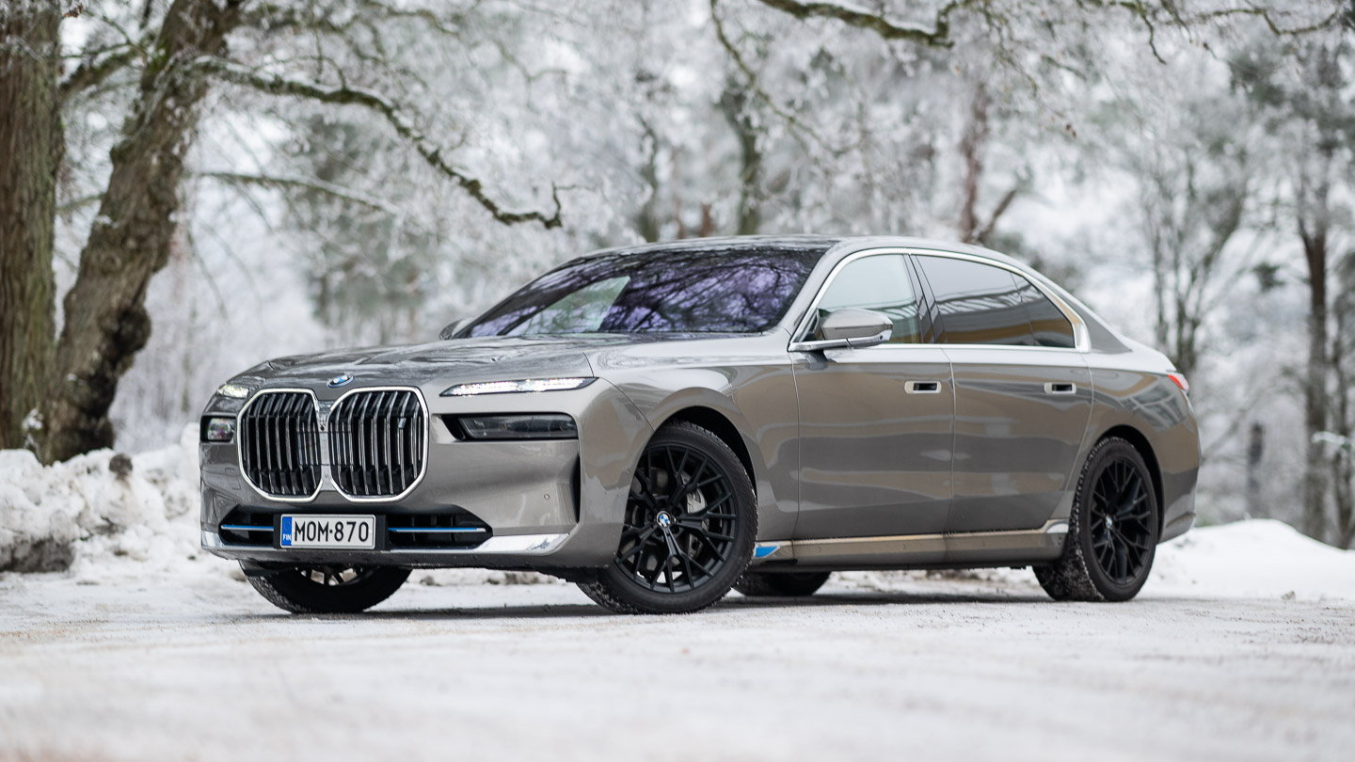
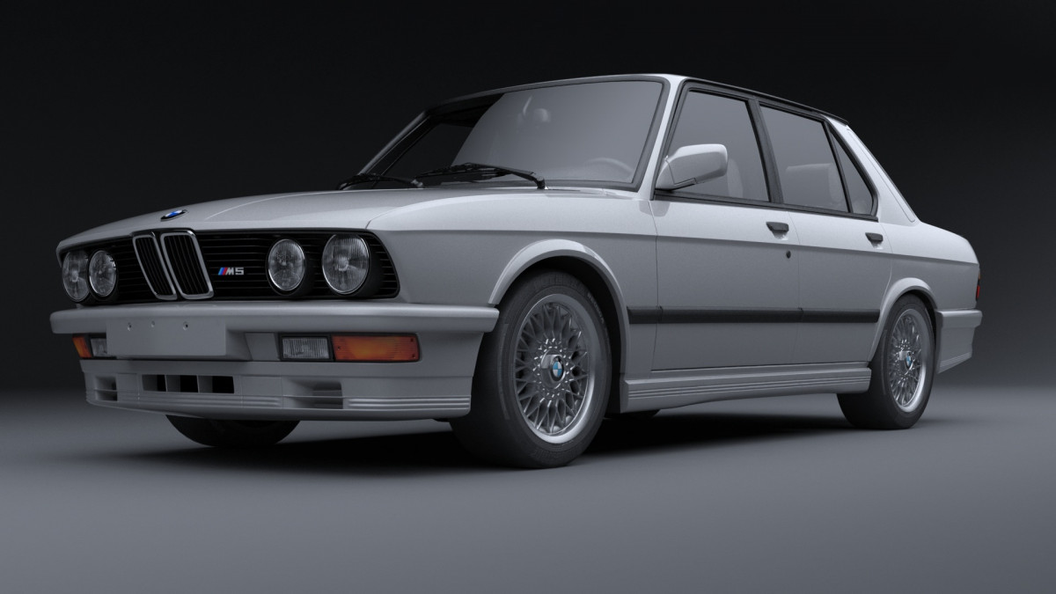
BMW
BMW is known for its high-end luxury vehicles, sporty designs, and advanced engineering. It has a wide range of models including sedans, SUVs, coupes, convertibles, and sports cars.
Founded in 1916
BMW (Bayerische Motoren Werke)
BMW wasn't originally a car manufacturer

Slide 6
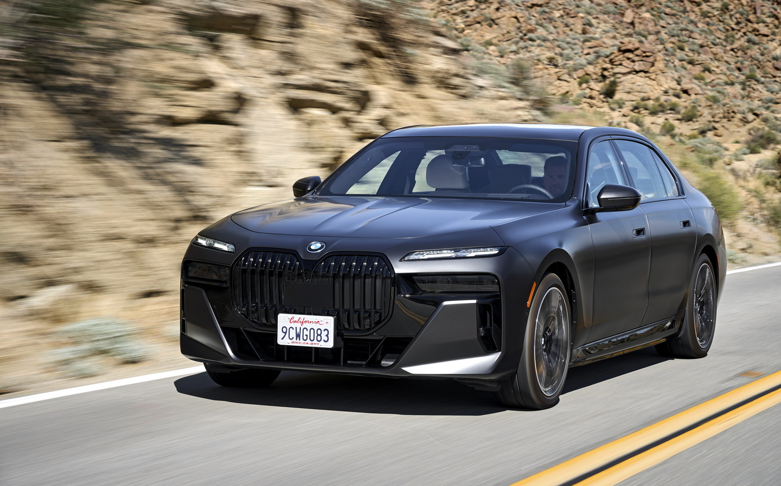
BMW I7 (2023)

Slide 7
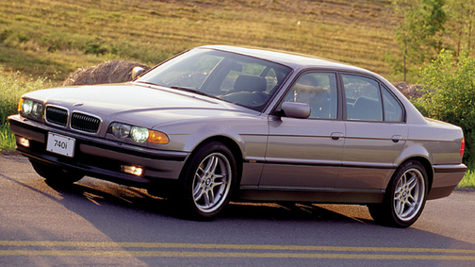
Inventions and developments by BMW
- fully-variable valve lift system in the new and innovative VALVETRONIC engine
Leading developement in hydrogen cars
Weird add campaigns

Slide 8
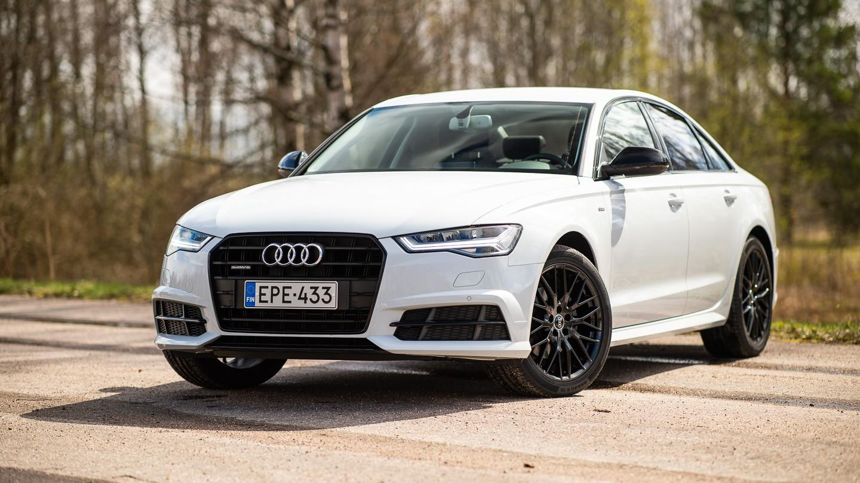
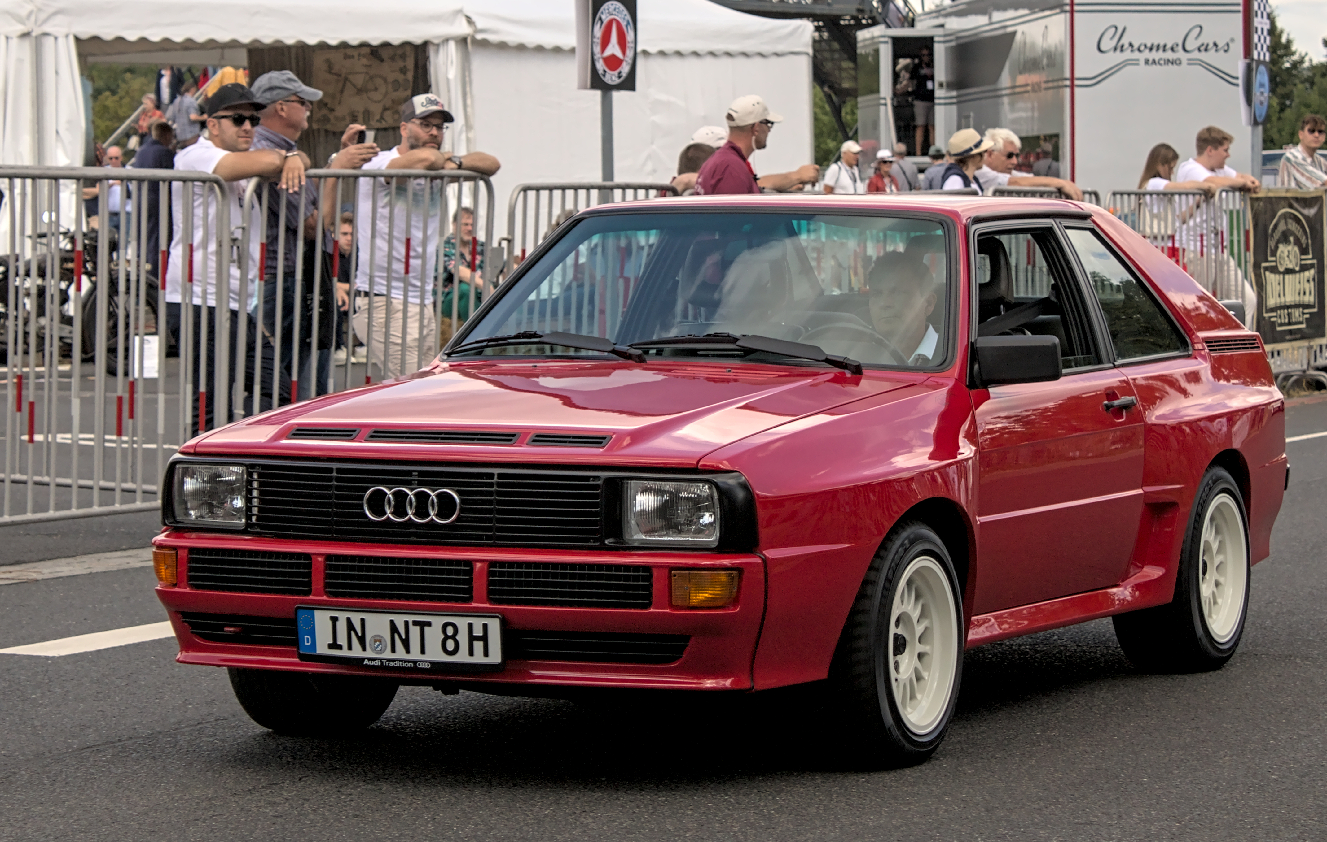
Audi
Audi is a luxury car brand that is known for its sleek and modern designs, advanced technology, and high performance. It is owned by Volkswagen Group and has a wide range of models including sedans, SUVs, coupes, and sports cars.
Founded in 1909
The most popular model is Audi Q5

Slide 9
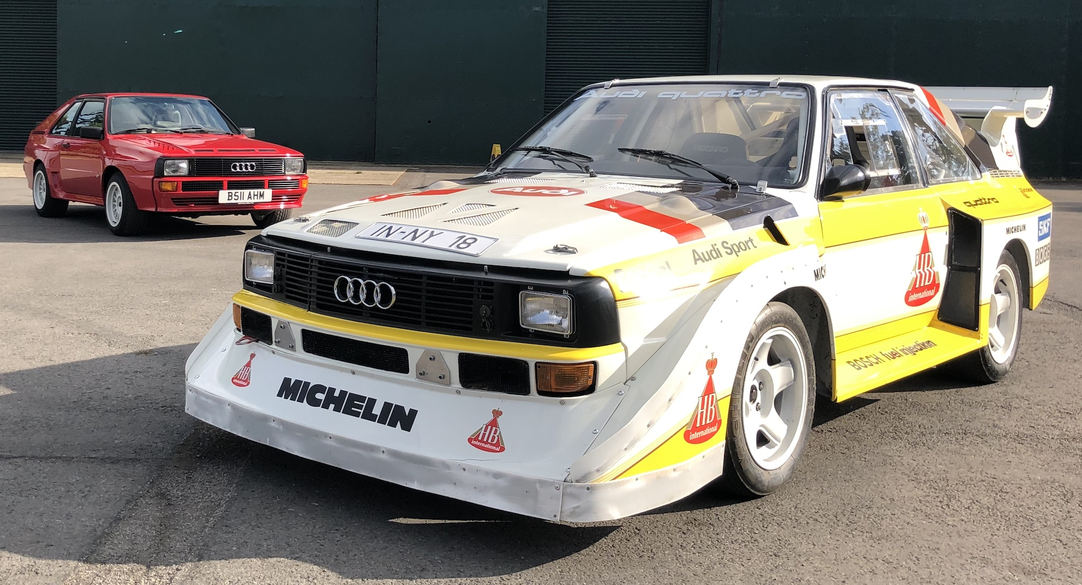
Inventions and developments by Audi
One of if not the best all-wheel drive sytem to date (1980)
Fully active and eletric braking system

Slide 10
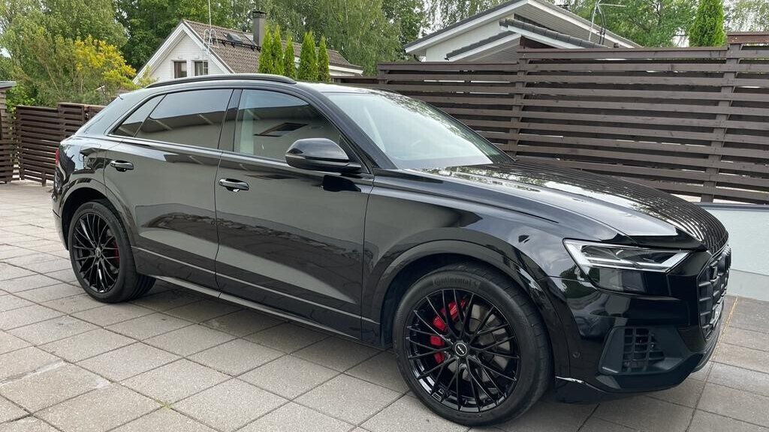
AUDI Q8 (2021)

Slide 11
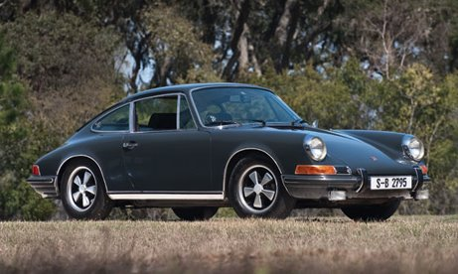
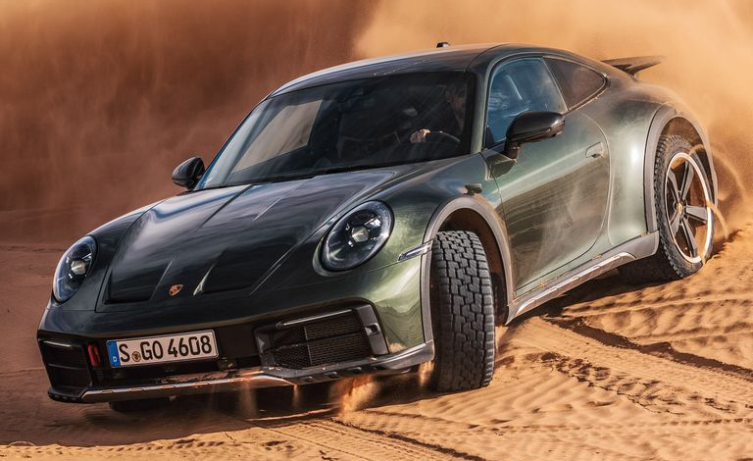
Porsche
Porsche is a German car brand that is known for its high-performance sports cars and luxury vehicles. It has a wide range of models including coupes, convertibles, and SUVs.
Founded in 1931
Started as a tank manufacturer
Porsche or Dr. Ing. h.c. F. Porsche AG

Slide 12
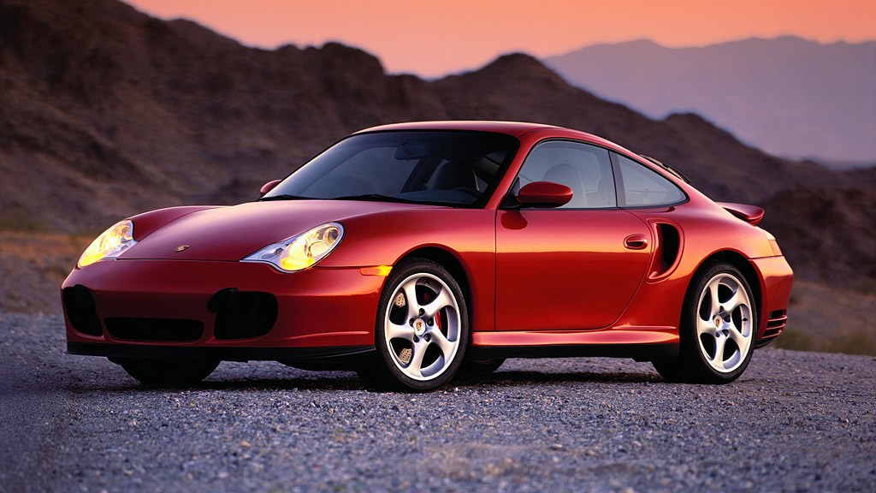
Inventions and developments by Porsche
The first ever all-wheel-drive system
The first ever hybrid car (1899)

Slide 13
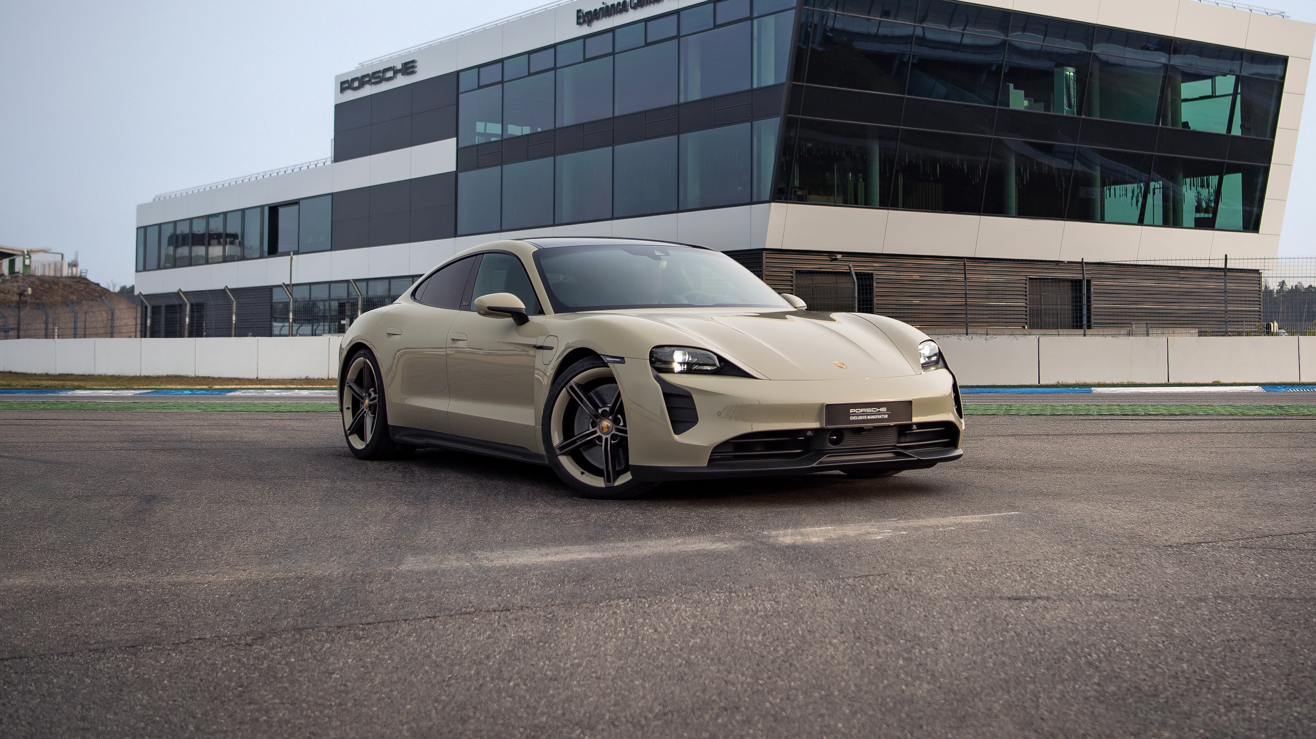
Porsche Taycan
GTS Hockenheimring Edition (2023)

Slide 14
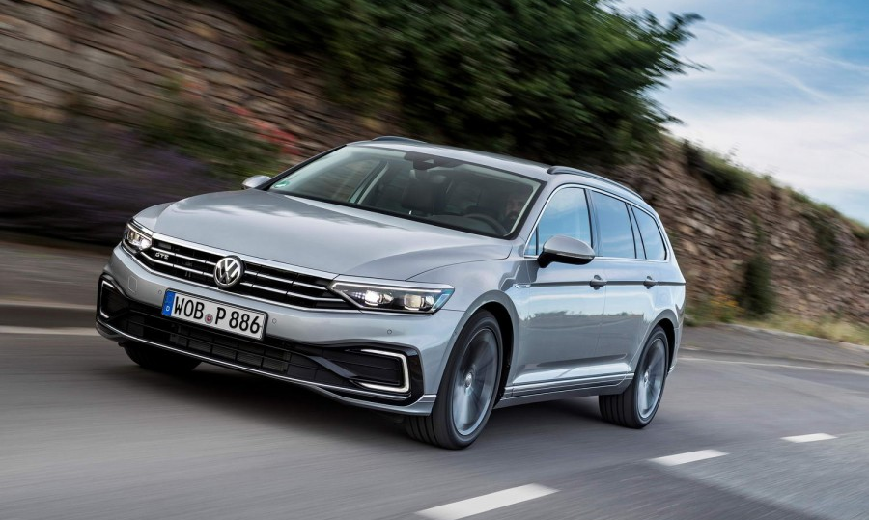
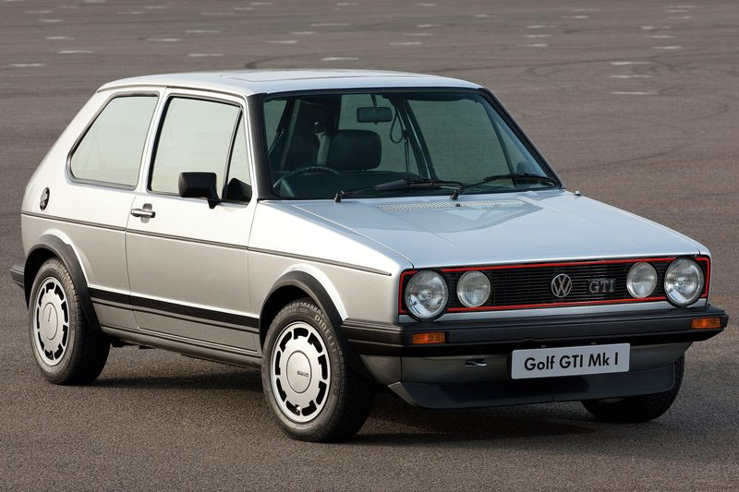
Volkswagen
Volkswagen is known for being a more modest German car brand producing reliable and low maintenance cars for the average people.
Founded in 1937 by the German government
The owner of Volkswagen is Porsche SE
The most popular model is Vokswagen Golf which has been produced since 1974

Slide 15

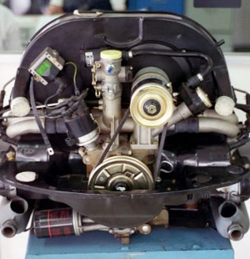
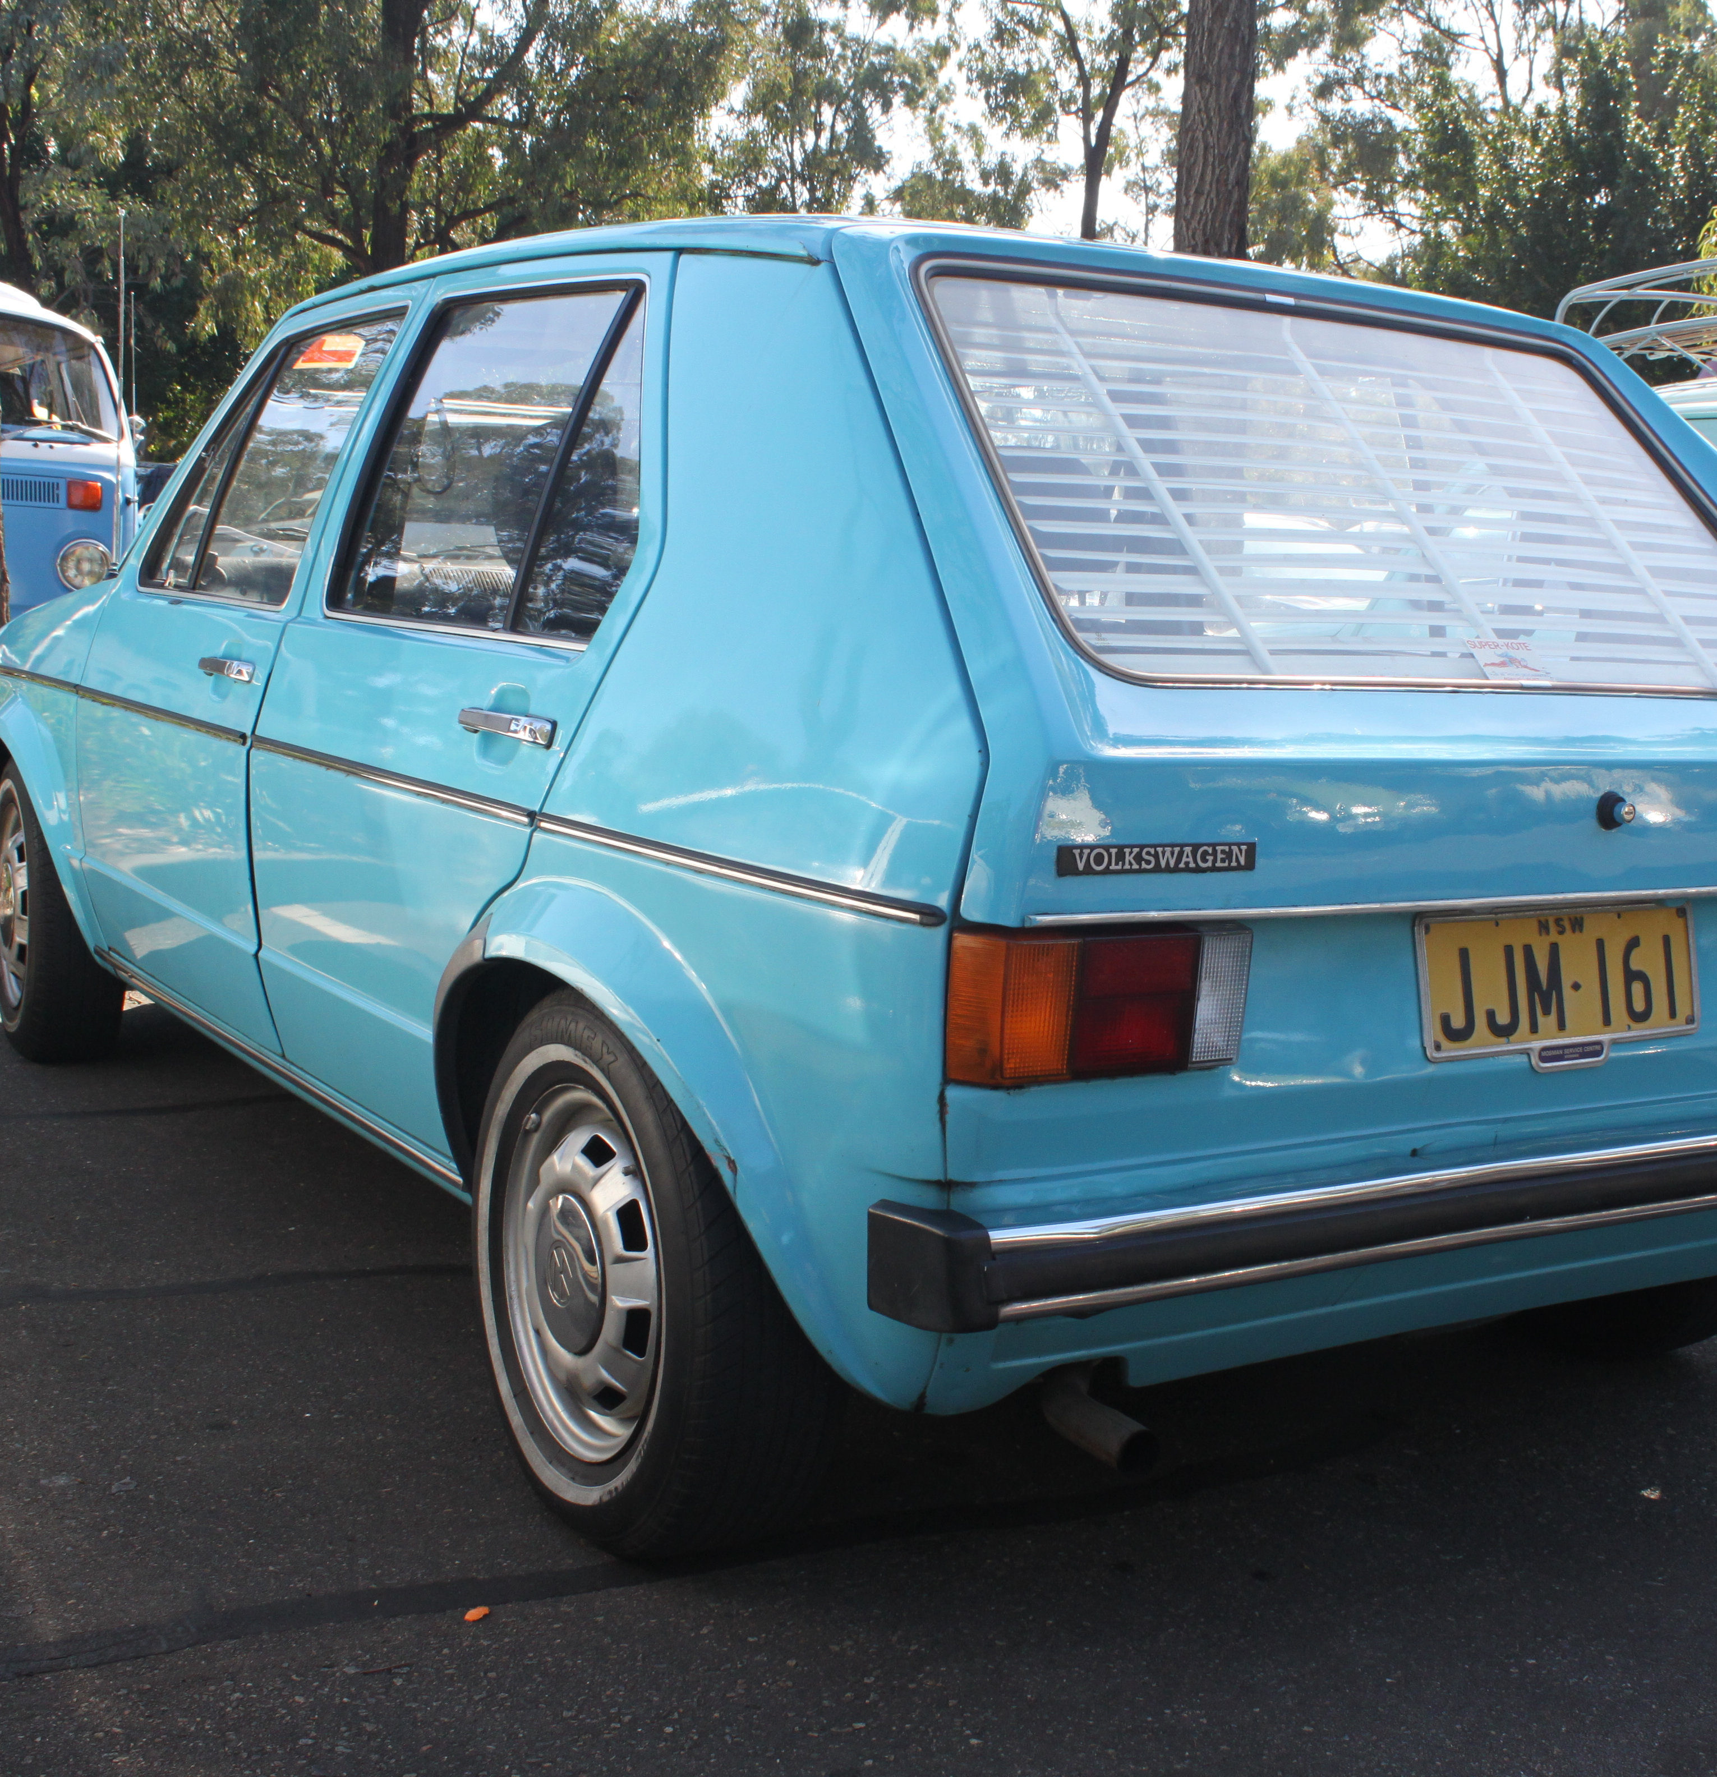
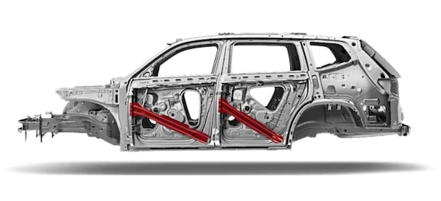
Inventions and developments by VW
Crumple zone (1952)
Boxer engine (1960s)
Hatchback (1970s)

Slide 16
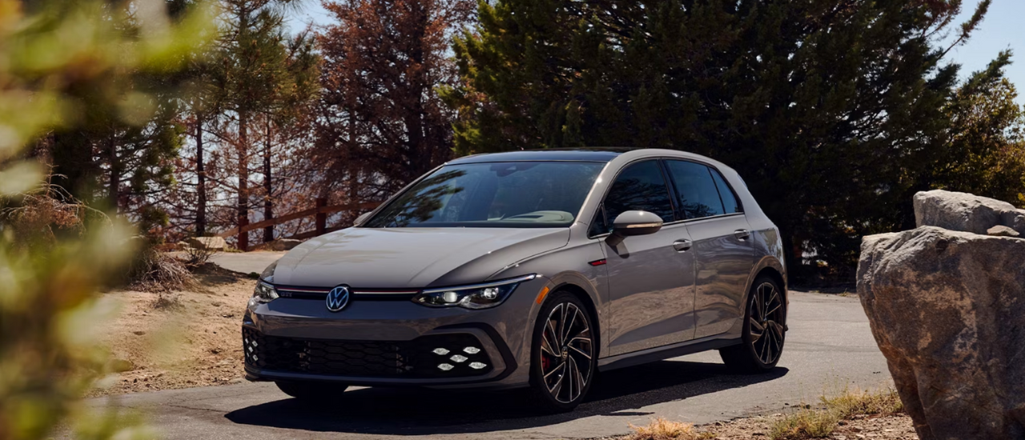
Volkswagen Golf GTI (2023)

Slide 17
Time line
Benz patent motor-wagen (1885)
Mercedes (1901)
Audi (1909)
BMW (1916)
Mercedes-Benz (1926)
Porcshe (1931)
VW (1937)

Slide 18
Sources (Sauce)
https://www.mbwestminster.com/the-mercedes-benz-history-of-innovation/
https://www.google.com/url?sa=i&url=http%3A%2F%2Fwww.speedhunters.com%2F2013%2F05%2Fthe-golf-gti-seven-generations-of-fun%2F&psig=AOvVaw2v96tf28JeWftGfLlibRGn&ust=1697186164110000&source=images&cd=vfe&opi=89978449&ved=0CBEQjRxqFwoTCPDDtaaN8IEDFQAAAAAdAAAAABAD
https://www.completecar.ie/img/testdrives/9269_large.jpg
https://innovolo-group.com/innovation-en/innovation-insights-en/what-are-audis-most-successful-innovations/
https://innovolo-group.com/uncategorized-en/the-history-and-culture-of-innovation-at-volkswagen/
https://www.visordown.com/features/top-10s/top-10-bmw-innovations
https://www.carkeys.co.uk/news/7-things-you-had-no-idea-volkswagen-invented
https://www.bmwgroup.com/en/innovation.html
https://www.trendhunter.com/slideshow/bmw-innovations

