Slide 1
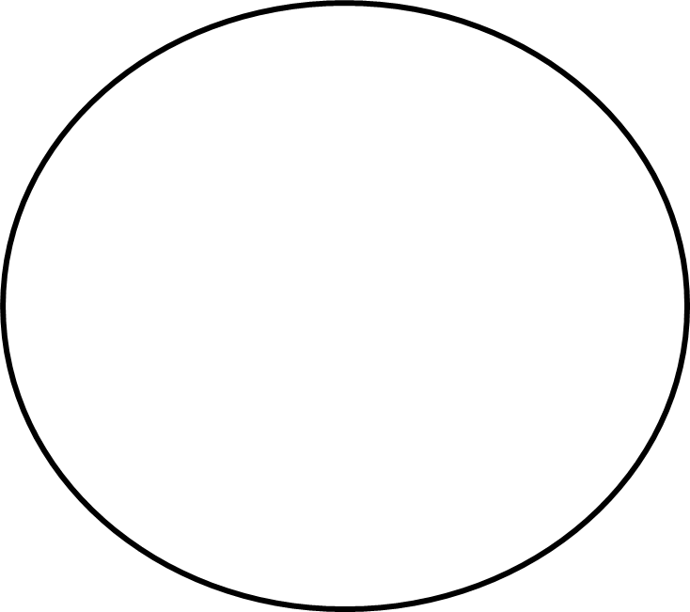
IHMINEN ASIA, ESINE
WHO THAT THAT
WHOM WHICH
WHOSE WHOSE ____ of WHICH

