Slide 1
Artikkelit erisnimien kanssa – Maantieteelliset nimet
New Insights
Module 3 Grammar

Slide 2
Artikkelit + maantieteelliset erisnimet
Perustapaus:
I live in Finland in northern Europe.
Normaalisti ei artikkelia
Poikkeuksia:
The Netherlands is also known as Holland.
The Atlantic Ocean is actually getting wider every year.
Eräissä tapauksissa the + maantieteellinen erisnimi

Slide 3
Ei artikkelia
Yhdistä esimerkit ja säännöt.
Asia
France
New York
Mont Blanc
Sardinia
Lake Superior
järvet
kaupungit
maanosat
maat
saaret
vuoret

Slide 4
Ei artikkelia
Asia
France
New York
Mont Blanc
Sardinia
Lake Superior
maanosat
maat
kaupungit
vuoret
saaret
järvet

Slide 5
Artikkeli the
Yhdistä esimerkit ja säännöt.
the Netherlands
the Pyrenees
the Hebrides
the Thames
the Pacific
the Panama Canal
the Sahara
the Finland of yesterday
autiomaat
joet
kanavat
meret ja valtameret
monikolliset sanat
of-rakenne määrittää
saaristot (monikko)
vuoristot (monikko)

Slide 6
Artikkeli the
monikolliset sanat
vuoristot (monikko)
saaristot (monikko)
joet
meret ja valtameret
kanavat
autiomaat
of-rakenne määrittää
the Netherlands
the Pyrenees
the Hebrides
the Thames
the Pacific
the Panama Canal
the Sahara
the Finland of yesterday

Slide 7
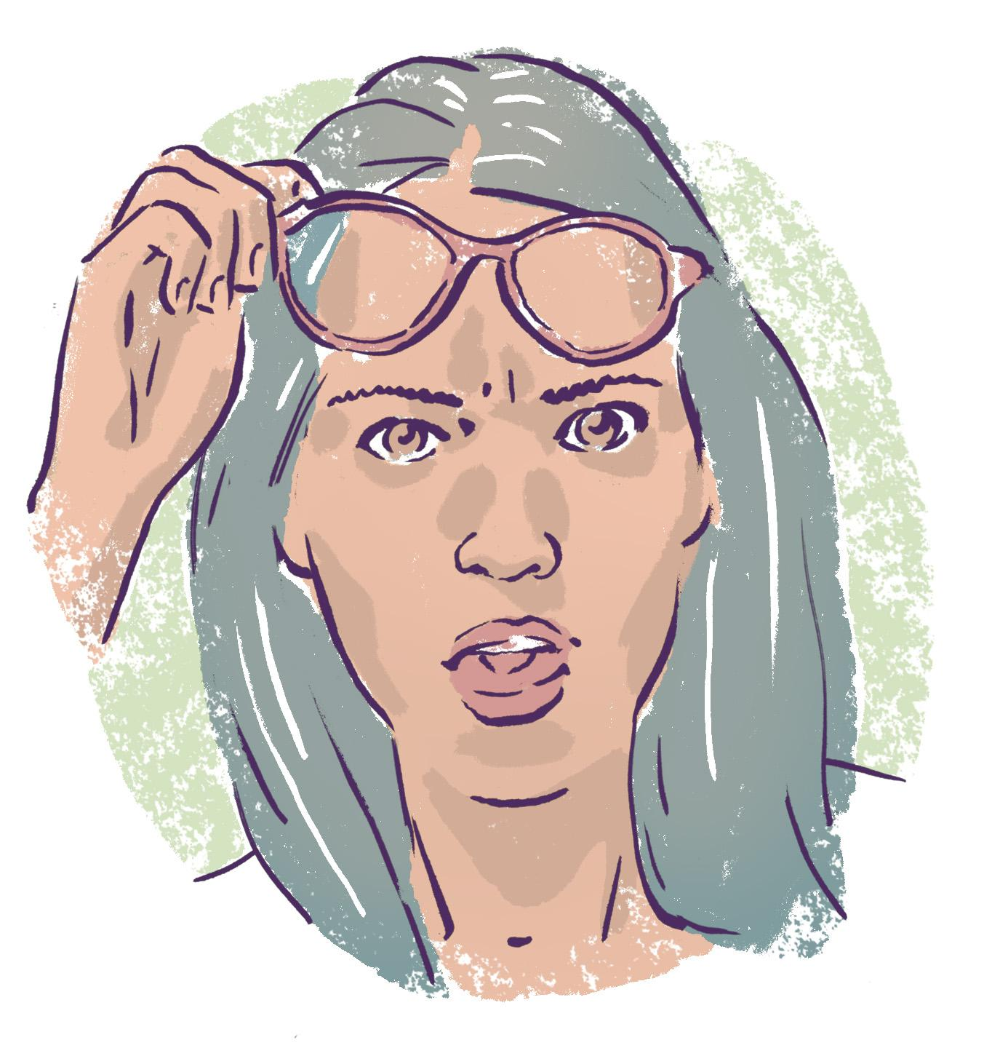
Maantieteellisten nimien kolme muistisääntöä
Yleensä ei artikkelia
2. Monikolliset sanat: the
3. Vesistösanoista kaikki paitsi järvet: the
Näiden sääntöjen ulkopuolelle jäävät autiomaat (ja of-rakenne), mutta näillä pärjäät pitkälle!

Slide 8
Yleisnimi osa erisnimeä
The Kingdom of Brunei is on Borneo.
The Isle of Man lies between Ireland and England.
The City of New Orleans is a popular spring break destination.
Joskus erisnimen osana on yleisnimi, jolloin tulee the. Tämä on perustapaus, koska artikkeli määrittää yleisnimeä.
Tällaisia yleisnimiä ovat mm. kingdom, empire, republic, isle, island, city, state.

Slide 9
Practise. Add the when needed.
1. My friend Louisa comes from ___ Colombia, which is in ___ South America.
2. I know ___ Andes is the big mountain range there but I didn’t know that the highest mountain is ___ Aconcagua.
3. At nearly 7000 metres, it is actually the highest peak outside of ___ Asia.
4. Did you know ___ Atacama in ___ Chile is the driest non-polar desert in the world?
5. ___ Amazon is of course the biggest river, and ___ Lake Titicaca is the highest of the world’s large lakes.

Slide 10
Practise. Add the when needed.
1. My friend Louisa comes from ___ Colombia, which is in ___ South America.
2. I know ___ Andes is the big mountain range there but I didn’t know that the highest mountain is ___ Aconcagua.
3. At nearly 7000 metres, it is actually the highest peak outside of ___ Asia.
4. Did you know ___ Atacama in ___ Chile is the driest non-polar desert in the world?
5. ___ Amazon is of course the biggest river, and ___ Lake Titicaca is the highest of the world’s large lakes.
1. My friend Louisa comes from - Colombia, which is in - South America.
2. I know THE Andes is the big mountain range there but I didn’t know that the highest mountain is - Aconcagua.
3. At nearly 7000 metres, it is actually the highest peak outside of - Asia.
4. Did you know THE Atacama in - Chile is the driest non-polar desert in the world?
5. THE Amazon is of course the biggest river, and - Lake Titicaca is the highest of the world’s large lakes.

Slide 11
Practise. Add the when needed.
6. My other friend Wolfgang is from ___ Germany in ___ central Europe.
7. ___ Rhine is the biggest river, and in the south they have ___ Alps.
8. Wolfgang is from ___ Kiel, close to ___ Denmark and best known for ___ Kiel Canal.
9. It joins ___ Baltic to ___ North Sea.
10. ___ Lake Constance is the biggest lake but it is also part of ___ Austria and ___ Switzerland.

Slide 12
Practise. Add the when needed.
6. My other friend Wolfgang is from - Germany in - central Europe.
7. THE Rhine is the biggest river, and in the south they haveTHE Alps.
8. Wolfgang is from - Kiel, close to - Denmark and best known forTHE Kiel Canal.
9. It joins THE Baltic toTHE North Sea.
10. - Lake Constance is the biggest lake but it is also part of - Austria and - Switzerland.
6. My other friend Wolfgang is from ___ Germany in ___ central Europe.
7. ___ Rhine is the biggest river, and in the south they have ___ Alps.
8. Wolfgang is from ___ Kiel, close to ___ Denmark and best known for ___ Kiel Canal.
9. It joins ___ Baltic to ___ North Sea.
10. ___ Lake Constance is the biggest lake but it is also part of ___ Austria and ___ Switzerland.

