Slide 1
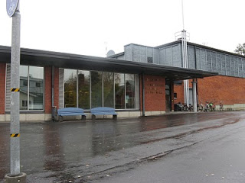
Anttola Comprehensive School
We have about 180 students in our school
The amount of staff is about 25
Our school was founded 130 years ago. It has been re-built a few times.

Slide 2
School subjects
In secondary school we have about 6 lessons per day.
We study for example maths, physics, chemistry, art, textile work and technical work.
Everybody studies at least 3 languages: Finnish, Swedish and English (French and German are optional).
We can also choose extra curricular subjects for ex. IT and drama.

Slide 3
Basic school days
Usually school starts at 8.15am. Some of the students, who live nearby the school, start school at 9.15am on some days.
The younger students’ school days are shorter than the older ones’. The shortest possible school day is only 3 hours and the longest possible is 7 hours. So, the last lesson in the afternoon finishes at 3.15pm.
Monday | Tuesday | Wednesday | Thursday | Friday
Maths | Finnish | Handicrafts | Finnish | Finnish
Finnish | Science | Maths | Finnish | Music
Science | Art | RE | PE | Maths
Handicrafts | Finnish | Finnish | PE

Slide 4
Holidays
Autumn break lasts one week in October.
At Christmas we have a fortnight holiday.
We have our one week spring break in March.
Our summer holiday starts at the switch of May and June and it finishes in the half way of August.

Slide 5
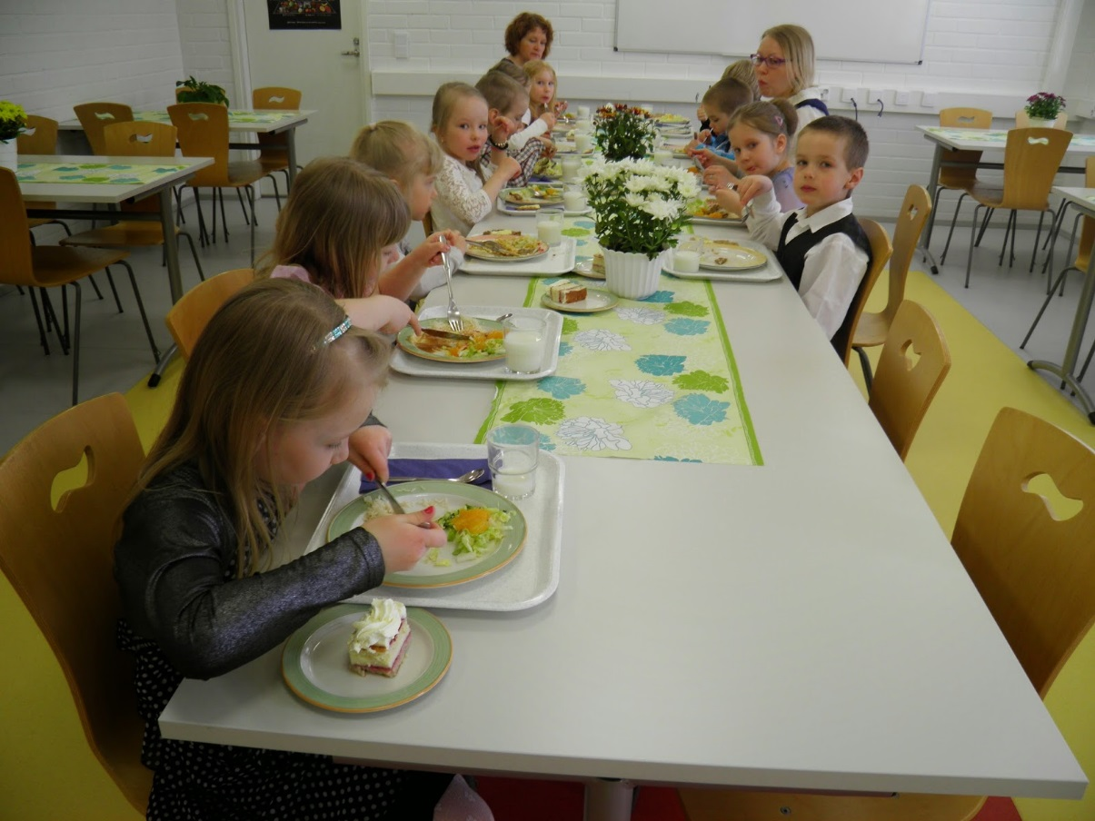
School lunch
Our school lunch is free for all students. Our lunch includes crispbread, milk and water, salad and the main course.
On special days the meal is a little more fancy.
Our school’s cantine is in another building next to our school.

Slide 6
Special days and celebrations
The most important days are the Christmas Event and the Term Ending Event.
At Christmas, the elementary school’s pupils get their certificates and in the beginning of summer, all students get certificates.

Slide 7
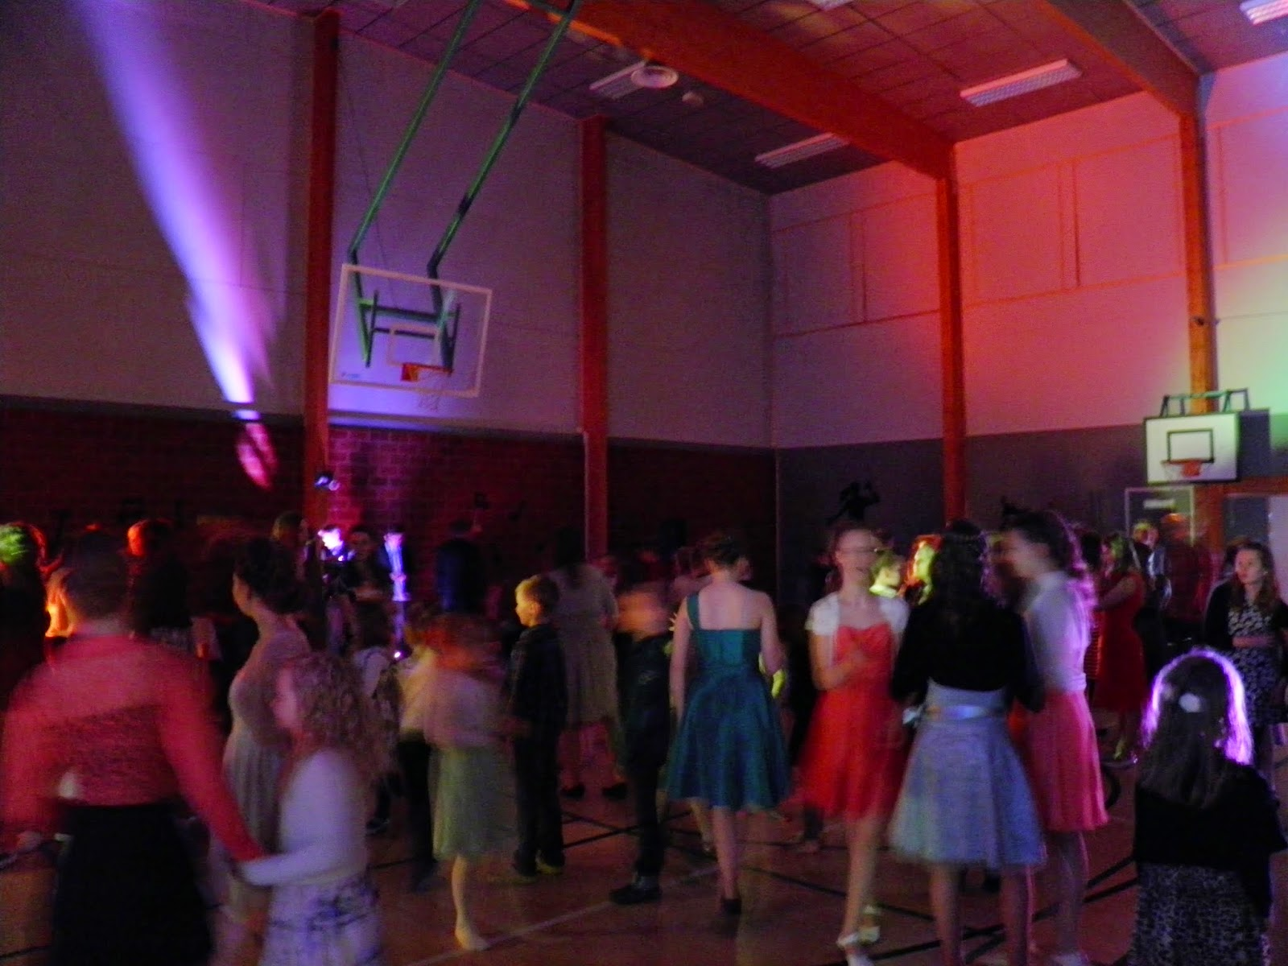
Other celebrations
There is a prom in our school every 1st of May.
It is for the pupils in secondary school.

Slide 8
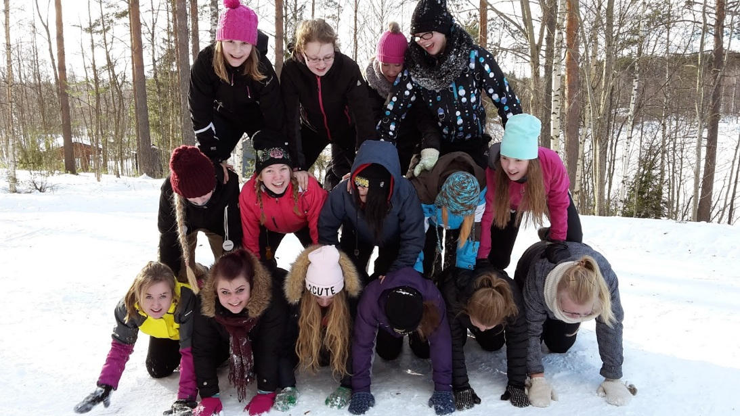
Sport days
Sometimes we also have sport days. In winter we have a winter sports day. We can choose which sport we want to do on that day. Options are usually cross-country skiing, skiing, skating, snow shoe walking, hiking and slide down a hill.
We also have our school’s own sports competitions: cross-country skiing, track and field and cross-country running.
Every autumn, there’s a floorball match between the 6th grade and teachers.
Every spring, the 9th grade plays football against teachers, either with a normal ball or a gym ball.

Slide 9
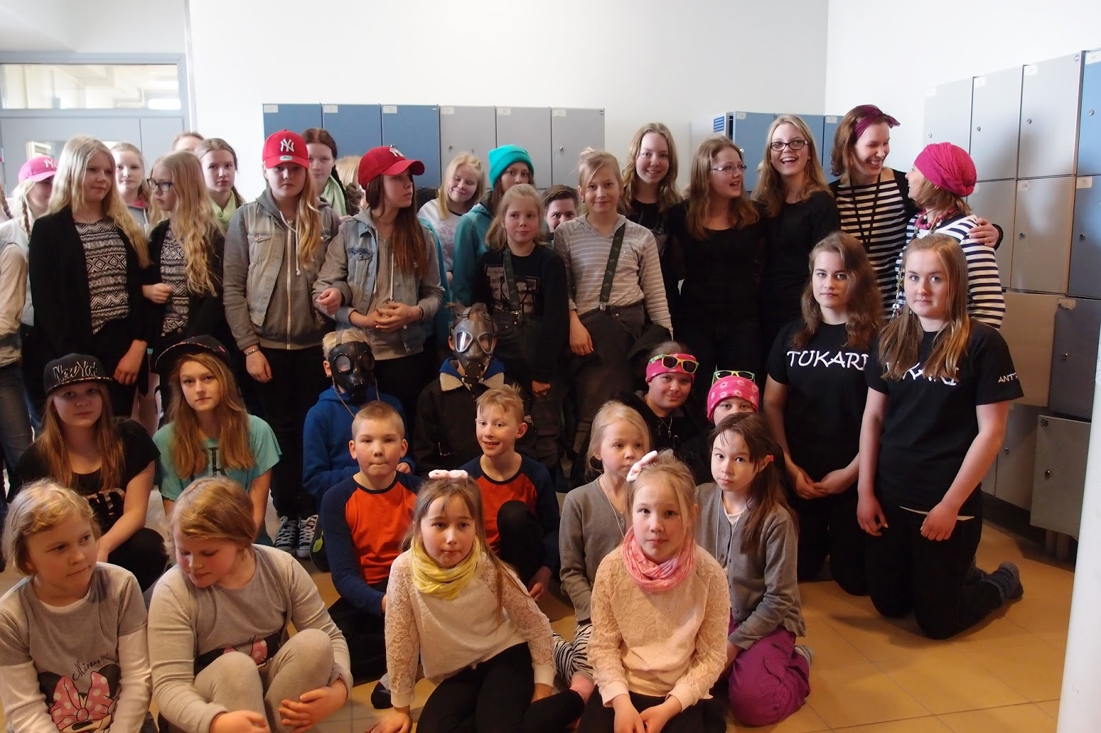
School uniforms
Here in Finland, none of the schools have uniforms, so we can wear the clothes that we want.
And even the teachers don’t have any restrictions.
Sometimes we have special days when we dress according to the theme.
Twin day.

