Slide 1

Linkkejä
Matematiikka, maantiede
Kymintehtaan koulu

Slide 2
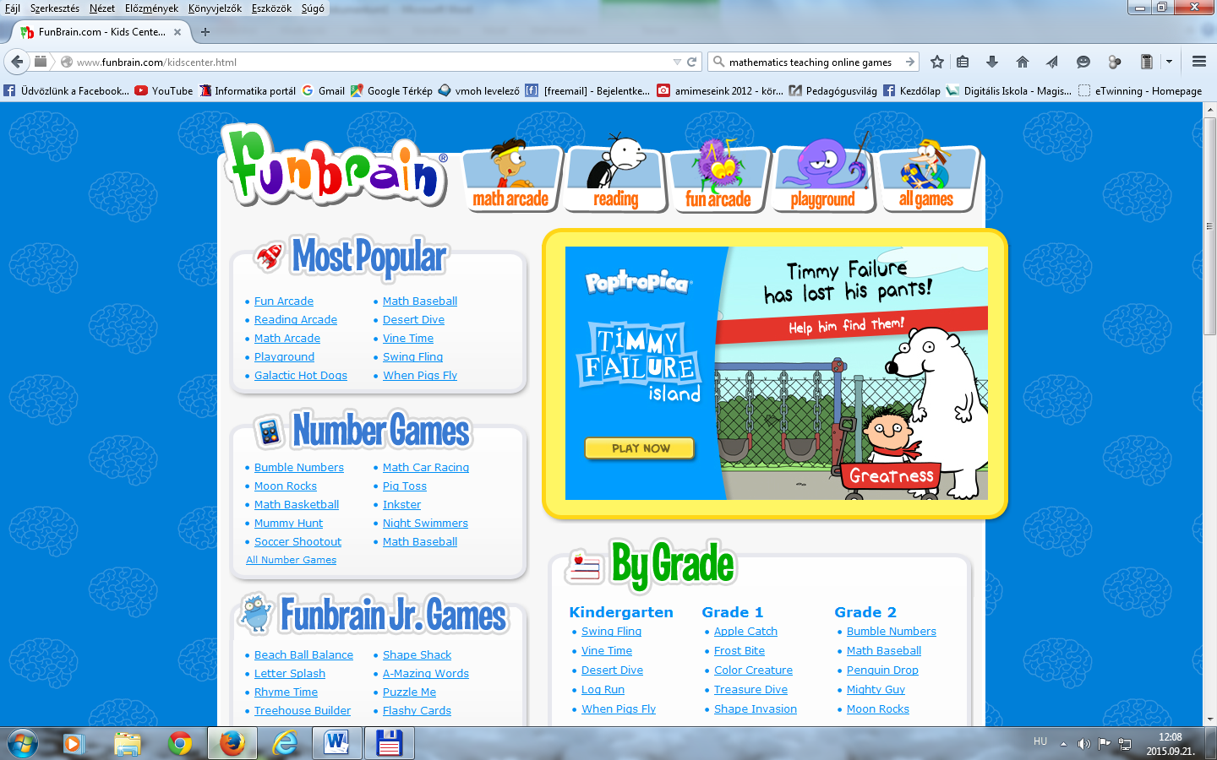

Slide 4
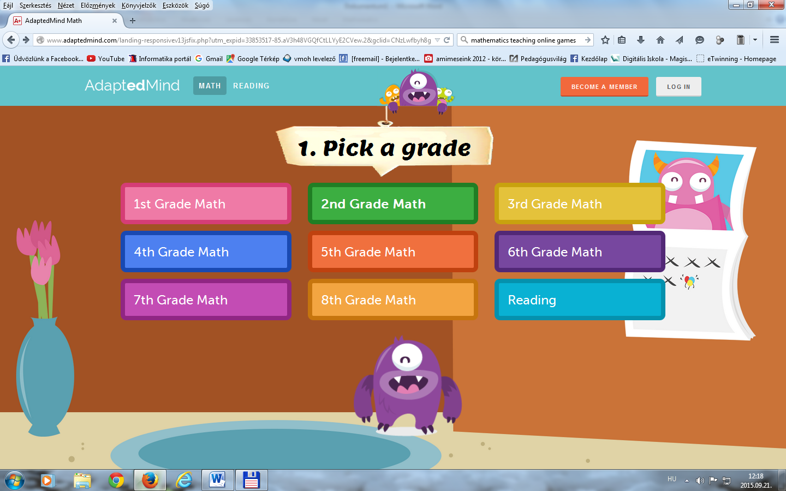
(One False Move)
http://www.education.com/games/math/kindergarten/
http://www.adaptedmind.com/landing-responsivev13jsfix.php?utm_expid=33853517-85.aV3h48VGQfCtLLYyE2CVew.2&gclid=CNzLwfbyh8gCFUe3Gwod1
usCKg&utm_referrer=http%3A%2F%2Ftpc.googlesyndication.com%2Fsafeframe%2F1-0-2%2Fhtml%2Fcontainer.html
Each lesson has 500 problems, explanations, and an instructional video.
http://www.topmarks.co.uk/maths-games/5-7-years/counting

Slide 5
Tablet friendly online games:
http://www.topmarks.co.uk/maths-games/5-7-years/counting
http://nrich.maths.org/public/leg.php?code=5039&cl=1&cldcmpid=5651
https://www.geogebra.org/
http://www.kidsmathgamesonline.com/
http://nrich.maths.org/public/leg.php?code=5039&cl=1&cldcmpid=5651

Slide 6
MAANTIEDE
  Brainpop Geography
  DK Reference
  Fact Monster
  GeoBeats
  I Know That
  Latitude & Longitude
  Mapping Our World
  Mr. Ferlazzo’s Geography Page
  National Geographic Videos
  Nations Illustrated
  Panoramas
  Scribble States
  Spotlight Videos
  World Info Zone
  World Wonders Project

Slide 7
  The Best Sites For Learning About The World’s Different Cultures
  The Best Online Activities For Learning About Time Zones
  Best Sites For Introducing Maps To English Language Learners
  The Best Sites For Introducing English Language Learners To Geography
  Google World Wonders Project
  Google Maps Street View Collections
  Stay.com
  InfoPlease: The 50 States
  Harcourt School: The 50 States
  The Global Closet Calculator
  Peek
  Reach The World Geo Games
  Map Battle
  Best Sites For Learning About Mexico, Central & South America

Slide 8
  Mr. Nussbaum
  The Best Geography Sites For Learning About The United States & Canada
  The Best Geography Sites For Learning About Europe
  GeoBeats
  I Like To Learn — Geography
  Discovery Atlas Video
  Go Social Studies Go
  The Best Geography Sites For Learning About Africa
  Geography Textbook (Click on top link)
  Funky English
  A Beginning List Of The Best Geography Sites For Learning About Asia & The Middle East
  The Best Sites For ELLs To Learn About The Pacific Region

Slide 9
  The Best Online Geography Games
  Travel Videos
  40 maps that explain the world
  World Geography Games
  The Best Sites For Learning About Brazil
  Trippin
  Video Bank
  The Best Sites For Learning About France
  The Best Sites For Learning About Italy
  The Best Sites For Learning About The United Kingdom
  The Best Sites For Learning About South Africa
  The Best “Sound Maps” & Webcams For Teaching Geography
http://education.nationalgeographic.com/teaching-resources/
(Lessons Grades K-2) Extreme Weather on Earth and Other Planets
http://world-geography-games.com/

