Slide 1
Vaikuttaako musiikki persoonallisuuteen?
6 Phases of Working (Which stage are you at???)
http://yadogg.com/pictures/6-phases-of-work-explained-with-cat-pics/

Slide 2
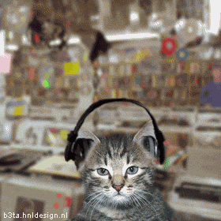
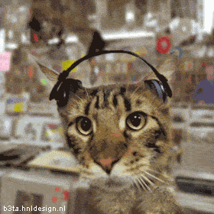
You are listening to jazz -- Your first day at work is great..
Your co-workers are wonderful, your office is cute, you love your boss.
You are listening to pop music -- After a while you are
so busy that you are not sure if you're coming or going anymore.

Slide 3
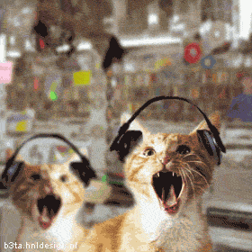
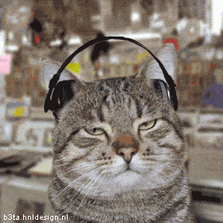
You are listening to hip hop -- You become bloated due to stress,
you're gaining weight due to lack of exercise because you are so tired
and have so much work to do and when you get home you have more work to do.
You feel sluggish and suffer from constipation. Your fellow co-workers are
too cheerful for your liking and the walls of your cubicle are closing in.
You are listening to heavy metal --
This is what happens after about SIX Months!

Slide 4
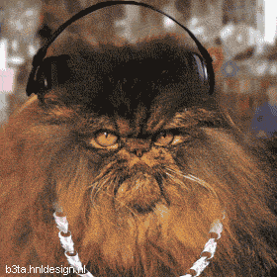
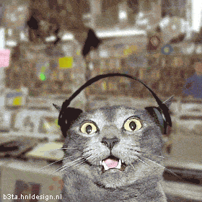
You are listening to GANGSTA RAP --
After more time passes, your eyes start to twitch,
you forget what a 'good hair day' feels like as you
just fall out of bed and load up on caffeine.
You are listening to THE VOICES IN YOUR HEAD --
You have locked the office door to keep people out,
You wonder WHY you are even here in the first
place and WHY did I come to work today!

