Slide 1
Lauseenvastikkeet – More advanced
New Insights
Module 7 Grammar

Slide 2
Aktiivilause
Seeing the accident I rushed in to help.
Nähdessäni onnettomuuden ryntäsin auttamaan.
Verbi korvataan ing-muodolla.
Having seen the accident I could also help the police.
Nähtyäni onnettomuuden osasin myös auttaa poliisia.
Menneisyyteen viittava verbi: having + 3. muoto
Huom. having seen = after seeing

Slide 3
Passiivilause
Given another chance I will do better.
Jos minulle annetaan toinen mahdollisuus, pärjään paremmin.
Verbistä jää vain 3. muoto (be-verbin osuus pois)
Having been given another chance I was determined to do better.
Kun minulle oli annettu uusi mahdollisuus, olin päättänyt pärjätä.
Menneisyyteen viittaava verbi: having + been + 3. muoto
Huom. having been given = after being given

Slide 4
Kielteinen lause
As I didn’t know what to do, I remained seated.
Not knowing what to do, I remained seated.
Since I had never done it before, I was nervous.
Never having done it before, I was nervous.
Because I hadn’t been told about it, I was furious.
Not being told about it, I was furious.
Kielteisen lauseenvastikkeen alkuun tulee not tai never.

Slide 5
Päälauseesta lauseenvastike
I went home, and I hoped to see her there.
I went home, hoping to see her there.
Yleensä lauseenvastike muodostetaan sivulauseesta.
Joskus voidaan kuitenkin yhdistää myös kaksi päälausetta, joilla on sama subjekti.
Tämä on käytössä lähinnä aktiivilauseissa.

Slide 6
Konjunktio
As I had done my best, I was satisfied with the work.
Having done my best, I was satisfied with the work.
Konjunktio jää usein pois lauseenvastikkeesta.
As jää aina pois.
(If) seen from another angle, the statue looks different.
(When) talking about it, I called it a masterpiece.
Vastike on usein helpoin hahmottaa, jos konjunktio säilyy siinä.
Erityisen usein säilyvät after, before, when ja while.

Slide 7
Subjekti
I took care of the dog farting furiously.
Huolehdin koirasta raivoisasti piereskellen.
Normaalisti lauseenvastikkeella on oltava sama subjekti kuin päälauseella. Vastikkeesta subjekti jää pois.
Eri subjekti johtaa usein vääriin viittaussuhteisiin.
Sam being late we were all anxious to get started.
With him/his having the key, there was nothing we could do.
Muodollisessa kielessä lauseenvastikkeella voi olla oma subjekti.
Persoonapronominista tulee joko objekti- tai omistusmuoto.

Slide 8
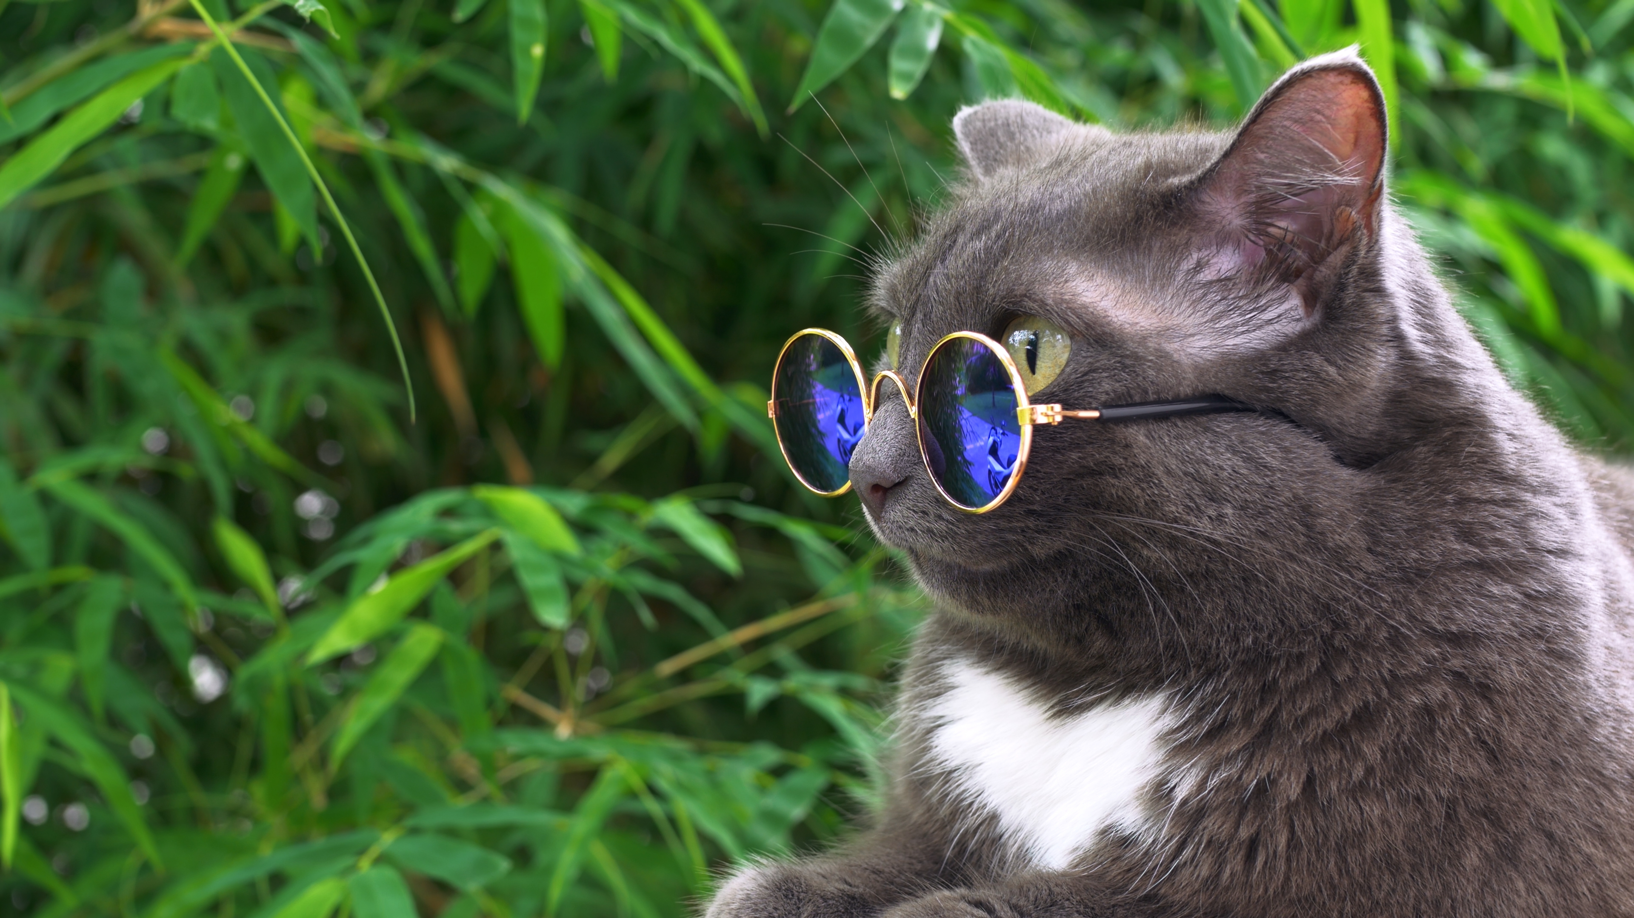
Vakiintuneet sanonnat
Generally speaking, things could be worse.
Judging by his appearance, the night had been wild.
Supposing this is true, what can you do about it?
Joidenkin vakiintuneiden sanontojen kanssa subjekti voi helposti olla eri päälauseessa ja sanonnan lauseenvastikkeessa.
iStock.com/Ivan Zhaborovskiy

Slide 9
Be-verbi
As he was an esteemed physicist, Richard Feynman was given a lot of awards.
(Being) an esteemed physicist, Richard Feynman was given a lot of awards.
Jos sivulauseessa, josta tulee lauseenvastike, on vain be-verbi, se jää usein pois lauseenvastikkeesta.
Silloin siinä ei ole verbiä ollenkaan.

Slide 10
Pilkun käyttö
Knowing this, I have to do something.
Having been sold to the idea, I was eager to start.
Englannissa lauseenvastike erotetaan usein pilkulla päälauseesta.
The woman singing on the song has a great voice.
The recording made in the 1970s still sounds fresh.
Relatiivilauseen vastiketta ei yleensä eroteta pilkulla.

Slide 11
Practise. Make shortened sentences.
When I read the book, I could easily picture the protagonist.
(When) reading the book, I could easily picture the protagonist.
2. As I had not read the book, the plot of the film was new to me.
Not having read the book, the plot of the film was new to me.
3. If it isn’t bought on sale, the book may not be cheap.
(If) not bought on sale, the book may not be cheap.
4. When it has been read, the book may be recycled.
Having been read / After being read, the book may be recycled.

Slide 12
Practise. Make shortened sentences.
5. Mike went hiking, and he tried to capture his youth.
Mike went hiking, trying to capture his youth.
6. As Flis was parachuting, we all looked in wonder.
With Flis parachuting, we all looked in wonder.
7. Since I knew the answer, the quiz was easy for us.
With me/my knowing the answer, the quiz was easy for us.
8. As she is an experienced chef, she makes food to die for.
(Being) an experienced chef, she makes food to die for.

