Slide 1
National holidays
The four most celebrated holidays in Finland

Slide 2
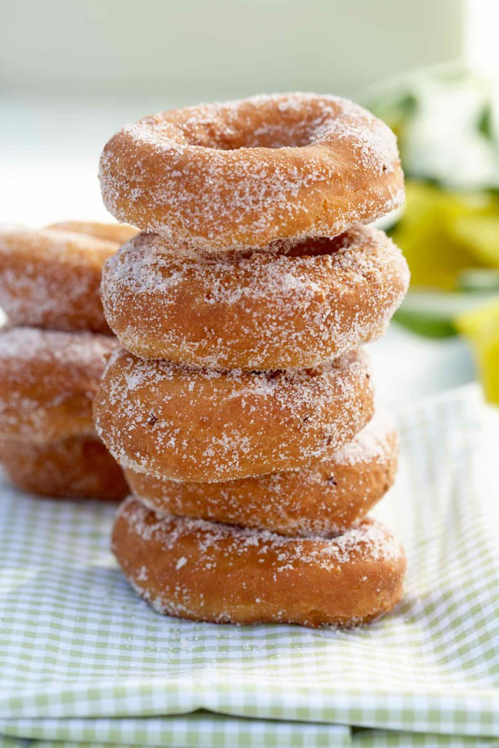
Vappu (May day)
In Finland, we celebrate Vappu as the international workers’ day. It’s an official flag flying day. It is a public holiday and schools and almost every workplace is closed. The day before May day we are offered strawberry jelly doughnut and juice in school. We also dress up in different costumes. It’s like halloween but without any of the scary things. Like spring Halloween!

Slide 3
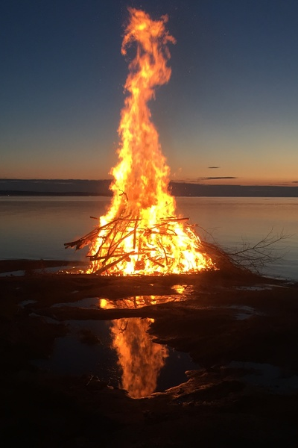
Juhannus (midsummer day)
Juhannus is celebrated in June. The nights near midsummer are very short. It’s celebrated as our ancient god’s Ukkos day. We light up a big Kokko (a bonfire). We believe that Kokko keeps the bad spirits away. We also have many Juhannus spells and beliefs for example, girls would run around the sauna three times, so they could see their future husbands.
Try to say this!
Kokko, kokoa koko kokko! (Kokko, gather the whole kokko!)
Koko kokkoko? (The whole kokko?)
Koko kokko! (The whole kokko!)

Slide 4
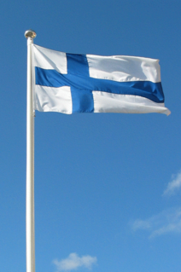
Itsenäisyys päivä (independence day)
Finnish independence day is celebrated on 6th of December. It’s the day when Finland freed itself from the Russian Empire in 1917. Last year Finland celebrated it’s 100th anniversary of freedom. In schools we have a big Independence day meal where we ususally eat reindeer meat. Everyone is dressed up in white and blue.

Slide 5
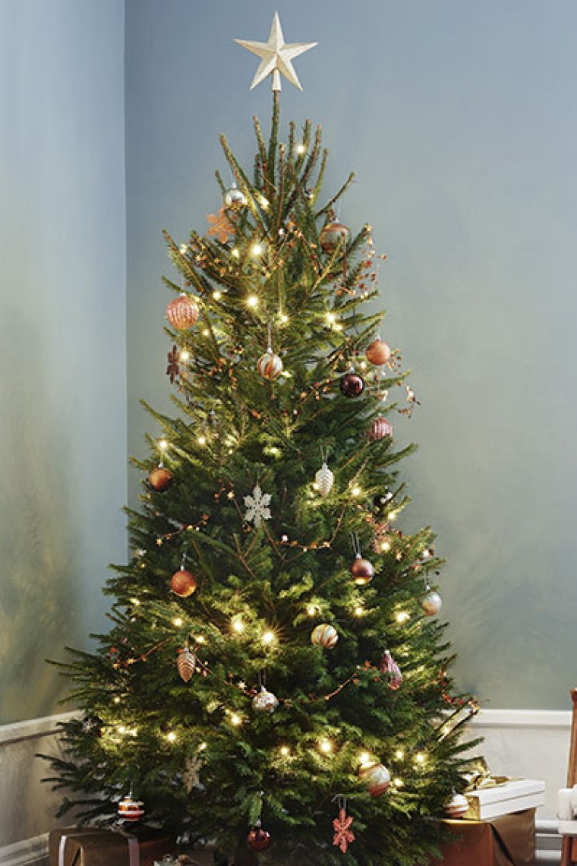
Joulu (christmas)
Christmas is a big thing to Finnish people. Christmas commercials and songs are already are played in November. Stores are full of christmas decorations and presents to buy. Everyone gets a christmas tree. We have a big dinner with our families and open up our presents after it. Unlike in America, we open them the night before christmas, not on Christmas morning. Schools usually have some kind of Christmas celebrations.

