Slide 1
Language, media and communication

Slide 2
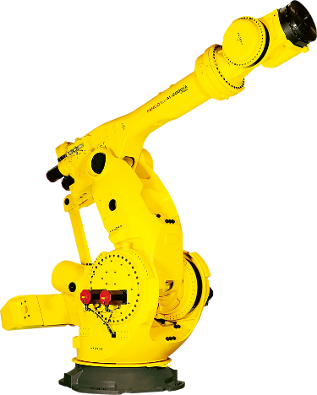
Our profile languages

Slide 3
Number of language hours at Språkskolan
English
Language choice
(of which 60 min/w is student’s choice

Slide 4
Communication
The students practice oral and written communication
Converse
Explains
Argues
Presents
Debates
Express themselves

Slide 5
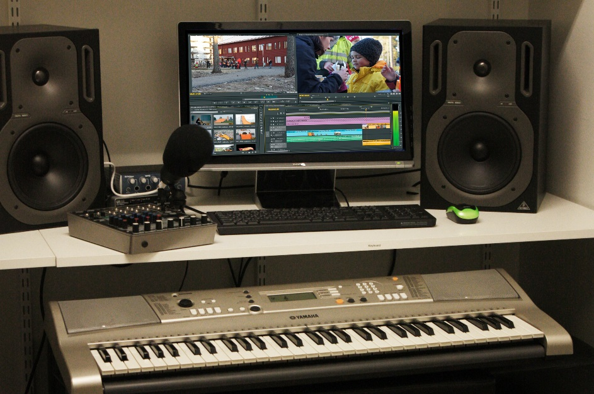
Media communications
Cross-curricular with image, video, photo and audio production
School paper and student blogs
Fundamental teaching in media production as student’s choice

Slide 6
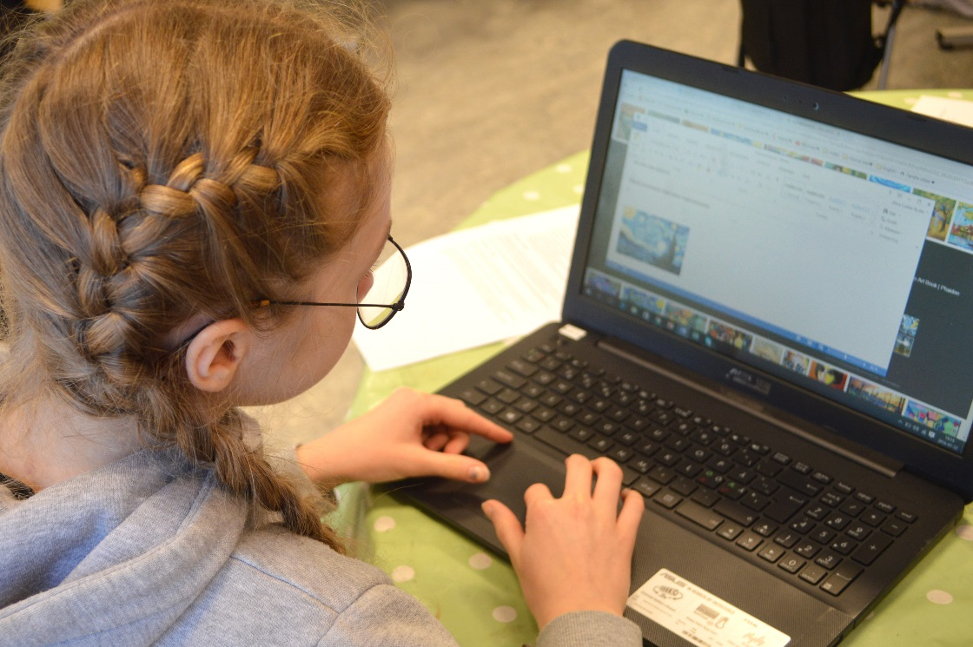
Individualization
The teaching is adapted to each student, their knowledge, experience, background and needs.

Slide 7
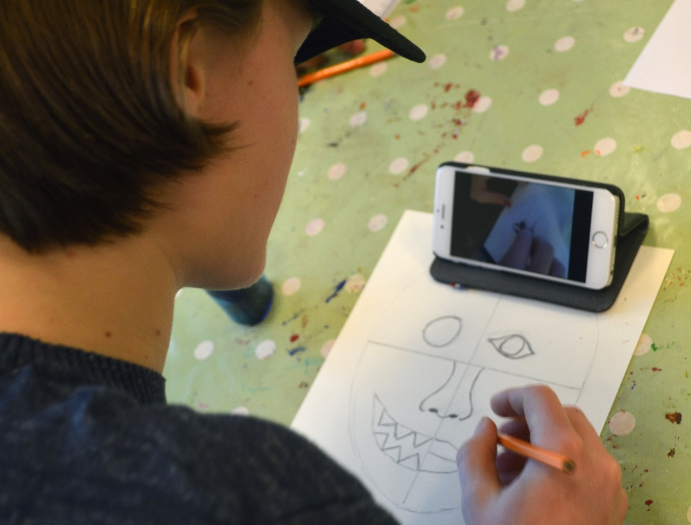
Various ways of learning
Practically
Theoretically
Art
Music
Movement
Communication

Slide 8
Student’s choice from grade 7
Mandarin or programming
Conversational English
Media communication

Slide 9
Comparison Språkskolan’s timetable with guaranteed hours

Slide 10
Our students thrive!
 | Grade F-2 | Grade 3-7
1. Teaching | 100 % | 98 %
2. Lessons | 100 % | 95 %
3. Teaching material | 100 % | 89 %
4. Study results | 100 % | 98 %
5. Influence | 100 % | 93 %
6. Treatment | 100 % | 98 %
7. Forms of study | 100 % | 97 %
8. Homework | 100 % | 96 %
Overall assessment | 100 % | 96 %
Comment: The response alternatives refers to positive results as satisfied/quite satisfied and good/pretty good. The numbers are rounded to the nearest whole number.

Slide 11
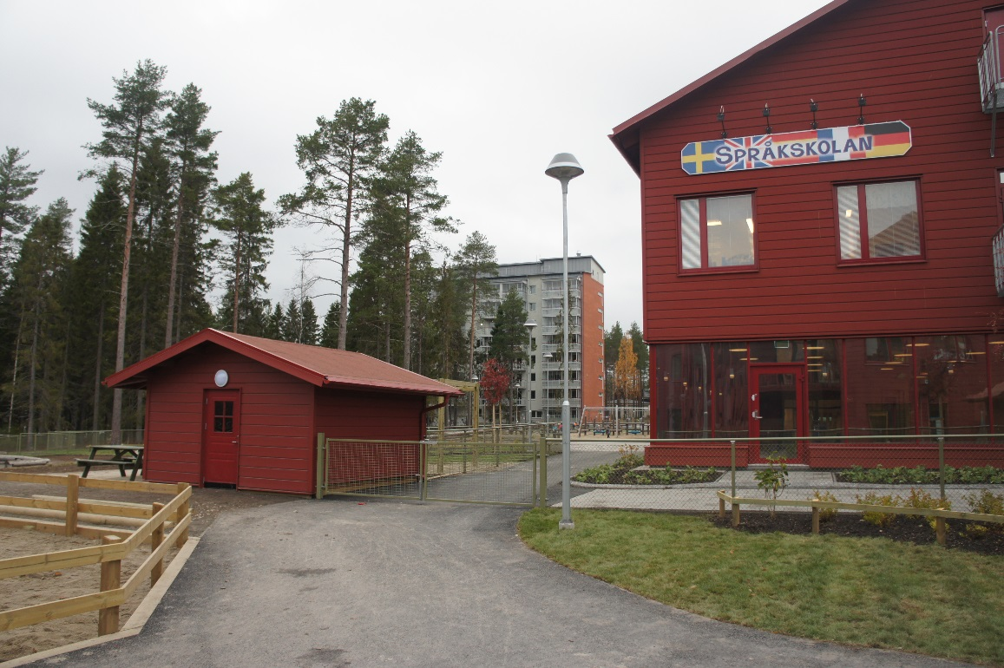
Economic Association
Språkskolan is run as an economic association without profit interests, any surplus is returned directly to the association.

Slide 12
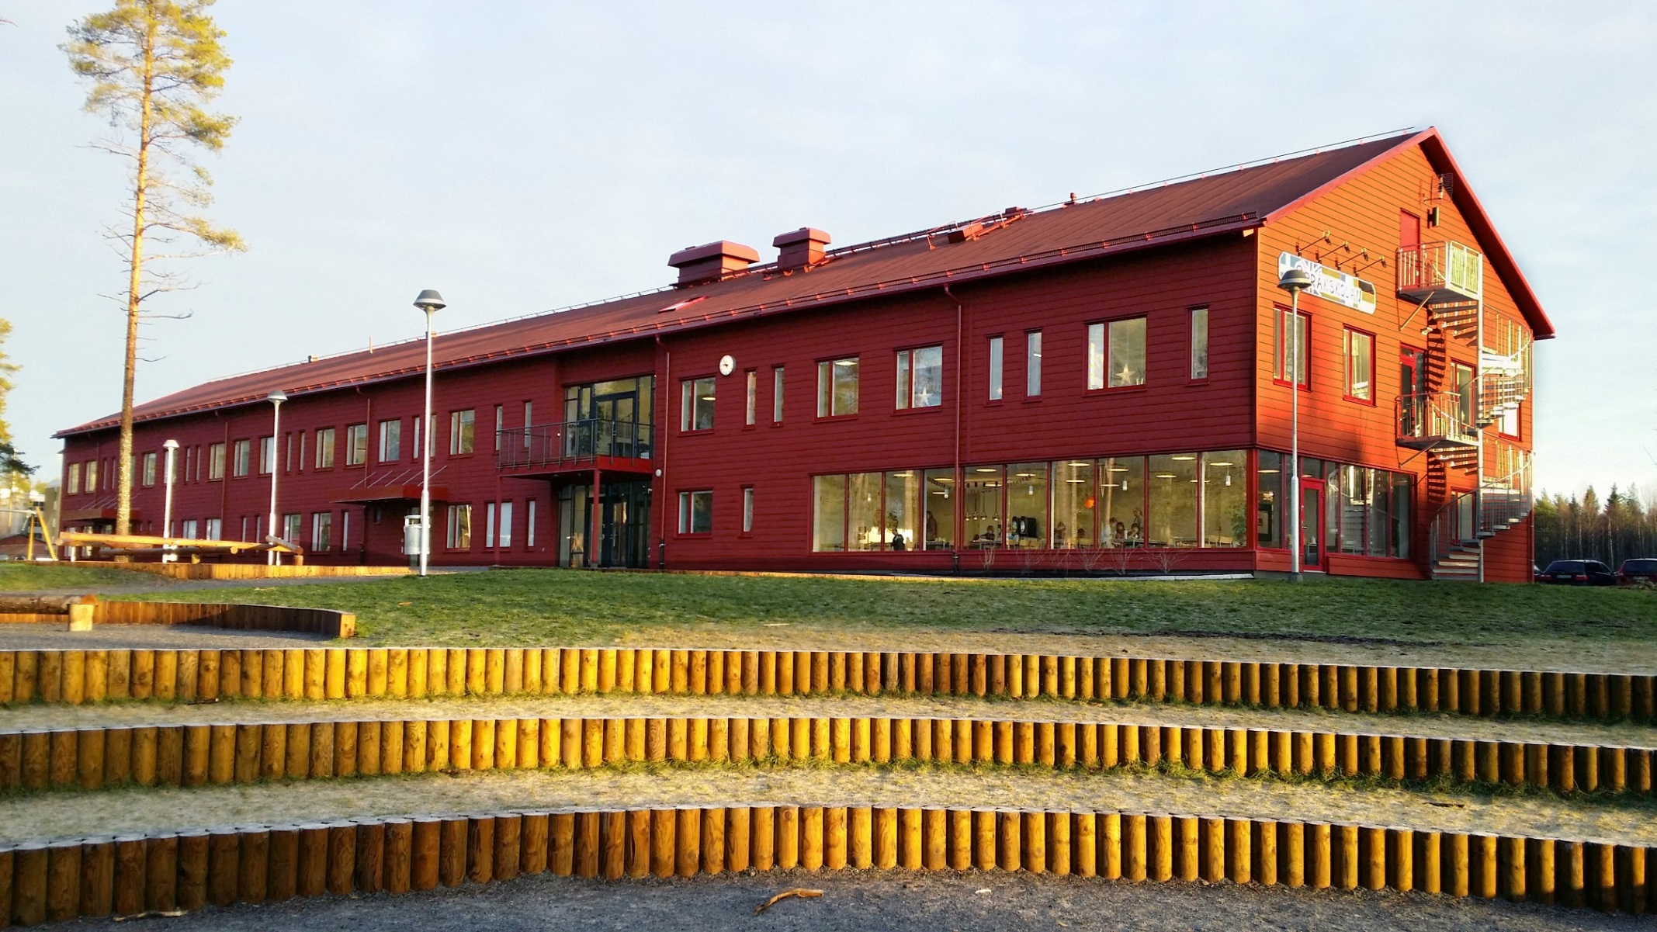
Språkskolan
Complete primary school from pre-school to grade 9
Newly built, modern, bright and fresh
New, bigger school yard

Slide 13
Our vision
Independent students
Good self-image
Can and dares to express themselves
Well equipped for future studies

Slide 14
Food from our own kitchen
Good and nutritious food
makes students more alert
A lot of organic and locally
produced ingredients
Bigger possibility for
origin control
Less processed foods
Reduced transports

Slide 15
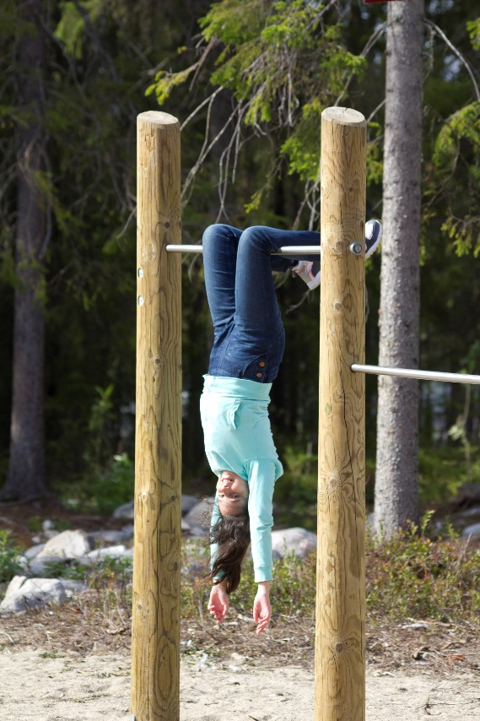
This is why you should
choose Språkskolan!
Early language learning
Proficient in English
Smaller groups – more teachers
Good learning environment
High level of knowledge
Good conflict management – safe children
Individualized
All children are seen!

