Slide 1
Profile
By: Agnese, Monica, Nina, Clarisse, David, Efthymia, Roosa V, Roosa M, Milja, Nelli & Kristiina

Slide 2
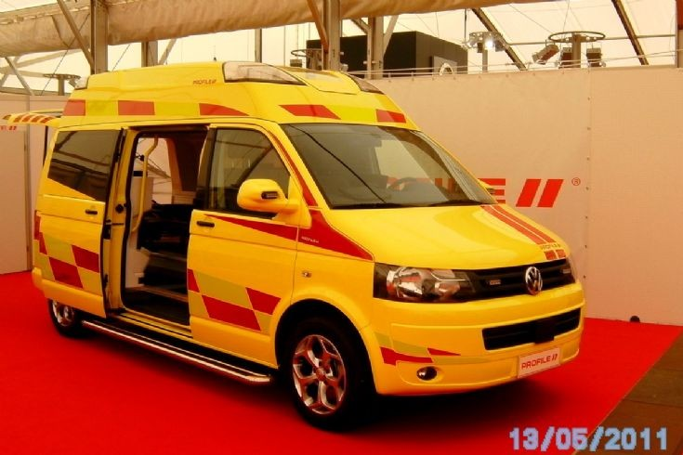
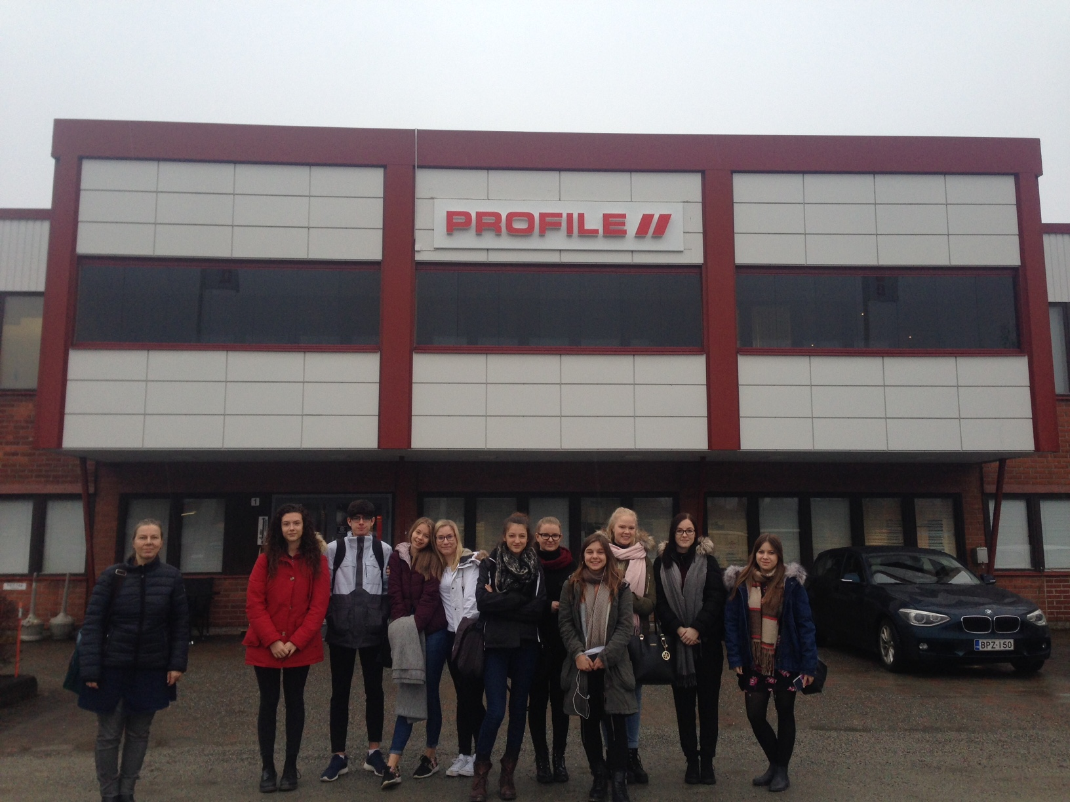

Slide 3
What is Profile?
It’s an ambulance company
It’s a private family company
Established in 1982
Founder : Kosti Repo and Keijo Repo
It sells 400-500 vehicles a year
There are over 7 franchises around the world and they sell in 20 countries including Poland,Germany,USA etc.
They cost about 100.000 euros. If they have special features they can cost about 20.000 euros.

Slide 4
WHO SPONSORS PROFILE?
Profile is sponsored by very famous companies :
Mercedes,
Volkswagen,
Ford,
Renault
BMW

Slide 5
History of profile
It was first called ”Iikori Ky” but quickly changed
It has sold over 600 vehicles globally and more than 200 in Iisalmi this year
They are a growing company
70% of Finnish ambulances are made by Profile local companies

Slide 6
SOME MORE FACTS
There are 13 processes
They have a can-bus control system
None of the material is recycled
Their roof is different from any other ambulance companies
Their products are highly recommendable in all over the world
41 pieces of ambulance were delivered for President Putin
Their staff is really careful and makes sure everything is safe

