Slide 1

Hobbies
What do you like to do?

Slide 2
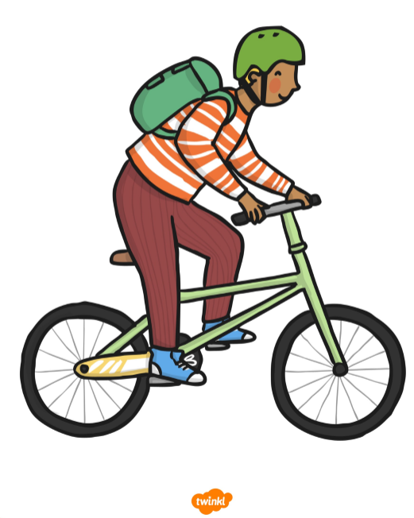
to ride a bike

Slide 3
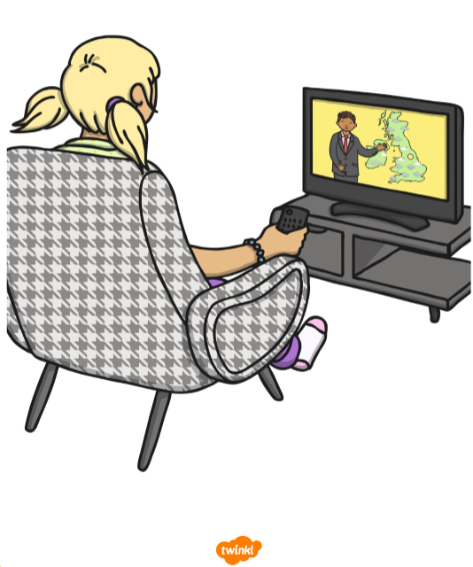
to watch TV

Slide 4

to sing

Slide 5
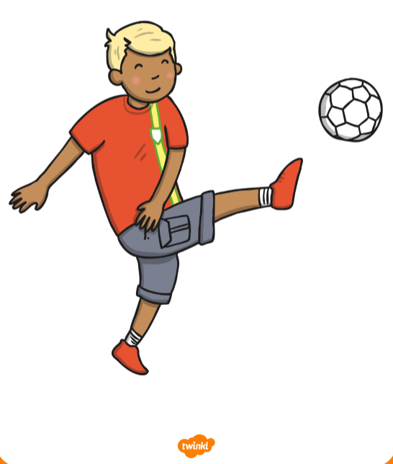
to play football

Slide 6
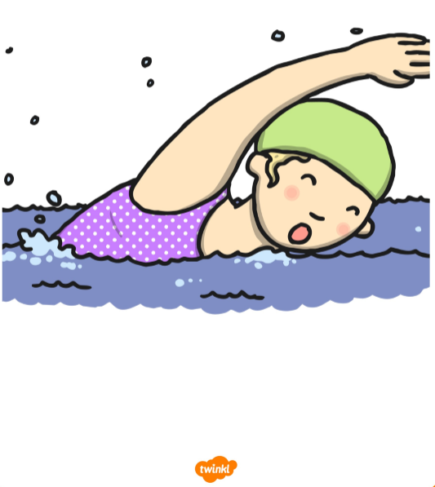
to swim

Slide 7

to read

Slide 8
https://www.youtube.com/watch?v=tYNap8gVNK4

Slide 9


Slide 10
I like to ride a bike.

Slide 11
I like to watch TV.

Slide 12
I like to sing.

Slide 13
I like to play football.

Slide 14
I like to swim.

Slide 15
I like to read.

Slide 16


Slide 17
I don’t like to ride a bike.

Slide 18
I don’t like to watch TV.

Slide 19
I don’t like to sing.

Slide 20
I don’t like to play football.

Slide 21
I don’t like to swim.

Slide 22
I don’t like to read.

